Slide 1
Introduction to Multimedia
Past, Present, and Future

Slide 2
What is multimedia?
.ppt presentation
Playing a video game
Describing a picture to your friend
Reading the newspaper in the morning
Videoconferencing
Watching TV and listening to radio
Browsing on internet
Having a telephone conversation

Slide 3
Multimedia – historical perspective
The word multimedia appeared in the beginning of the 1990s
Mainly after the success of digital audio recording on CDs
The next anticipated step was to create digital content involving image, text, video, along with the audio
First multimedia CD-ROMs which included informational content and games (Encyclopedia Britannica, games with simple graphics, animations and audio)
Experience only limited to a single user interacting with a PC
Things have changed dramatically since then, mainly due to
Low-cost capture devices
Larger storage devices
Advances in digital networks and distribution technologies
Notes:
First experiences were limited to a single person interacting with the PC. This changes dramatically with the advances in

Slide 4
Main processes in multimedia systems
State-of-the-art multimedia:
Multimedia content creation and multimedia authoring (HW/SW)
Storage & Compression
Distribution (wired cables, optical networks, wireless networks, satellite, TV, PDAs, ..)

Slide 5
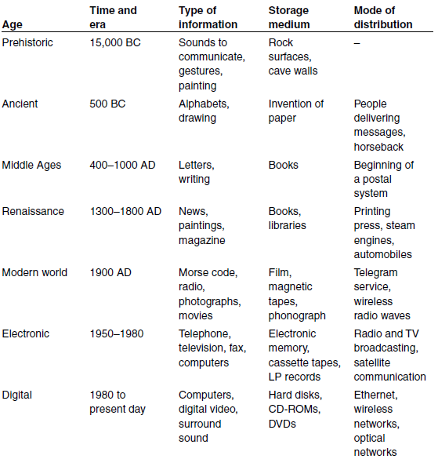
Evolution of information

Slide 6
Types of multimedia data
Mainstream multimedia:
Text (formatted, hypertext (non-linear), )
Audio (dimensionality, frequency range, voice, music)
Image (2d array of pixels, bit-depth, formats )
Video (aspect ration, width to height, 1d scanning)
Graphics (2d/3d vector coordinates, color, thickness)
Animation?
Still not mainstream multimedia:
Holograph
Haptic

Slide 7
Qualities of multimedia data
Digital (always bits and bytes), which enables creation of rich content
Voluminous (challenges in storing, searching, transmitting over bandwidth) -> compression
Interactive, Jumping (jump chapters in pdf book, hyperlinked text in WWW, jump audio and video tracks)
Real-time & synchronization (very small delay)
Example: watching football match on your PC

Slide 8
Classification of multimedia systems
Static vs dynamic (watching .ppt or video)
Real-time vs orchestered (live broadcast, DVD)
Linear vs non-linear (eBook vs hypertext in case of text, hypermedia for other types)
Person-to-machine vs Person-to-Person (CD-ROM game vs videoconferencing)
Single user, peer-to-peer, peer-to-multipeer, broadcast (web browsing, chatting, chat room, radio or TV broadcast)

Slide 9
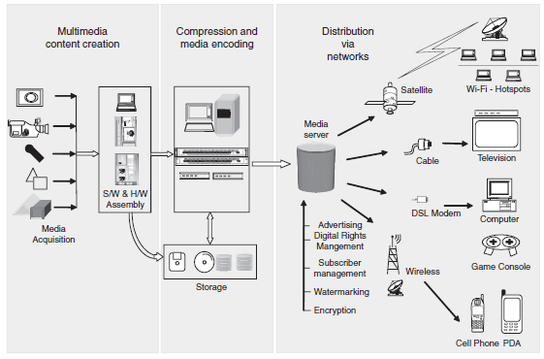
Multimedia today

Slide 10
What is multimedia?
.ppt presentation
Playing a video game
Describing a picture to your friend
Reading the newspaper in the morning
Videoconferencing
Watching TV and listening to radio
Browsing on internet
Having a telephone conversation

Slide 11
The multimedia revolution
Digitalization of every device
Digitalization of libraries
Evolution of communication and data networks
New algorithms for compression
Better hardware performances
Smarted user interfaces for interaction

Slide 12
Groups for standardization
ISO (international organization for standardization)
ITU (International Telecommunication Union)
JPEG (Joint pictures expert group)
MPEG (Motion pictures expert group)
OSI (Open Systems for Interconnection)
VRML (Virtual relality modeling language)

Slide 13
A possible future
Smartphones, GPS, …
Needs for application that can search through multimedia information
Google
Agents and software robots
DRM (Digital right management), protecting the ownership/copyright of digital content

