Slide 1

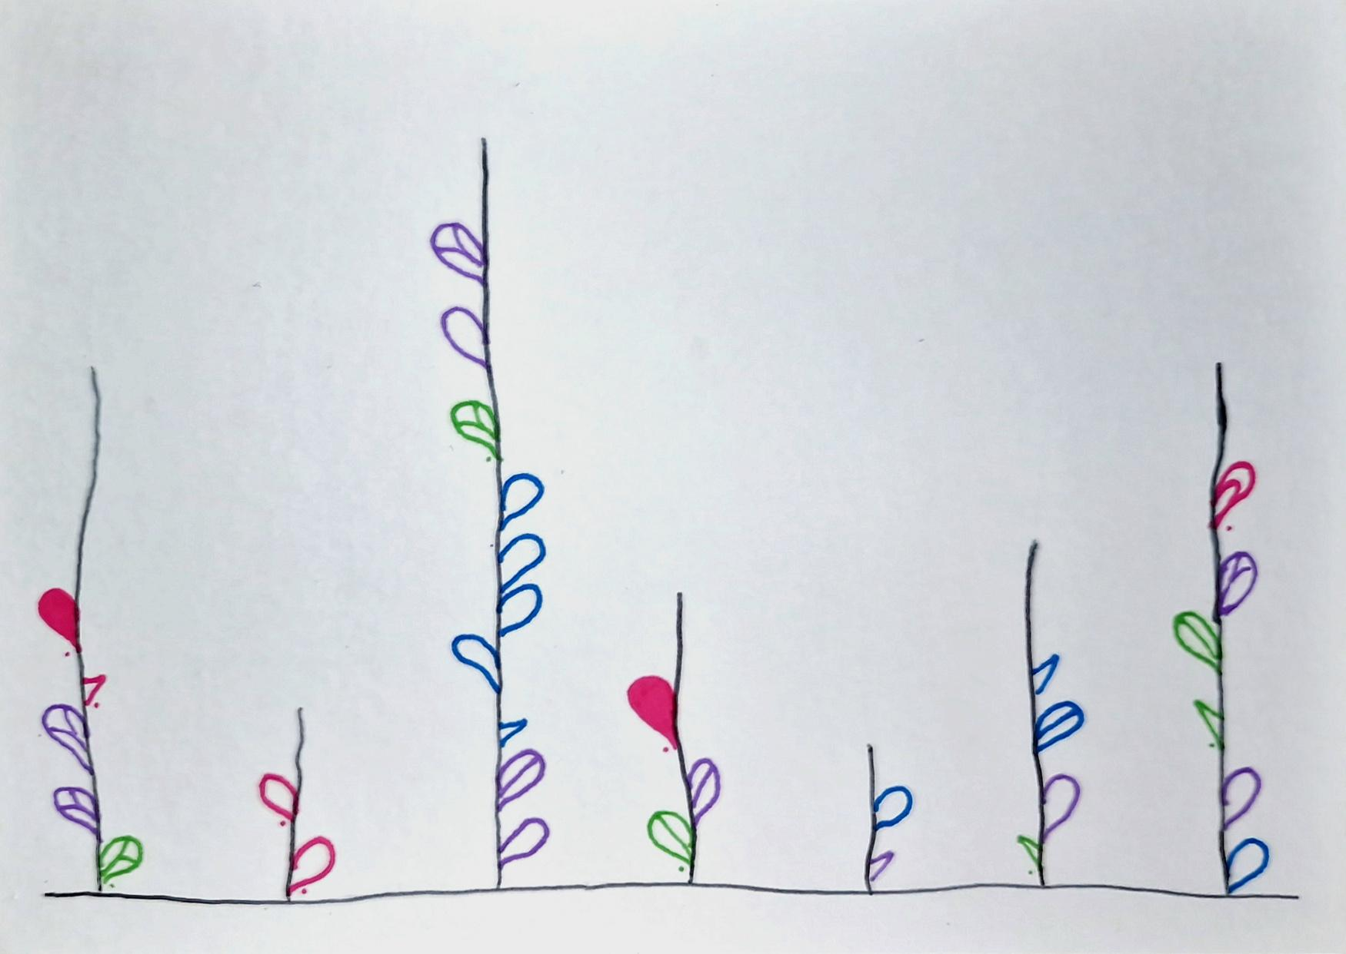
Ana Margarida Almeida
Dear Data
A week of calls back home
Information Visualization 2024/2025

Slide 2
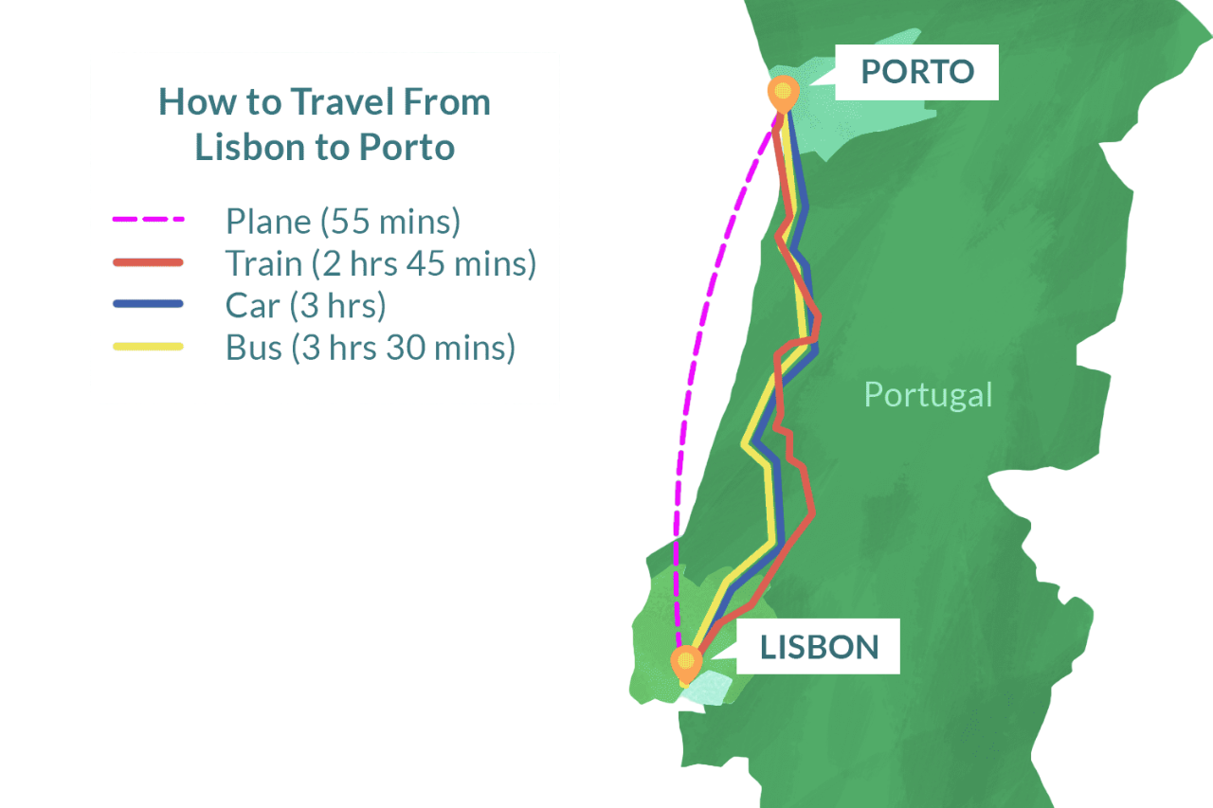
Motivation

Slide 3
The Data
01.
02.
03.
Time (day and time)
Duration
With Whom
04.
05.
06.
Who Initiated
Subject
Video or Voice

Slide 4
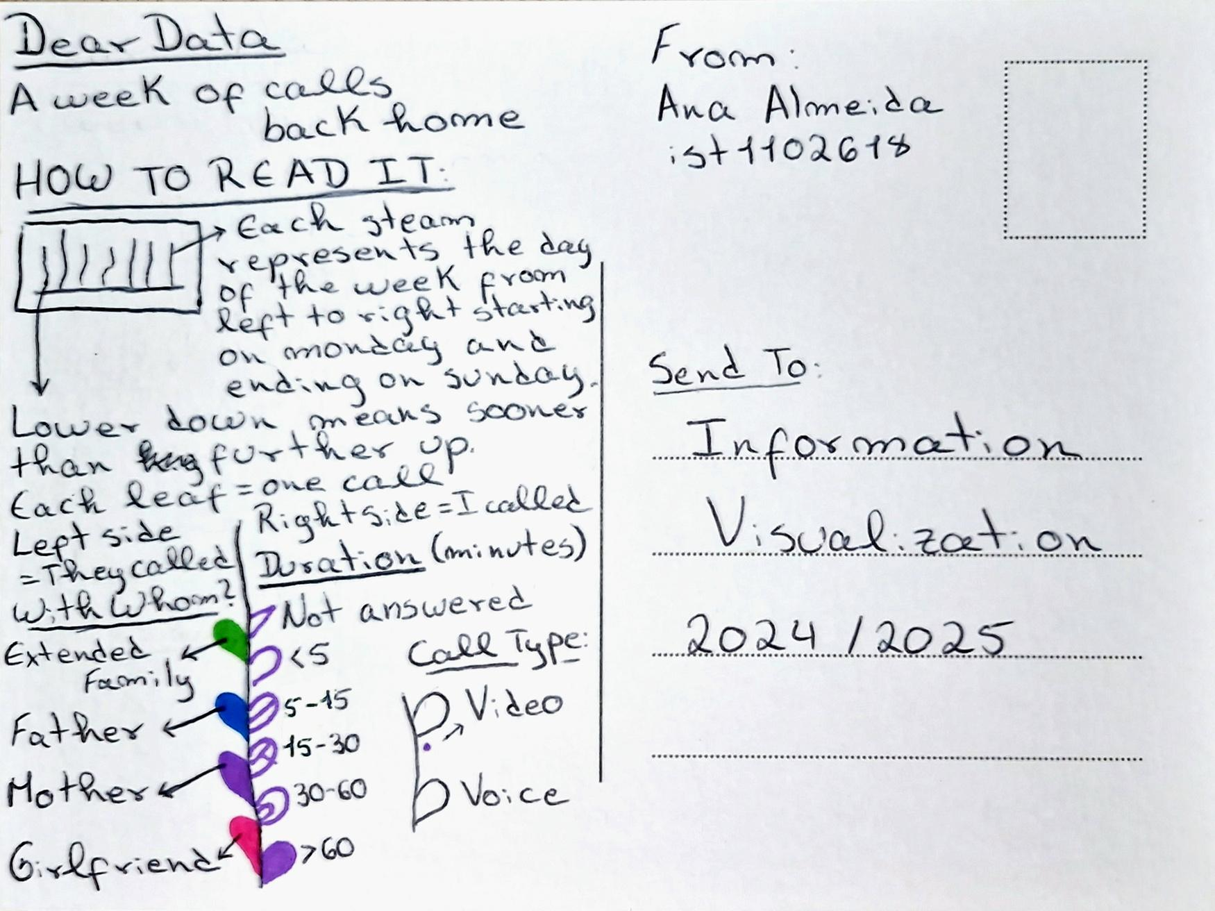

Slide 5

Conclusion

Slide 6

Ana Margarida Almeida
Thank you very much!
Information Visualization 2024/2025

