Slide 1
Fake News detection
Ana Morais

Slide 2
Project overview
Objective: Build a classifier to distinguish between real and fake news headlines.
Dataset:
training_data.csv
contains news headlines and labels: 0 = Fake, 1 = Real)

Slide 3
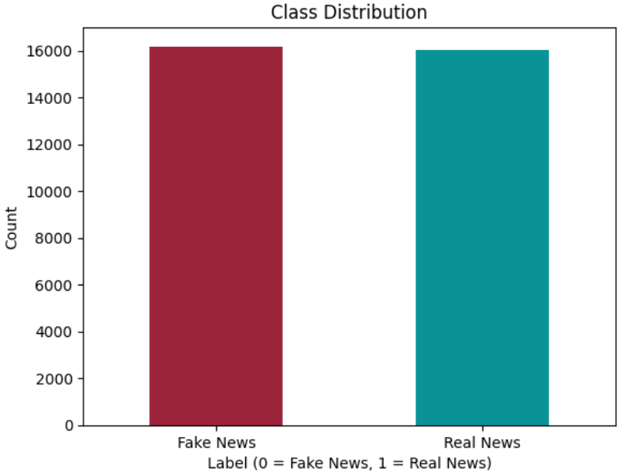
Balanced dataset
tag | counts
0 | 17572
1 | 16580
T | 34152

Slide 4
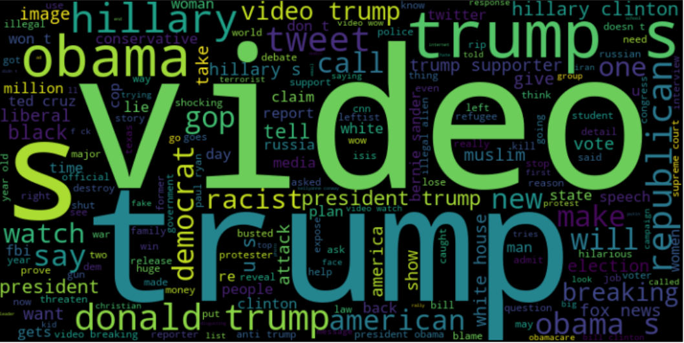
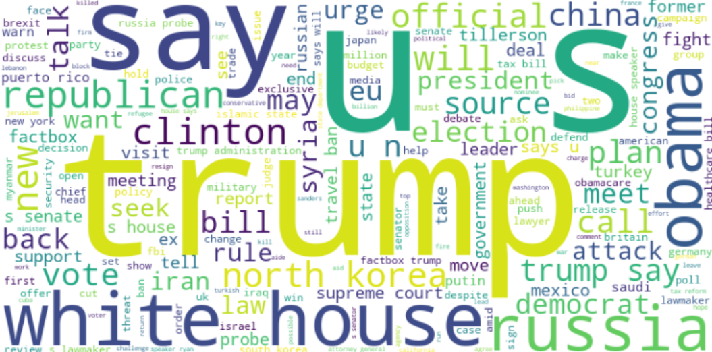
Fake News
Real News

Slide 5
Implementation details (base model)
Data preprocessing:
Base Model: Random Forest Classifier
N_estimators=200
Evaluation Metrics:
Accuracy, Precision, Recall, F1-Score
TF-IDF vectorizer
Criterion=‘entropy’
Max_depth=10
Train-Test Split
Notes:
TF-IDF vectorizer (Term Frequency-Inverse Document Frequency) – to convert the text into a numerical format. It highlights the most important words in a document while reducing the noise from less informative terms.
It is processing the text by removing common English stop words, splitting the text into unigrams and bigrams, and filtering out rare terms and overly common terms.
Max_df=0.8 ignores terms that appear in more than 80% of documents because these terms are likely to be too common
Min_df=5: ignores terms that appear in fewer than 5 documents; Rare terms may not provide useful information and can introduce noise
N_estimators=200: good balance (I think) between performance and training time
Criterion=‘entropy’: we want to split the dataset into subsets that are as ‘pure’/ homogeneous as possible. Splits are made where the information gain is higher (suited for classification problems)
Max_depth=10: allows sufficient complexity while avoiding overfitting on our relatively large dataset

Slide 6
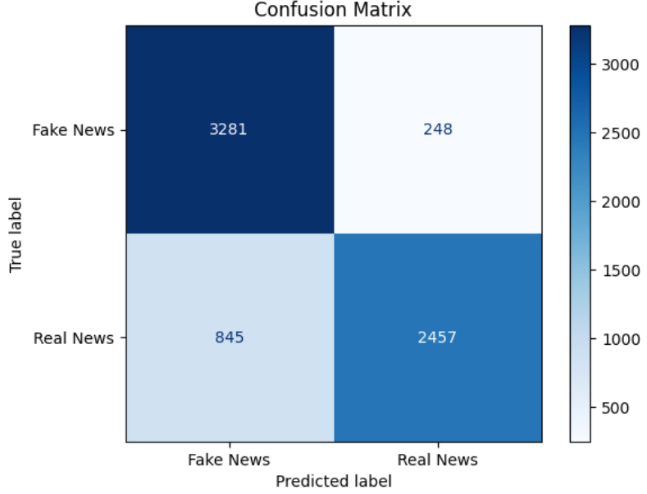
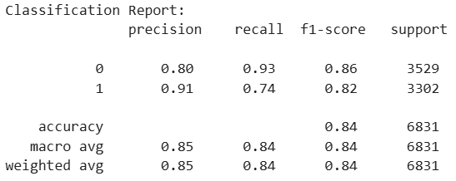
Base Model Evaluation

Slide 7
Implementation details (base model + Lemmatization)
Data preprocessing:
Base Model: Random Forest Classifier
Same parameters
Evaluation Metrics:
Accuracy, Precision, Recall, F1-Score
TF-IDF vectorizer
Removed duplicates and missing values
Removed special characters
Lemmatization with WordNetLemmatizer()
Train-Test Split
Notes:
Lemmarization: reducing a word to its base/dictionary form (lemma) while preserving its meaning. Simplifies text processing.
The WordNetLemmatizer from NLTK library uses the WordNet lexical database to perform lemmatization. This allows it to accurately handle English vocabulary and grammar.

Slide 8
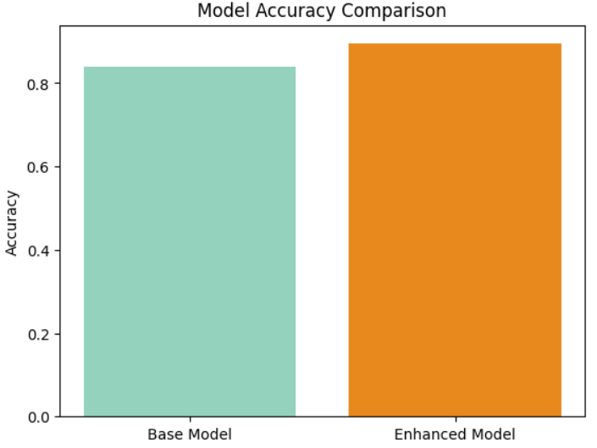
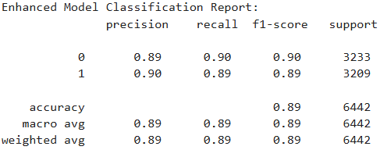
Model Evaluation

Slide 9
Using a transformer-based model

Slide 10
Implementation details
Data Preprocessing:
Model:
DistilBERT (lightweight transformer model)
Evaluation Metrics:
Accuracy, Precision, Recall, F1-Score
Removed duplicates and missing values
Removed special characters
Lemmatization with WordNetLemmatizer()
Train-Test Split
Fine-tuned for binary classification
Training and Evaluation with Hugging Faces’ Trainer class
Tokenization with Autotokenizer and a tokenize_function with padding, truncation and batch processing
Notes:
Tokenization: breaking down text into smaller units (tokens).
Hugging Face’s AutoTokenizer: automatically selects the appropriate tokenizer for the chosen pre-trained model (in this case, DistilBERT)
Padding: shorter sequences are extended to match the required or maximum sequence length by adding dummy tokens. Ensures all sequences are the same length (along with truncation) Truncation: Shortens longer sequences to max_length=128 tokens.
Batch Processing: Applies the tokenization function to the dataset efficiently.
Steps involved in the fine-tuning: adding a pre-built classification head and loss function(AutoModelForSequenceClassification class; and training with labeled data) on top of the DistilBERT model to output probabilities for two classes

Slide 11
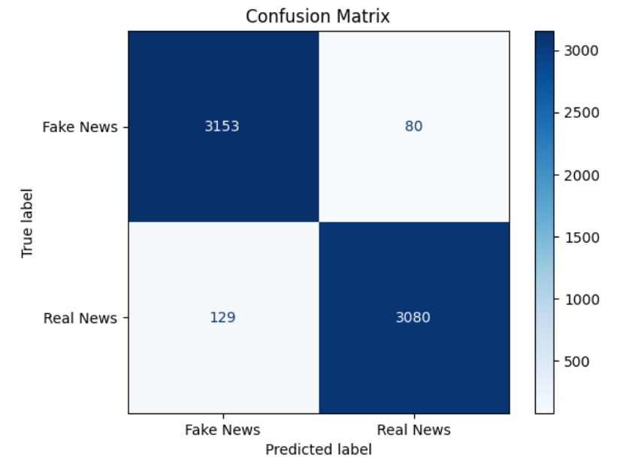
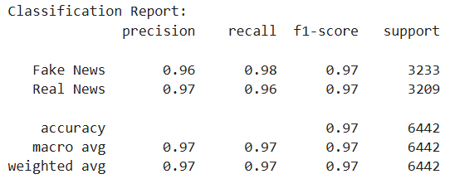
Model Evaluation

Slide 12
Final tips & takeaways
DistilBERT Classifier with preprocessed data worked better
From 85% to 97% accuracy
Preprocessing is key! (again) And making sure you work compatible packages
Next Steps:
Experiment with other token importance methods and transformer models

Slide 13
THANK YOU

