Slide 1
Rockbuster Stealth: Data analysis Summary
Ana Renahan, March 11, 2023

Slide 2

PROJECT CONTEXT
Context: The Rockbuster Stealth management team is planning to use existing movie licenses to launch an online video rental service. This is because the company is facing stiff competition from streaming services such as Netflix and Amazon Prime.
We will be answering management’s key questions (listed on the right) to assist with the 2020 company strategy.
Look for the ‘s to see where these key questions are being answered!
What movies contributed the most/least to revenue gain?
What was the average rental duration for all videos?
Where are customers with a high lifetime value based?
Do sales figures vary between geographic regions?
ANALYSIS BY COUNTRY
Which countries are Rockbuster customers based in?

Slide 3
More about our FILMS…

Slide 4
INITIAL DATA
FILM DATA: What kind of films do we have in inventory?
# of Movies in our Catalog:
1000
Release Year:
2006
Language(s):
English
Breakdown of Ratings:
Longest Film(s)
185 min.
Average Film(s)
114 min.
Shortest Film(s)
46 min.
Note: Our dataset for this analysis only includes English films that were released in 2006. If additional data is available on other films in our catalog (released in other years or different languages), we should re-do this analysis.
Notes:
For queries and output in Technical doc, see:
Count of Movies in Catalog
Count of Release Years
Count of Languages
Breakdown of Ratings
MAX, AVG, MIN of Film Duration

Slide 5
INITIAL DATA
FILM DATA: How do we manage our films?
Rental Duration:
Minimum:
3 Days
Average:
5 Days
Maximum:
7 Days
Minimum:
$0.99 / day
Maximum:
$4.99 / day
Average:
$2.99 / day
Minimum:
$9.99
Average:
$19.99
Maximum:
$29.99
Rental Rate:
Replacement Cost:
The average rental duration for our movies is 5 days.
Notes:
For queries and output in Technical doc, see:
MAX, AVG, MIN of Rental Duration
MAX, AVG, MIN of Rental Rate
MAX, AVG, MIN of Replacement Cost

Slide 6
How do our films “perform”?

Slide 7
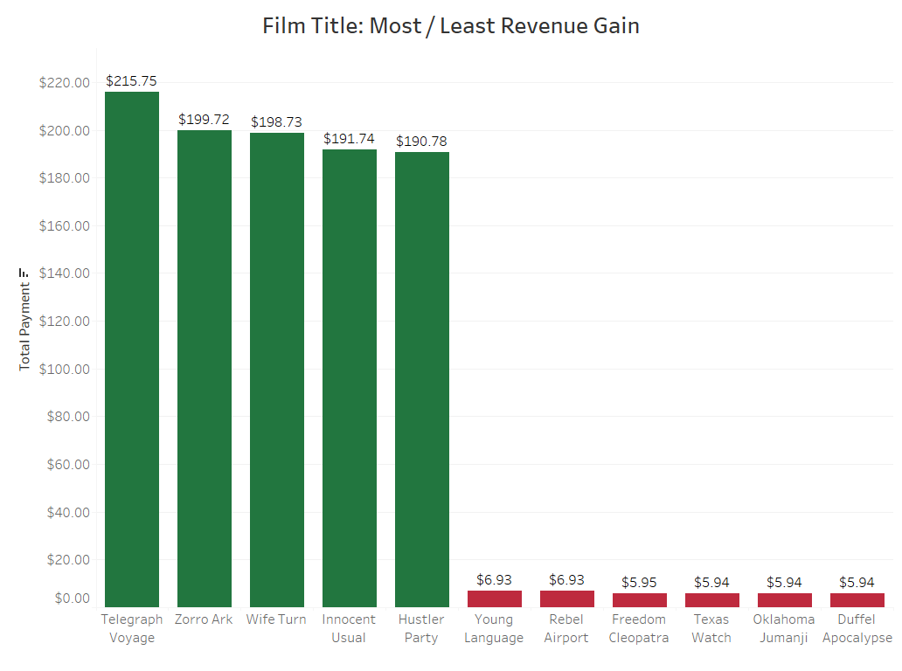
ANALYSIS
What movies contributed to the most/least revenue gain?
Our dataset shows rental dates from 05/24/2005 – 02/14/2006. During this time…
The film Telegraph Voyage contributed to the most revenue gain (with a total payment amount of $215.75).
There were 42 films that did not have any rentals (total payment amount is $0).
The bottom 6 films shown to the left had the lowest / non-zero revenue.
Top 5 Films by Revenue
Bottom 6 Films by Revenue
Notes:
For queries and output in Technical doc, see:
Film Names by Total Payment
Rental Date Groups

Slide 8
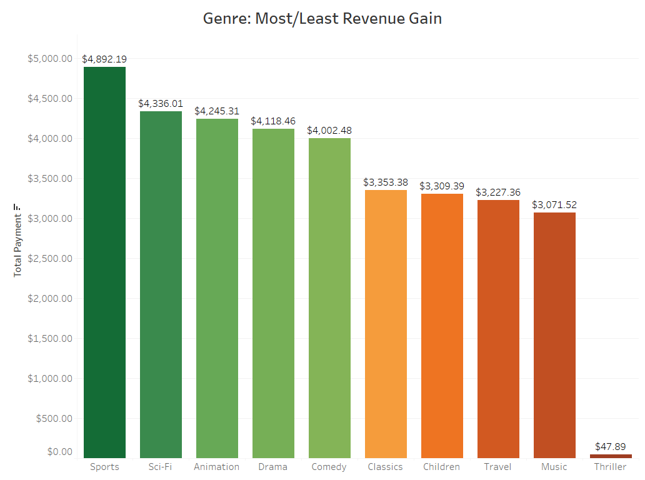
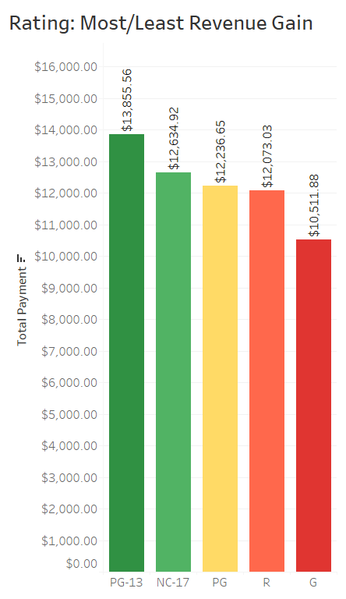
ANALYSIS
What genres and ratings contributed to the most/least revenue gain?
Our dataset shows rental dates from 05/24/2005 – 02/14/2006. During this time…
The Sports genre contributed the most revenue gain, while the Thriller genre had the least revenue gain.
PG-13 movies contributed the most revenue gain, while G movies had the least revenue gain.
Top 5 Genres by Revenue
Bottom 5 Genres by Revenue
Ratings by Revenue
Notes:
For queries and output in Technical doc, see:
Genres by Total Payment
Ratings by Total Payment

Slide 9
More about our CUSTOMERS…

Slide 10
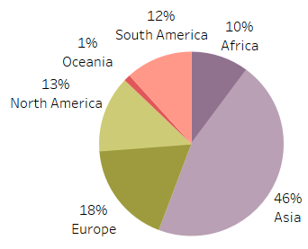
INITIAL DATA
CUSTOMER DATA: What do we know about our customers?
# of customers in our dataset:
599
# of countries customers are based in:
108
# of customers linked to each store:
Continents with the largest % of customers:
Continents with the largest % of revenue:
This gives us a quick understanding of how many customers we have and how many countries they reside in, as well as it shows us that sales figures vary by continent (i.e. geographic region)! More detail on this variation in the following slides.
Notes:
For queries and output in Technical doc, see:
Count of Customers
Count of Countries
% of customers by Continent
Count of Customers by Store_ID
Store_ID Country

Slide 11
Where are our top customers located?

Slide 12
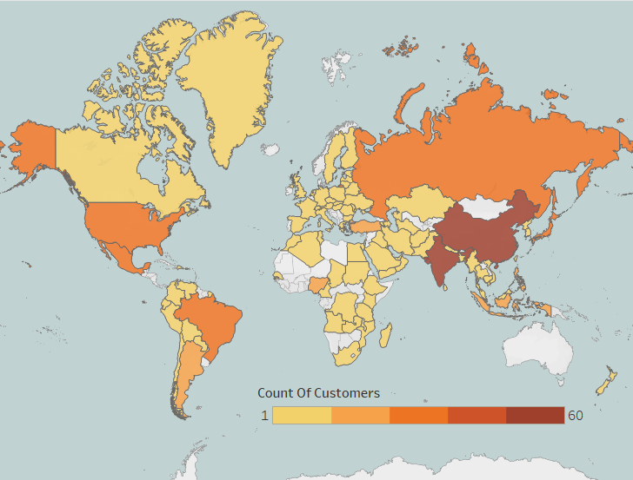
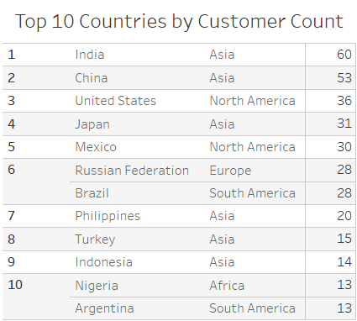
ANALYSIS
Top 10 Countries for Rockbuster (based on # of Customers)
The map shows us the 108 countries that Rockbuster customers are based in (the darker the shade, the more customers located there).
Note: There is a tie for 6th place, and this is why our rank only shows up to 9th place.
Link to Tableau Public
Notes:
For queries and output in Technical doc, see:
Top 10 Countries by Customer Count

Slide 13
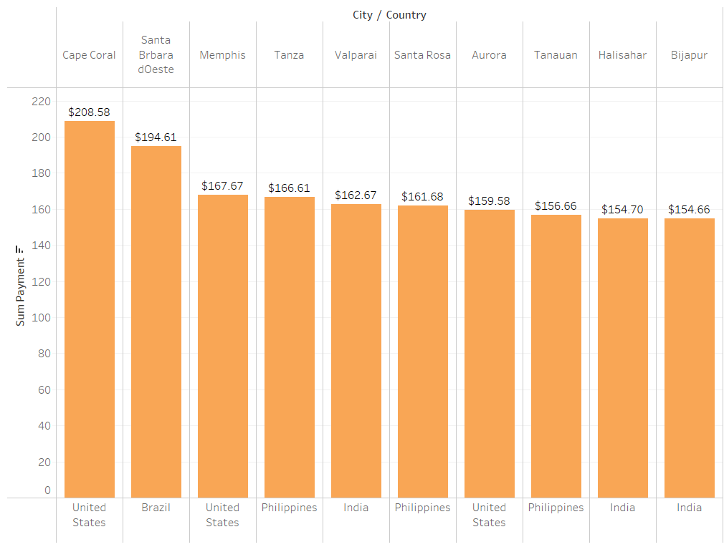
ANALYSIS
Top 10 Cities within the Top 10 Countries for Rockbuster (based on Customer Payments)
With the Top Countries defined by customer count, we can then find the Top Cities within those countries based on Customer Payments
These cities are where there are customers with a high lifetime value. The following slide shows our top customers in these cities!
From this, we can see that the United States and India each account for the most top cities (3 each).
Cape Coral in the United States is the city with the highest amount of customer payments.
Notes:
For queries and output in Technical doc, see:
Top 10 Cities within the Top 10 Countries by Customer Payments

Slide 14
ANALYSIS
Top 5 Customers within the Top 10 Cities for Rockbuster (based on Customer Payments)
The following customers could be rewarded for their loyalty!
$208.58 Karl Seal Cape Coral, United States
$194.61 Marion Snyder Santa Brbara dOeste, Brazil
$166.61 Marcia Dean Tanza, Philippines
$162.67 Mike Way Valparai, India
$152.68 Steve Mackenzie Probolinggo, Indonesia

Slide 15
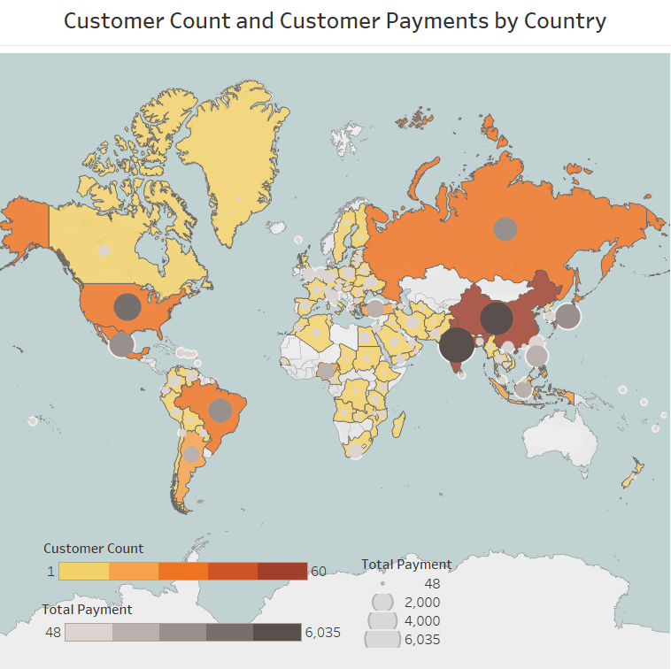
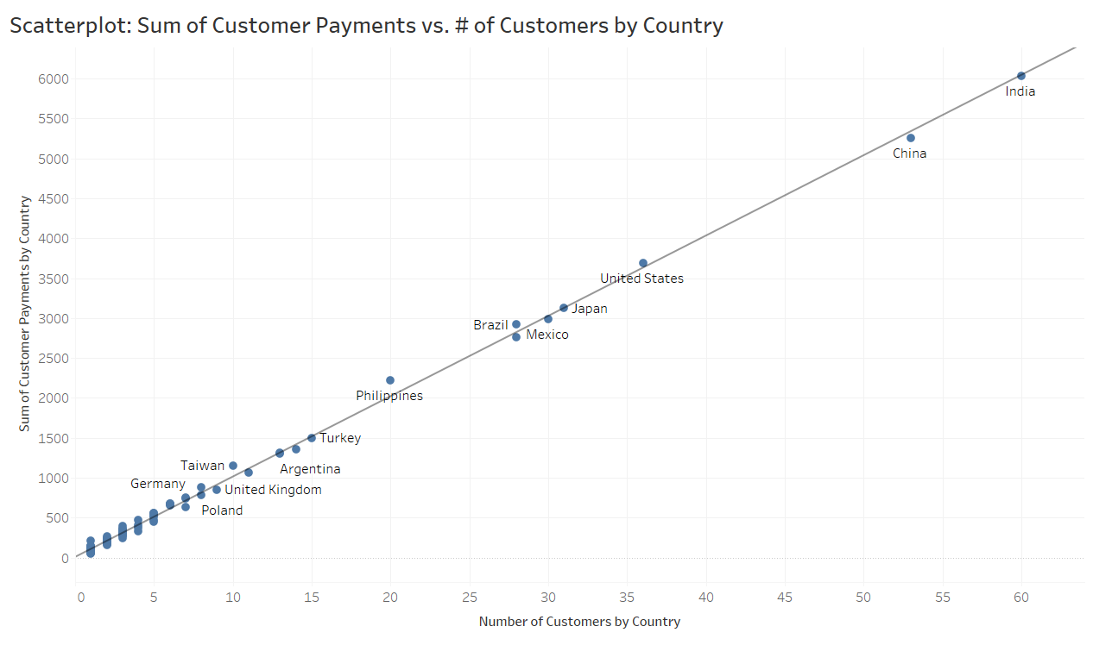
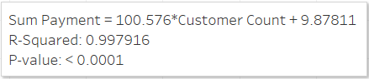
ANALYSIS
Does the revenue generated by each country correlate to the number of customers in each country?
Correlation Coefficient = 1.00
Yes! The scatterplot points being close to the trend line along with our correlation coefficient lets us know that the relationship between these two variables is strong.
Link to Tableau Public

Slide 16
CONCLUSIONS AND RECOMMENDATIONS
CONCLUSIONS |  | RECOMMENDATIONS
Our data shows us which countries Rockbuster customers are based in and where customers with a high lifetime value are based. It also shows us that sales figures vary between geographic regions. |  | We should show our appreciation to loyal customers and further understand if there are other variables that contribute to success in top cities.
Our data shows us which film titles, genres, and ratings from the Rockbuster catalog produced the most and least revenue gain. |  | We should continue our analysis on the performance of top titles and genres. We should investigate how genres perform by region and market to those regions accordingly.
The findings presented can be used to help with the launch strategy for our new online video services.

Slide 17
QUESTIONS?
Please reach out if you have any questions!
Ana Renahan ana.renahan@gmail.com
Thank you for your time!

Slide 18
BACKUP
A note on data limitations:
Our dataset only contained English language films released in 2006. In addition, our customer revenue was based on customer rental dates from 05/24/2005 – 02/14/2006. |  | We should expand our dataset to include non-English language films released in various years to see if other languages are more successful across our customer base. We should look at more recent sales transactions, as well.

