Slide 1
Sortari
Hodivoianu Anamaria

Slide 2
Complexitati
Heap Sort
Timp: O(nlogn)
Spatiu: O(1)
Merge Sort
Timp: O(nlogn)
Spatiu: O(n)
Quick Sort
Timp: O(nlogn), O(n^2) worst
Spatiu: O(1)
Shell Sort
Timp: O(nlogn), O(n^2) worst
Spatiu: O(1)
Radix Sort
Timp: O((n+b)*log_{b}k), unde b=baza, k=numarul maxim
Spatiu: O(log_{b}k)

Slide 3
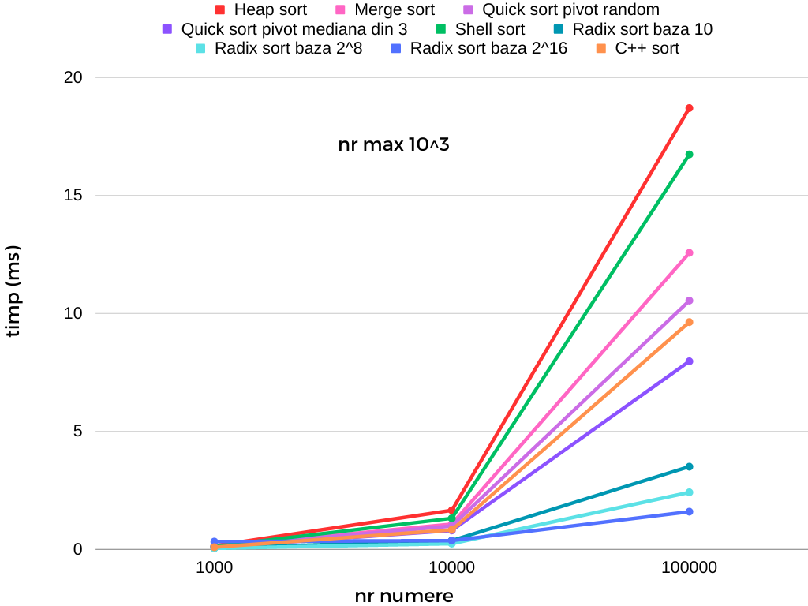
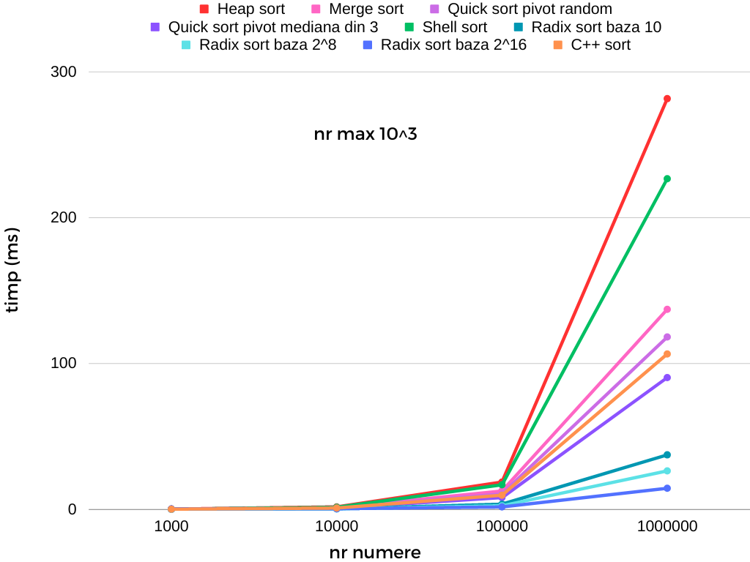
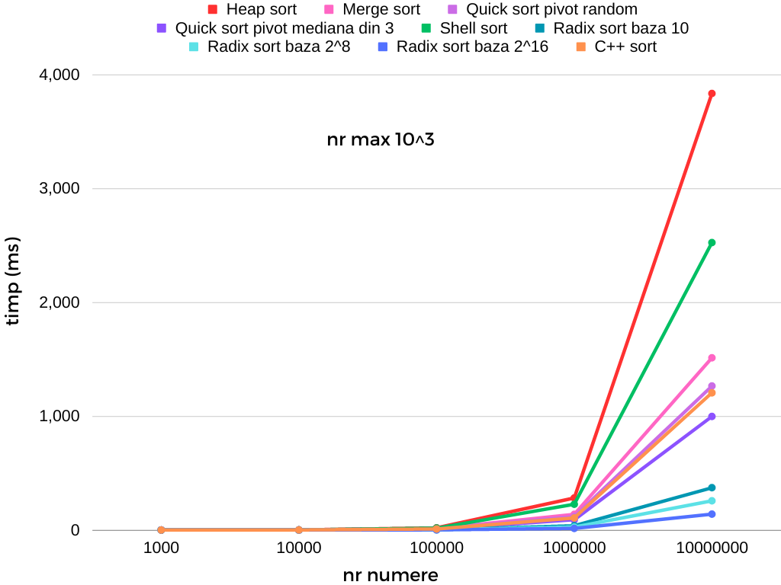
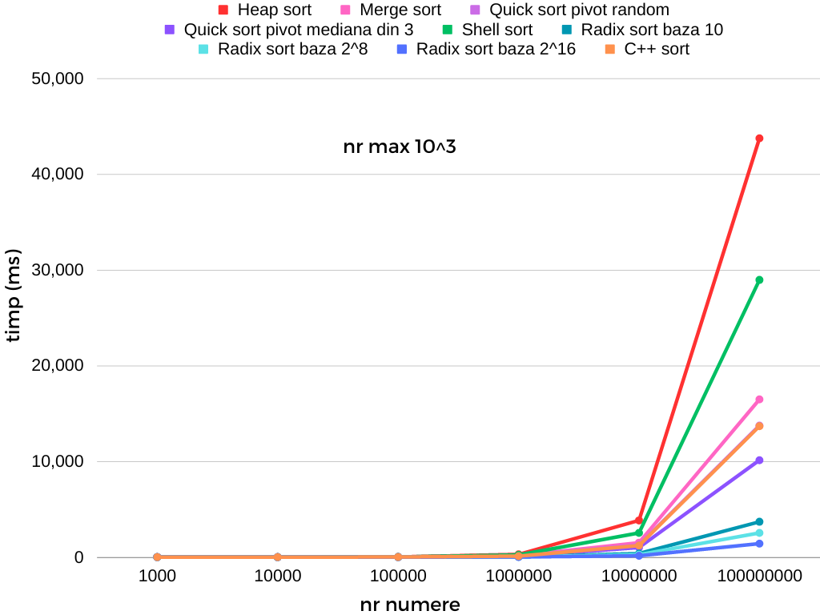
Vector random, numar maxim 10³

Slide 4
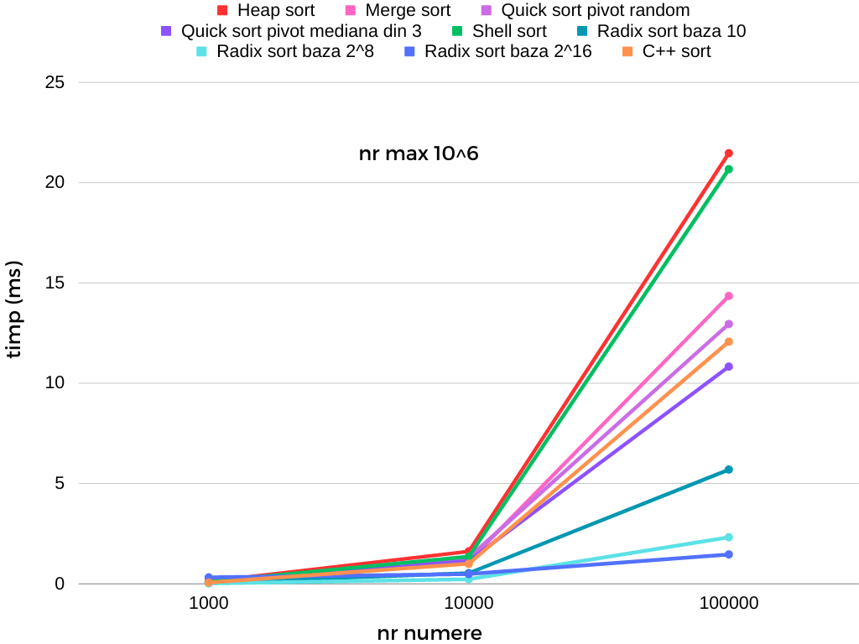
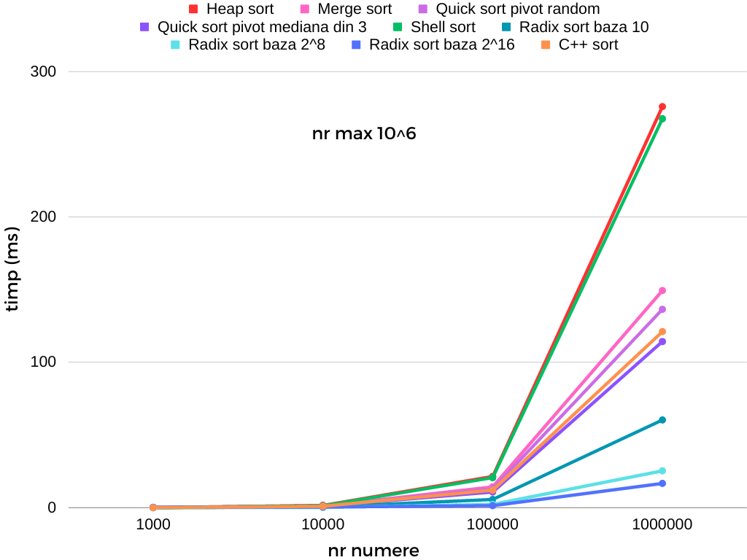
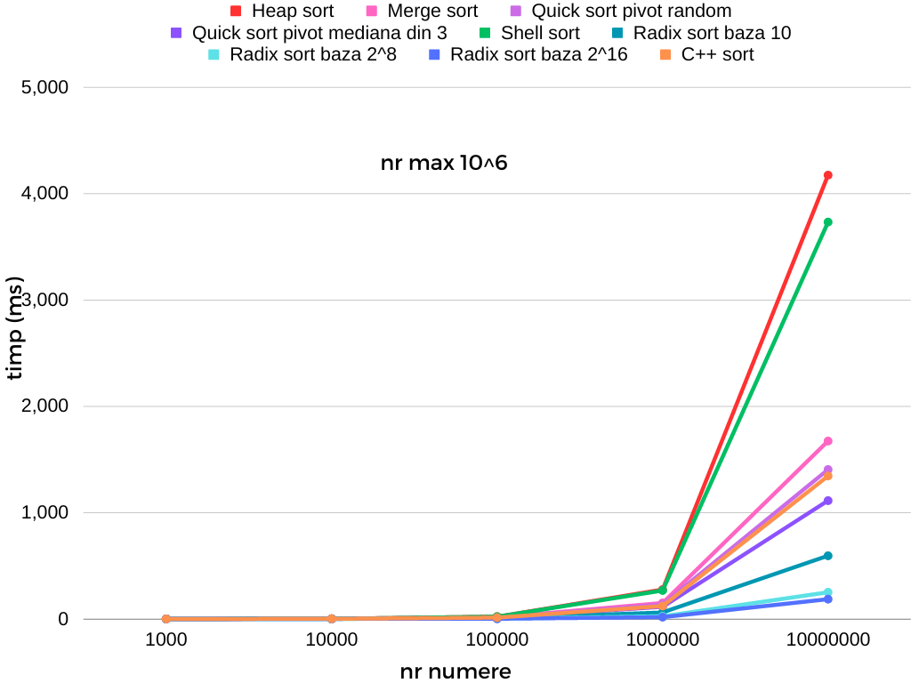
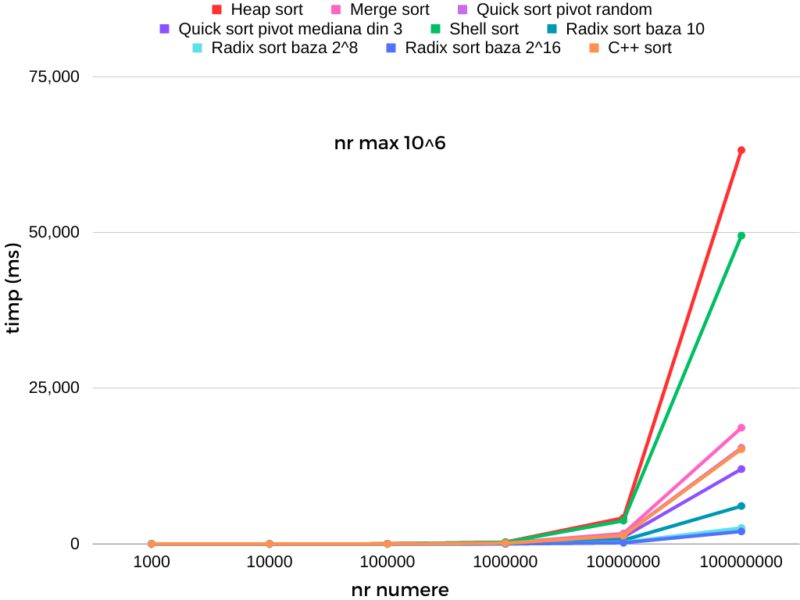
Vector random, numar maxim 10⁶

Slide 5
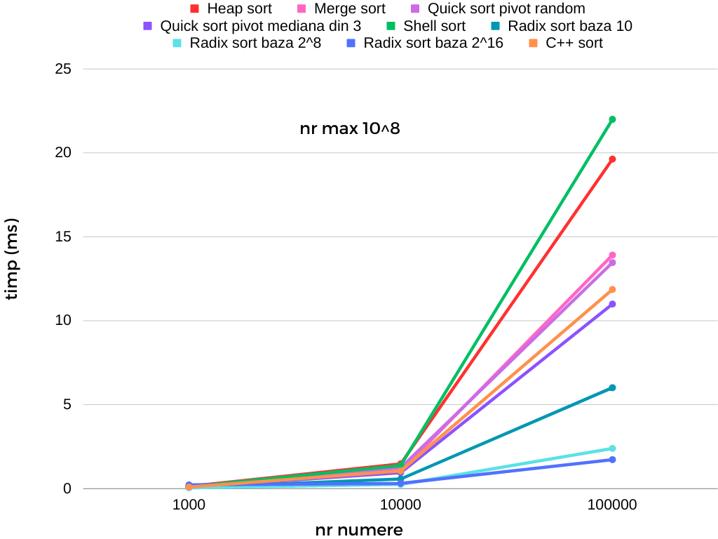
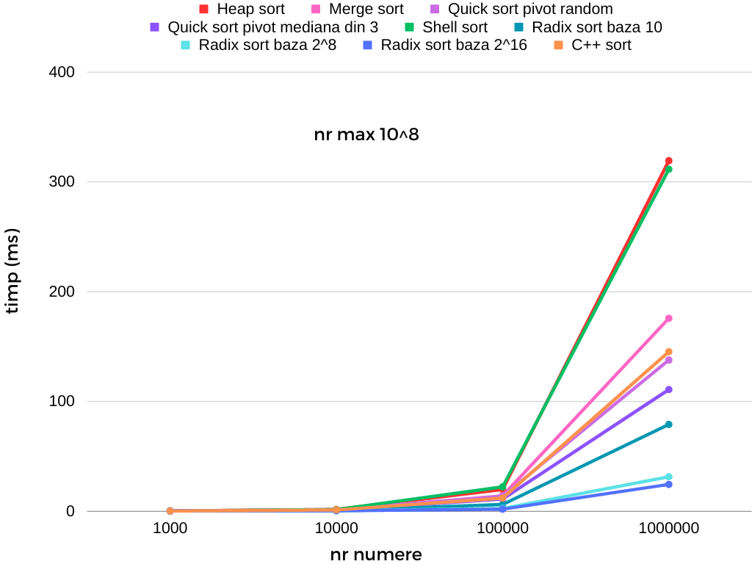
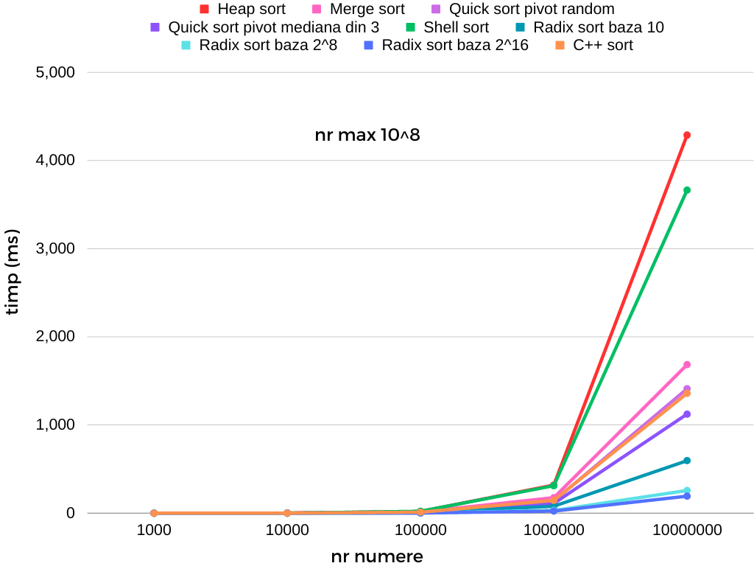
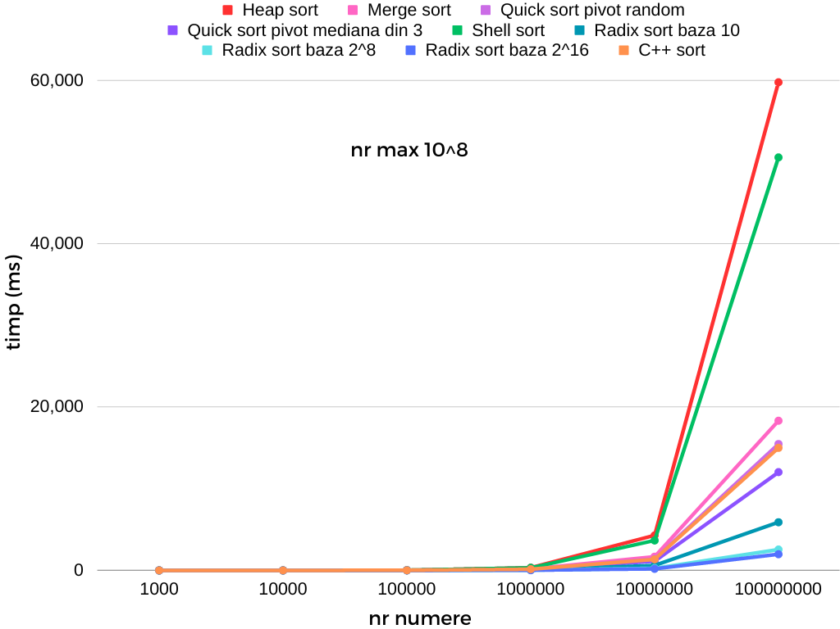
Vector random, numar maxim 10⁸

Slide 6
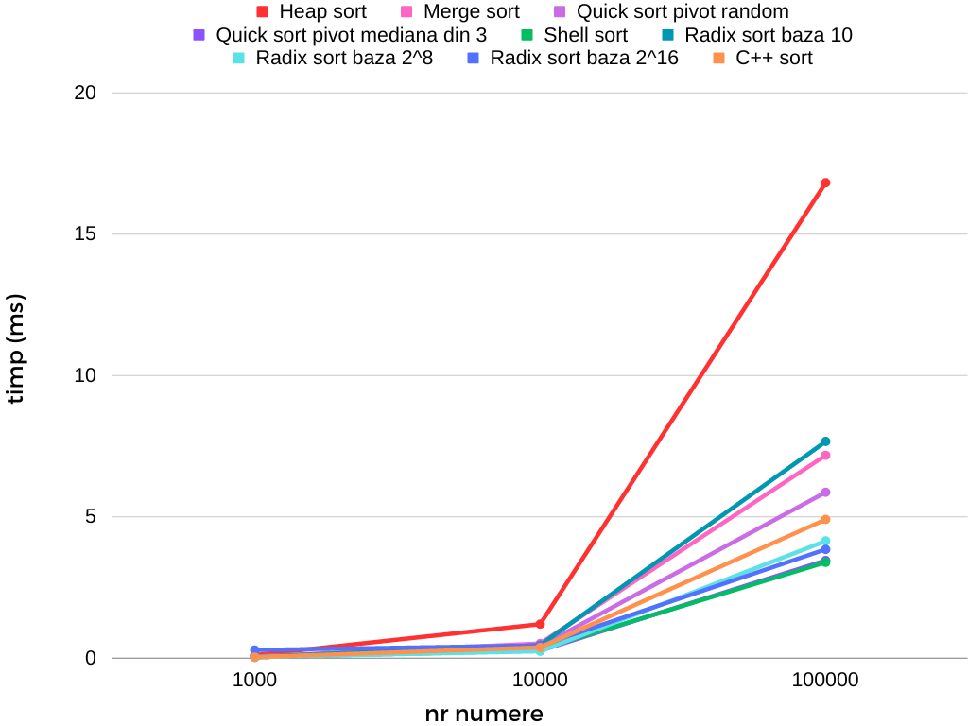
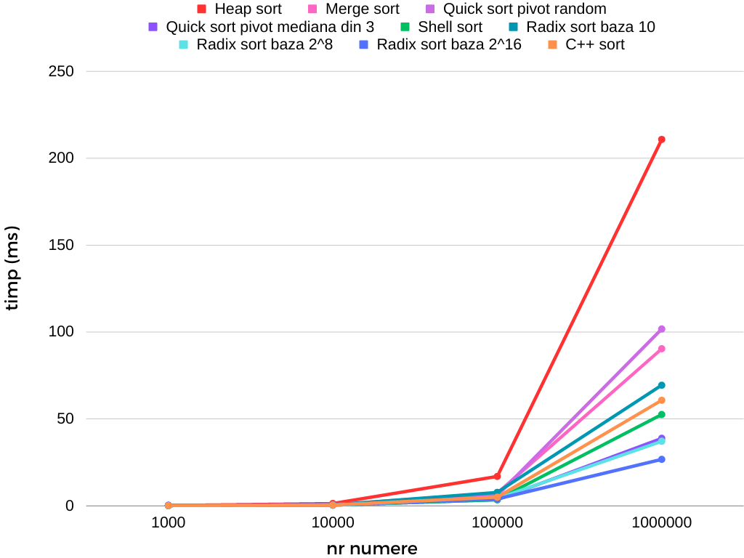
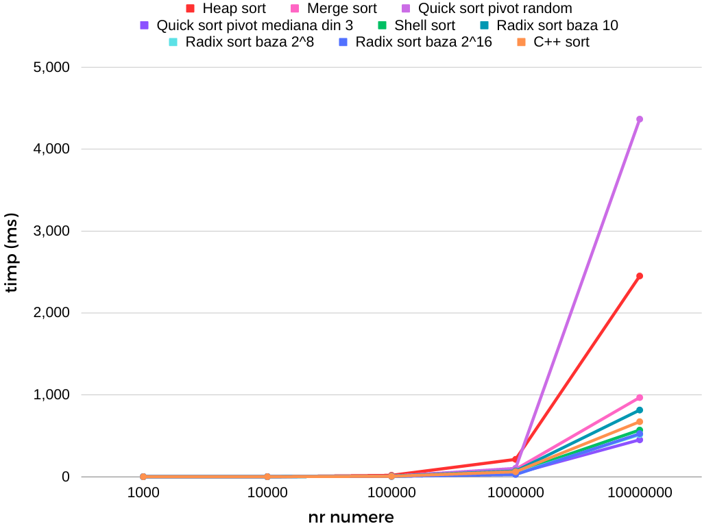
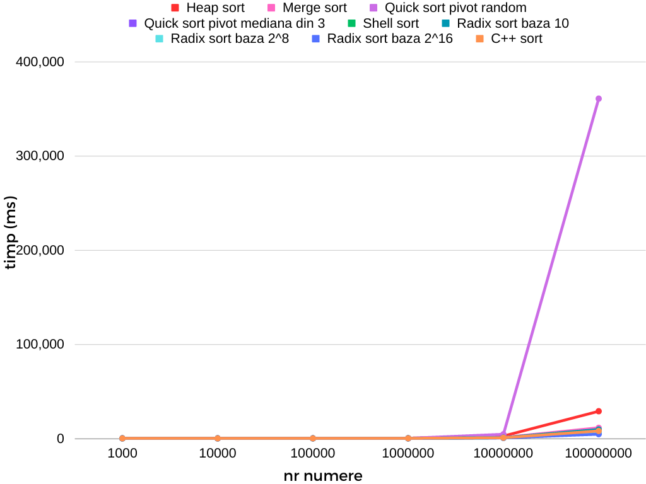
Vector crescator

Slide 7
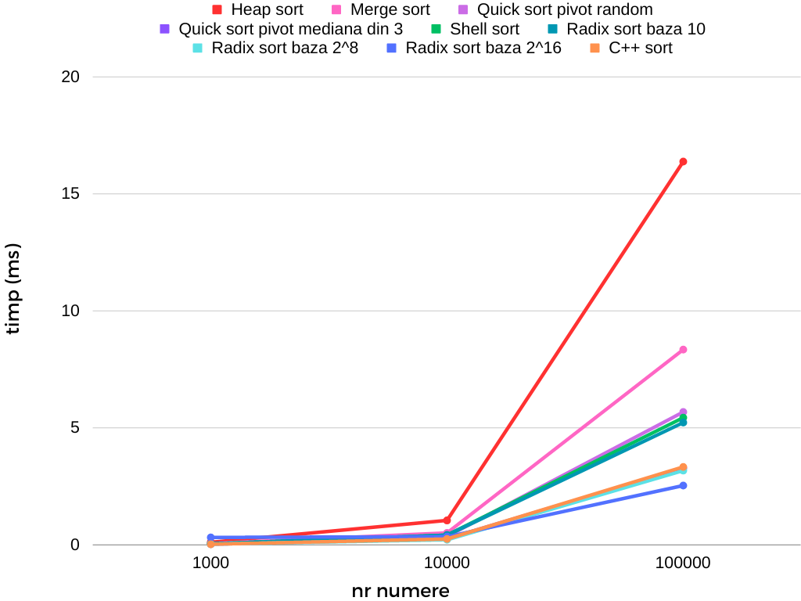
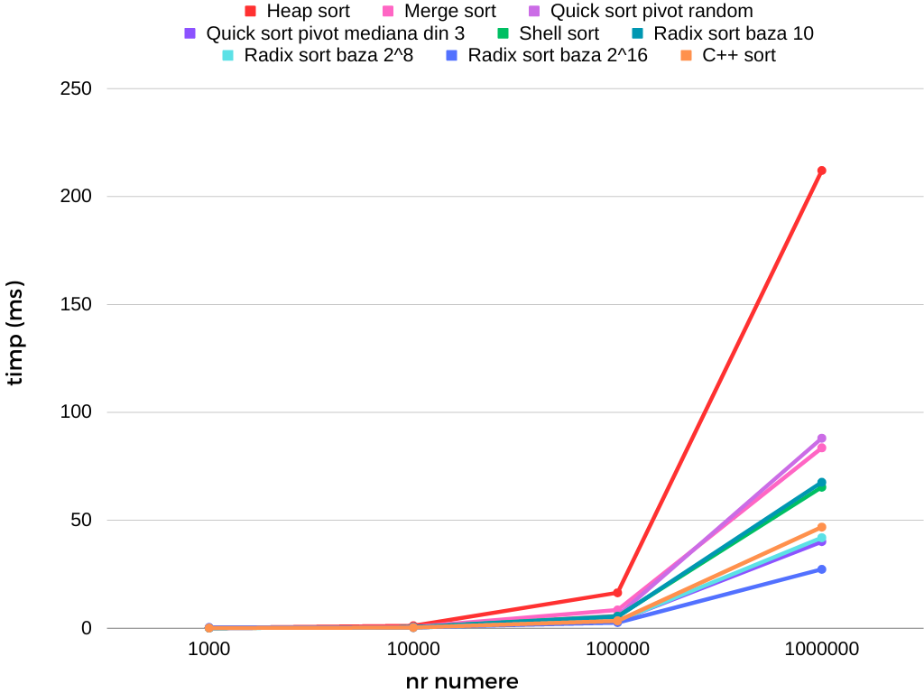
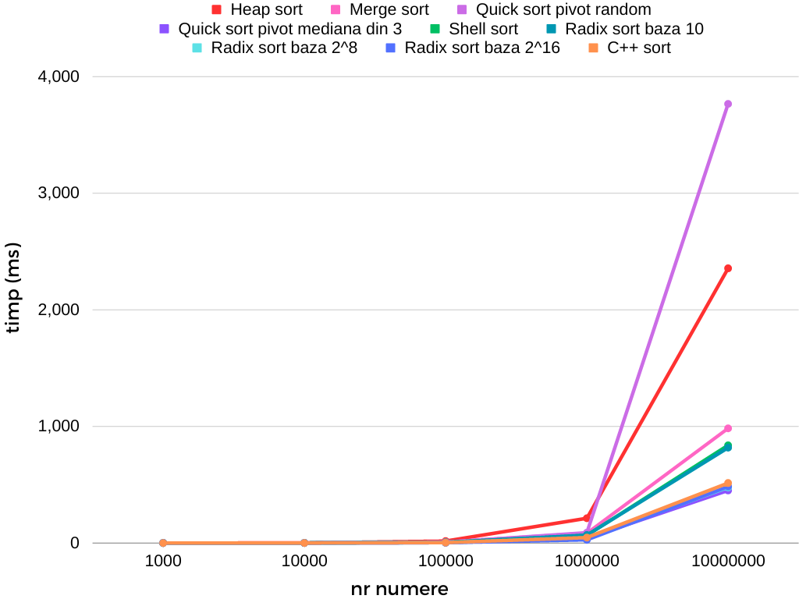
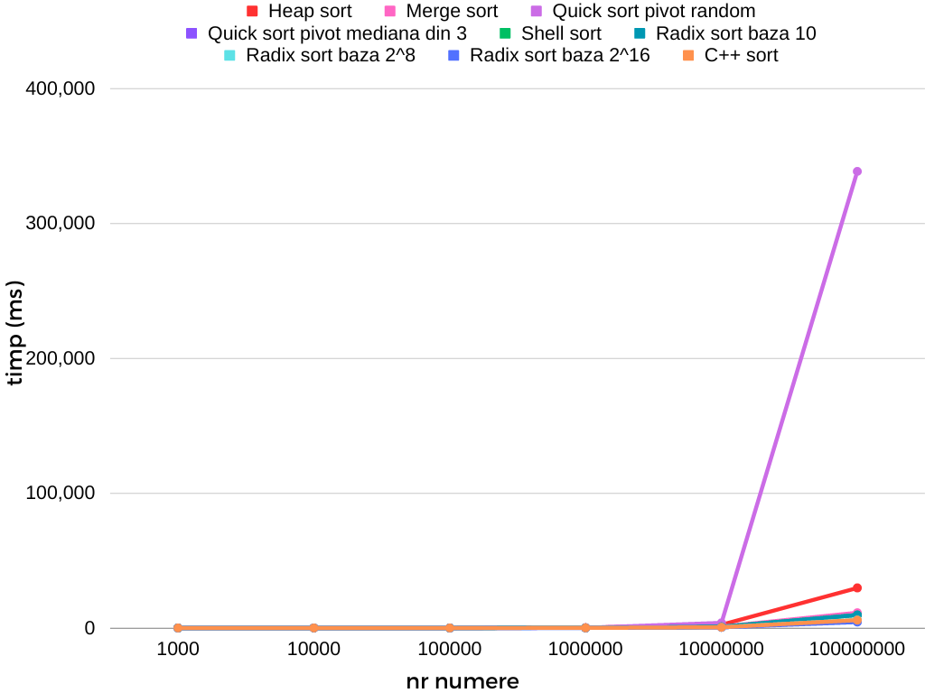
Vector descrescator

Slide 8
Concluzii
In general:
Radix sort baza 2¹⁶
Radix sort baza 2⁸
Radix sort baza 10
Quick sort pivot mediana din 3
C++ sort
Quick sort pivot random
Merge sort
Shell sort
Heap sort
Pentru un vector crescator/descrescator:
Quick sort pivot random merge prost pentru multe numere
In rest, ordinea este cam aceeasi

