Slide 1
Marlbroke
THE BROKE WILL SMOKE
SMOKING DEPENDENCY IN LOW INCOME COMMUNITIES FOSTERED BY BIG TOBACCO

Slide 2
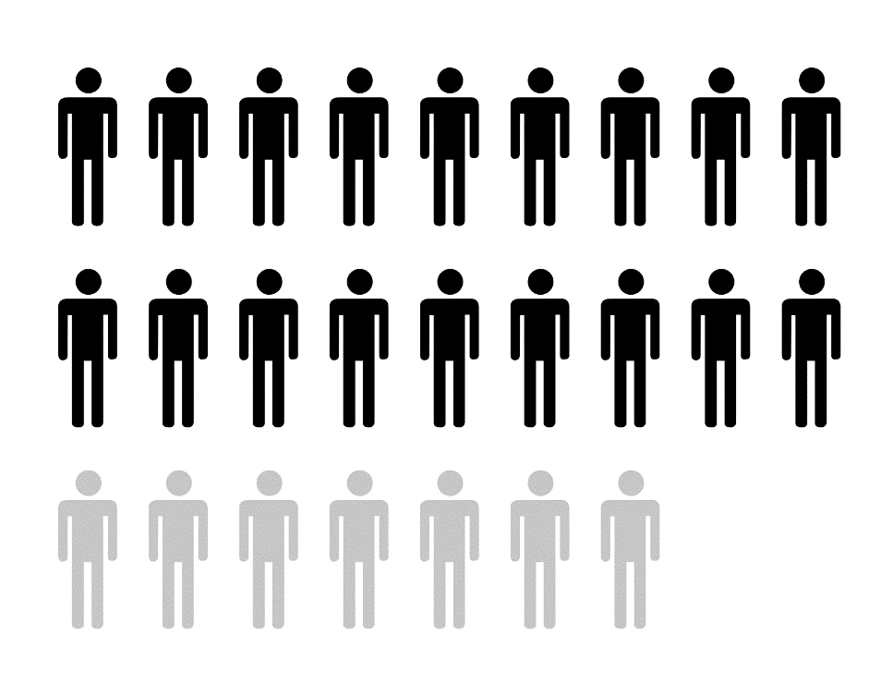
Big Tobacco targets the working class and the less educated
“In the future, marketing to a working class/present oriented mindset will be even more important in appealing to younger smokers”
- R.J. Reynolds Tobacco Co. 1986 Bates no. 505923292/3295
CLICK EACH GRAPH TO VIEW THE DISTRIBUTION OF SMOKERS IN THE UNITED STATES
72% of all smokers come from low-income households
Only 7.1% of the US smoker population has a college degree

Slide 3

Young adults are the most at risk for tobacco addiction
88% of adult smokers began before the age of 18
Nearly 3,200 young adults try their first cigarette each day
And 2,100 youths become daily smokers each day
CLICK
5.6 million young people alive today are projected to die prematurely from tobacco use.
99% of adult smokers began by the time they were 26
And are heavily targeted by tobacco companies

Slide 4
Percent of Smokers by Race
Even though the total percentage of smokers decreased from 2006 to 2010, the percent of black and Hispanic smokers increased due to concentrated marketing efforts.
Percentage of 20 to 24 year olds who identified themselves as current smokers by race/ethnicity after the 1998 Maser Settlement Agreement placed restrictions on tobacco advertising

Slide 5
Advertising Menthol
Tobacco company expenditures have become increasingly concentrated on marketing efforts that reduce the prices of targeted tobacco products.
Area shows the total budget for marketing each year
Where menthol smokers make up only 29 percent of the general market, almost 70 percent of Black smokers choose a menthol brand.
Newport holds over 80% of the younger adult Black market
CLICK HERE TO SEE THE DISTRIBUTION OF BRAND PREFRENCE BY RACE/ETHNICITY

Slide 6

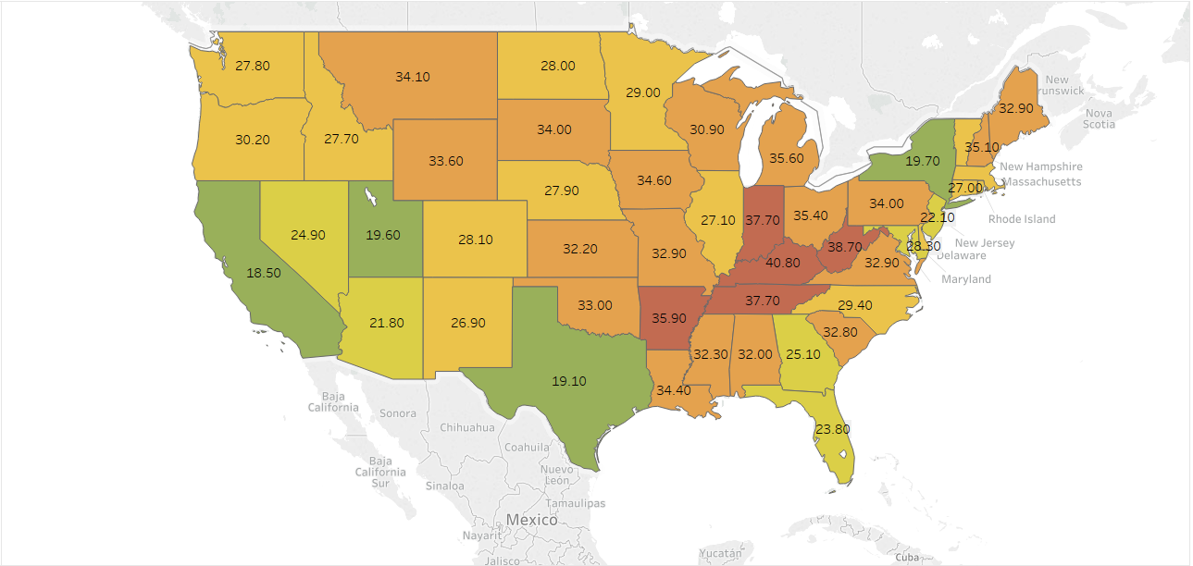
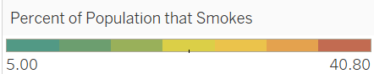
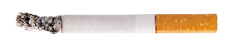
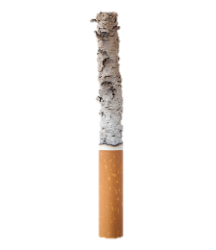
Smoking by Income
HOME
MEDIAN YEARLY INCOME
LESS THAN $25,000
$25,000-$49,999
$50,000-$74,999
$75,000 OR MORE
BACK
NEXT

Slide 7
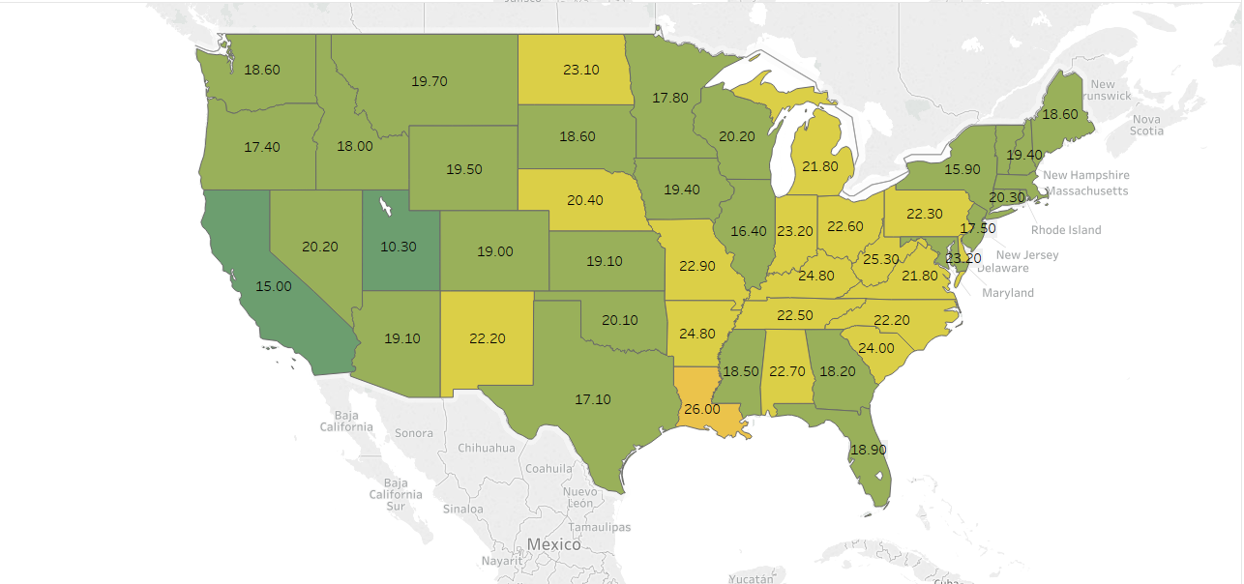
Smoking by Income
HOME
MEDIAN YEARLY INCOME
LESS THAN $25,000
$25,000-$49,999
$50,000-$74,999
$75,000 OR MORE
BACK
NEXT

Slide 8
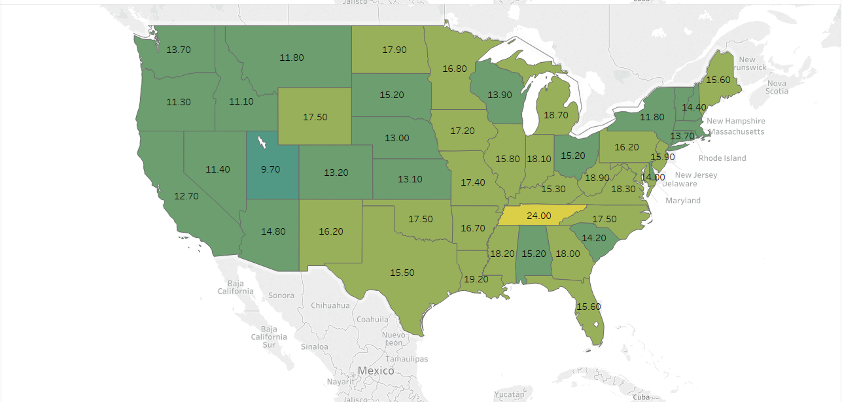
Smoking by Income
HOME
MEDIAN YEARLY INCOME
LESS THAN $25,000
$25,000-$49,999
$50,000-$74,999
$75,000 OR MORE
BACK
NEXT

Slide 9
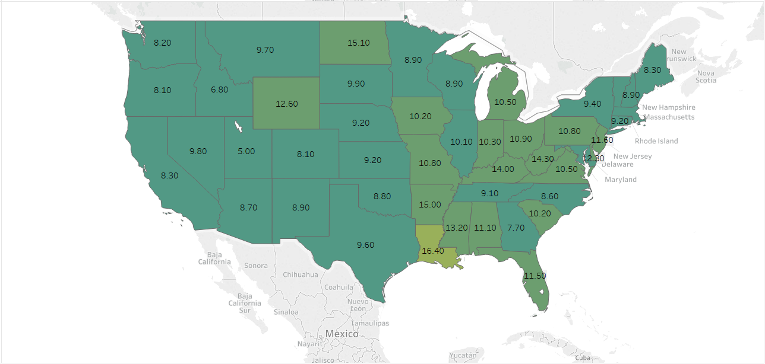
Smoking by Income
HOME
MEDIAN YEARLY INCOME
LESS THAN $25,000
$25,000-$49,999
$50,000-$74,999
$75,000 OR MORE
BACK
NEXT

Slide 10
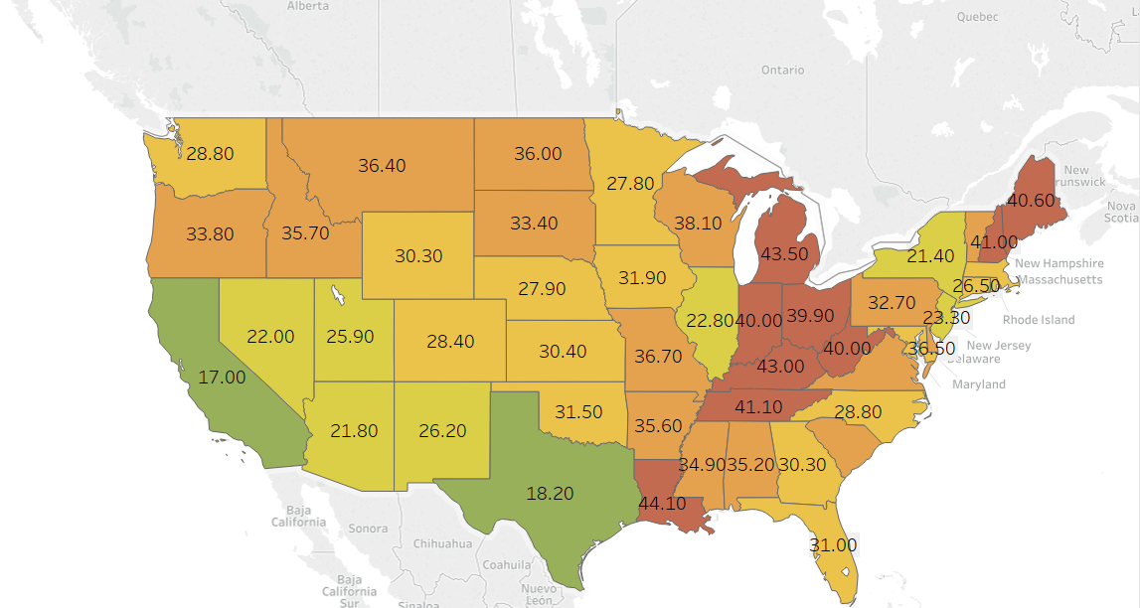

Smoking by Education
HOME
Highest Level Completed
LESS THAN HIGH SCHOOL
HIGH SCHOOL GRADUATE
SOME COLLEGE
COLLEGE GRADUATE
BACK
NEXT

Slide 11
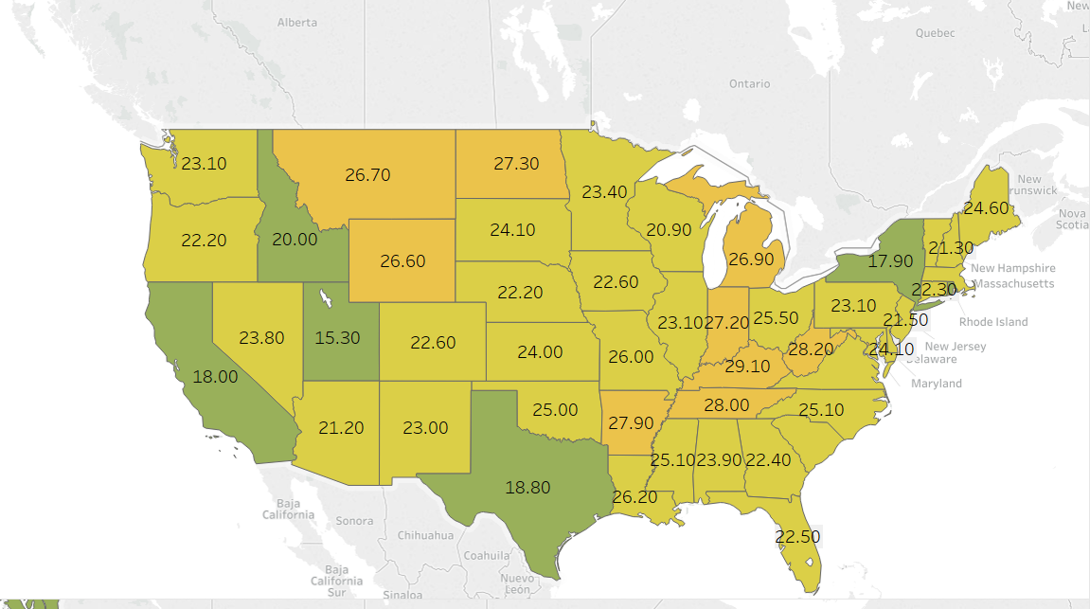
Smoking by Education
HOME
Highest Level Completed
LESS THAN HIGH SCHOOL
HIGH SCHOOL GRADUATE
SOME COLLEGE
COLLEGE GRADUATE
BACK
NEXT

Slide 12
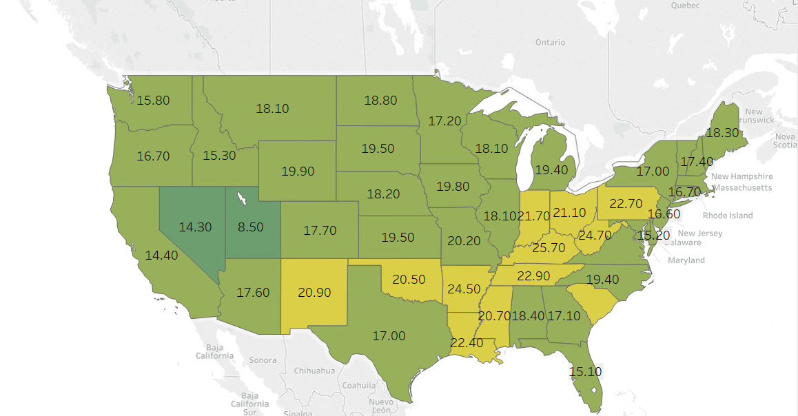
Smoking by Education
HOME
Highest Level Completed
LESS THAN HIGH SCHOOL
SOME HIGH SCHOOL
SOME COLLEGE
COLLEGE GRADUATE
BACK
NEXT

Slide 13
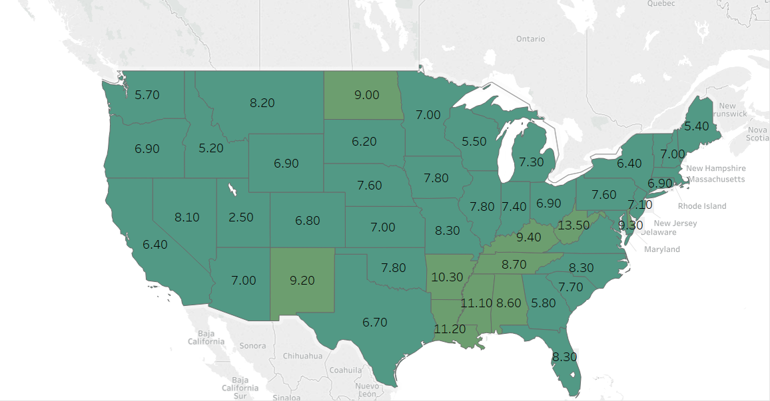
Smoking by Education
HOME
Highest Level Completed
LESS THAN HIGH SCHOOL
HIGH SCHOOL GRADUATE
SOME COLLEGE
COLLEGE GRADUATE
BACK
NEXT

Slide 14
Smoking by Income
HOME
MEDIAN YEARLY INCOME
LESS THAN $25,000
$25,000-$49,999
$50,000-$74,999
$75,000 OR MORE
MAP SHOWS A STATE-TO-STATE COMPARISON OF PERCENTAGE OF REPORTED SMOKERS BASED ON THEIR MEDIAN ANNUAL HOUSEHOLD INCOME IN 2015. SELECT AN INCOME BRACKET ON THE MENU TO VIEW ITS MAP.
Source: United Health Foundation, America’s Health Ranking Composite Measure
BACK
NEXT

Slide 15
Smoking by Income
HOME
MEDIAN YEARLY INCOME
LESS THAN $25,000
$25,000-$49,999
$50,000-$74,999
$75,000 OR MORE
MAP SHOWS A STATE-TO-STATE COMPARISON OF PERCENTAGE OF REPORTED SMOKERS BASED ON THEIR MEDIAN ANNUAL HOUSEHOLD INCOME IN 2015. SELECT AN INCOME BRACKET ON THE MENU TO VIEW ITS MAP.
Source: United Health Foundation, America’s Health Ranking Composite Measure
BACK
NEXT

Slide 16
Smoking by Income
HOME
MEDIAN YEARLY INCOME
LESS THAN $25,000
$25,000-$49,999
$50,000-$74,999
$75,000 OR MORE
MAP SHOWS A STATE-TO-STATE COMPARISON OF PERCENTAGE OF REPORTED SMOKERS BASED ON THEIR MEDIAN ANNUAL HOUSEHOLD INCOME IN 2015. SELECT AN INCOME BRACKET ON THE MENU TO VIEW ITS MAP.
Source: United Health Foundation, America’s Health Ranking Composite Measure
BACK
NEXT

Slide 17
Smoking by Income
HOME
MEDIAN YEARLY INCOME
LESS THAN $25,000
$25,000-$49,999
$50,000-$74,999
$75,000 OR MORE
MAP SHOWS A STATE-TO-STATE COMPARISON OF PERCENTAGE OF REPORTED SMOKERS BASED ON THEIR MEDIAN ANNUAL HOUSEHOLD INCOME IN 2015. SELECT AN INCOME BRACKET ON THE MENU TO VIEW ITS MAP.
Source: United Health Foundation, America’s Health Ranking Composite Measure
BACK
NEXT

Slide 18
Smoking by Education
HOME
Highest Level Completed
LESS THAN HIGH SCHOOL
HIGH SCHOOL GRADUATE
SOME COLLEGE
COLLEGE GRADUATE
MAP SHOWS A STATE-TO-STATE COMPARISON OF THE PERCENTAGE DISTRIBUTION OF TOTAL STATE POPULATION WHO ARE IDENTIFIED AS SMOKERS BY HIGHEST COMPLETED LEVEL OF EDUCATION
Source: United Health Foundation, America’s Health Ranking Composite Measure
BACK
NEXT

Slide 19
Smoking by Education
HOME
Highest Level Completed
LESS THAN HIGH SCHOOL
HIGH SCHOOL GRADUATE
SOME COLLEGE
COLLEGE GRADUATE
MAP SHOWS A STATE-TO-STATE COMPARISON OF THE PERCENTAGE DISTRIBUTION OF TOTAL STATE POPULATION WHO ARE IDENTIFIED AS SMOKERS BY HIGHEST COMPLETED LEVEL OF EDUCATION
Source: United Health Foundation, America’s Health Ranking Composite Measure
BACK
NEXT

Slide 20
Smoking by Education
HOME
Highest Level Completed
LESS THAN HIGH SCHOOL
HIGH SCHOOL GRADUATE
SOME COLLEGE
COLLEGE GRADUATE
MAP SHOWS A STATE-TO-STATE COMPARISON OF THE PERCENTAGE DISTRIBUTION OF TOTAL STATE POPULATION WHO ARE IDENTIFIED AS SMOKERS BY HIGHEST COMPLETED LEVEL OF EDUCATION
Source: United Health Foundation, America’s Health Ranking Composite Measure
BACK
NEXT

Slide 21
Smoking by Education
HOME
Highest Level Completed
LESS THAN HIGH SCHOOL
HIGH SCHOOL GRADUATE
SOME COLLEGE
COLLEGE GRADUATE
MAP SHOWS A STATE-TO-STATE COMPARISON OF THE PERCENTAGE DISTRIBUTION OF TOTAL STATE POPULATION WHO ARE IDENTIFIED AS SMOKERS BY HIGHEST COMPLETED LEVEL OF EDUCATION
Source: United Health Foundation, America’s Health Ranking Composite Measure
BACK
NEXT

