Slide 2
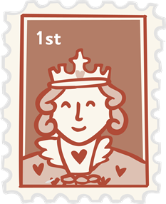

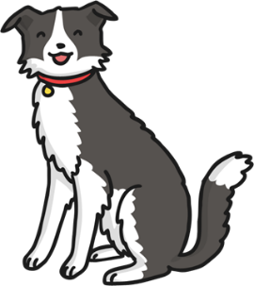


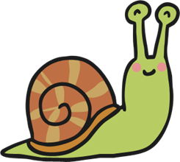



Click the pictures that begin with ‘s’ to move them into the middle.
s

Slide 3

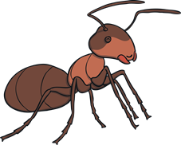

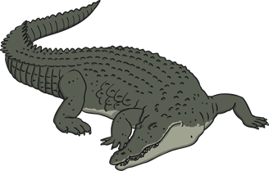

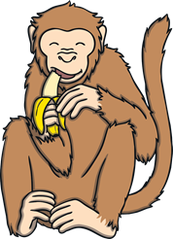



Click the pictures that begin with ‘a’ to move them into the middle.
a

Slide 4


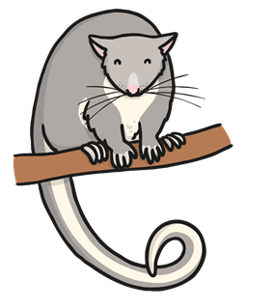





Click the pictures that begin with ‘t’ to move them into the middle.
t

Slide 5
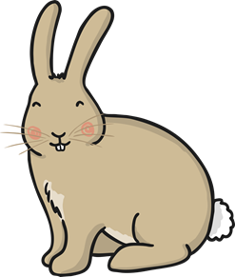







Click the pictures that begin with ‘p’ to move them into the middle.
p

Slide 6









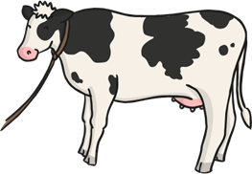

Click the pictures that begin with ‘i’ to move them into the middle.
i

Slide 7



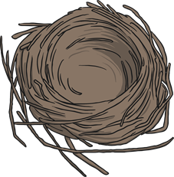
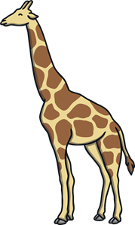
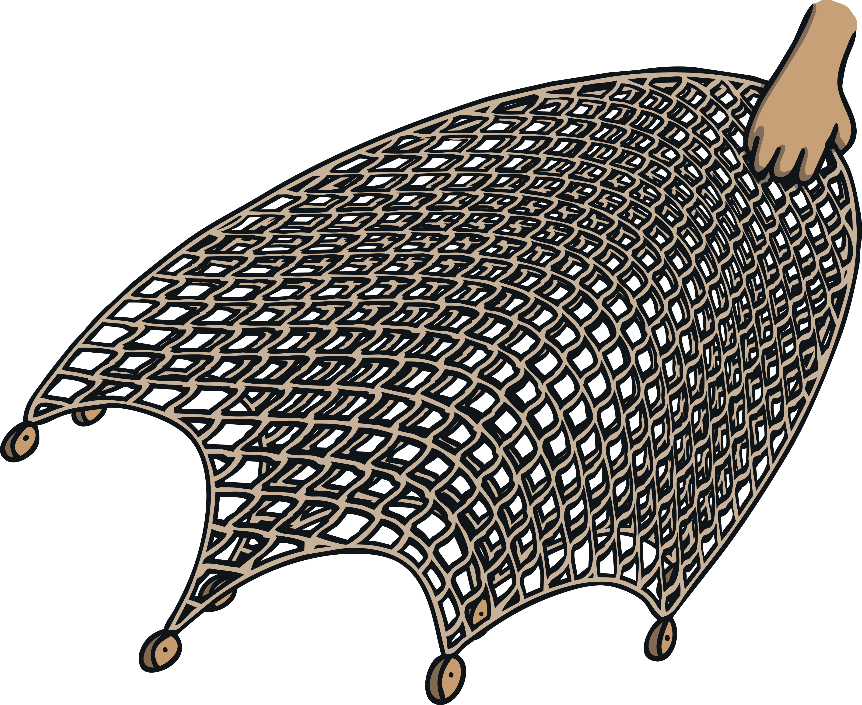

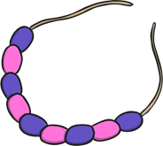
Click the pictures that begin with ‘n’ to move them into the middle.
n

