Slide 1
Hill Climbing Algorithm

Slide 2
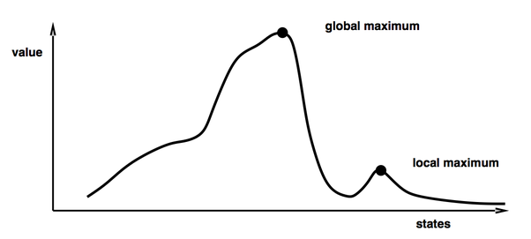
Hill-climbing methods (1)
Hill-climbing methods use an iterative improvement technique and this is applied to a single point in the search space.
During each iteration, a new point is selected from the neighborhood of the current point. If that new point provides a better value in light of the evaluation function, the new point becomes the current point. Otherwise, some other neighbor is selected and tested against the current point. The method terminates if no further improvement is possible, or we run out of time or patience.

Slide 3
Hill-climbing methods
Hill-climbing methods:
can only provide locally optimum values,
these values depend on the selection of the starting point
Start hill-climbing methods from a large variety of different starting points
Choose the initial points at random, or on some grid or regular pattern, or even in the light of other information that's available, as a result of prior searches

Slide 4
versions of hill-climbing algorithms
Versions differ mainly in the way a new solution is selected for comparison with the current solution (for example: steepest ascent hill-climbing)
Initially, all possible neighbors of the current solution are considered, and the one Vn that returns the best value eval(Vn) is selected to compete with the current string Vc. If eval(Vc) is worse than eval(Vn), then the new string v n becomes the current string. Otherwise, no local improvement is possible: the algorithm has reached a local or global optimum (local= TRUE). In such a case, the next iteration (t ← t + 1) of the algorithm is executed with a new current string selected at random.
The success or failure of a single iteration (i.e., one complete climb) of the above hill-climbing algorithm is determined completely by the initial point. For problems with many local optima, particularly those where these optima have large basins of attraction, it's often very difficult to locate a globally optimal solution.

Slide 5
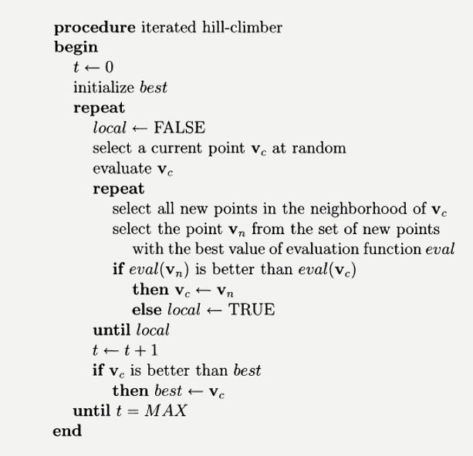
steepest ascent procedure

Slide 6
Hill-climbing algorithms weaknesses
They usually terminate at solutions that are only locally optimal.
There is no information as to the amount by which the discovered local optimum deviates from the global optimum, or perhaps even other local optima.
The optimum that's obtained depends on the initial configuration.
In general, it is not possible to provide an upper bound for the computation time.

Slide 7
Hill-climbing techniques
Hill-climbing techniques exploit the best available solution for possible improvement but neglect exploring a large portion of the search space S. In contrast, a random search - where points are sampled from S with equal probabilities - explores the search space thoroughly but foregoes exploiting promising regions of the space.
Getting stuck in local optima is a serious problem. It's one of the main deficiencies that plague industrial applications of numerical optimization.

Slide 8
design a search algorithm
How can we design a search algorithm that has a chance to escape local optima, to balance exploration and exploitation, and to make the search independent from the initial configuration?
One option, is to execute the chosen search algorithm for a large number of initial configurations.
It's also possible to modify the criteria for accepting transitions to new points that correspond with a negative change in the evaluation function. That is, we might want to accept a worse solution from the local neighborhood in the hope that it will eventually lead to something better.

Slide 9
Escaping Local Optima
Traditional problem-solving strategies share a common pattern. Either they guarantee discovering the global solution, but are too expensive (i.e., too time consuming) for solving typical real-world problems, or else they have a tendency of "getting stuck" in local optima.
Since there is almost no chance to speed up algorithms that guarantee finding the global solution, i.e., there is almost no chance of finding polynomial-time algorithms for most real problems (NP-hard).

Slide 10
"a horse with wings"
After reaching a local optimum, a new starting point is generated and the search is commenced all over again until escaping local optima within a single run of an algorithm.
An additional parameter (called temperature) that changes the probability of moving from one point of the search space to another, or a memory, which forces the algorithm to explore new areas of the search space.

Slide 11
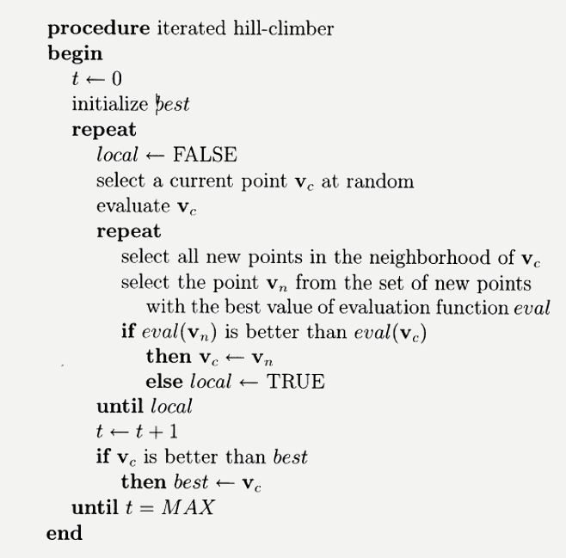
Simulated annealing

Slide 12
Modifyed simulated anneling procedure
Changes in the procedure:
Instead of checking all of the strings in the neighborhood of a current point Vc and selecting the best one, select only one point, Vn, from this neighborhood.
Accept this new point, i.e., Vc +- Vn, with some probability that depends on the relative merit of these two points, i.e., the difference between the values returned by the evaluation function for these two points.

Slide 13
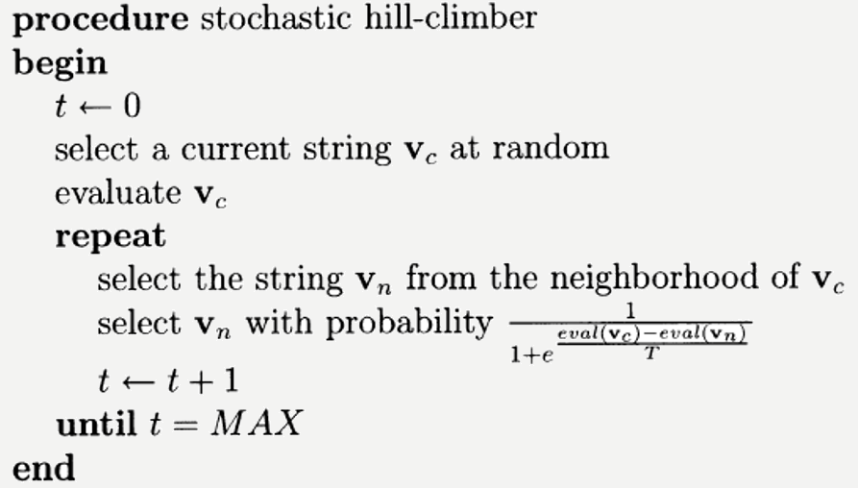
stochastic hill-climber procedure

Slide 14
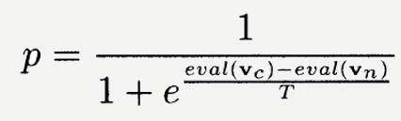
stochastic hill-climber
First, the stochastic hill-climber has only one loop. We don't have to repeat its iterations starting from different random points. Second, the newly selected point is "accepted" with some probability p. This means that the rule of moving from the current point Vc to the new neighbor, Vn, is probabilistic. It's possible for the new accepted point to be worse than the current point. Note, however, that the probability of acceptance depends on the difference in merit between these two competitors, i.e., eval(Vc)- eval(Vn), and on the value of an additional parameter T. T remains constant during the execution of the algorithm.

Slide 15
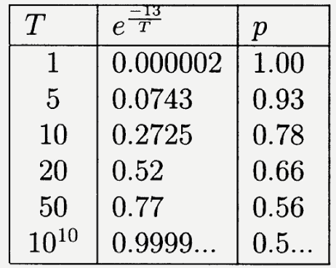
role of the parameter T
For example, that the evaluation for the current and next points are eval(Vc) = 107 and eval(Vn) = 120. The difference in our example is eval(Vc)- eval(Vn) or -13, meaning that the new point Vn is better than Vc· What is the probability of accepting this new point based on different values of T.

Slide 16
Parameter t evaluations
The greater the value of T, the smaller the importance of the relative merit of the competing points Vc and Vn! if T is very small (e.g., T = 1), the stochastic hill-climber reverts into an ordinary hill-climber! we have to find an appropriate value of the parameter T for a particular problem: not too low and not too high.
If the new point is better, the probability of acceptance is greater than 0.5. There is a small chance to choose a weaker solution then the current individual. The probability of acceptance grows together with the (negative) difference between these evaluations. In particular, if the new solution is much better than the current one (say, eval(Vn) = 150), the probability of acceptance is close to 1.

Slide 17
stochastic hill-climber vs. simulated annealing
The main difference between the stochastic hill-climber and simulated annealing is that the latter changes the parameter T during the run. It starts with high values of T making the procedure more similar to a purely random search, and then gradually decreases the value of T. Towards the end of the run, the values of T are quite small so the final stages of simulated annealing merely resemble an ordinary hill-climber. In addition, we always accept new points if they are better than the current point.

Slide 18
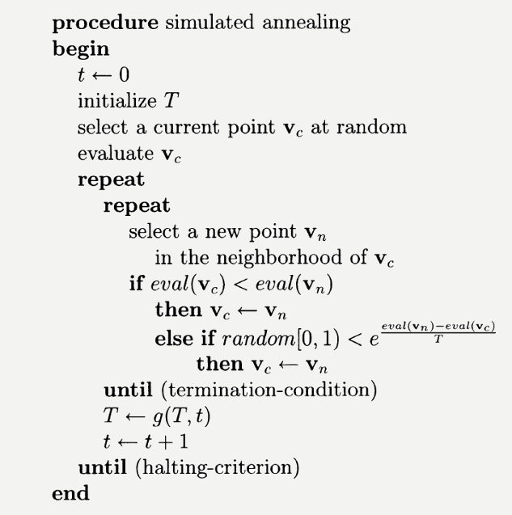
simulated annealing procedure

Slide 19
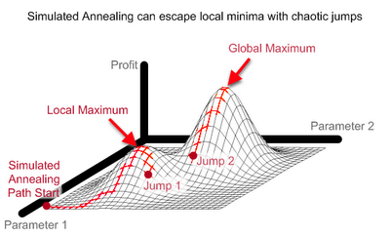
Monte Carlo annealing
Simulated annealing - also known as Monte Carlo annealing, statistical cooling, probabilistic hill-climbing is based on an analogy taken from thermodynamics. To grow a crystal, you start by heating a row of materials to a molten state. You then reduce the temperature of this crystal melt until the crystal structure is frozen in. Bad things happen if the cooling is done too quickly.

Slide 20

problem-specific questions
As with any search algorithm, simulated annealing requires the answers for the following problem-specific questions:
What is a solution?
What are the neighbors of a solution?
What is the cost of a solution?
How do we determine the initial solution?
How do we determine the initial "temperature" T?
How do we determine the cooling ratio g(T, t)?
How do we determine the termination condition?
How do we determine the halting criterion?

Slide 21
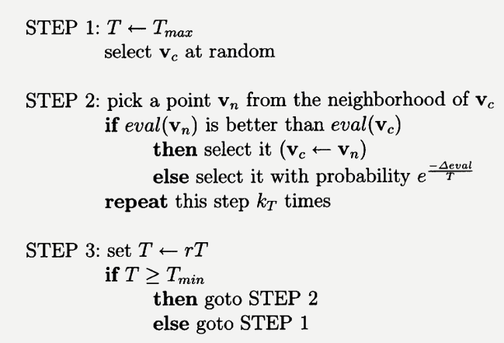
simulated annealing - sequence of steps

Slide 22

sequence of steps - explication
We have to set the values of the parameters Tmax, kr, r, and Tmin, which correspond to the initial temperature, the number of iterations, the cooling ratio, and the frozen temperature, respectively.

Slide 23

Summary
Simulated annealing is designed for the purpose of escaping local optima;
Simulated annealing is a stochastic algorithm;
Simulated annealing have parameters to worry about, such as temperature, rate of reduction but how to choose the parameters of the algorithm so that it performs optimally. This is a pervasive issue that accompanies the vast majority of algorithms that can escape local optima. The more sophisticated the method, the more you have to use your judgment as to how it should be utilized.

