Slide 1
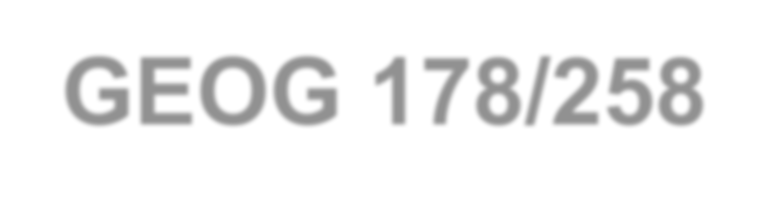
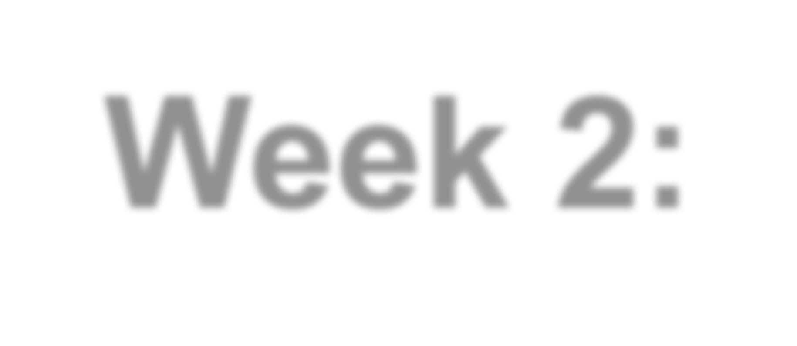



GEOG 178/258
Week 2:
Variables, Debugging, and Loops
mike johnson
www.johnsonmike.wix/geog178

Slide 2
OVERVIEW
**Click on titles to jump to the corresponding section:
Week
2
Variables and their primitive types
Practice problems to declare, manipulate and print variables
Contents
Learn to import an existing program file
Launch and navigate the Eclipse Debugger
Look at the syntax and logic of the for and while loop

Slide 3
1. Variables
www.johnsonmike.wix/geog178

Slide 4
What are Variables??
Variables represent space reserved in memory to store values
So, creating a variable is reserving a set amount of memory space, and defining what can be stored there…
Every variable is made up of three components:
A type – i.e. how much memory to save
A name – i.e. what it’s called (human reference)
A value – what it represents or is equal to
Week
2
Variables
An example: int x = 100;
Here we are creating an integer value called x that is equal to 100

Slide 5
Primative Variable Types
In Java there are 8 type of primitive variables
Each of these reserves a different length of space in memory AND allows different types of data to be stored.
These are predefined by Java and are represented by a key word type:
Byte
Short
Int
Long
Float
Double
Char (character)
Boolean (true/false)
Week
2
Variables

Slide 6
Variable Types
Byte
8-bit signed two's complement integer
Week
2
Minimum value: -128 (-2^7)
Maximum value: 127 (inclusive)(2^7 -1)
Default value is 0
Byte data type is used to save space in large arrays, mainly in place of integers, since a byte is four times smaller than an integer.
Variables
Short
16-bit signed two's complement integer
Minimum value: -32,768 (-2^15)
Maximum value is 32,767 (inclusive) (2^15 -1)
Short data type can also be used to save memory as byte data type.
A short is 2 times smaller than an integer
Default value is 0.

Slide 7
Variable Types
Int
2
32-bit signed two's complement integer.
Week
Minimum value is - 2,147,483,648 (-2^31)
Maximum value is 2,147,483,647(inclusive) (2^31 -1)
Integer is generally used as the default data type for integral values unless there is a concern about memory.
The default value is 0
Variables
Short
64-bit signed two's complement integer
Minimum value is -9,223,372,036,854,775,808(-2^63)
Maximum value is 9,223,372,036,854,775,807 (inclusive)(2^63 -1)
This type is used when a wider range than int is needed
Default value is 0L

Slide 8
Variable Types
Float
Single-precision 32-bit IEEE 754 floating point
Week
2
Float is mainly used to save memory in large arrays of floating point numbers
Default value is 0.0f
Float data type is never used for precise values such as currency
Variables
Double
Double-precision 64-bit IEEE 754 floating point
This data type is generally used as the default data type for decimal values, generally the default choice
Double data type should never be used for precise values such as currency
Default value is 0.0d

Slide 9
Variable Types
Boolean
One bit
Week
2
Two possible values: true (1) and false (0)
This data type is used for simple flags that track true/false conditions
Default value is false
Variables
Char
Single 16-bit Unicode character
Minimum value is '\u0000' (or 0)
Maximum value is '\uffff' (or 65,535 inclusive)
Used to store any SINGLE character
A variable type ‘String’ must be used to store multiple characters

Slide 10
2. Examples
www.johnsonmike.wix/geog178

Slide 11
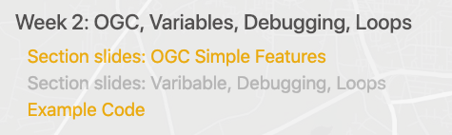
Download / Load Sample Code for this week
Option 1) If you have cloned the classes repo, be sure to fetch the new data
> cd … working directory…. ## Enter the location you want the repo to go
> git clone https://github.com/mikejohnson51/geog178.git ## Clone (copy the repo) into that location
> cd ./geog178. ## Enter the new geog178 folder (your local repo)
> git pull origin ## Pull new files from the origin page
Option 2) Download the zip file from the course page

Slide 12
Importing an Existing Project
Open a workspace on your flash drive or local desktop in Eclipse
Go to: File → Import → General → Existing
Week
12
Debugging
Select ”Select root directory”
Click ‘Browse’
Point it to the ‘Week2_examples’ folder on your desktop
Click ‘Finish’

Slide 13
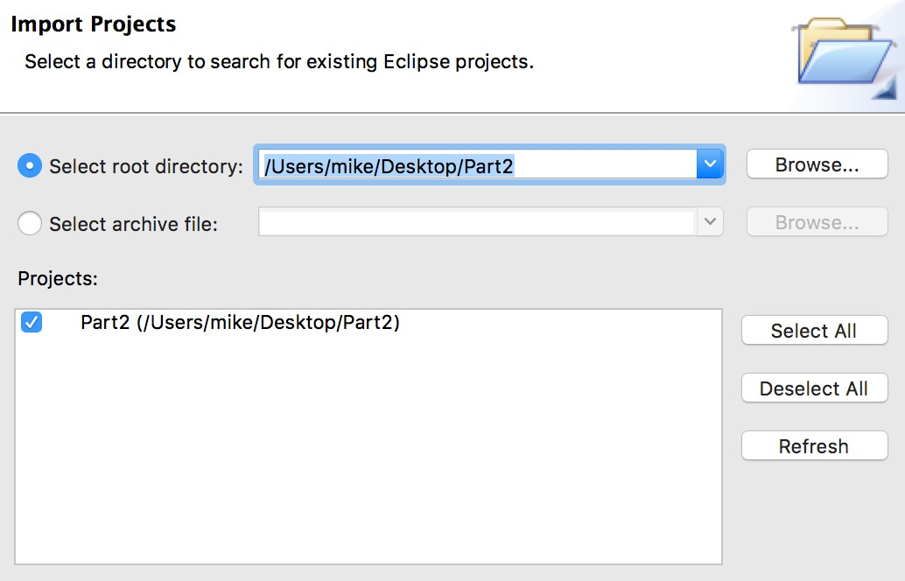
Importing an Existing Project
Select ”Select root directory”
Click ‘Browse’
Point it to the downloaded folder on your desktop
Week
2
Debugging
Click ‘Finish’

Slide 14
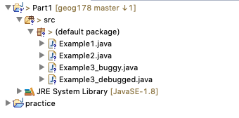
Under the src folder of the new project you should see the examples for today. Don’t open them yet!!

Slide 15
Where is UCSB (simple program)
Using what we now know about variables write a program that prints the following statement using variables and comments.
Week
2
Example #1
In this program make location name, lat and long variables to be printed.
(Answer on the next slide and in Example1.java)

Slide 16
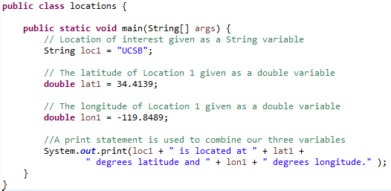
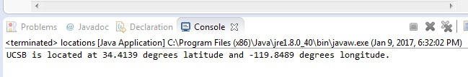
Where is UCSB (simple program)
Week
2
Example #1

Slide 17
How far is your home from UCSB? (more complex program)
If Example 1 was easy, try to calculate the distance between two points:
Where you went to high school and UCSB:
Week
2
Look up the lat, long of your high school in decimal degrees
E.g.: I went to Cheyenne Mountain in Colorado Springs, Colorado
Lat: 38.8031 Lon: -104.8572
We will use the Haversine formula to determine the distance between these locations. To do this we will need to find functions and/or do the following:
Example #2
Convert decimal degrees to radians
Determine the differences in lat and long between locations
Apply the equation using the java math package (see hyperlink)
Print out your answer!

Slide 18
How far is your home from UCSB??
Give it a try!
(Answer on the next slide and in Example2.java)
Week
2
Example #2

Slide 19
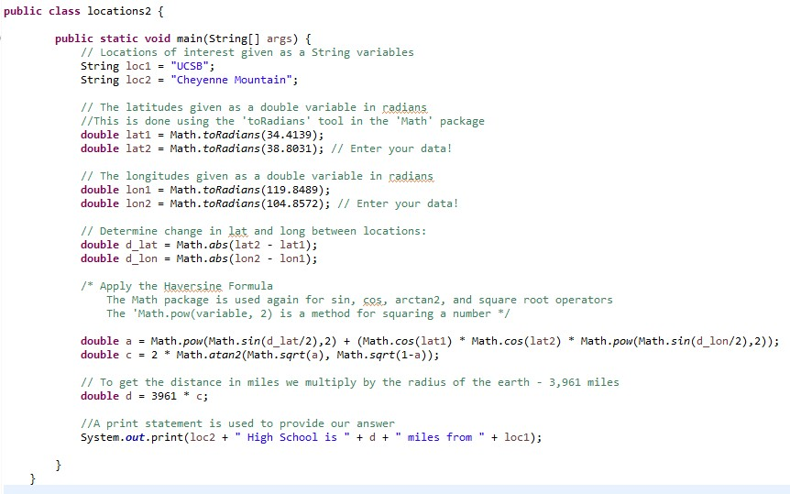

How far is your home from UCSB? (Example Code)
Example Code:
Week
2
Example #2
Output:

Slide 20
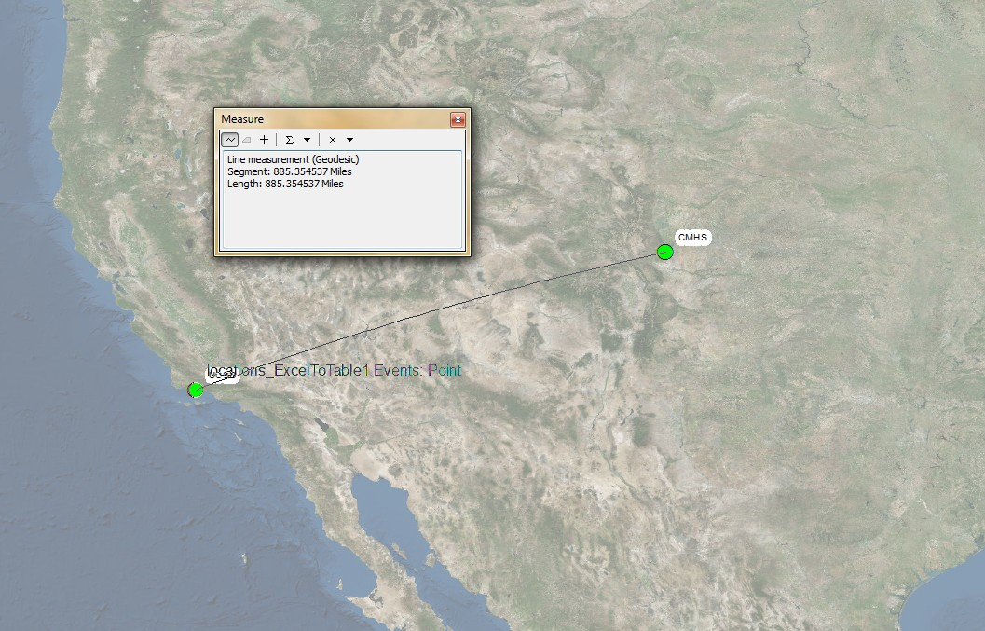
How far is your home from UCSB? (more complex program)
Validation using ESRI ArcGIS
Week
2
Example #2
Percent Difference:
[885.3545 − 884.2627) / 885.3545] * 100 = .12%

Slide 21
3. Debugging

Slide 22
Debugging
It is very easy, and natural, to make mistakes when programing
Week
2
There are a number of ways to find mistakes:
Visually
Working/reading the program backwards
Debugging
In Eclipse, debugging allows to run a program INTERACTIVLY while watching the source code and the variables as it executes
Debugging
Eclipse even provides a ‘Debug Perspective’ loaded with a pre-confined set of VIEWS to help do this
It will also allow you to control the execution flow through embedded ‘debug’ commands.

Slide 23
Common Mistakes to watch for:
Missing Semicolons
Typos
Wrong Variable Types
Uneven brackets, parentheses, etc.
Missing package extensions (i.e ‘Math.’)
Week
2
Debugging

Slide 24
Debugging Practice
In this example we do the following:
Week
2
Create breakpoints
Open the “debugging perspective” (DP)
Execute code in the DP
Edit Variables and breakpoints in DP
Example #3

Slide 25


Problem:
Open Example3_buggy.java
This code is written to:
A) select a random number of values (1-10)
B) determine how many coordinate pairs can be made from the values
C) determine what kind of geometry can be formed with that number of coordinate pairs, and
D) print out a pseudo WKT string
Run the code a few times:
Good !!
1
POINT
POINT [ X, Y ]
Bad !!

Slide 26
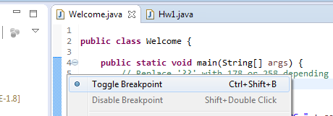

Adding/Removing Breakpoints
Breakpoints are locations in the source code, created by you, where the program should stop during debugging.
Week
2
Once the program stops, you can examine variables, change their content, among other things.
Debugging
Break points can be added and removed in two ways:
1. Right clicking on a line number and selecting “Toggle Break Point”
Line number
2. Having you cursor on a line and holding down ‘Ctrl +Shift + B”
For MAC user anytime a shortcut is given, replace Ctrl with command
When a break point is added successfully a ‘blue dot’ will appear
• Add a break point to lines 9, 14, 22, 34, 45

Slide 27
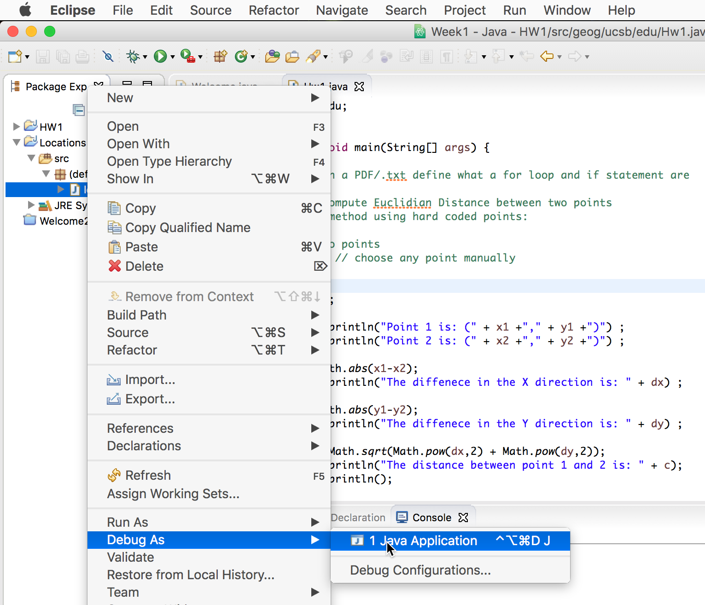
Starting the debugger
To begin debugging a Java File Right click on the ‘Example3_buggy.java’ file and select:
Week
2
Debug As → Java Application
Debugging

Slide 28
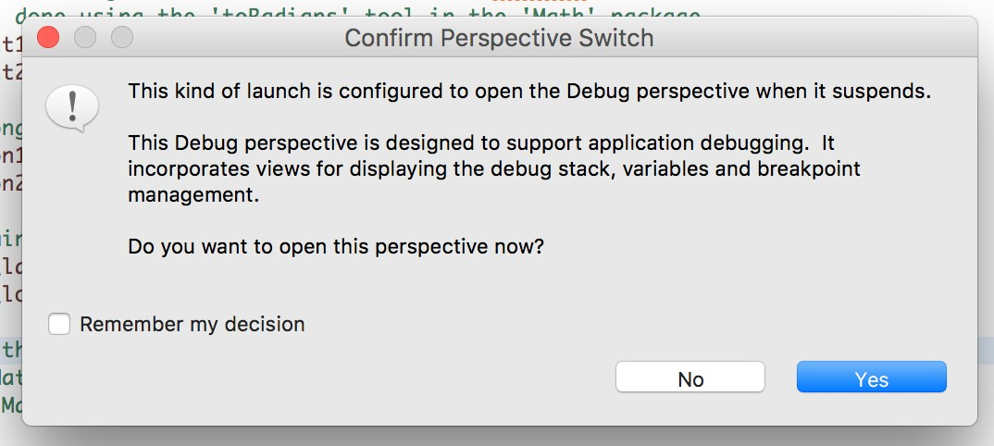
Starting the debugger
If you have not defined any break points the continue programing normally. Remember that debugging will ONLY work if breakpoints have been assigned!
Week
2
When BREAKPOINTS are assigned, and the DEBUGGER is run Eclipse will ask if you want to switch to the Debugger Perspective.
Debugging
Select ‘YES’

Slide 29
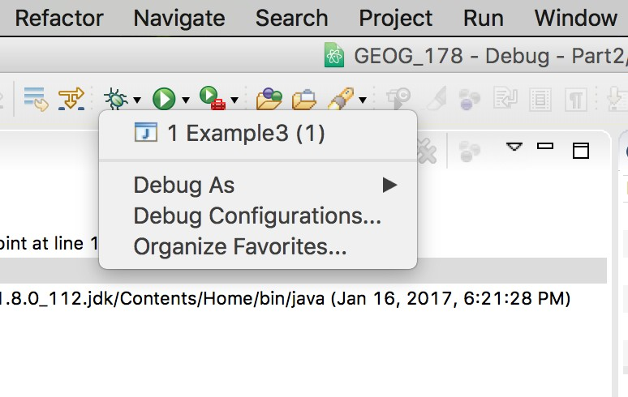
Starting the debugger
The Debugger can also be launched and executed from the Top Toolbar!
Week
2
Debugging

Slide 30
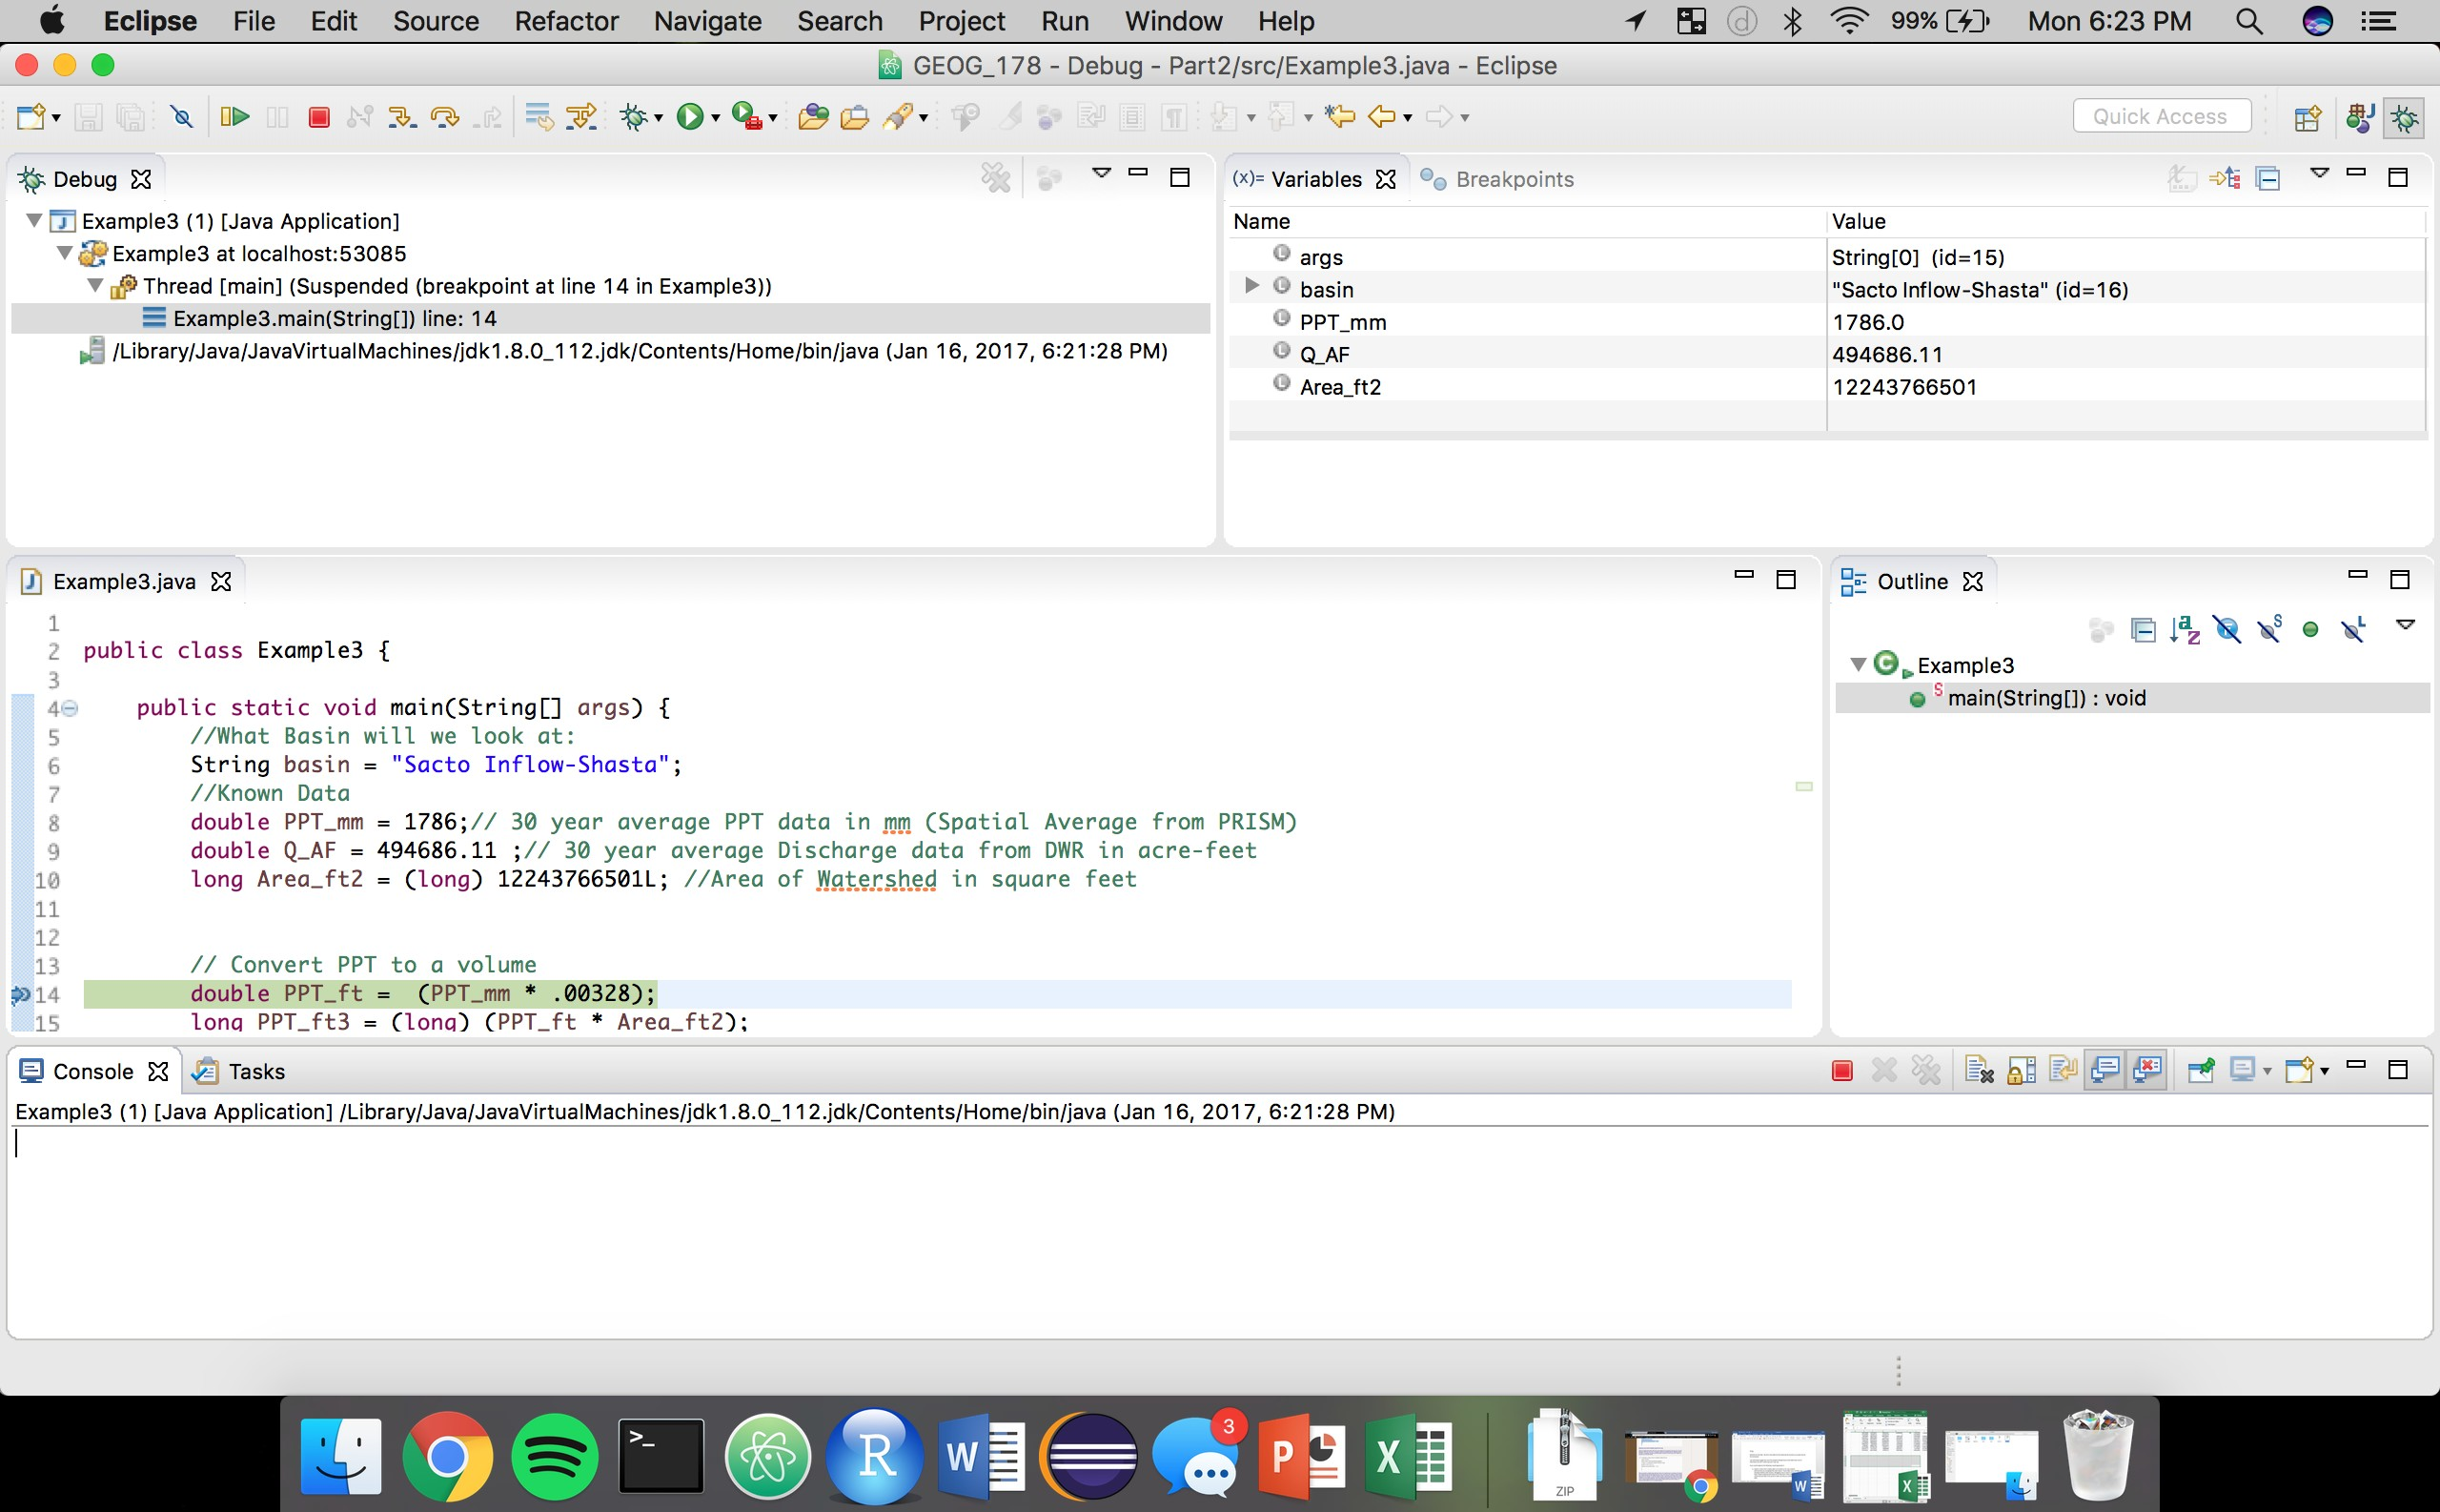
The Debugger Perspective
Once you enter the Debugger Perspective you will see the following:
Week
2
Variable View
Call Stack
Execution Control |  | Brea
Debugging
k Points View

Slide 31

Execution Control
In the “Debugging Perspective” Eclipse allows you to control the execution of a program.
Week
2
The Following shows how these commands work in addition to there keyboard shortcuts:
Debugging
F8 STOP F5 F6 F7
F5 → Executes the currently selected line.
F6 → Executes a method – or ‘steps-over’ a call without stepping into the debugger (MOST USEFULL!!)
F7 → ‘Steps out’ to the caller of the currently executed method
F8 → Tells the Debugger to resume the execution of the program code until it reaches the next break point.

Slide 32
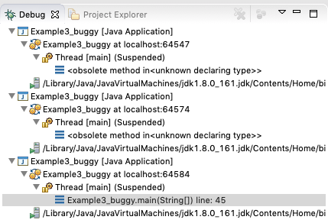
The Call Stack
The current stack is displayed in the DP
The call stack shows the parts of your program which are currently executed and how they relate to each other
Week
2
Call Stack
Clicking on one element of this stack switches the editor view to display the corresponding class, and "variables" view will show variables of this stack element.

Slide 33
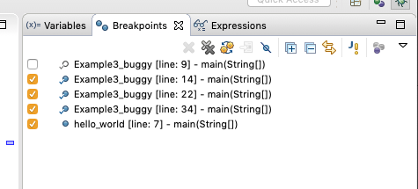
The Breakpoint View
This view port allows you to delete, deactivate and modify properties of breakpoints.
Week
2
You can deactivate a breakpoint by unselecting the check box next to each or….
Breakpoint View
You can delete them using the corresponding buttons in the toolbar.
Delete all or one Breakpoint(s)
Activate/Deactivate Breakpoint

Slide 34
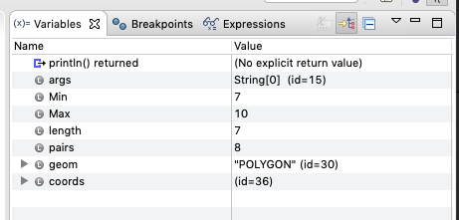
Variable View
The Variables Viewport shows the fields and local variables from the current executing stack.
Week
2
You must run the Debugger (click on the little bug in the toolbar) to see the variables in the view!
Variable View
This is a good place to make sure all variable are initializing and are representing what you think they should…

Slide 35
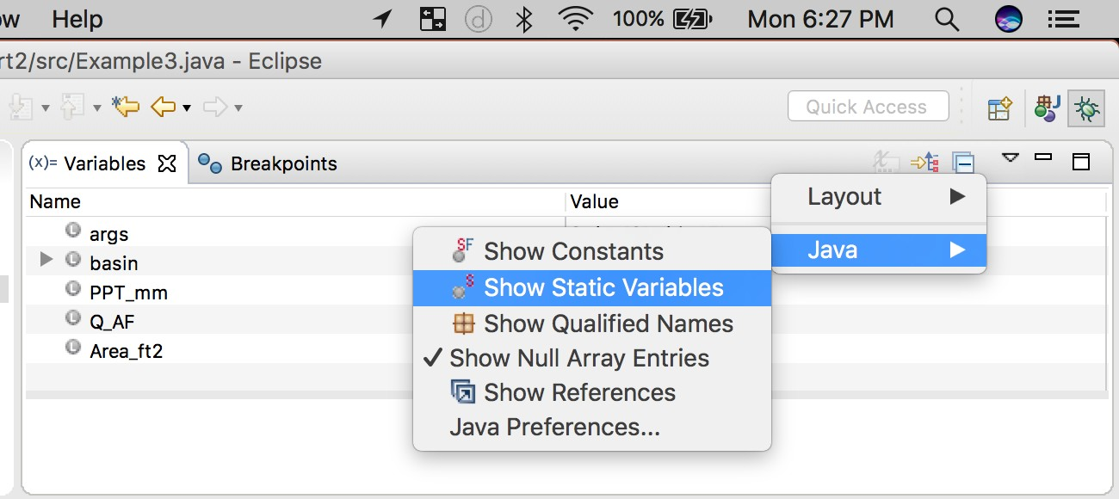
Variable View
In the Variable Veiwport, you can use the Drop-Down Menu to display static variables
Week
2
Variable View

Slide 36
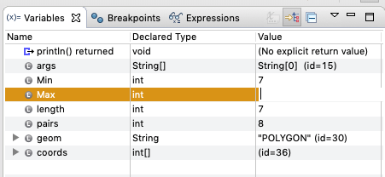
Variable View
The Variables Viewport also allows you to change the value of each static variable before resuming!
Do this by double clicking (or right clicking on the value box)
Week
2
Variable View

Slide 37
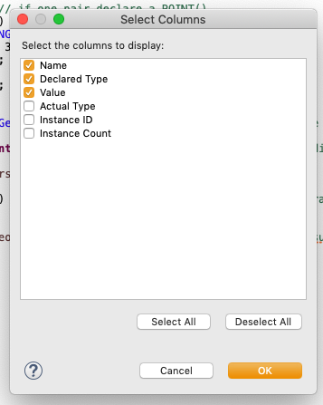
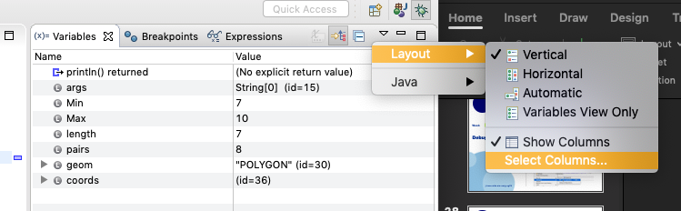
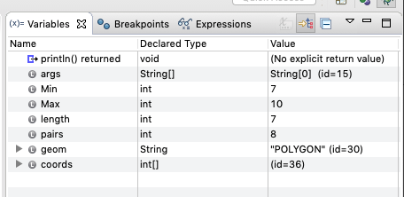
Variable View
And you can customize the what is displayed for each. For example say you wanted to know the TYPE of each variable.
Week
2
(2)
Go: Layout → Select Columns → Type
Variable View
(1)
(3)

Slide 38
Why did we do this??
In this example try to figure out where the logic in the buggy script is failing and correct it …
Week
2
Big Picture
The idea is to be comfortable exploring a new program (or your own) in the debugger to both find errors AND familiarize yourself with it.
Even though you did not write this the sample code you should have a good understanding of the variables and steps executed after using the debugger….
A debugged solution can be found in Example3_debugged.java

Slide 39
4. Loops
www.johnsonmike.wix/geog178

Slide 40
What are Loops??
Loops are a sequence of instructions to be continually repeated until a specific condition is reached.
Week
2
Loops
They are helpful when checking for a condition or when repeating the same process over a large amount of data points…
Anytime you want to do something many times a loop will be helpful!

Slide 41
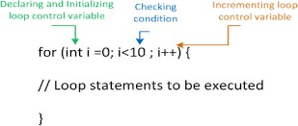
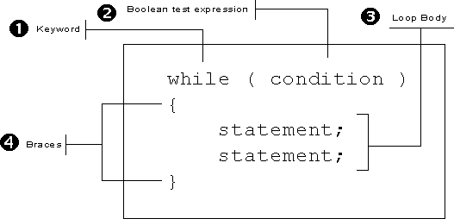
For Loops and While Loops
FOR LOOP SYNTAX
Week
2
Loops
WHILE LOOP SYNTAX

Slide 42
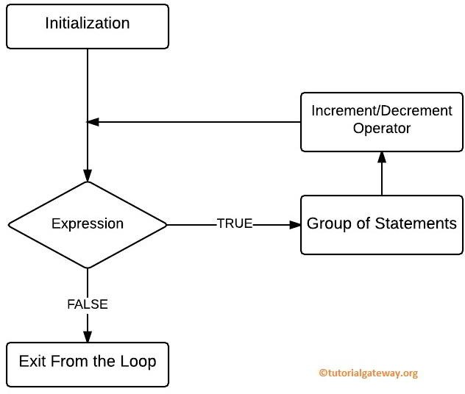
Loop Logical Flowchart
Week
2
Loops

Slide 43
Summary:
At this point you should be comfortable:
1. Launching a workspace and creating a Java Project in
Eclipse on both your machine AND a lab machine
Week
2
2. Importing a program from the class website, github, your flash, or a partners flash
END:
3. The different types of variables, their uses, and how to
declare them
Manipulating variables with the ‘Math’ package and print
statements
Writing, and reading, for and while loops in your program and others
Opening and navigating the Debugger (this will become valuable when our programs get more complicated)
If you have any questions please don’t hesitate to email of visit office hours!

