Slide 1

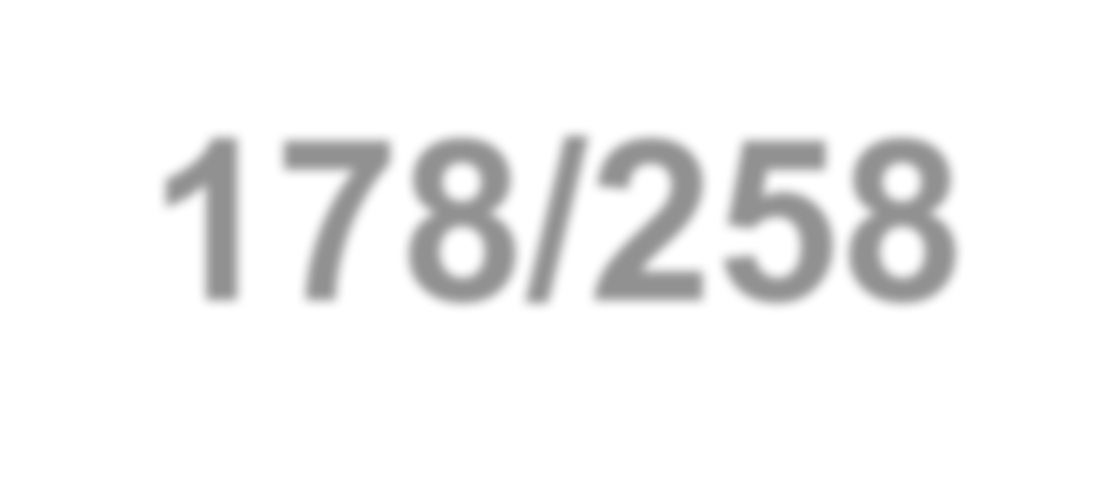




GEOG 178/258
Week 3:
Arrays, Objects and Classes
mike johnson

Slide 2
Recap:
Package: collection of pieces of code that can be shared together
Public: This declares public access to a member across a package
Void: This means that a method has no return value
Main: the part of the code that will execute.
It is a static method meaning it is part of its class and not part of objects.

Slide 3
1. Arrays

Slide 4
So far…
So far we have looked at initializing variables as single values:
Week
3
For example int x = 10
This creates an integer called x that is equal to 10
Arrays
Sometimes we want a collection of data to be stored together.
Examples of this might be:
Large data tables or matrices
Lat, Long Pairs
Yearly values (Jan, Feb, March values)
A list of any sort
What can you think of??

Slide 5
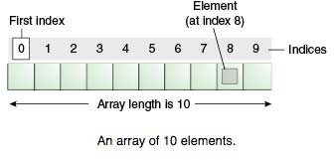
What is an Array??
An array acts as a ‘container’ object to hold a fixed number of values of the same type!
Week
3
Arrays
When an array is initialized the type of data it can contain AS WELL as the length must be established!
In an array, each item is called an element, and the below diagram highlights how Java interprets an array

Slide 6
Creating an array…
1. Initializing an array is similar to initializing a
variable with one difference:
Week
3
Int[] testArray; // An array of integers is declared
2. The length of the array is then specified:
testArray = new int[10];
// memory reserved in testArray for 10 integers
// be sure to include the ‘new’, its significance will be covered soon…
Arrays
3. Elements can then be set using the numerical
indexof the array:
testArray[0] = 10; // first element set to 10 testArray[1] = 20; // second element set to 20
...
4. Remember that Java is a 0 referenced language. This means the first entery of an array is indexed at 0 NOT 1.

Slide 7
Challenge!!
Create an array that takes a pair of lat, long
points for UCSB
The coordinates for UCSB are:
Week
3
Latitude: 34.41
Longitude: -119.84
Arrays
Print: “The Latitude of UCSB is 34.41.”
using your array…
Print an empty line:
Print: “The Longitude of UCSB is - 119.84.” again, using your array…

Slide 8
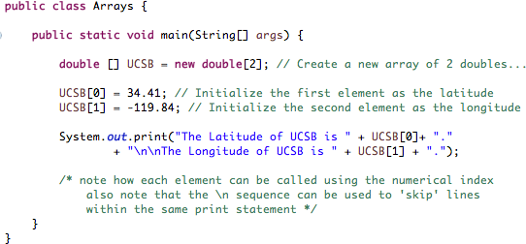


Solution
Week
3
Arrays

Slide 9
2. Objects

Slide 10
What is Java??... OOP
Java is an Object-Oriented language, or Object-Oriented Program (OOP)
Week
3
As such, it has the following characteristics:
Objects
Organized around ‘objects’ rather than ‘actions’
Organized around ‘data’ rather then ‘logic’
OOP’s care about the objects we want to manipulate rather then the logic that manipulates them.
Other languages are often viewed viewed as a logical sequence to process input data and produces output data. (Think R or instances of MatLab)

Slide 11
What is an OBJECT??
An OBJECT has states and behaviors
States are conditions (think long-term/identity)
The apple is (red, yellow, green, big, 1/2, whole, …)
Week
3
Objects
The door is (wood, metal, glass, heavy, thin, …)
The chair is (recliner, rocker, leather, soft, hard, …)
Behaviors are ‘actions’ (think short-term)
The apple is (hanging, falling, ripe, rotten, wet, …)
The door is (open, closed, broken, working, …)
The chair is (reclined, empty, taken, …)
Objects are like the things we interact with everyday, there are millions and millions of objects and trying to code that into a computer language would prove very difficult…

Slide 12
3. Classes
www.johnsonmike.wix/geog178

Slide 13
What is a CLASS??
One of the first jobs of a OOP is to identify the objects that need in a model, what defines them, and how they relate to each other.
This is known as data modeling
Once an OBJECT is identified it can be generalized into its core components…
Week
3
Classes
In Java this generalized form is the CLASS.
It describes the relevant states and behaviors
Defines the kind of data it contains and the logical sequences that can manipulate it
It provides methods for getting and changing these states and behaviors
Each logic sequence in a class is known as a method.

Slide 14
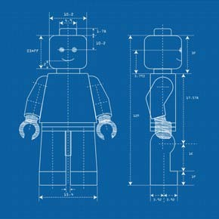
The Blueprints within Java
Ways to think of Classes….
Week
3
In Java classes are templates for describing an object….
Classes
It is the generic form of an object and describes what it “means to be that object”
It is an object with “Open Variables”
It is a form that needs to be filled out …

Slide 15
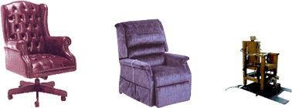
Plato’s ‘Doctrine of the Forms’…
Consider a chair…
If I ask you to think of a chair, each of you knows what I am talking about.
Week
3
Classes
If I asked you to sit in a chair you won’t mistakenly sit on a table.
If I asked you to build me a chair you would all be able to.
Given there are so many type of chairs, how do you all know what I am taking about???

Slide 16




Plato’s ‘Doctrine of the Forms’…
If ‘chair’ is to have a definite meaning there must be something common to ALL chairs…
Week
3
The thing that is common to all chairs is considered “the form of the chair”
Classes
The form of the ‘chair’ allows people to communicate:

Slide 17
So…
An object is a specific instance of a more general idea deconstructed into a sum of parts
Week
3
If you look around the class you see that all your peers are ’people’. None of us are ‘aliens’, ’dogs’ or ‘cats’.
Classes
However your brain is also is able to detect characteristics that make each of us unique, and specific 'objects' of the class ‘people’.
For example we all have a gender, hair color, age, race, and occupation, ect that make us unique.
All ’people’ have these things (this is the class people), and each object (individual) has a unique make up of these general qualities.

Slide 18
So…
Class/ the “Form of a Person”:
person (“gender”, ”age”, ”hair color”, “occupation”, “eye color”)
Week
3
Object/ Individauls:
person mike = new person (male, 26, brown, grad student, green)
Classes
Mike is a person who is a male grad student with brown hair and green eyes…
person carolina= new person(female,24, black, teacher, brown)
Carolina is a person who is a female teacher with black hair and brown eyes…

Slide 19
Why are CLASSES important?
Classes make it possible to define subclasses of data objects that share some or all class characteristics. This feature is known as inheritance.
Week
3
The concept of data classes allow programmer’s to create new data types that are not pre-defined in the language.
Classes
Class definitions are reusable by both the program it was created for and other OOP’s. This allows them to be distributed more easily across networks.
Classes define only the data it is concerned with. Thus when an instance of that class (an OBJECT) is run, the code will not accidently access other program data. This avoids unintended data corruptions AND enhances system security.

Slide 20
3. Practice

Slide 21
Example:
In this example we will do the following:
Week
3
Create a class called point
Construct the general form of point 3.Create a method in the point class 4.Create two points using the point
class
Practice Problem
5.Call on the point method to perform an operation

Slide 22
Example:
Week
3
Open a new project and create a class called ‘Point’
Do NOT elected to create a ‘main’ string.
Practice Problem

Slide 23
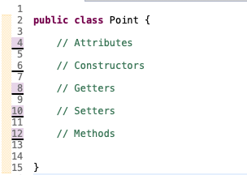
1. Creating a point class
Week
3
Practice Problem
Line 2: Creates a new public class called ‘Point’
Line 4: Sets aside space to define the attributes of a point
Line 6: Sets aside space to define the constructors of a point
Line 8: Sets aside space to define the getters of a point
Line 10: Sets aside space to define the setters of a point
Line 12: Sets aside space to define the methods of a point
Line 15: Closes the point class

Slide 24

2. Defining the attributes
Week
3
Practice Problem
Line 12: Declares that all points are comprised of values X and Y (doubles)

Slide 25
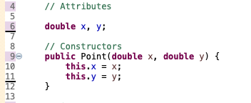
2. Defining the constructor
Week
3
Practice Problem
Line 9: Defines a new public method called Point that takes an input x and y value (doubles) and assigns them to an internal value to that point.

Slide 26
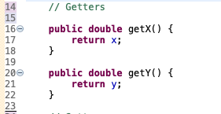
2. Defining the getters
Getters allow you (and the program) to access elements of a class
Week
3
Practice Problem
Line 16: Defines a new public method, that can be applied to any object of class point, that returns a double, called getX(). When run, getX() returns the ‘x’ value associated with the object it is called on.
Line 20: Does the same for y.

Slide 27
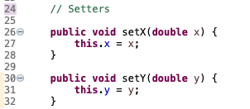
2. Defining the setters
Setters allow you (or the program) to modify the attributes of an object
Week
3
Practice Problem
Line 26: Creates a public method, that has no return value called setX(). SetX() requires an input double ‘x’ and sets that values within the point constructor to the new x value, ‘this.x’.
Line 30: Does the same for y

Slide 28

3. Add an method to the point class
* Return a point as a WKT string
Week
3
Practice Problem
Line 36: Creates a public method called toWKT() that returns a String. This method uses the ‘x’ and ‘y’ values of the Point object it is called on to populate the returned string.

Slide 29
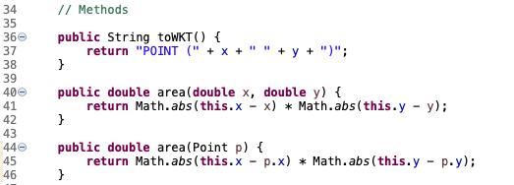
3. Add another method
* Calculate the area between two points
Week
3
Practice Problem
Line 40: Creates a public method called area() that returns a double. This method requires a user supplied x and y (doubles) and computes the area between them and the x (this.x) and y (this.y) values of the Point object it is called on.

Slide 30
3. Duplicate Methods for Robust Classes
* Calculate distance between two points
Week
3
Practice Problem
Line 44: Creates a public method called area() that returns a double. This method requires a user supplied Point and computes the area between it (p.x, p.y) and the x (this.x) and y (this.y) values of the Point object it is called on.

Slide 31
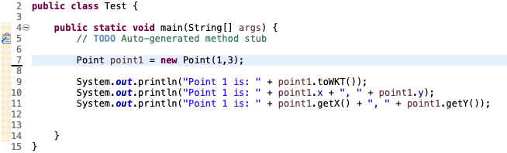
4. Create Points using the point Class:
Week
3
Practice Problem
Line 7: Creates a new point object in the same way as a principle type in the main() method:
Type(point) name(P1) = new value (x,y)
The addition is that the value needed is a set of integers as defined by the class and the addition of the ‘new’ statement. By doing this Java is creating a new object and attaching the reference to that object within the variable.
Line 9: Prints a description of point1 using the toWKT() method
Line 10: Prints a description of point1 using direct access
Line 11: Prints a description of point1 using our getters

Slide 32
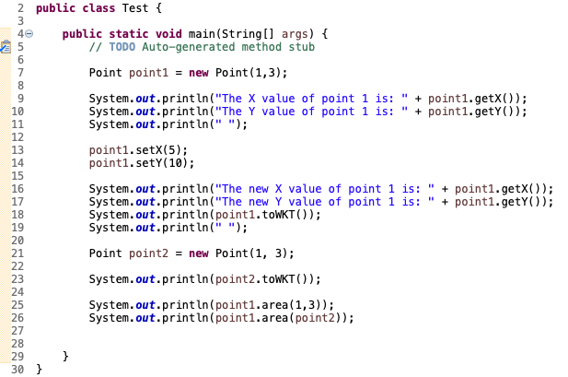
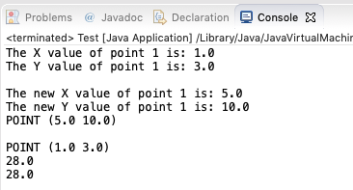
Test our code, apply our methods:
Week
3
Practice Problem

Slide 33
HW 2 Hints
Define a Point class (look at these notes)
2. Define a BoundingBox class
> Think of the attributes, constructors, getters,
setters needed
3. Add a distance method to the Point class
> Make this robust!
4. Add an isInside method to BoundingBox
> Make this robust!
5. Test your code !!
> Be sure to think of unique instances that
might break your code and test to make sure
they don’t
Week
3
HW #2

Slide 34
Summary
Variables are able to store single values
Java offers you a set of Primitive variable types such as int, long, double, char, float, short…
If you want to store a collection of values you can create an array of length x where each value is an numerically indexed element.
Week
3
End
String is an example of an array of char elements
Java is an object oriented program (OOP) thus is is focused of the states and behaviors of objects (people, places and things...)
Objects are specific examples of a more generic template.
These templates are classes!
Data modeling is essentially about defining the states and behaviors of the needed classes to answer a problem!!

