Slide 1
Finding the best place to open a restaurant – Bronx

Slide 2
Business problem
Great competition in gastronomy
It is good to know the location and competition in the area well
Nummbers of restaurants of a certain type in a location
which types of gastronomic facility already exist and in which locations

Slide 3
Data
Site https://geo.nyu.edu/catalog/nyu_2451_34572
Foursquare location data

Slide 4
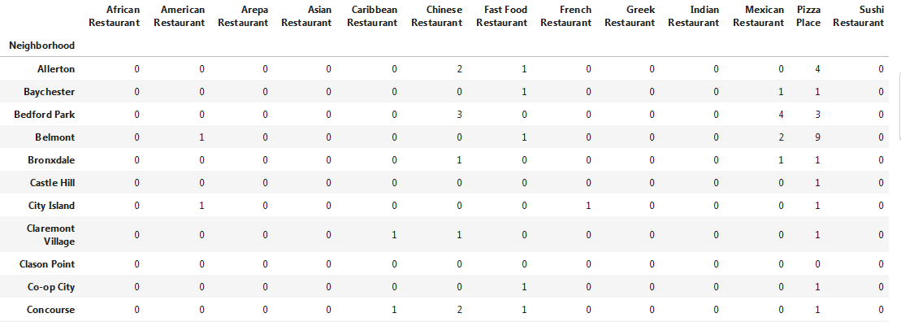
Restaurant categories (review for the first few neighborhoods)

Slide 5
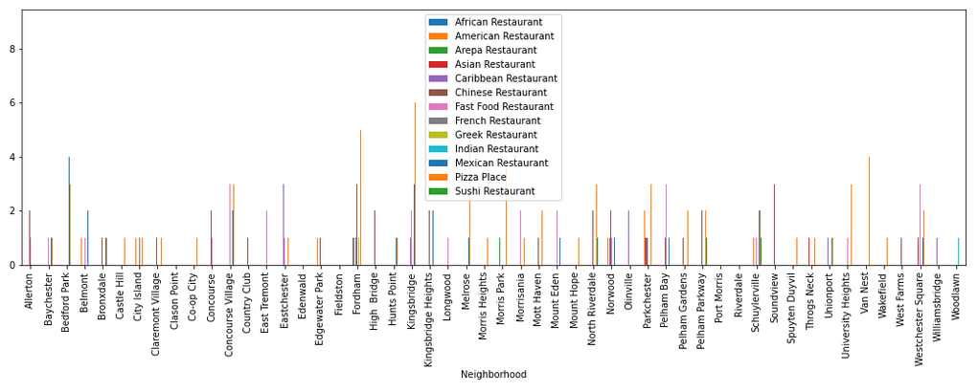
Bar plot

Slide 6
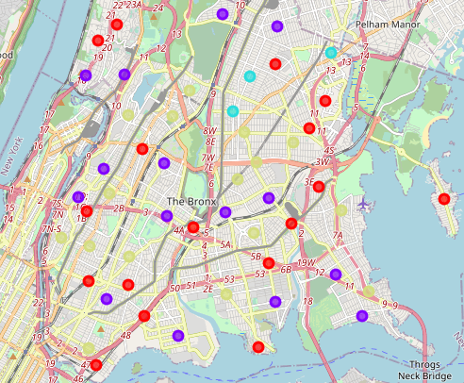
Map of 4 clasters

Slide 7
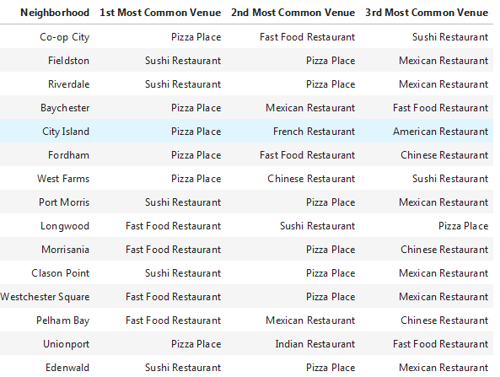
Red dots on the - first cluster- it is not advisable to open Pizza Place, Sushi Restaurant or Fast Food Restaurant.

Slide 8
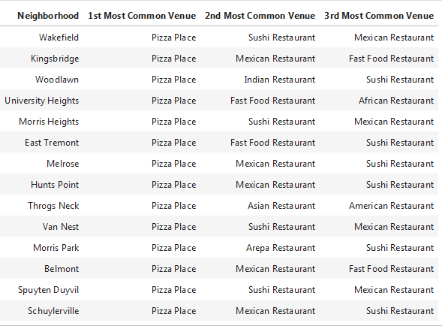
Blue dots on the - second cluster - it is not advisable to open Pizza Place, Sushi Restaurant or Mexican Restaurant.

Slide 9
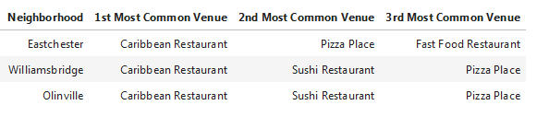
Turquoise dots on the map - third cluster - it is not advisable to open Caribbean Restaurant or Sushi Restaurant.

Slide 10
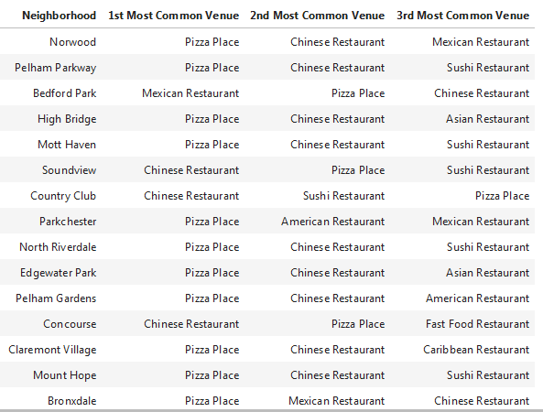
Green dots on the map - 4th cluster - it is not advisable to open Pizza Place, Chinese Restaurant or Mexican Restaurant.

Slide 11
Conclusion
Opening a gastronomic facility in the Bronx in terms of competition would be good in the neighborhoods: Clason Point, Edenwald, Fieldston, Port Morris, Riverdale, since there are no restaurants or fast food there. As for the other neighborhoods, you should pay attention to the four tables above and in each neighborhood avoid type of restaurants that appear in the first most common venue and if possible the second and third common venue.

