Slide 1


CCMS
Street Light Centralized Control & Monitoring Systems Data Analysis

Slide 2
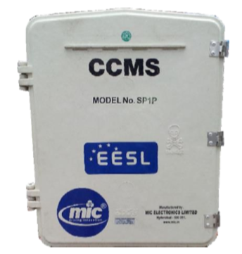
What it Does:-
Switch ON and OFF the lights of a particular switching point.
Control lights automatically throughout the year
Single Switch point can support up to 300 lighting poles
GPRS based remote streetlight with self protection from short‐circuit
Over voltage protection and anti‐ theft alert.
Battery backup of 4 hours.
Metal/Polycarbonate/SME enclosure with proper lock arrangement.

Slide 3
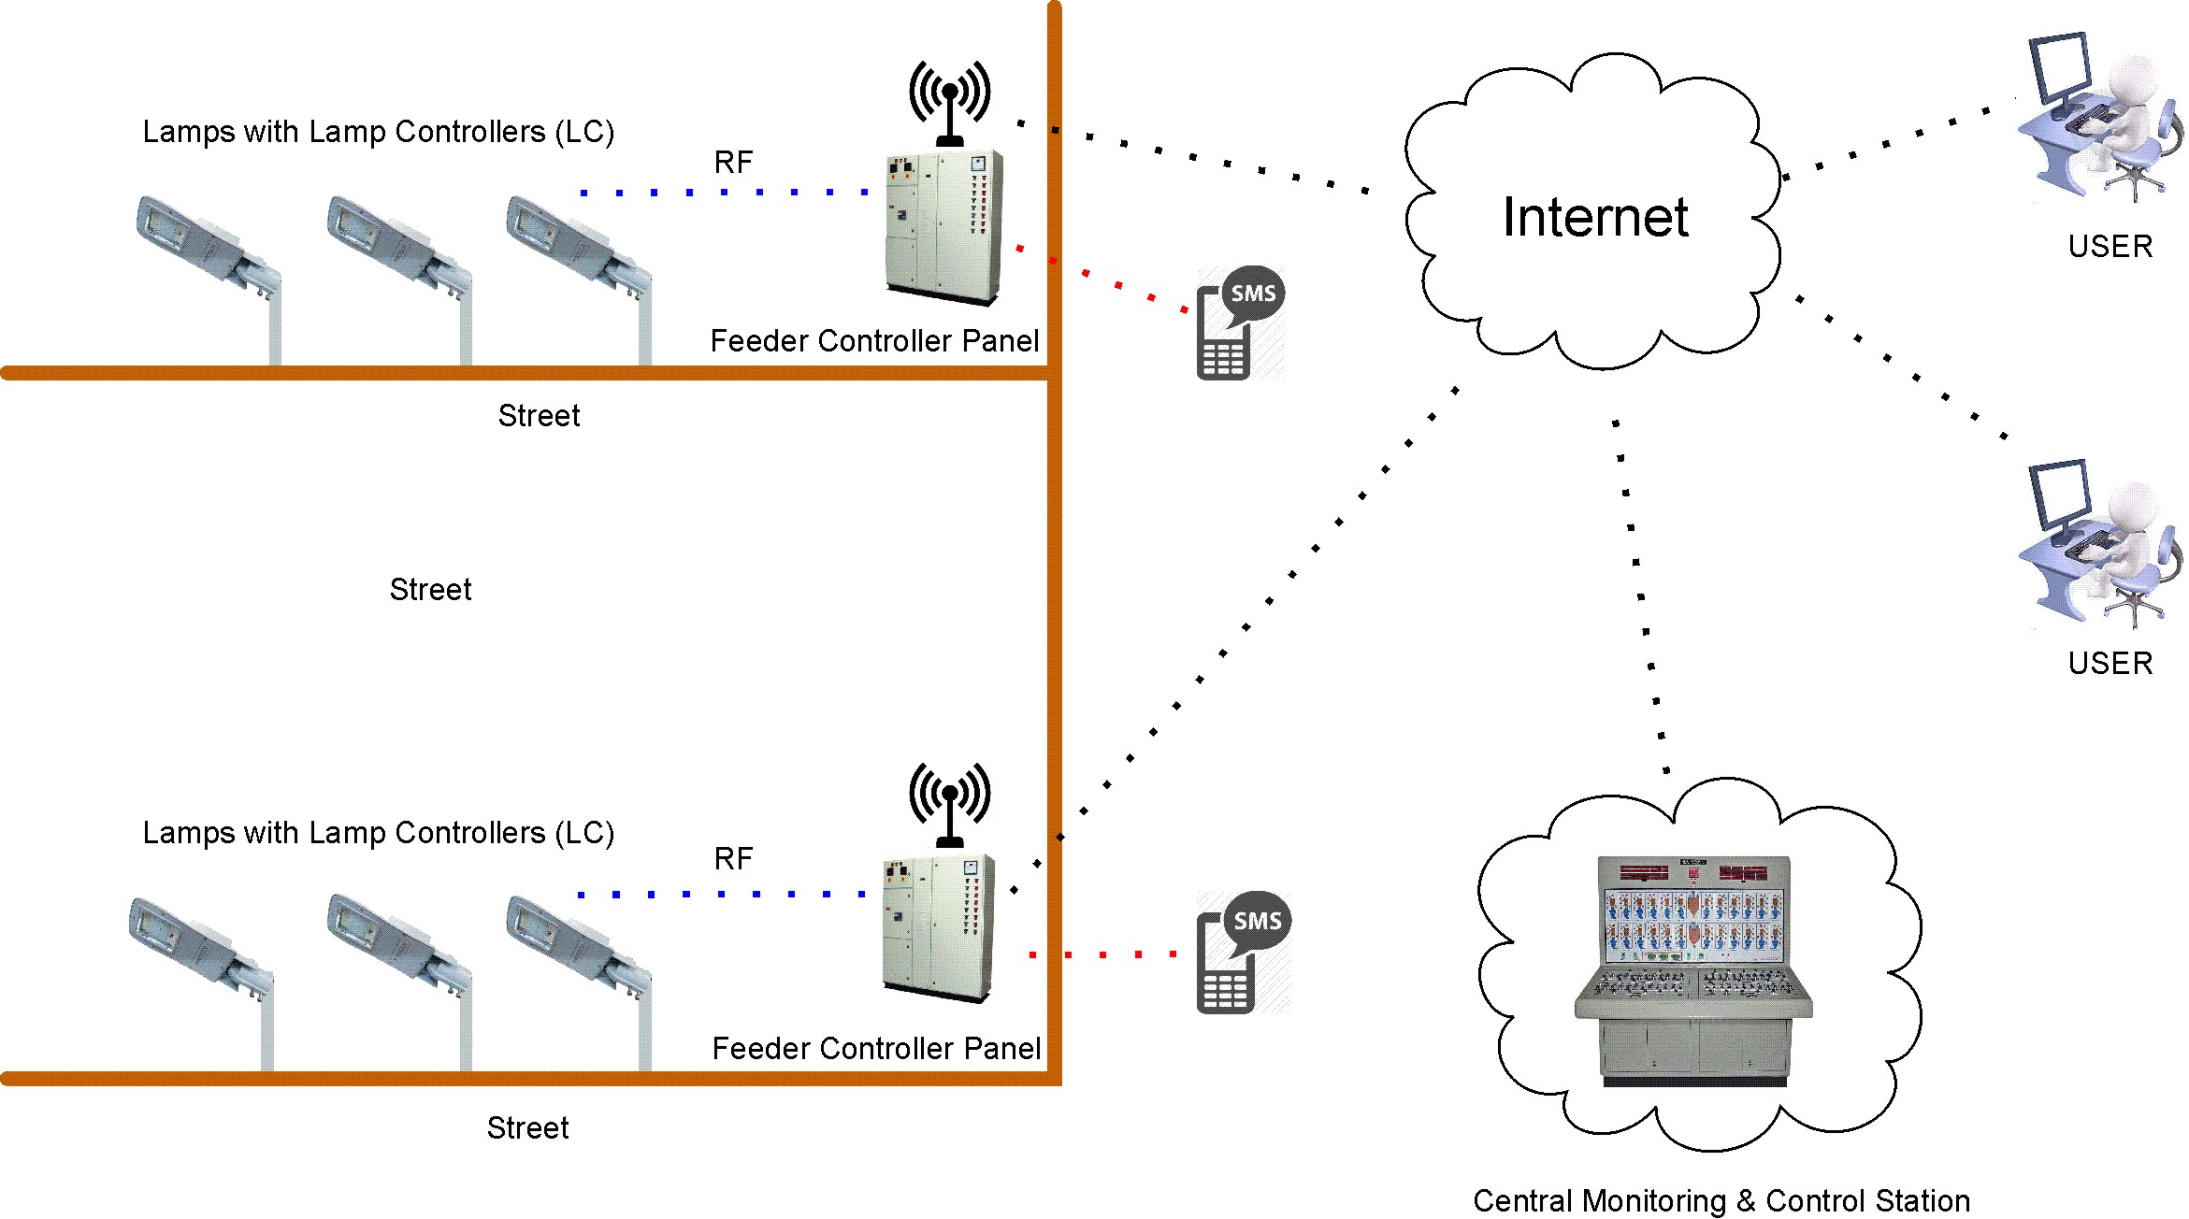
Workflow of CCMS
CCMS has a web‐server to receive and record all data from the street
Displays the power failure details of a particular switching point. Registers all fault conditions like excess
Registers all fault conditions like excess
It shows the accumulated power consumption of all the switch points
It is the real time total power consumption of all the street lights connected to switch points based on selection criteria like State/District/City.

Slide 4
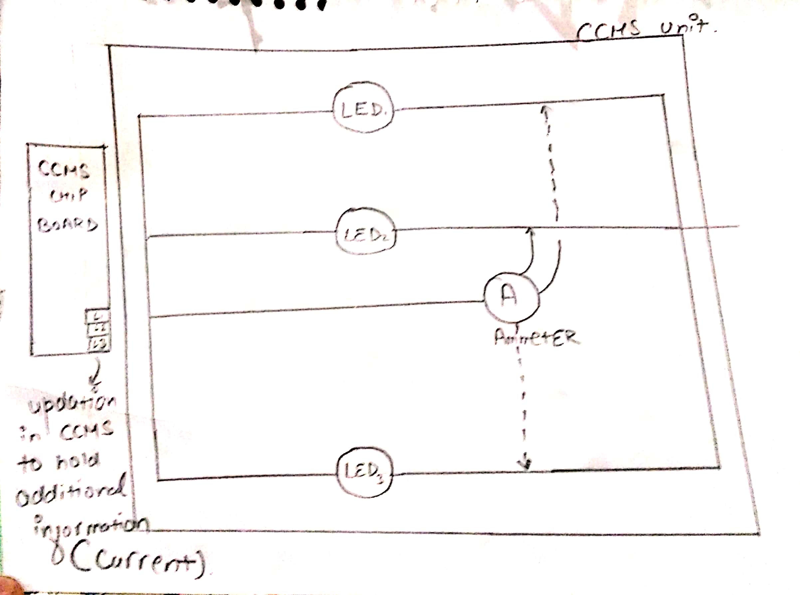
architecture to endorse our solutions:-

Slide 5
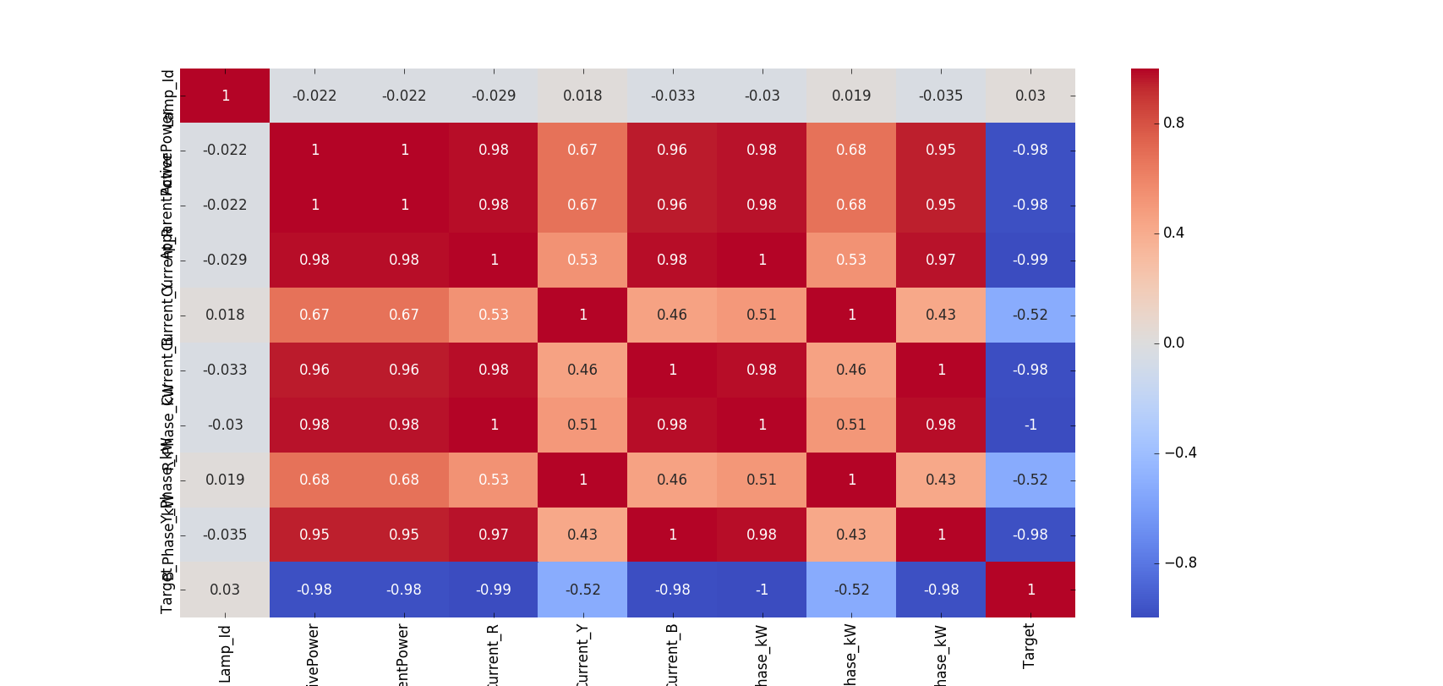
Solution to Problem Statement #1
We have tried to come up with a solution by using hashing to identify different LED lamps and then the data has been cleansed and thoroughly visualized to see various correlations between the different attributes in the datasets.

Slide 6
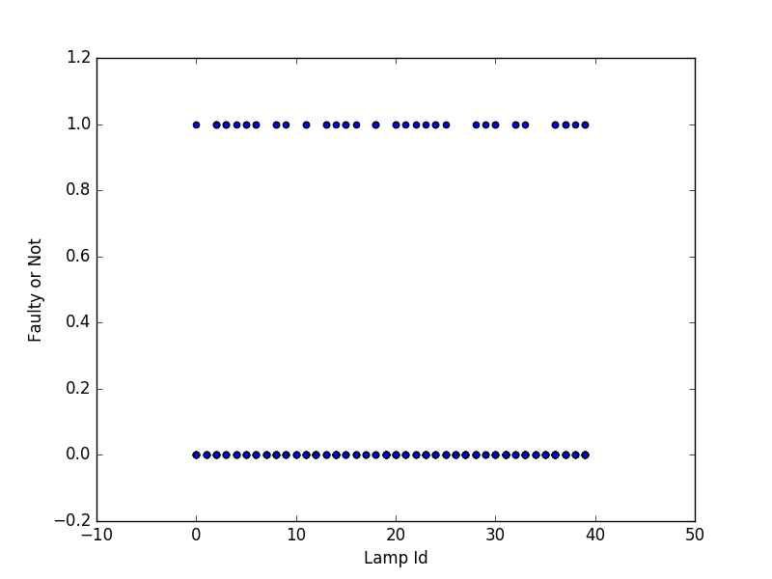
Problem Statement #1 prototype
Then we have used Decision Tree to predict the faulty LED lamp by building a model using Sci-kit.

Slide 7
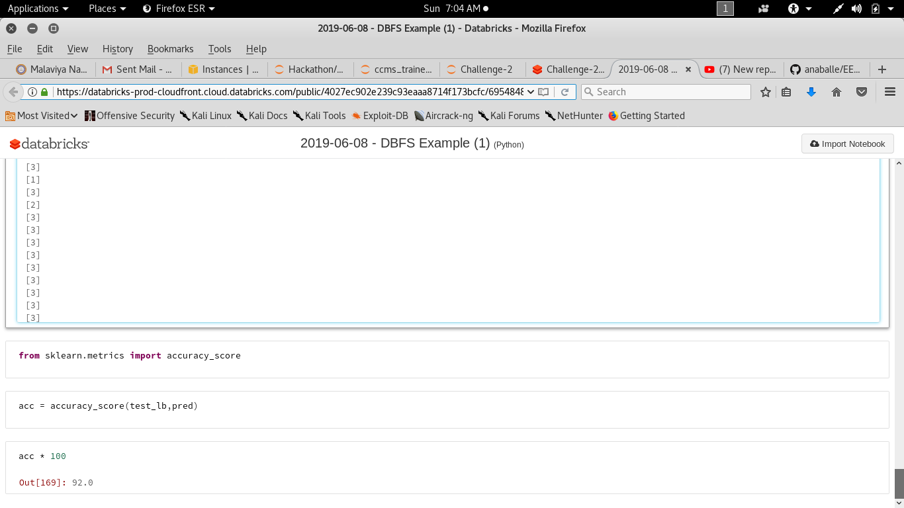
Solution to Problem Statement #2
Here we have build again a model using the famous Support Vector Machine(SVM) algorithm. Different attributes have been evaluated based on their correlation factors and then a model with an accuracy of 92% has been achieved.

Slide 8
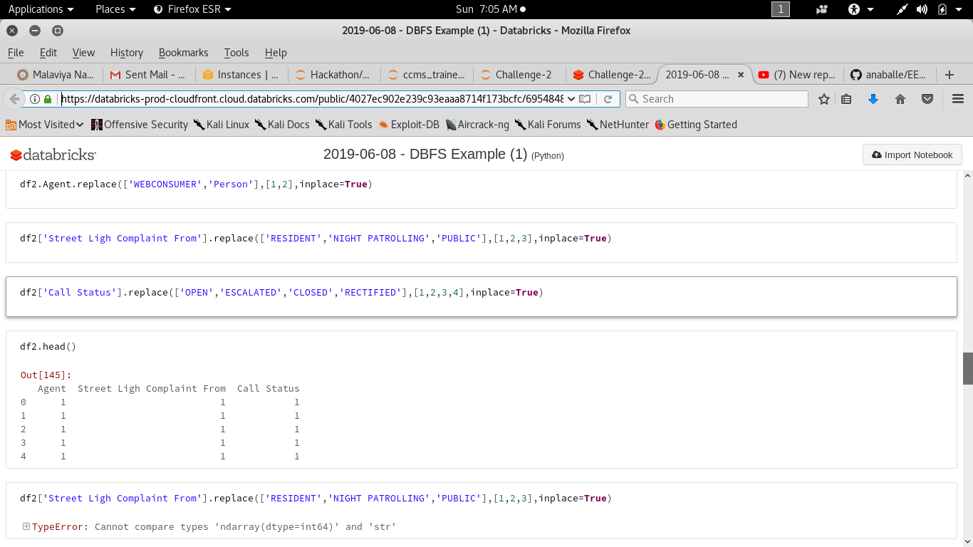
Problem Statement #2 prototype
A permanent link to the notebook can been found at https://databricks-prod-cloudfront.cloud.databricks.com/public/4027ec902e239c93eaaa8714f173bcfc/6954848893521581/1283534314062248/2558959897262863/latest.html

Slide 9
Some Problems and Effective solutions:-
Group the different problems based on there states and try to find core relation between status of complain and the agent.
Use this agent to successfully monitor no. of complain coming from your locality.
Find co-relation between different attributes and also solve problems on bases of time duration.

Slide 10
..
Since the state of complain are categories in 4 categories.
OPEN | CLOSE | ESCULATED | RECTIFIED
We will categories problems based on LIMITS ,DURATION ,TYPE co-relation with there states.
These can be used fundamentally to dose find an opinion.
Solution based on some raw data provides to us weather we can just find the possibility to problem accuracy.

Slide 11
REFERENCE
http://scikit-learn.org/stable/documentation.html
https://www.incubateind.com/inspirehackathon/
https://docs.databricks.com/
https://stackoverflow.com/

Slide 12


