Slide 1
Bias-Variance Analysis of Ensemble Learning
Thomas G. Dietterich
Department of Computer Science
Oregon State University
Corvallis, Oregon 97331
http://www.cs.orst.edu/~tgd

Slide 2
Outline
Bias-Variance Decomposition for Regression
Bias-Variance Decomposition for Classification
Bias-Variance Analysis of Learning Algorithms
Effect of Bagging on Bias and Variance
Effect of Boosting on Bias and Variance
Summary and Conclusion

Slide 3
Bias-Variance Analysis in Regression
True function is y = f(x) + ε
  where ε is normally distributed with zero mean and standard deviation σ.
Given a set of training examples, {(x_{i}, y_{i})}, we fit an hypothesis h(x) = w ¢ x + b to the data to minimize the squared error
  Σ_{i} [y_{i} – h(x_{i})]²

Slide 4
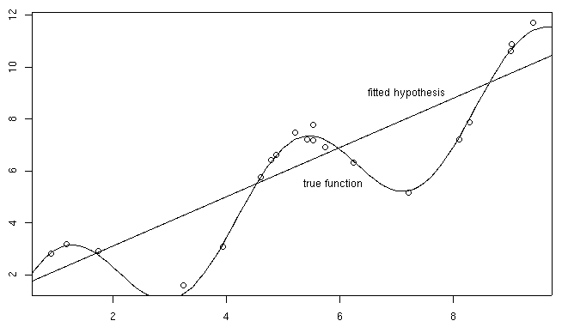
Example: 20 points y = x + 2 sin(1.5x) + N(0,0.2)

Slide 5
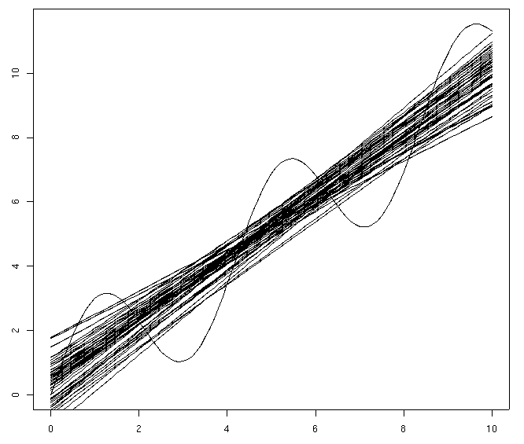
50 fits (20 examples each)

Slide 6
Bias-Variance Analysis
Now, given a new data point x* (with observed value y* = f(x*) + ε), we would like to understand the expected prediction error
E[ (y* – h(x*))² ]

Slide 7
Classical Statistical Analysis
Imagine that our particular training sample S is drawn from some population of possible training samples according to P(S).
Compute E_{P} [ (y* – h(x*))² ]
Decompose this into “bias”, “variance”, and “noise”

Slide 8
Lemma
Let Z be a random variable with probability distribution P(Z)
Let Z = E_{P}[ Z ] be the average value of Z.
Lemma: E[ (Z – Z)² ] = E[Z²] – Z²
E[ (Z – Z)² ] = E[ Z² – 2 Z Z + Z² ]
= E[Z²] – 2 E[Z] Z + Z²
= E[Z²] – 2 Z² + Z²
= E[Z²] – Z²
Corollary: E[Z²] = E[ (Z – Z)² ] + Z²

Slide 9
Bias-Variance-Noise Decomposition
E[ (h(x*) – y*)² ] = E[ h(x*)² – 2 h(x*) y* + y*² ]
= E[ h(x*)² ] – 2 E[ h(x*) ] E[y*] + E[y*²]
= E[ (h(x*) – h(x*))² ] + h(x*)² (lemma)
– 2 h(x*) f(x*)
+ E[ (y* – f(x*))² ] + f(x*)² (lemma)
= E[ (h(x*) – h(x*))² ] + [variance]
(h(x*) – f(x*))² + [bias²]
E[ (y* – f(x*))² ] [noise]

Slide 10
Derivation (continued)
E[ (h(x*) – y*)² ] =
= E[ (h(x*) – h(x*))² ] +
(h(x*) – f(x*))² +
E[ (y* – f(x*))² ]
= Var(h(x*)) + Bias(h(x*))² + E[ ε² ]
= Var(h(x*)) + Bias(h(x*))² + σ²
Expected prediction error = Variance + Bias² + Noise²

Slide 11
Bias, Variance, and Noise
Variance: E[ (h(x*) – h(x*))² ]
Describes how much h(x*) varies from one training set S to another
Bias: [h(x*) – f(x*)]
Describes the average error of h(x*).
Noise: E[ (y* – f(x*))² ] = E[ε²] = σ²
Describes how much y* varies from f(x*)

Slide 12
50 fits (20 examples each)

Slide 13
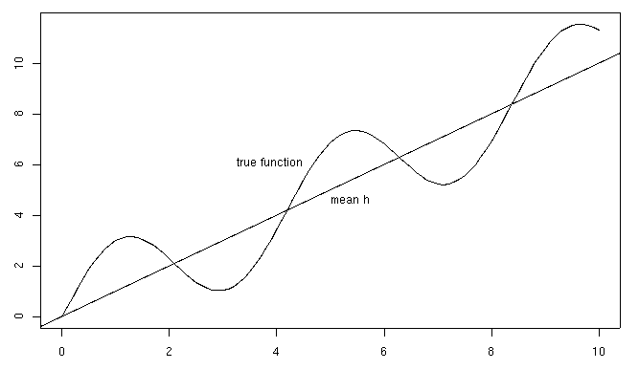
Bias

Slide 14
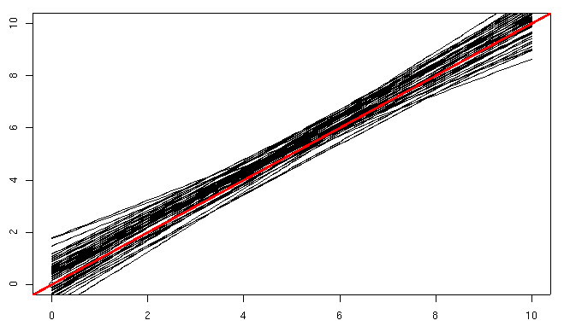
Variance

Slide 15
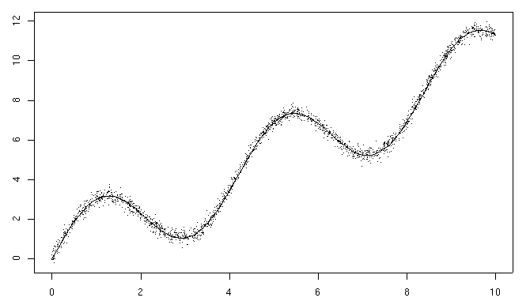
Noise

Slide 16
50 fits (20 examples each)

Slide 17
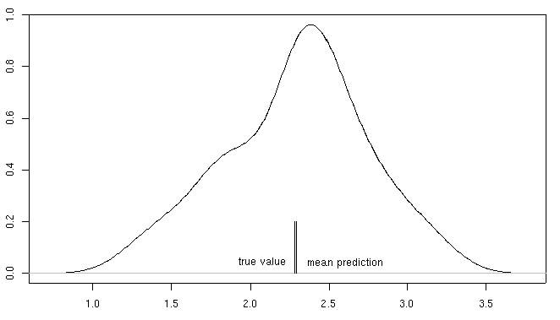
Distribution of predictions at x=2.0

Slide 18
50 fits (20 examples each)

Slide 19
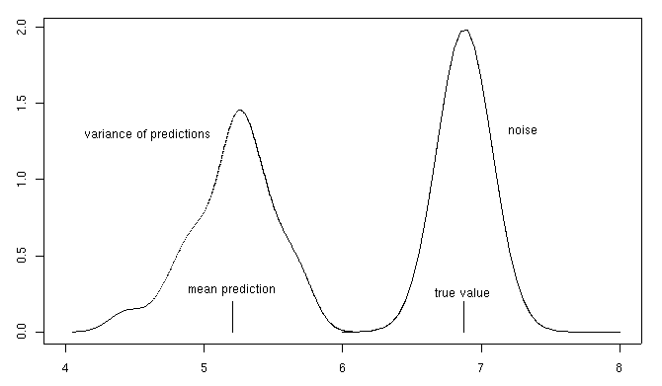
Distribution of predictions at x=5.0

Slide 20
Measuring Bias and Variance
In practice (unlike in theory), we have only ONE training set S.
We can simulate multiple training sets by bootstrap replicates
  S’ = {x | x is drawn at random with replacement from S} and |S’| = |S|.

Slide 21
Procedure for Measuring Bias and Variance
Construct B bootstrap replicates of S (e.g., B = 200): S₁, …, S_{B}
Apply learning algorithm to each replicate S_{b} to obtain hypothesis h_{b}
Let T_{b} = S \ S_{b} be the data points that do not appear in S_{b} (out of bag points)
Compute predicted value h_{b}(x) for each x in T_{b}

Slide 22
Estimating Bias and Variance (continued)
For each data point x, we will now have the observed corresponding value y and several predictions y₁, …, y_{K}.
Compute the average prediction h.
Estimate bias as (h – y)
Estimate variance as Σ_{k} (y_{k} – h)²/(K – 1)
Assume noise is 0

Slide 23
Approximations in this Procedure
Bootstrap replicates are not real data
We ignore the noise
  If we have multiple data points with the same x value, then we can estimate the noise
  We can also estimate noise by pooling y values from nearby x values (another use for Random Forest proximity measure?)

Slide 24
Bagging
Bagging constructs B bootstrap replicates and their corresponding hypotheses h₁, …, h_{B}
It makes predictions according to
  y = Σ_{b} h_{b}(x) / B
Hence, bagging’s predictions are h(x)

Slide 25
Estimated Bias and Variance of Bagging
If we estimate bias and variance using the same B bootstrap samples, we will have:
  Bias = (h – y) [same as before]
  Variance = Σ_{k} (h – h)²/(K – 1) = 0
Hence, according to this approximate way of estimating variance, bagging removes the variance while leaving bias unchanged.
In reality, bagging only reduces variance and tends to slightly increase bias

Slide 26
Bias/Variance Heuristics
Models that fit the data poorly have high bias: “inflexible models” such as linear regression, regression stumps
Models that can fit the data very well have low bias but high variance: “flexible” models such as nearest neighbor regression, regression trees
This suggests that bagging of a flexible model can reduce the variance while benefiting from the low bias

Slide 27
Bias-Variance Decomposition for Classification
Can we extend the bias-variance decomposition to classification problems?
Several extensions have been proposed; we will study the extension due to Pedro Domingos (2000a; 2000b)
Domingos developed a unified decomposition that covers both regression and classification

Slide 28
Classification Problems:
Noisy Channel Model
Data points are generated by y_{i} = n(f(x_{i})), where
  f(x_{i}) is the true class label of x_{i}
  n(¢) is a noise process that may change the true label f(x_{i}).
Given a training set {(x₁, y₁), …, (x_{m}, y_{m})}, our learning algorithm produces an hypothesis h.
Let y* = n(f(x*)) be the observed label of a new data point x*. h(x*) is the predicted label. The error (“loss”) is defined as L(h(x*), y*)

Slide 29
Loss Functions for Classification
The usual loss function is 0/1 loss. L(y’,y) is 0 if y’ = y and 1 otherwise.
Our goal is to decompose E_{p}[L(h(x*), y*)] into bias, variance, and noise terms

Slide 30
Discrete Equivalent of the Mean: The Main Prediction
As before, we imagine that our observed training set S was drawn from some population according to P(S)
Define the main prediction to be
  y_{m}(x*) = argmin_{y’} E_{P}[ L(y’, h(x*)) ]
For 0/1 loss, the main prediction is the most common vote of h(x*) (taken over all training sets S weighted according to P(S))
For squared error, the main prediction is h(x*)

Slide 31
Bias, Variance, Noise
Bias B(x*) = L(y^{m}, f(x*))
  This is the loss of the main prediction with respect to the true label of x*
Variance V(x*) = E[ L(h(x*), y^{m}) ]
  This is the expected loss of h(x*) relative to the main prediction
Noise N(x*) = E[ L(y*, f(x*)) ]
  This is the expected loss of the noisy observed value y* relative to the true label of x*

Slide 32
Squared Error Loss
These definitions give us the results we have already derived for squared error loss L(y’,y) = (y’ – y)²
  Main prediction y^{m} = h(x*)
  Bias²: L(h(x*), f(x*)) = (h(x*) – f(x*))²
  Variance:
  E[ L(h(x*), h(x*)) ] = E[ (h(x*) – h(x*))² ]
  Noise: E[ L(y*, f(x*)) ] = E[ (y* – f(x*))² ]

Slide 33
0/1 Loss for 2 classes
There are three components that determine whether y* = h(x*)
  Noise: y* = f(x*)?
  Bias: f(x*) = y^{m}?
  Variance: y^{m} = h(x*)?
Bias is either 0 or 1, because neither f(x*) nor y^{m} are random variables

Slide 34
Case Analysis of Error
f(x*) = y^{m}?
yes
no [bias]
y^{m} = h(x*)?
y^{m} = h(x*)?
yes
no [variance]
yes
no [variance]
y* = f(x*)?
y* = f(x*)?
y* = f(x*)?
y* = f(x*)?
yes
no [noise]
yes
no [noise]
yes
no [noise]
yes
no [noise]
correct
error
[noise]
error
[variance]
correct
[noise
cancels
variance]
error
[bias]
correct
[noise
cancels
bias]
correct
[variance
cancels
bias]
error
[noise
cancels
variance
cancels
bias]

Slide 35
Unbiased case
Let P(y* ≠ f(x*)) = N(x*) = τ
Let P(y^{m} ≠ h(x*)) = V(x*) = σ
If (f(x*) = y^{m}), then we suffer a loss if exactly one of these events occurs: L(h(x*), y*) = τ(1-σ) + σ(1-τ)
= τ + σ – 2τσ
= N(x*) + V(x*) – 2 N(x*) V(x*)

Slide 36
Biased Case
Let P(y* ≠ f(x*)) = N(x*) = τ
Let P(y^{m} ≠ h(x*)) = V(x*) = σ
If (f(x*) ≠ y^{m}), then we suffer a loss if either both or neither of these events occurs:
L(h(x*), y*) = τσ + (1–σ)(1–τ)
= 1 – (τ + σ – 2τσ)
= B(x*) – [N(x*) + V(x*) – 2 N(x*) V(x*)]

Slide 37
Decomposition for 0/1 Loss
(2 classes)
We do not get a simple additive decomposition in the 0/1 loss case:
E[ L(h(x*), y*) ] =
  if B(x*) = 1: B(x*) – [N(x*) + V(x*) – 2 N(x*) V(x*)]
  if B(x*) = 0: B(x*) + [N(x*) + V(x*) – 2 N(x*) V(x*)]
In biased case, noise and variance reduce error; in unbiased case, noise and variance increase error

Slide 38
Summary of 0/1 Loss
A good classifier will have low bias, in which case the expected loss will approximately equal the variance
The interaction terms will usually be small, because both noise and variance will usually be < 0.2, so the interaction term 2 V(x*) N(x*) will be < 0.08

Slide 39
0/1 Decomposition in Practice
In the noise-free case:
E[ L(h(x*), y*) ] =
  if B(x*) = 1: B(x*) – V(x*)
  if B(x*) = 0: B(x*) + V(x*)
It is usually hard to estimate N(x*), so we will use this formula

Slide 40
Decomposition over an entire data set
Given a set of test points
T = {(x*₁,y*₁),…, (x*_{n},y*_{n})},
we want to decompose the average loss:
L = Σ_{i} E[ L(h(x*_{i}), y*_{i}) ] / n
We will write it as
L = B + Vu – Vb
where B is the average bias, Vu is the average unbiased variance, and Vb is the average biased variance (We ignore the noise.)
Vu – Vb will be called “net variance”

Slide 41
Classification Problems:
Overlapping Distributions Model
Suppose at each point x, the label is generated according to a probability distribution y ~ P(y|x)
The goal of learning is to discover this probability distribution
The loss function L(p,h) = KL(p,h) is the Kullback-Liebler divergence between the true distribution p and our hypothesis h.

Slide 42
Kullback-Liebler Divergence
For simplicity, assume only two classes: y 2 {0,1}
Let p be the true probability P(y=1|x) and h be our hypothesis for P(y=1|x).
The KL divergence is
  KL(p,h) = p log p/h + (1-p) log (1-p)/(1-h)

Slide 43
Bias-Variance-Noise Decomposition for KL
Goal: Decompose E_{S}[ KL(y, h) ] into noise, bias, and variance terms
Compute the main prediction:
h = argmin_{u} E_{S}[ KL(u, h) ]
This turns out to be the geometric mean:
  log(h/(1-h)) = E_{S}[ log(h/(1-h)) ]
  h = 1/Z * exp( E_{S}[ log h ] )

Slide 44
Computing the Noise
Obviously the best estimator h would be p. What loss would it receive?
E[ KL(y, p) ] = E[ y log y/p + (1-y) log (1-y)/(1-p)
= E[ y log y – y log p +
(1-y) log (1-y) – (1-y) log (1-p) ]
= -p log p – (1-p) log (1-p)
= H(p)

Slide 45
Bias, Variance, Noise
Variance: E_{S}[ KL(h, h) ]
Bias: KL(p, h)
Noise: H(p)
Expected loss = Noise + Bias + Variance
E[ KL(y, h) ] = H(p) + KL(p, h) + E_{S}[ KL(h, h) ]

Slide 46
Consequences of this Definition
If our goal is probability estimation and we want to do bagging, then we should combine the individual probability estimates using the geometric mean
  log(h/(1-h)) = E_{S}[ log(h/(1-h)) ]
In this case, bagging will produce pure variance reduction (as in regression)!

Slide 47
Experimental Studies of Bias and Variance
Artificial data: Can generate multiple training sets S and measure bias and variance directly
Benchmark data sets: Generate bootstrap replicates and measure bias and variance on separate test set

Slide 48
Algorithms to Study
K-nearest neighbors: What is the effect of K?
Decision trees: What is the effect of pruning?
Support Vector Machines: What is the effect of kernel width σ?

Slide 49
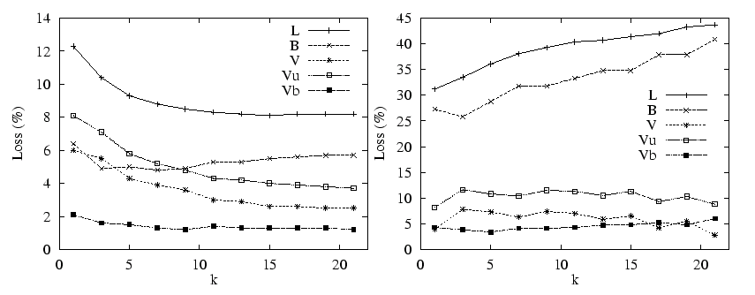
K-nearest neighbor
(Domingos, 2000)
Chess (left): Increasing K primarily reduces Vu
Audiology (right): Increasing K primarily increases B.

Slide 50
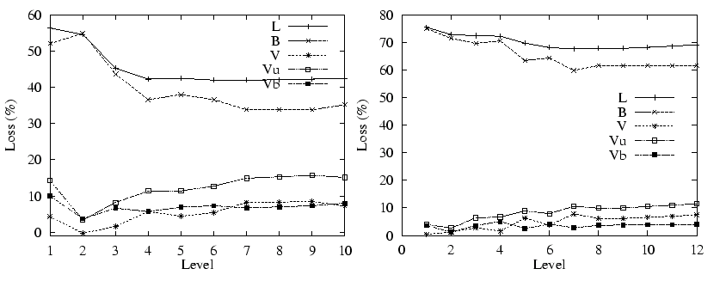
Size of Decision Trees
Glass (left), Primary tumor (right): deeper trees have lower B, higher Vu

Slide 51
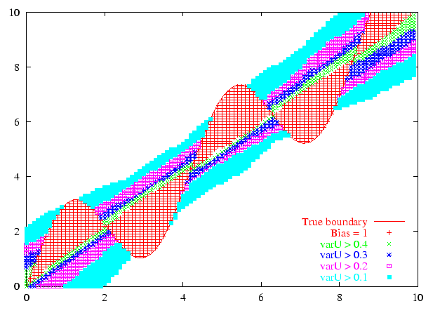
Example: 200 linear SVMs (training sets of size 20)
Error: 13.7%
Bias: 11.7%
Vu: 5.2%
Vb: 3.2%

Slide 52
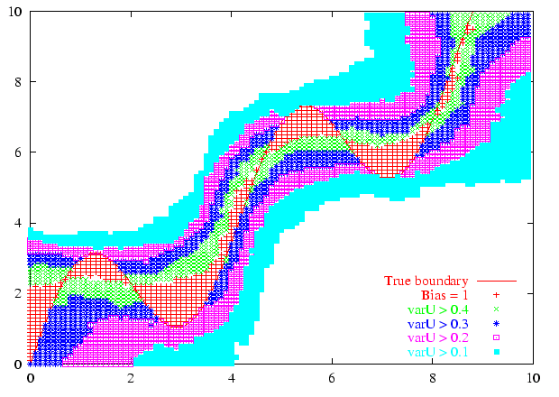
Example: 200 RBF SVMs σ = 5
Error: 15.0%
Bias: 5.8%
Vu: 11.5%
Vb: 2.3%

Slide 53
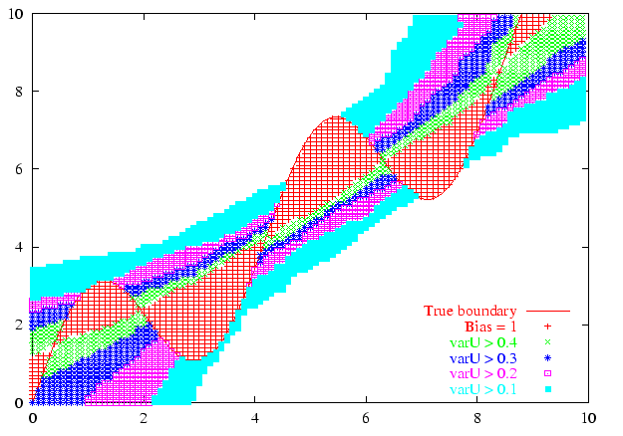
Example: 200 RBF SVMs σ = 50
Error: 14.9%
Bias: 10.1%
Vu: 7.8%
Vb: 3.0%

Slide 54
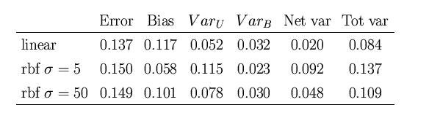
SVM Bias and Variance
Bias-Variance tradeoff controlled by σ
Biased classifier (linear SVM) gives better results than a classifier that can represent the true decision boundary!

Slide 55
B/V Analysis of Bagging
Under the bootstrap assumption, bagging reduces only variance
  Removing Vu reduces the error rate
  Removing Vb increases the error rate
Therefore, bagging should be applied to low-bias classifiers, because then Vb will be small
Reality is more complex!

Slide 56
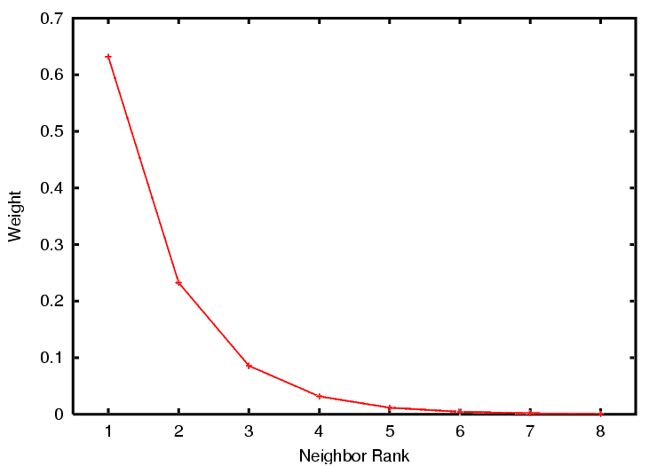
Bagging Nearest Neighbor
Bagging first-nearest neighbor is equivalent (in the limit) to a weighted majority vote in which the k-th neighbor receives a weight of
exp(-(k-1)) – exp(-k)
Since the first nearest neighbor gets more than half of the vote, it will always win this vote. Therefore, Bagging 1-NN is equivalent to 1-NN.

Slide 57
Bagging Decision Trees
Consider unpruned trees of depth 2 on the Glass data set. In this case, the error is almost entirely due to bias
Perform 30-fold bagging (replicated 50 times; 10-fold cross-validation)
What will happen?

Slide 58
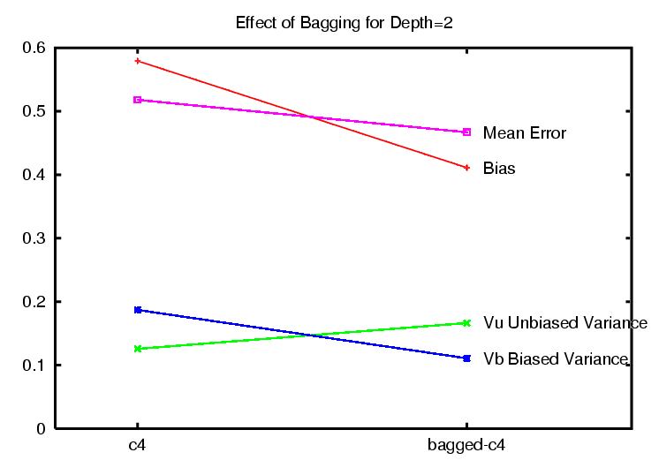
Bagging Primarily Reduces Bias!

Slide 59
Questions
Is this due to the failure of the bootstrap assumption in bagging?
Is this due to the failure of the bootstrap assumption in estimating bias and variance?
Should we also think of Bagging as a simple additive model that expands the range of representable classifiers?

Slide 60
Bagging Large Trees?
Now consider unpruned trees of depth 10 on the Glass dataset. In this case, the trees have much lower bias.
What will happen?

Slide 61
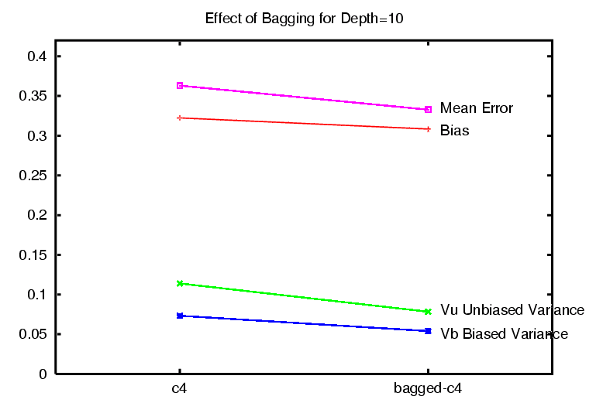
Answer: Bagging Primarily Reduces Variance

Slide 62
Bagging of SVMs
We will choose a low-bias, high-variance SVM to bag: RBF SVM with σ=5

Slide 63
RBF SVMs again: σ = 5

Slide 64
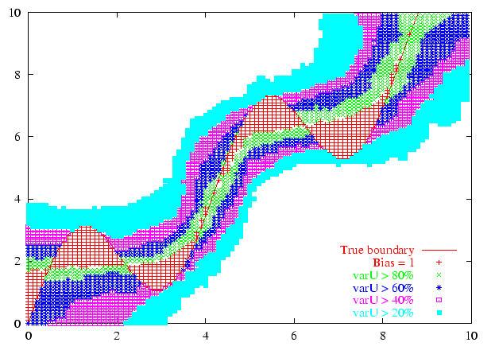
Effect of 30-fold Bagging: Variance is Reduced

Slide 65
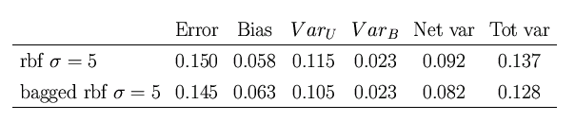
Effects of 30-fold Bagging
Vu is decreased by 0.010; Vb is unchanged
Bias is increased by 0.005
Error is reduced by 0.005

Slide 66
Bias-Variance Analysis of Boosting
Boosting seeks to find a weighted combination of classifiers that fits the data well
Prediction: Boosting will primarily act to reduce bias

Slide 67
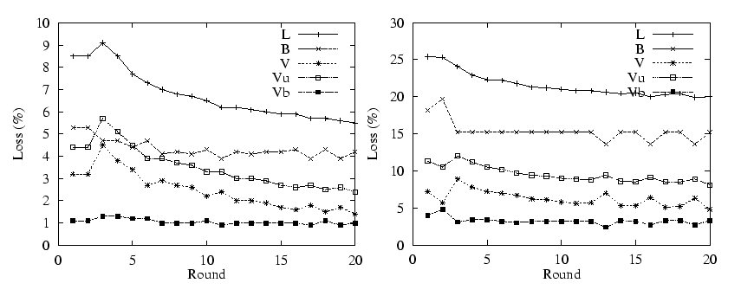
Boosting DNA splice (left) and Audiology (right)
Early iterations reduce bias. Later iterations also reduce variance

Slide 68
Review and Conclusions
For regression problems (squared error loss), the expected error rate can be decomposed into
  Bias(x*)² + Variance(x*) + Noise(x*)
For classification problems (0/1 loss), the expected error rate depends on whether bias is present:
  if B(x*) = 1: B(x*) – [V(x*) + N(x*) – 2 V(x*) N(x*)]
  if B(x*) = 0: B(x*) + [V(x*) + N(x*) – 2 V(x*) N(x*)]
  or B(x*) + Vu(x*) – Vb(x*) [ignoring noise]

Slide 69
Sources of Bias and Variance
Bias arises when the classifier cannot represent the true function – that is, the classifier underfits the data
Variance arises when the classifier overfits the data
There is often a tradeoff between bias and variance

Slide 70
Effect of Algorithm Parameters on Bias and Variance
k-nearest neighbor: increasing k typically increases bias and reduces variance
decision trees of depth D: increasing D typically increases variance and reduces bias
RBF SVM with parameter σ: increasing σ increases bias and reduces variance

Slide 71
Effect of Bagging
If the bootstrap replicate approximation were correct, then bagging would reduce variance without changing bias
In practice, bagging can reduce both bias and variance
  For high-bias classifiers, it can reduce bias (but may increase Vu)
  For high-variance classifiers, it can reduce variance

Slide 72
Effect of Boosting
In the early iterations, boosting is primary a bias-reducing method
In later iterations, it appears to be primarily a variance-reducing method (see end of Breiman’s Random Forest paper)

