Slide 1


Detecting, Mapping, and Grading Sidewalks using Street View Images and Secondary Sources for the city of Dallas
Andrew Abbott, Alex Deshowitz, Dennis Murray
Advisor: Dr. Eric Larson

Slide 2
Executive Summary
The city of Dallas currently has an infrastructure spend allocation problem for several essential portions of the city’s infrastructure. Currently, there is no scientific approach to allocating these resources which often leads to waste or unclear priorities
The city’s sidewalk infrastructure is one area where this is evident
Our goal is to create a system that identifies sidewalks from images, grades the sidewalks for quality and obstacles, and then recommends which sidewalks should be repaired
The training process will be the most complex phase of this project. We have 2 training options. First, we may be able to leverage work that has been done by the University of Maryland or we may need to create our own training data via the use of manual image manipulation (bounding boxes)
Once a reliable data creation process is completed, we plan to test a series of machine learning algorithms including: Convolutional Neural Networks and Bayesian Belief Networks

Slide 3
Agenda
Problem Statement
Project Plan
Ethical Consideration

Slide 4
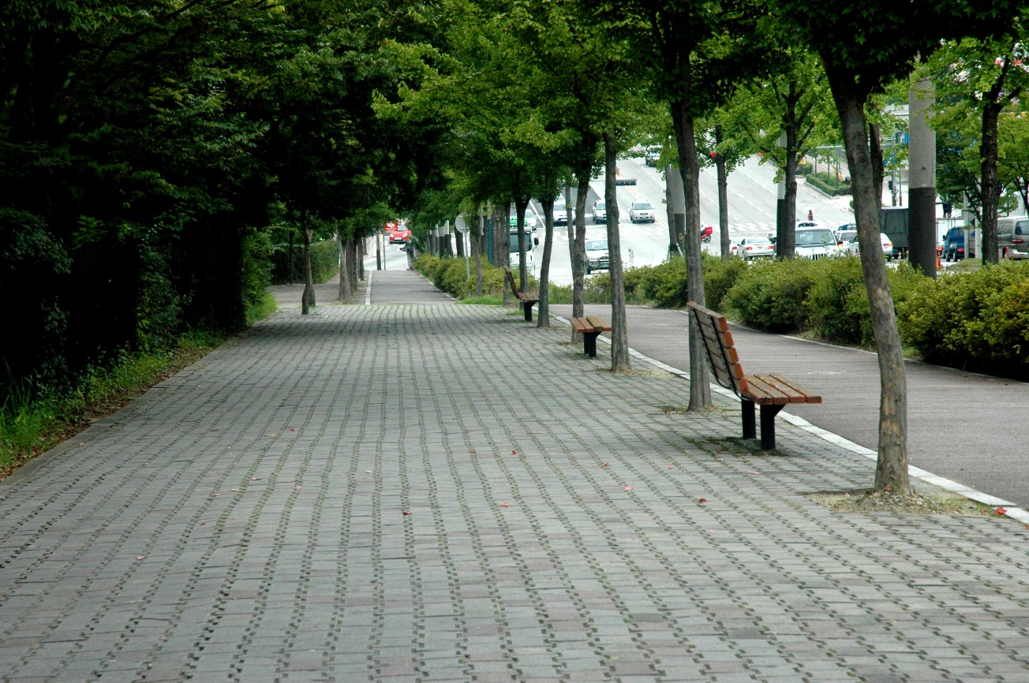
Current state of Dallas sidewalks
Dallas is currently one of the least walkable cities in the country and this provides a disparity for those who cannot afford to own a car or do not have the means to drive a vehicle or access other transportation
For a city like Dallas, walkable sidewalks are essential as the city grows in both size and diversity
According to Walkscore.com¹, Dallas’ walk score rating is 46.
This compares to cities such as New York, Boston, and San Francisco which have Walk Scores between 81 and 89
While on par with peer cities such as Houston (49) and Austin (40), Dallas has the opportunity to tailor the infrastructure in place by upgrading areas that need improvement for those citizens who are in the most need
The city has added over $16.7M to the annual Street Services² budget in the past year and the most recent citizen survey places infrastructure improvement as the number one area of importance for Dallas residents
1.
2. Dallas city budget: http://financialtransparency.dallascityhall.com/Budget/proposed1516/proposed-fy15-16-BudgetBook.pdf

Slide 5
Potential approaches to training data Our plan is to either leverage the University of Maryland approach or design our own approach via the use of bounding boxes to feed those pixel boundaries into our dataset
Approaches to creating the data
1
2
University of Maryland
Manual approach
Summary: Our approach will take a series of training images from Google Streetview and complete 2 steps
Process:
Identify sidewalk feature in image
Encode specific features
Obstacles
Transitions
Harsh curbs
Identify non-sidewalk elements to mark as bad data
Bicycles/toys
Trash
Markers/cones
Humans

Slide 6
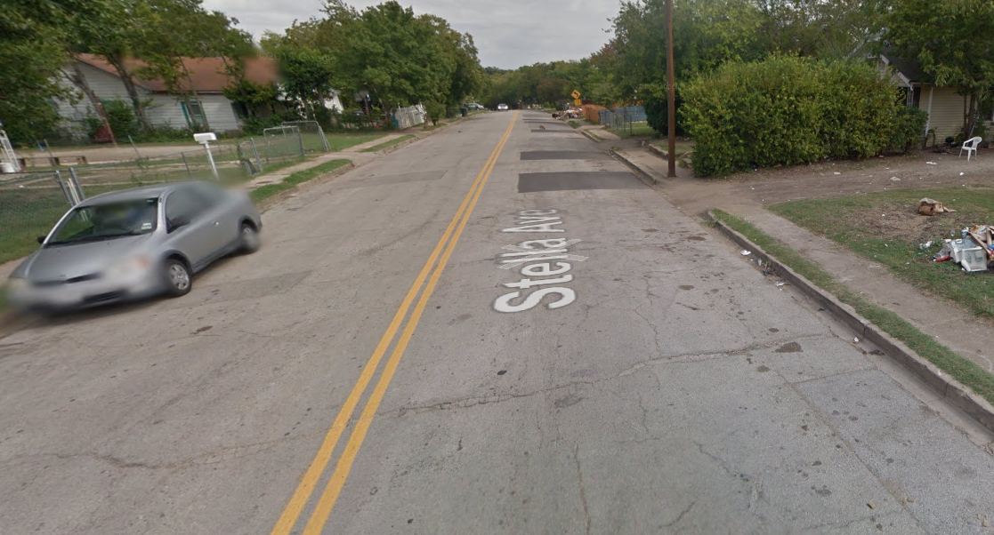
Details of the manual approach the manual approach will encode sidewalks first and then identify the key features that will help us determine the characteristics and ultimate grade of the sidewalk
1
Identify sidewalk
dog
2
Identify obstacles
(ex: telephone pole, shrub, etc)
car
3
Find and flag bad data

Slide 7
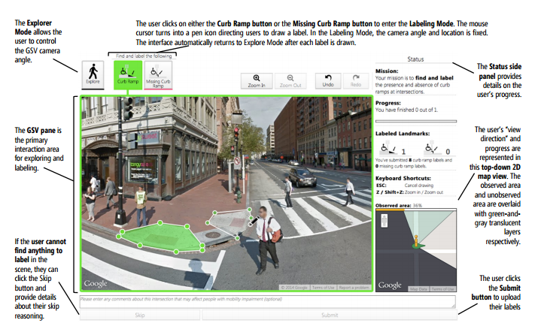
Project Sidewalk – University of Maryland Seeks to Document accessibility
Project combines Google Street View image data with crowd sourced labor to review intersections and document locations of curb cuts
Uses Java script online tool called “svLabel” to label features in images using a wire-frame style layer
Work in svLabel is followed by svDetect and svVerify to label additional images and then to verify outputs
SOURCE: Hara, Sun, Moore et al: “Tohme: Detecting Curb Ramps in Google Street View Using Crowdsourcing, Computer Vision, and Machine Learning.” UIST ‘13, Honolulu, HI.

Slide 8
Data Sourcing
Google Street View API
Terms of use allow for scraping image data for Street View
Open Street Map/Mapzen
Open Street Map is a crowdsourced project that has most
Dallas OpenData 311 Requests
MapMyRun User GPS Tracks

Slide 9
Project Plan

Slide 10
Major Steps
Creation of an adequate data set of labeled/wireframed images for training model
This is a lot of hands on time!
There’s probably a best method of performing this task, that we hope to uncover through prior research
Integration with prior data collection from UMD Project Sidewalk team
Existing base of ~67,000 labeled images
Learning the available convolutional neural network libraries/packages

Slide 11
Ethics
Are underserved areas usually comprised of low-income or disadvantaged house holds?

