Slide 1


Detecting, Mapping, and Grading Sidewalks using Street View Images and Secondary Sources for the city of Dallas
Andrew Abbott, Alex Deshowitz, Dennis Murray
Advisor: Dr. Eric Larson

Slide 2
Executive Summary
The city of Dallas currently has an infrastructure spend allocation problem for several essential portions of the city’s infrastructure. Currently, there is no scientific approach to allocating these resources which often leads to waste or unclear priorities
The city’s sidewalk infrastructure is one area where this is evident
Our goal is to create a system that identifies sidewalks from images, grades the sidewalks for quality and obstacles, and then recommends which sidewalks should be repaired
The training process will be the most complex phase of this project. We have 2 training options. First, we may be able to leverage work that has been done by the University of Maryland or we may need to create our own training data via the use of manual image manipulation (bounding boxes)
Once a reliable data creation process is completed, we plan to test a series of machine learning algorithms including: Convolutional Neural Networks and Bayesian Belief Networks

Slide 3
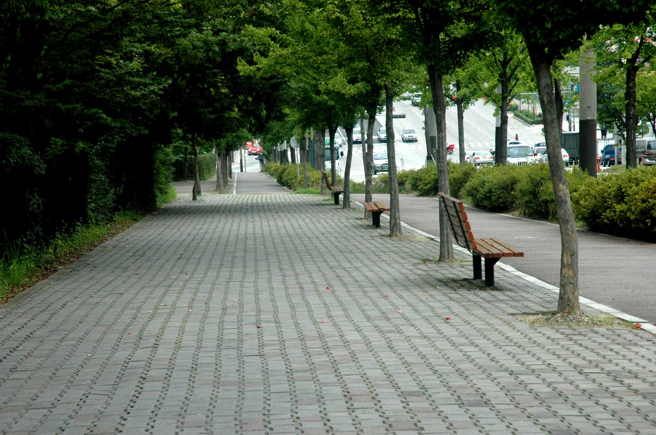
Current state of Dallas sidewalks
Dallas is currently one of the least walkable cities in the country and this provides a disparity for those who cannot afford to own a car or do not have the means to drive a vehicle or access other transportation
For a city like Dallas, walkable sidewalks are essential as the city grows in both size and diversity
According to Walkscore.com¹, Dallas’ walk score rating is 46.
This compares to cities such as New York, Boston, and San Francisco which have Walk Scores between 81 and 89
While on par with peer cities such as Houston (49) and Austin (40), Dallas has the opportunity to tailor the infrastructure in place by upgrading areas that need improvement for those citizens who are in the most need
The city has added over $16.7M to the annual Street Services² budget in the past year and the most recent citizen survey places infrastructure improvement as the number one area of importance for Dallas residents
1.
2. Dallas city budget: http://financialtransparency.dallascityhall.com/Budget/proposed1516/proposed-fy15-16-BudgetBook.pdf

Slide 4
Potential approaches to training data Our plan is to either leverage the University of Maryland approach or design our own approach via the use of bounding boxes to feed those pixel boundaries into our dataset
1
2
University of Maryland
Summary: The project has collected and labeled images from Google StreetView with multiple classifiers, mostly binary markers of presence/absence of features. Additionally, this data source also enables the use of LIDAR data
Data: Already compiled 60,000 labeled images with data points contained in JSON structure
Manual approach
Summary: Our approach will take a series of training images from Google Streetview and complete 2 steps
Process:
Identify sidewalk feature in image
Encode specific features
Obstacles
Transitions
Harsh curbs
Identify non-sidewalk elements to mark as bad data
Bicycles/toys
Trash
Markers/cones
Humans

Slide 5
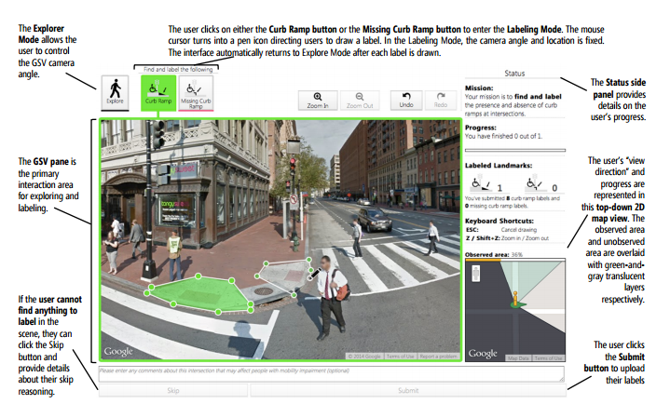
Project Sidewalk – University of Maryland Seeks to Document accessibility
Project combines Google Street View image data with crowd sourced labor to review intersections and document locations of curb cuts
Uses Java script online tool called “svLabel” to label features in images using a wire-frame style layer
Work in svLabel is followed by svDetect and svVerify to label additional images and then to verify outputs
SOURCE: Hara, Sun, Moore et al: “Tohme: Detecting Curb Ramps in Google Street View Using Crowdsourcing, Computer Vision, and Machine Learning.” UIST ‘13, Honolulu, HI.

Slide 6
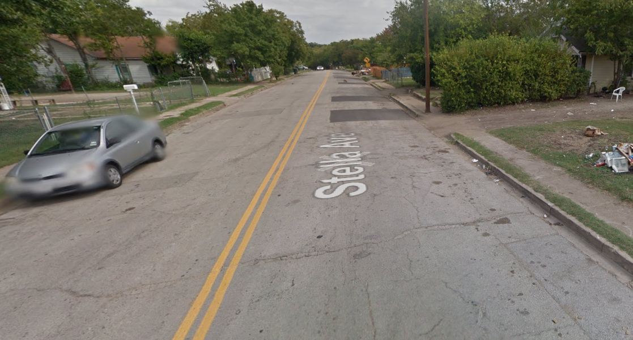
Details of the manual approach the manual approach will encode sidewalks first and then identify the key features that will help us determine the characteristics and ultimate grade of the sidewalk
1
Identify sidewalk
dog
2
Identify obstacles
(ex: telephone pole, shrub, etc)
car
3
Find and flag bad data

Slide 7
Data Sourcing
University of Maryland Project Sidewalk
Approximately 60,000 labels for Google Street View sourced images
Labels contain binary indication
Open Street Map/Mapzen
Open Street Map is a crowdsourced project that has most
Dallas OpenData 311 Requests
MapMyRun User GPS Tracks

Slide 8
Project Plan

Slide 9
Major steps
Creation of an adequate data set of labeled/wireframed images for training model
This is a lot of hands on time!
There’s probably a best method of performing this task, that we hope to uncover through prior research
Integration with prior data collection from UMD Project Sidewalk team
Existing base of ~67,000 labeled images
Design an image parser with small sample of data from previous step to feed the neural network
Learning the available convolutional neural network libraries/packages to train the model
Develop scalable, tuned neural network for recommendation engine

Slide 10
Hurdles and Challenges
Computing Power Requirements
Training of the Convolutional Neural Network requires repetitive processing of chunks of the image
Campus super computing resources will be needed
Image Storage for Training and Processing
Google SV images can be transitive, and not permanent. Using linked files versus warehoused means labeling might apply to an image no longer available
Created Box account to start the process, but realize that we may need a more robust source
Are underserved areas usually comprised of low-income or disadvantaged house holds?
Development of Sidewalk scoring methodology
Will require consultation with domain scoring experts

Slide 11
THANK YOU

