Slide 1

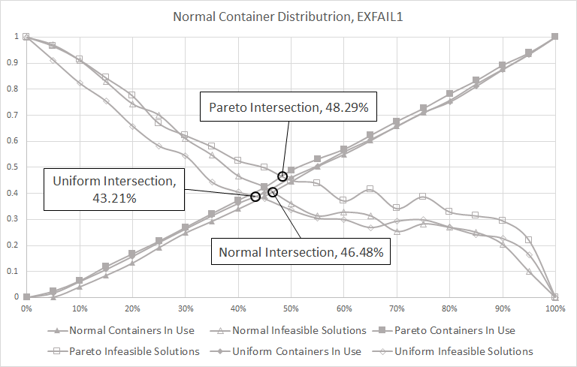
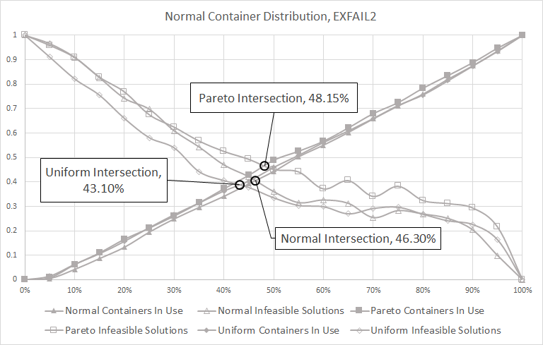
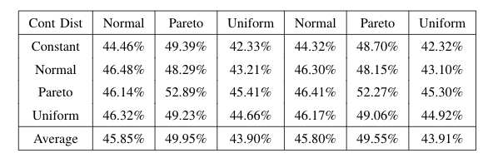
Detecting Accessibility Features from Street View Imagery
Andrew Abbott, Alex Deshowitz and Dennis Murray
Advisor: Dr. Eric Larson
Master of Science in Data Science
Southern Methodist University, Dallas, TX 75275, USA
DataScience@SMU
This side of the slide is probably the:
Background information (motivation)
Problem
Introduction
Image Sourcing and Preparation
This side of the slide is probably the:
Talking about the images, prep
Training the models
Measuring accuracy
Further steps
Nearly One in Five Americans is Disabled
Just more than ½ of intersections may have curb ramps in the direct travel path for all directions
Panoramic images were sourced from Google StreetView, as collected by the Project Sidewalk team from the University of Maryland
Main Topics
Can Image Classification and Object Detection algorithms replicate or replace in-person audits?
Do as I Say
This is simply a representation of what you should have in your poster.
Follow the template.
Keep font sizes as they are.
Work and be creative within the confines of this hot mess
When in doubt, ask.
Problem
Be sure to state your problem clearly
  You may use sub bullets
  These are good for simply listing requirements.
And you may have other information here
Motivation may or may not be in a separate box…depends on how you decide to lay out your poster
Not as I Do
This is not a very good story.
Your goal is to make this pretty and informative.
Tell your story and break some eggs, but just make sure you have accomplished the task of a poster.
Contents Tell a Story
The contents that you do include must tell a complete story.
Note that all the details in your paper do not necessarily show up in your poster
Be sure to properly motivate your problem too
Conclusions
The Convolutional Neural Network outperforms Logistic Regression for speed of Training
The Convolutional Neural Network produces a model that is 20% more accurate than logistic regression
Visualizations:
Accuracy comparison of models?
Loss function from Andrew’s model
Panoramic Image
Bounded Box cropped image
Image with object detection boxes

