Slide 1
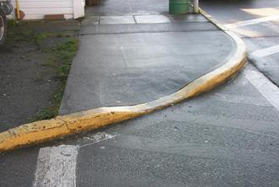
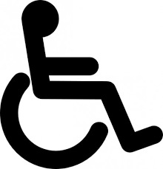
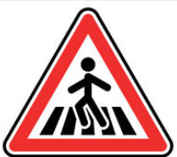

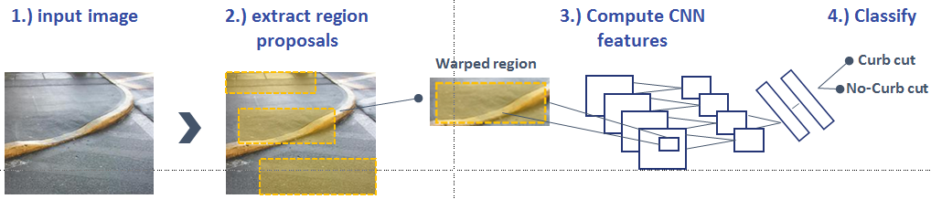

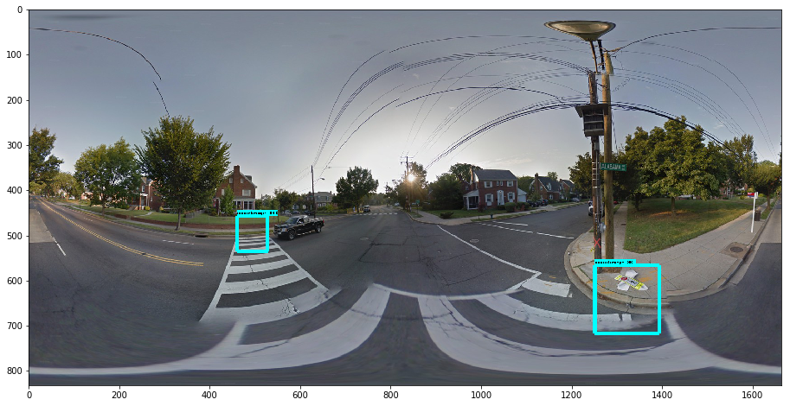

WalkNet: A Deep Learning Approach to Improving Sidewalk Quality and Accessibility
Andrew Abbott, Alex Deshowitz, and Dennis Murray
Advisor: Dr. Eric Larson
Master of Science in Data Science
Southern Methodist University, Dallas, TX 75275, USA
DataScience@SMU
Problem
Why machine learning failed
Municipalities and local governments lack an efficient process for optimally allocating sidewalk infrastructure spending
Mainly rely on word of mouth , community surveys, and spreadsheet based solves
Creates spending bias
Project overview
The machine learning models tested did a poor job of generalizing to new data once trained
The reason that these models performed so poorly is most likely due to the fact that very small portions of the images represented the “curb” versus “no-curb” cases
These small variations represent challenges for these types of models to identify
This side of the slide is probably the:
Talking about the images, prep
Training the models
Measuring accuracy
Further steps
Original Google Street View Panoramas
Project Sidewalk isolated curb cuts with bounding boxes
Why it matters?
Convolutional neural networks
Disproportionately impacts the handicapped
This puts pedestrians and cyclists at risk
Poor sidewalks only encourage sedentary living
Our winning model was a form of learning called convolutional neural networks (CNN)
These models iteratively learn the features of images getting more specific with each “layer”
Trained a series of models (machine vs. deep learning)
CNN proved to be the best model
The data
In order to solve this problem, a partnership with UMD’s Project sidewalk was established
Project sidewalk provided over 40 GB of crowd sourced sidewalk labels for use in classification models
Productionizing with TensorFlow
Now that a model was trained, we used the Object Detection API to feed panoramic images from Street View into a model that identified curbs
The curbs were then classified into “good” and “bad” categories
Productionized model with Object Detection API
The approach
This model allows areas of interest in any image to be classified and fed into apps and dashboards
Our approach was to first test a series of machine learning models and then move into deep learning
Conclusions and applications
The deep learning approach outperforms even the most robust machine learning models
This fully-trained model combined with the object detection API allows for any street for any city to be “graded”
This production-ready model can be applied to “hotspot” identification, navigation aid, and infrastructure improvement within major metropolitan areas
In the future, adding feature types is a goal
A
B
Machine learning
Deep learning
Logistic regression
Support vector machines
AdaBoost
Random forest
Artificial neural networks
Convolutional neural networks
Pre-trained networks

