Slide 1
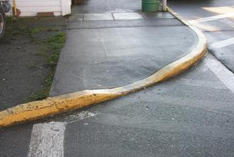
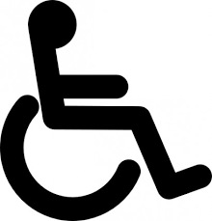
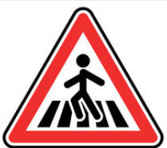

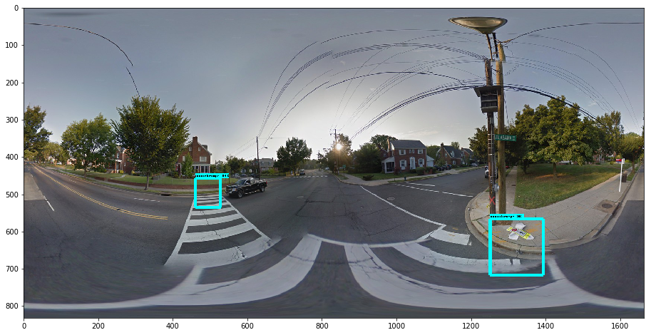
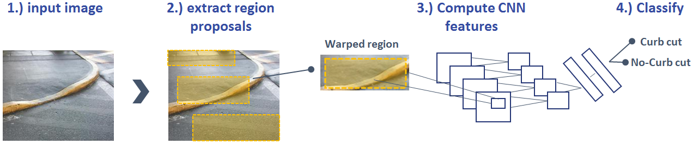

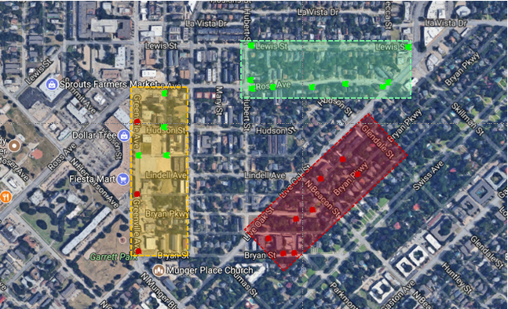
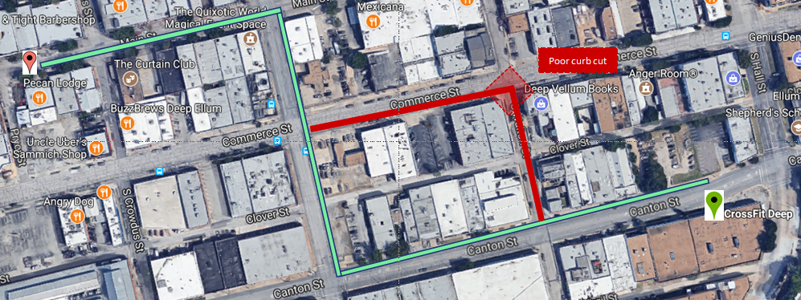

WalkNet: A Deep Learning Approach to Improving Sidewalk Quality and Accessibility
Andrew Abbott, Alex Deshowitz, and Dennis Murray
Advisor: Dr. Eric Larson
Master of Science in Data Science
Southern Methodist University, Dallas, TX 75275, USA
DataScience@SMU
Problem
Why machine learning failed
Municipalities and local governments lack an efficient process for optimally allocating sidewalk infrastructure spending
Mainly rely on word of mouth , community surveys, and spreadsheet based solves
Creates spending bias
Project overview
The machine learning models tested did a poor job of generalizing to new data once trained
The reason that these models performed so poorly is most likely due to the fact that very small portions of the images represented the “curb” versus “no-curb” cases
These small variations represent challenges for these types of models to identify
This side of the slide is probably the:
Talking about the images, prep
Training the models
Measuring accuracy
Further steps
Original Google Street View Panoramas
Project Sidewalk isolated curb cuts with bounding boxes
Why it matters?
Convolutional neural networks
Disproportionately impacts the handicapped
This puts pedestrians and cyclists at risk
Poor sidewalks only encourage sedentary living
Our winning model was a form of learning called convolutional neural networks (CNN)
These models iteratively learn the features of images getting more specific with each “layer”
Picked most accurate model
Productionized with object detection API
The data
In order to solve this problem, a partnership with UMD’s Project sidewalk was established
Project sidewalk provided over 40 GB of crowd sourced sidewalk labels for use in classification models
Productionizing with TensorFlow
The Project Sidewalk data was good if curbs were previously cut from panoramic images, but this is not practical going forward
Now that a model was trained, we used the Object Detection API to feed panoramic images from Street View into a model that identified curbs
The curbs were then classified as “good” and “bad” using the original model
Implementation in various applications:
The approach
Heat mapping problem areas for cities
Route optimization
Our approach was to first test a series of machine learning models and then move into deep learning
Conclusions and applications
The deep learning approach outperforms even the most robust machine learning models
This fully-trained model combined with the object detection API allows for any street in any city to be “graded”
This production-ready model can be applied to “hotspot” identification, navigation aid, and infrastructure improvement within major metropolitan areas
In the future, adding feature types is a goal
A
B
Machine learning
Deep learning
Logistic regression
Support vector machines
AdaBoost
Random forest
Artificial neural networks
Convolutional neural networks
Pre-trained networks

