Slide 1
PROJECT CHE4230

Slide 2
PCA

Slide 3
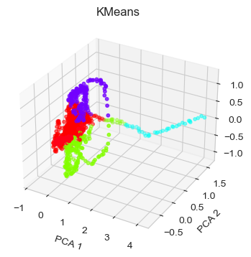
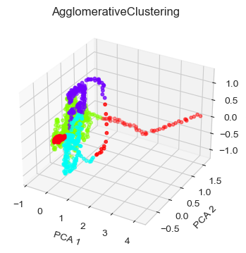
Kmeans & AgglomerativeClustering

Slide 4
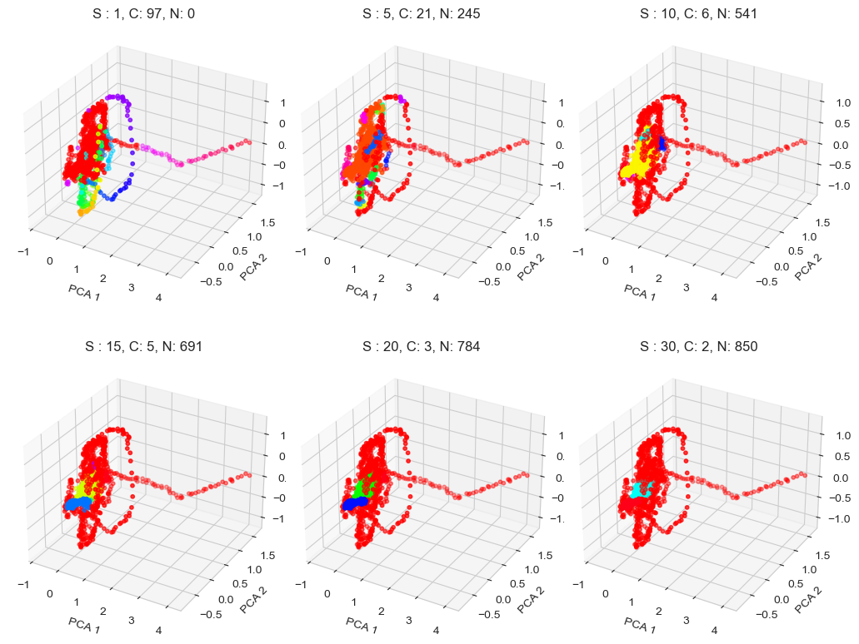
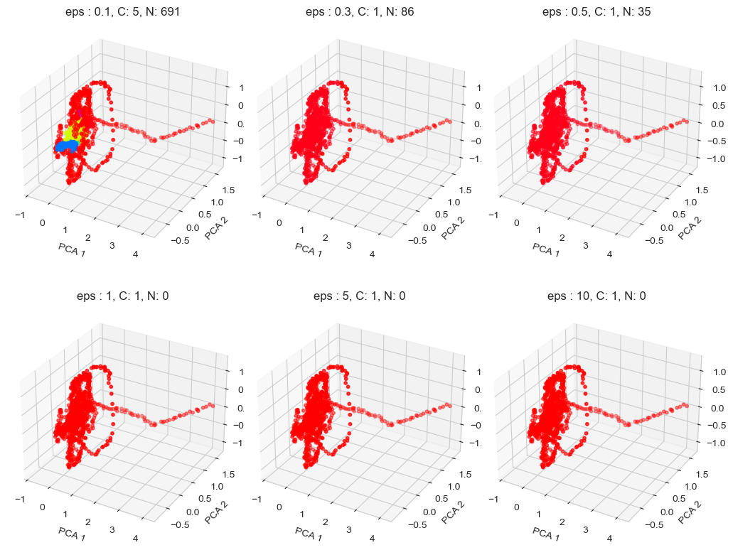
DBSCAN
Final:
1) eps: 0.1
2) min_samples: 15
Fig. 2: Effect maximum distance between two samples for one to be considered as in the neighborhood of the other. Set min_samples = 15
Fig. 1: Effect of minimum samples in a neighborhood:
Set eps = 0.1

Slide 5
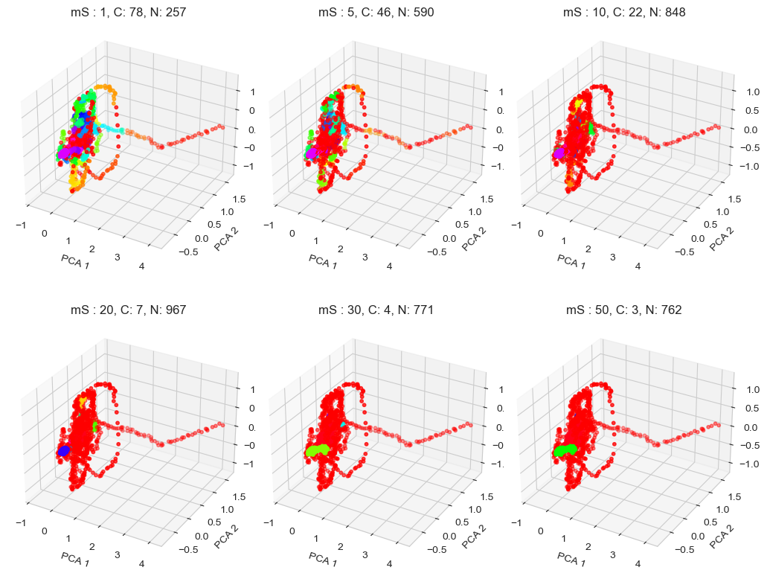
HDBSCAN
Final:
1) min_cluster_size: 5
2) min_samples: 28
Fig. 1: Effect of minimum samples in a neighborhood:
Set min_cluster_size = 5
Fig. 2: Effect of min_cluster_size in a single scluster:
Set min_samples = 5

Slide 6
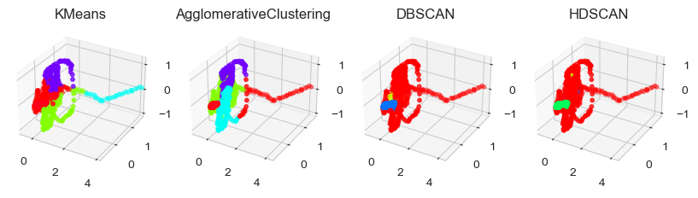
PCA-All
Fig. 1: Effect of minimum samples in a neighborhood:
Set eps = 0.1

Slide 7
tSNE

Slide 8
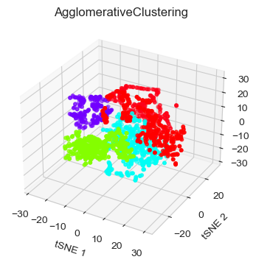
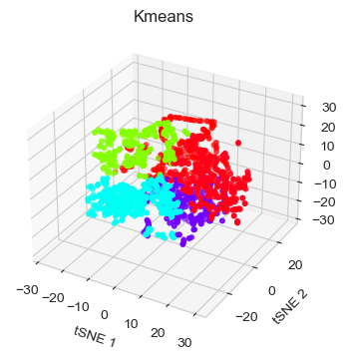
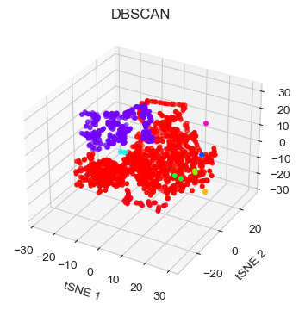
tSNE
Fig. 1: Effect of minimum samples in a neighborhood:
Set eps = 0.1

Slide 9
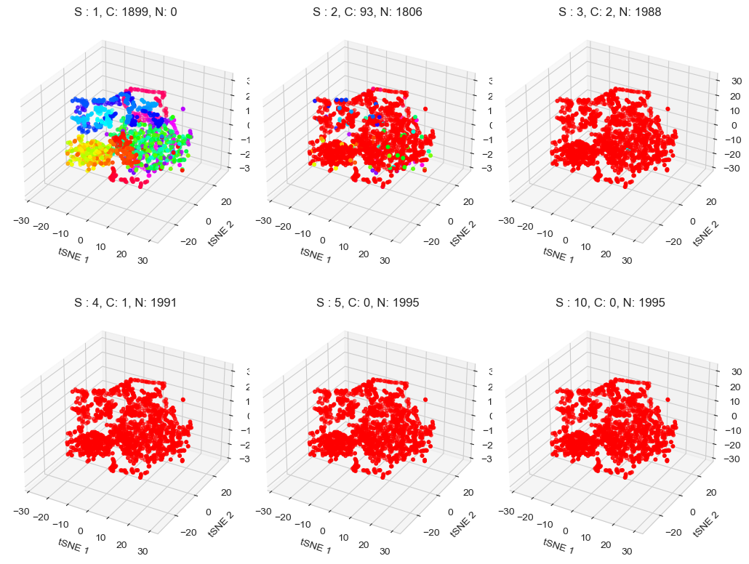
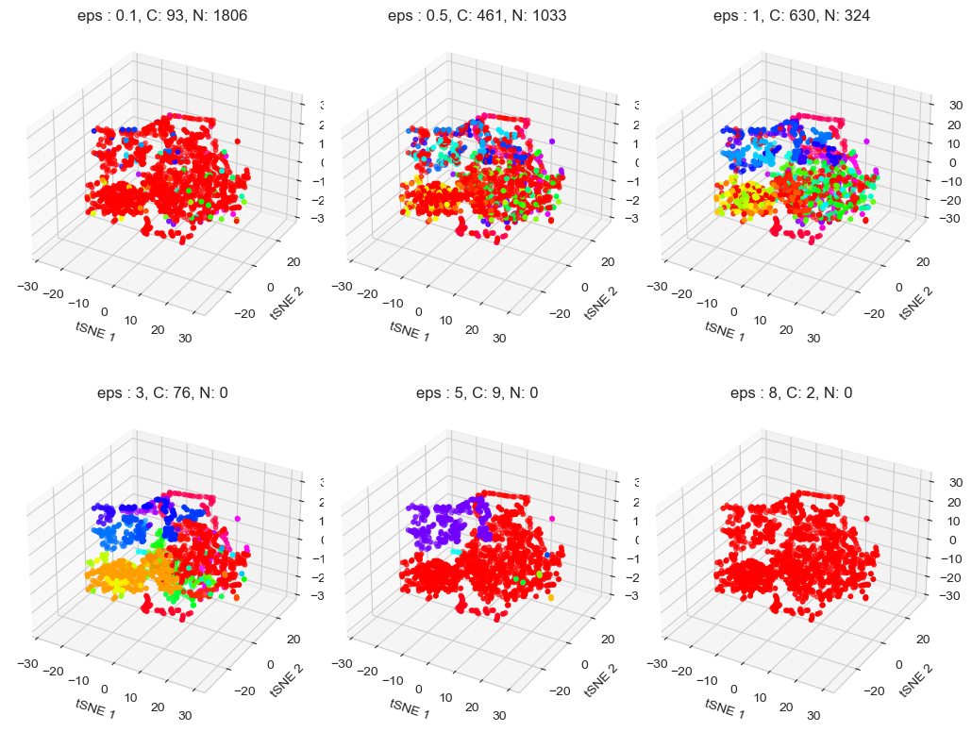
DBSCAN
Final:
1) eps: 5
2) min_samples: 2
Fig. 2: Effect maximum distance between two samples for one to be considered as in the neighborhood of the other. Set min_samples = 2
Fig. 1: Effect of minimum samples in a neighborhood:
Set eps = 0.1

Slide 10
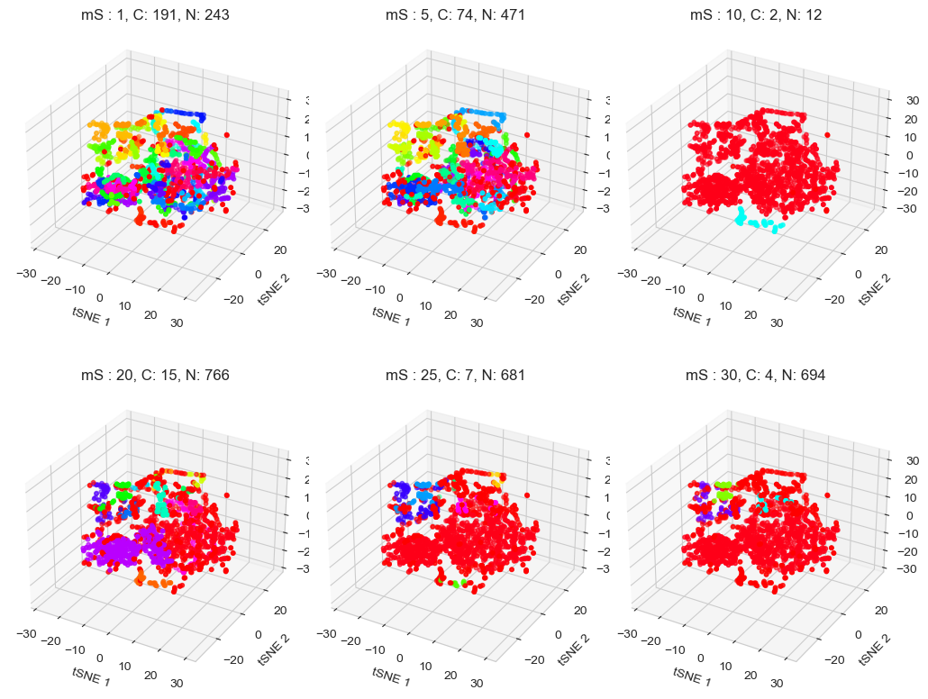
HDBSCAN
Final:
1) min_cluster_size: 5
2) min_samples: 22
Fig. 1: Effect of minimum samples in a neighborhood:
Set eps = 0.1

Slide 11
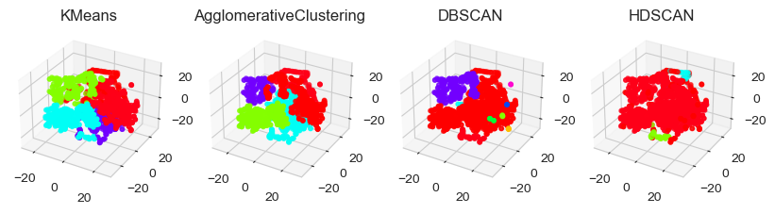
tSNE-All

Slide 12
ISOMAP

Slide 13
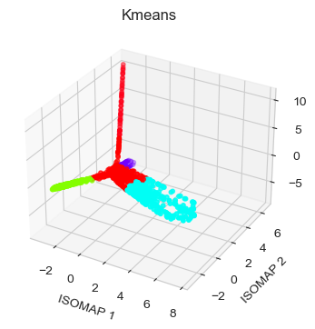
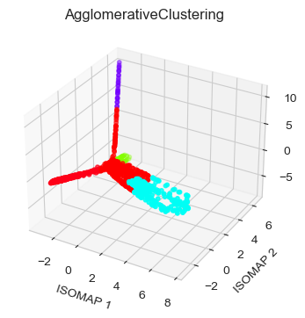

Slide 14
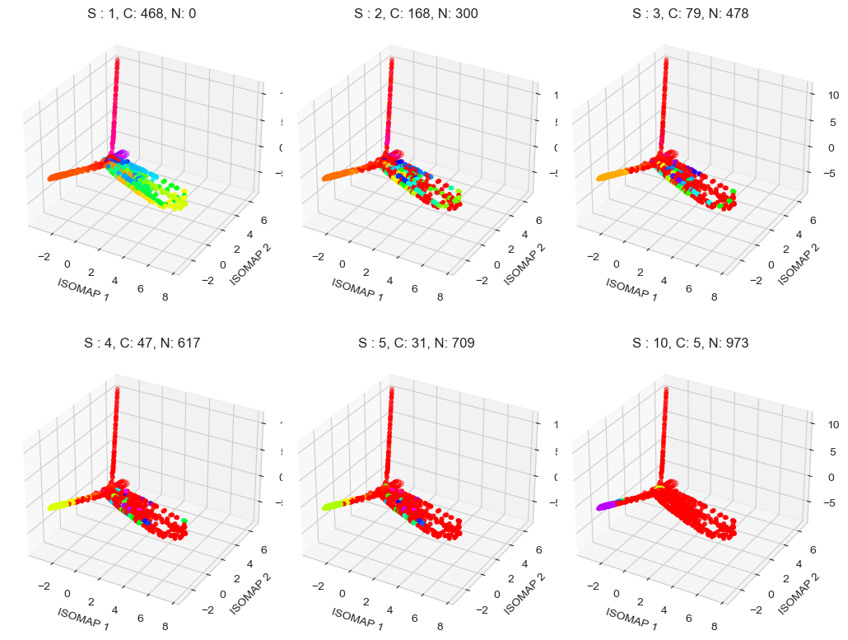
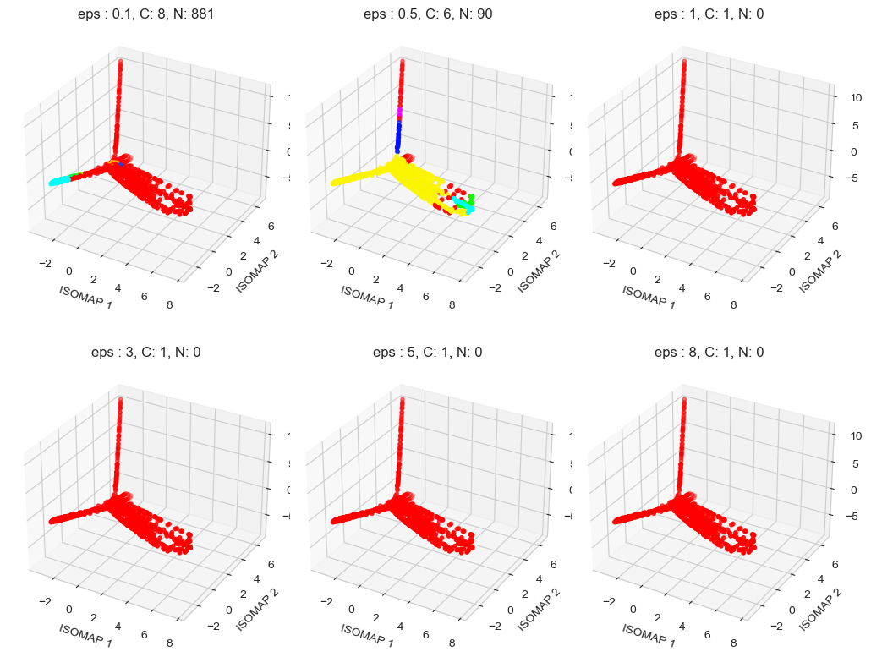
DBSCAN
Final:
1) eps: 0.5
2) min_samples: 7
Fig. 2: Effect maximum distance between two samples for one to be considered as in the neighborhood of the other. Set min_samples = 7
Fig. 1: Effect of minimum samples in a neighborhood:
Set eps = 0.1

Slide 15
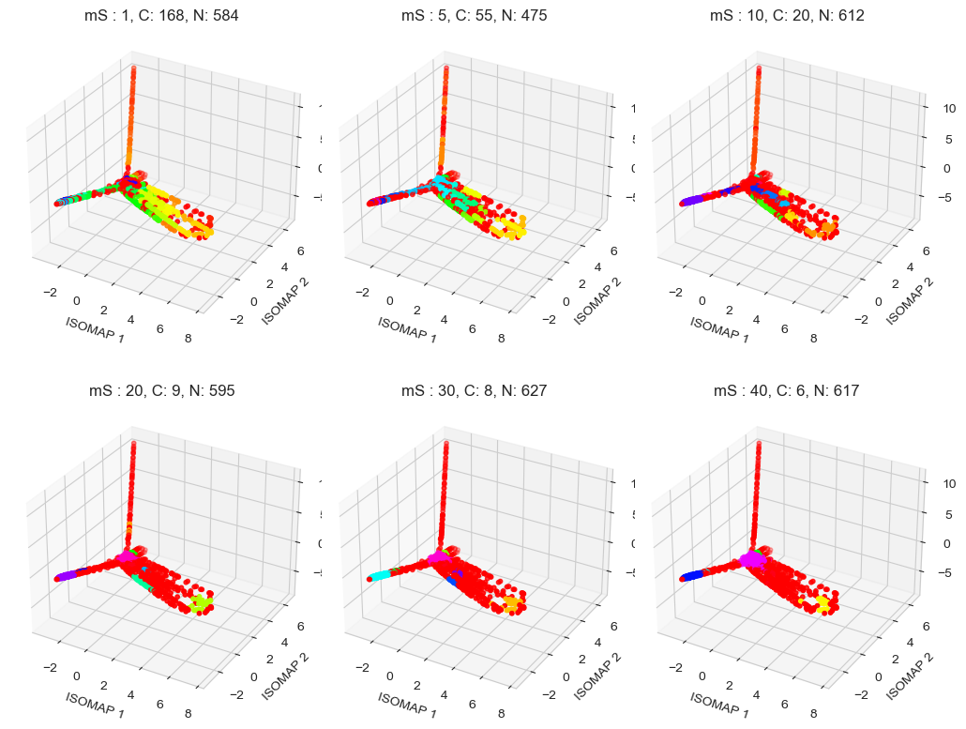
HDBSCAN
Final:
1) min_cluster_size: 5
2) min_samples: 40

Slide 16
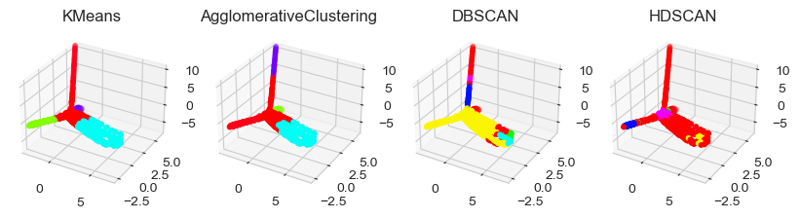
ISOMAP-All

Slide 17
Fast ICA

Slide 18
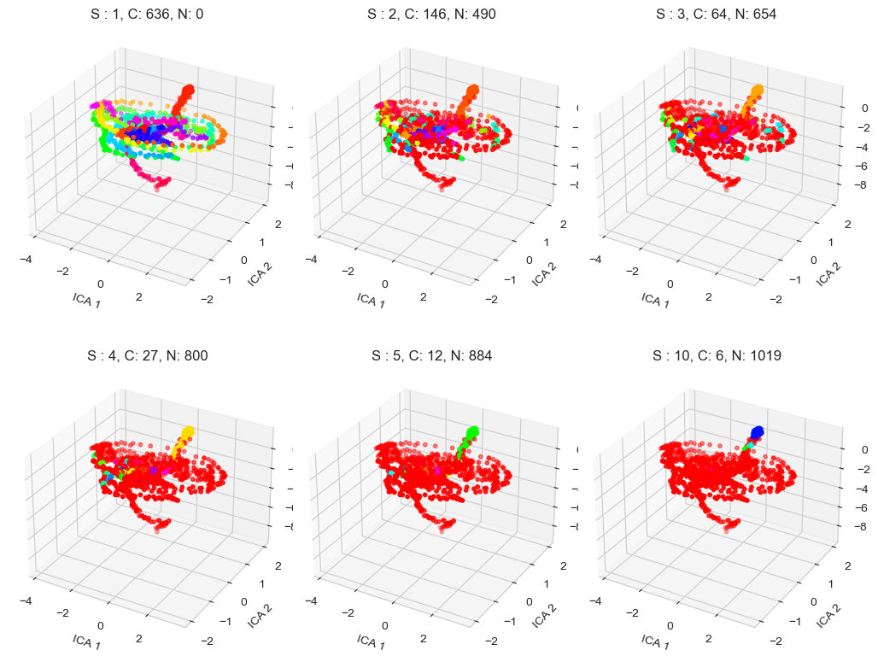
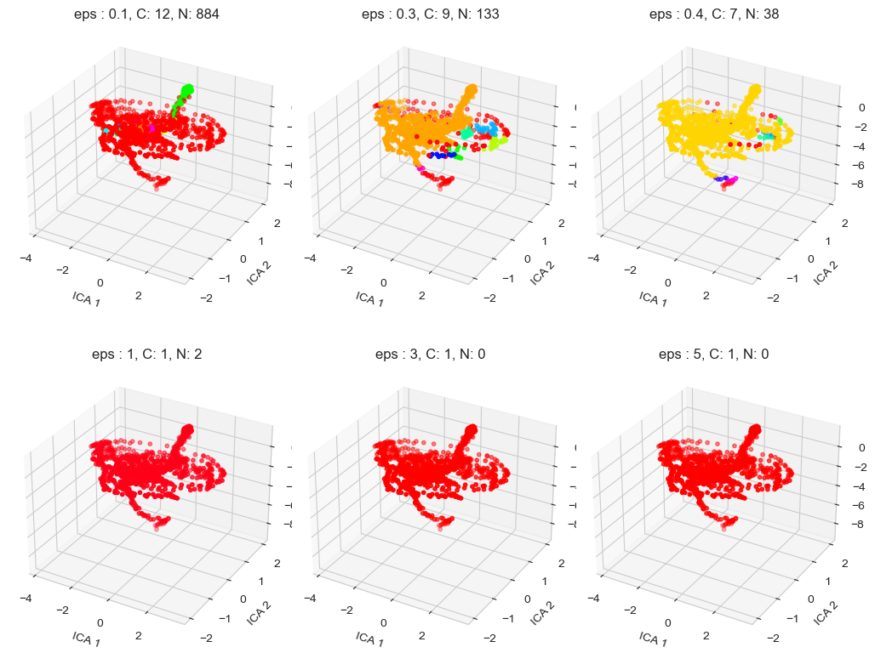
DBSCAN
Final:
1) eps: 0.4
2) min_samples: 5
Fig. 2: Effect maximum distance between two samples for one to be considered as in the neighborhood of the other. Set min_samples = 5
Fig. 1: Effect of minimum samples in a neighborhood:
Set eps = 0.1

Slide 19
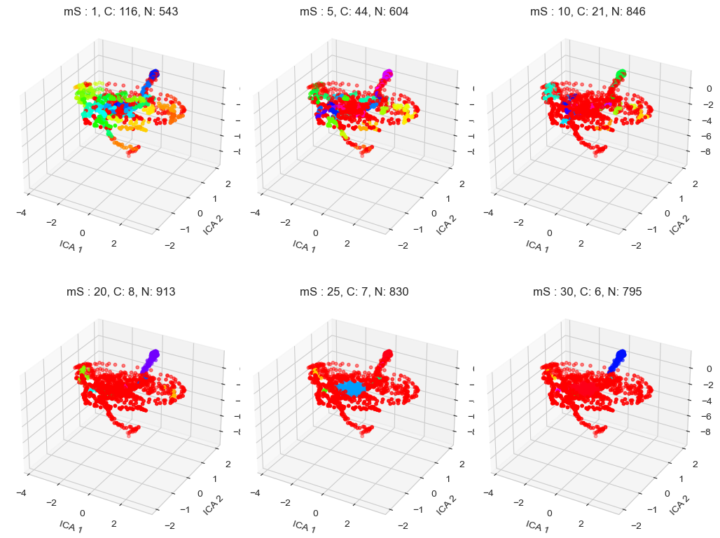
HDBSCAN
Final:
1) min_cluster_size: 5
2) min_samples: 22

Slide 20
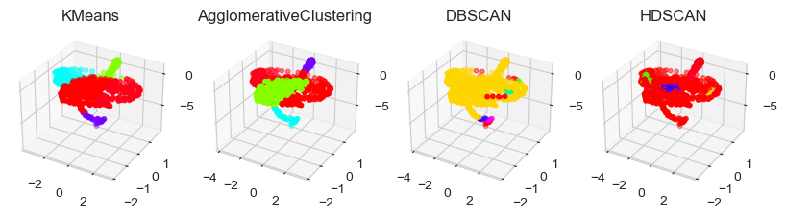
ICA-All

Slide 21
Spectral Embedding

Slide 22
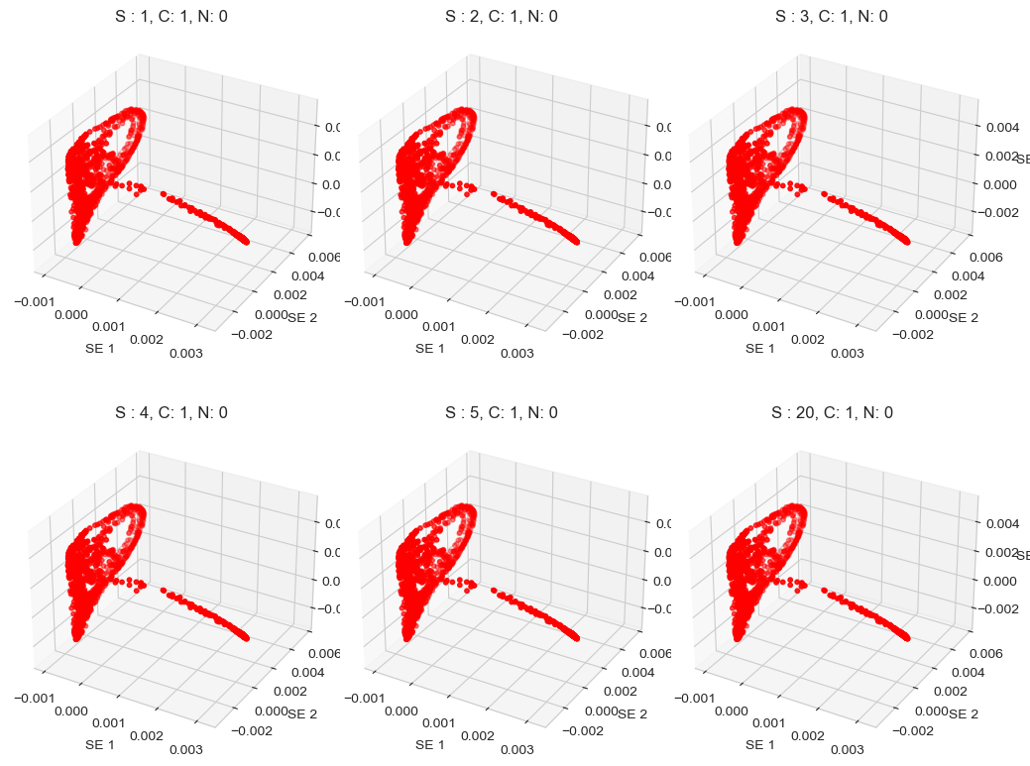

DBSCAN
Final:
1) eps: 0.4
2) min_samples: 5
Fig. 2: Effect maximum distance between two samples for one to be considered as in the neighborhood of the other. Set min_samples = 5
Fig. 1: Effect of minimum samples in a neighborhood:
Set eps = 0.1

Slide 23
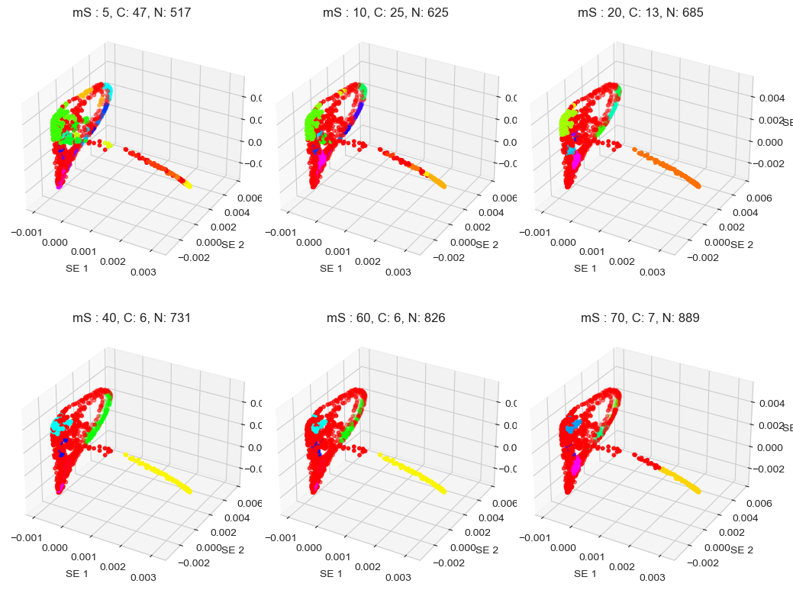
HDBSCAN
Final:
1) min_cluster_size: 5
2) min_samples: 38

Slide 24
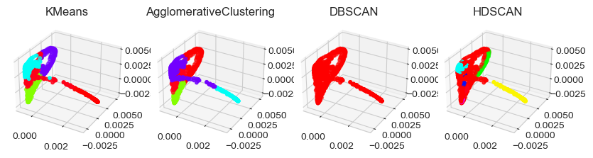
SE-All

Slide 25
PCA
tSNE
ICA
ISOMAP
S Embed

