Slide 1
PROJECT CHE4230

Slide 2
PCA

Slide 3
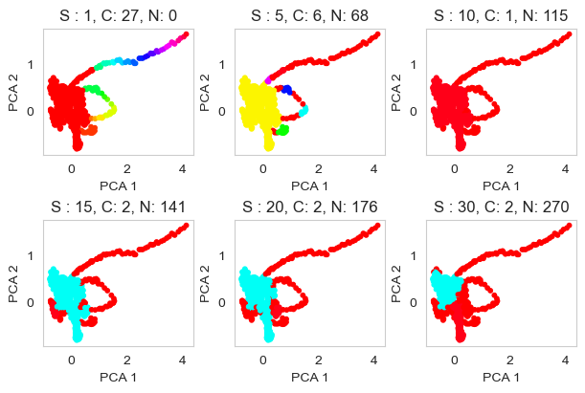
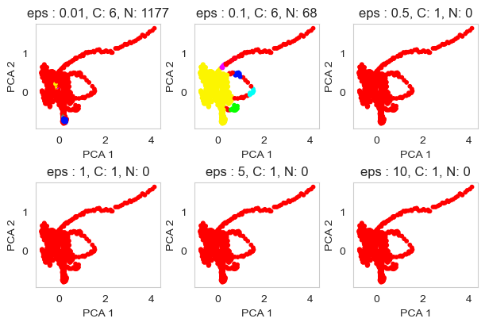
DBSCAN
Final:
1) eps: 0.1
2) min_samples: 5
Fig. 2: Effect maximum distance between two samples for one to be considered as in the neighborhood of the other. Set min_samples = 5
Fig. 1: Effect of minimum samples in a neighborhood:
Set eps = 0.1

Slide 4
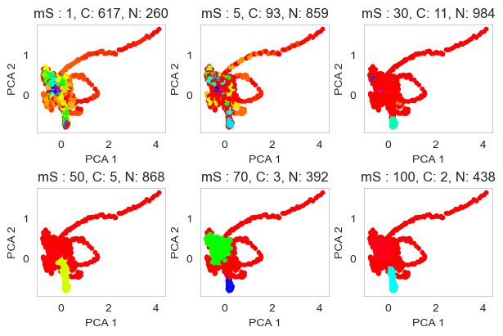
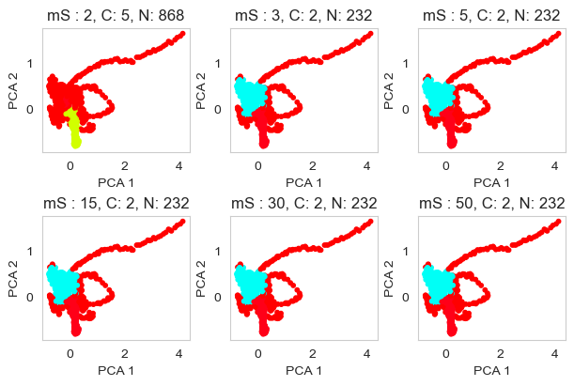
HDBSCAN
Final:
1) min_cluster_size: 3
2) min_samples: 50
Fig. 1: Effect of minimum samples in a neighborhood:
Set min_cluster_size = 2
Fig. 2: Effect of min_cluster_size in a single scluster:
Set min_samples = 50

Slide 5
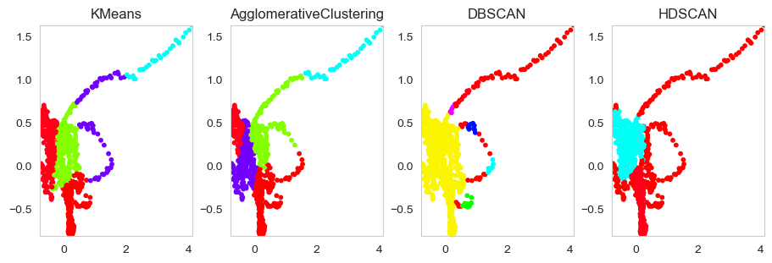
PCA-All

Slide 6
tSNE

Slide 7
tSNE
Fig. 1: Effect of minimum samples in a neighborhood:
Set eps = 0.1

Slide 8
DBSCAN
Final:
1) eps: 5
2) min_samples: 2
Fig. 2: Effect maximum distance between two samples for one to be considered as in the neighborhood of the other. Set min_samples = 2
Fig. 1: Effect of minimum samples in a neighborhood:
Set eps = 0.1

Slide 9
HDBSCAN
Final:
1) min_cluster_size: 5
2) min_samples: 22
Fig. 1: Effect of minimum samples in a neighborhood:
Set eps = 0.1

Slide 10
tSNE-All

Slide 11
ISOMAP

Slide 12
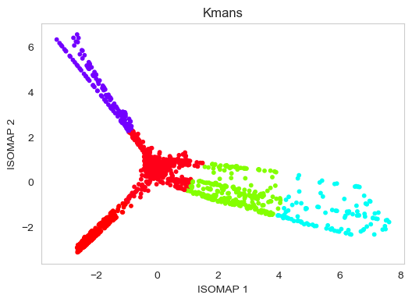
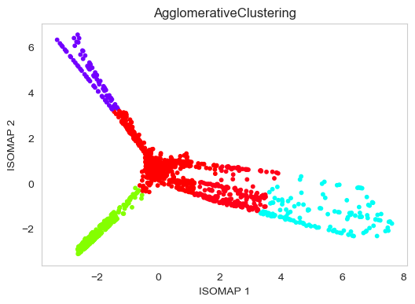

Slide 13
DBSCAN
Final:
1) eps: 0.5
2) min_samples: 7
Fig. 2: Effect maximum distance between two samples for one to be considered as in the neighborhood of the other. Set min_samples = 7
Fig. 1: Effect of minimum samples in a neighborhood:
Set eps = 0.1

Slide 14
HDBSCAN
Final:
1) min_cluster_size: 5
2) min_samples: 40

Slide 15
ISOMAP-All

Slide 16
Fast ICA

Slide 17
DBSCAN
Final:
1) eps: 0.4
2) min_samples: 5
Fig. 2: Effect maximum distance between two samples for one to be considered as in the neighborhood of the other. Set min_samples = 5
Fig. 1: Effect of minimum samples in a neighborhood:
Set eps = 0.1

Slide 18
HDBSCAN
Final:
1) min_cluster_size: 5
2) min_samples: 22

Slide 19
ICA-All

Slide 20
Spectral Embedding

Slide 21
DBSCAN
Final:
1) eps: 0.4
2) min_samples: 5
Fig. 2: Effect maximum distance between two samples for one to be considered as in the neighborhood of the other. Set min_samples = 5
Fig. 1: Effect of minimum samples in a neighborhood:
Set eps = 0.1

Slide 22
HDBSCAN
Final:
1) min_cluster_size: 5
2) min_samples: 38

Slide 23
SE-All

Slide 24
PCA
tSNE
ICA
ISOMAP
S Embed

