Slide 1
PROJECT CHE4230

Slide 2
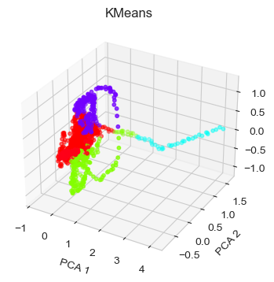
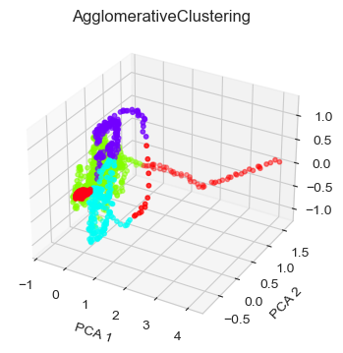
Kmeans & AgglomerativeClustering

Slide 3
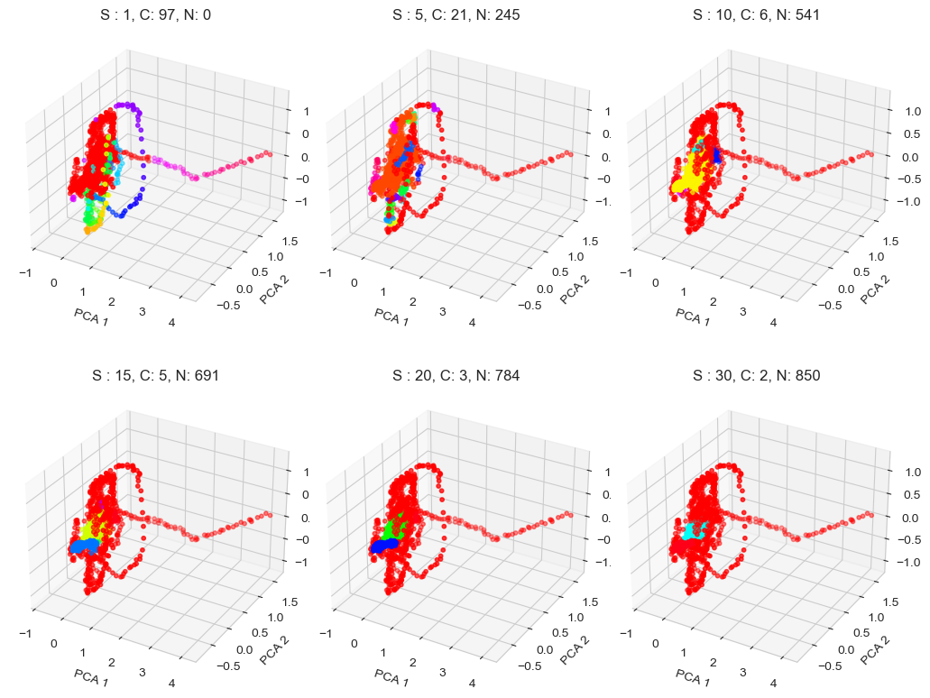
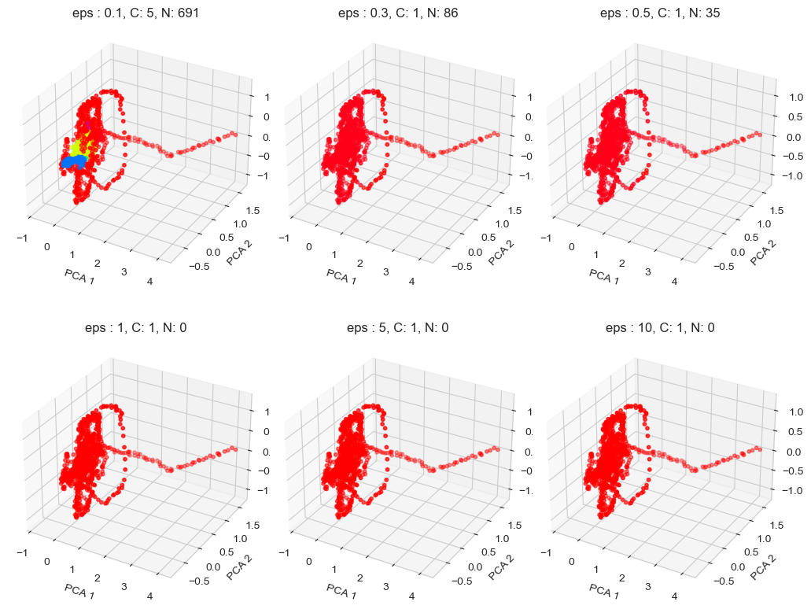
DBSCAN
Final:
1) eps: 0.1
2) min_samples: 15
Fig. 2: Effect maximum distance between two samples for one to be considered as in the neighborhood of the other. Set min_samples = 15
Fig. 1: Effect of minimum samples in a neighborhood:
Set eps = 0.1

Slide 4
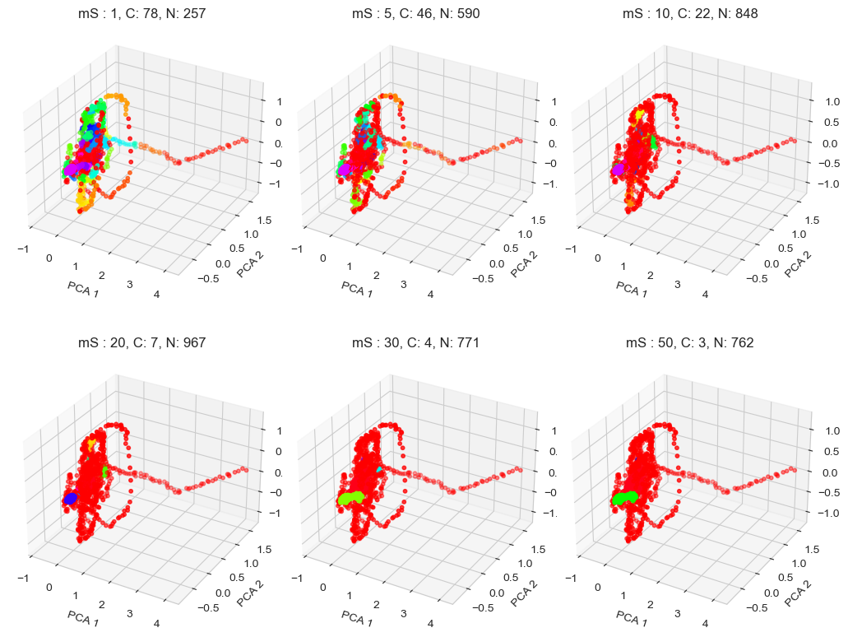
HDBSCAN
Final:
1) min_cluster_size: 5
2) min_samples: 28
Fig. 1: Effect of minimum samples in a neighborhood:
Set eps = 0.1

Slide 5
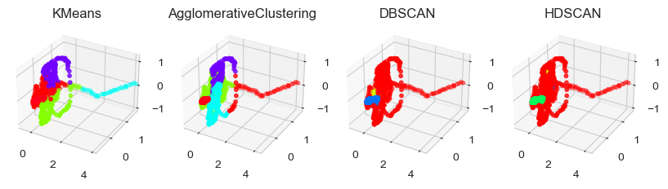
PCA
Fig. 1: Effect of minimum samples in a neighborhood:
Set eps = 0.1

Slide 6
tSNE
Fig. 1: Effect of minimum samples in a neighborhood:
Set eps = 0.1

