Slide 1
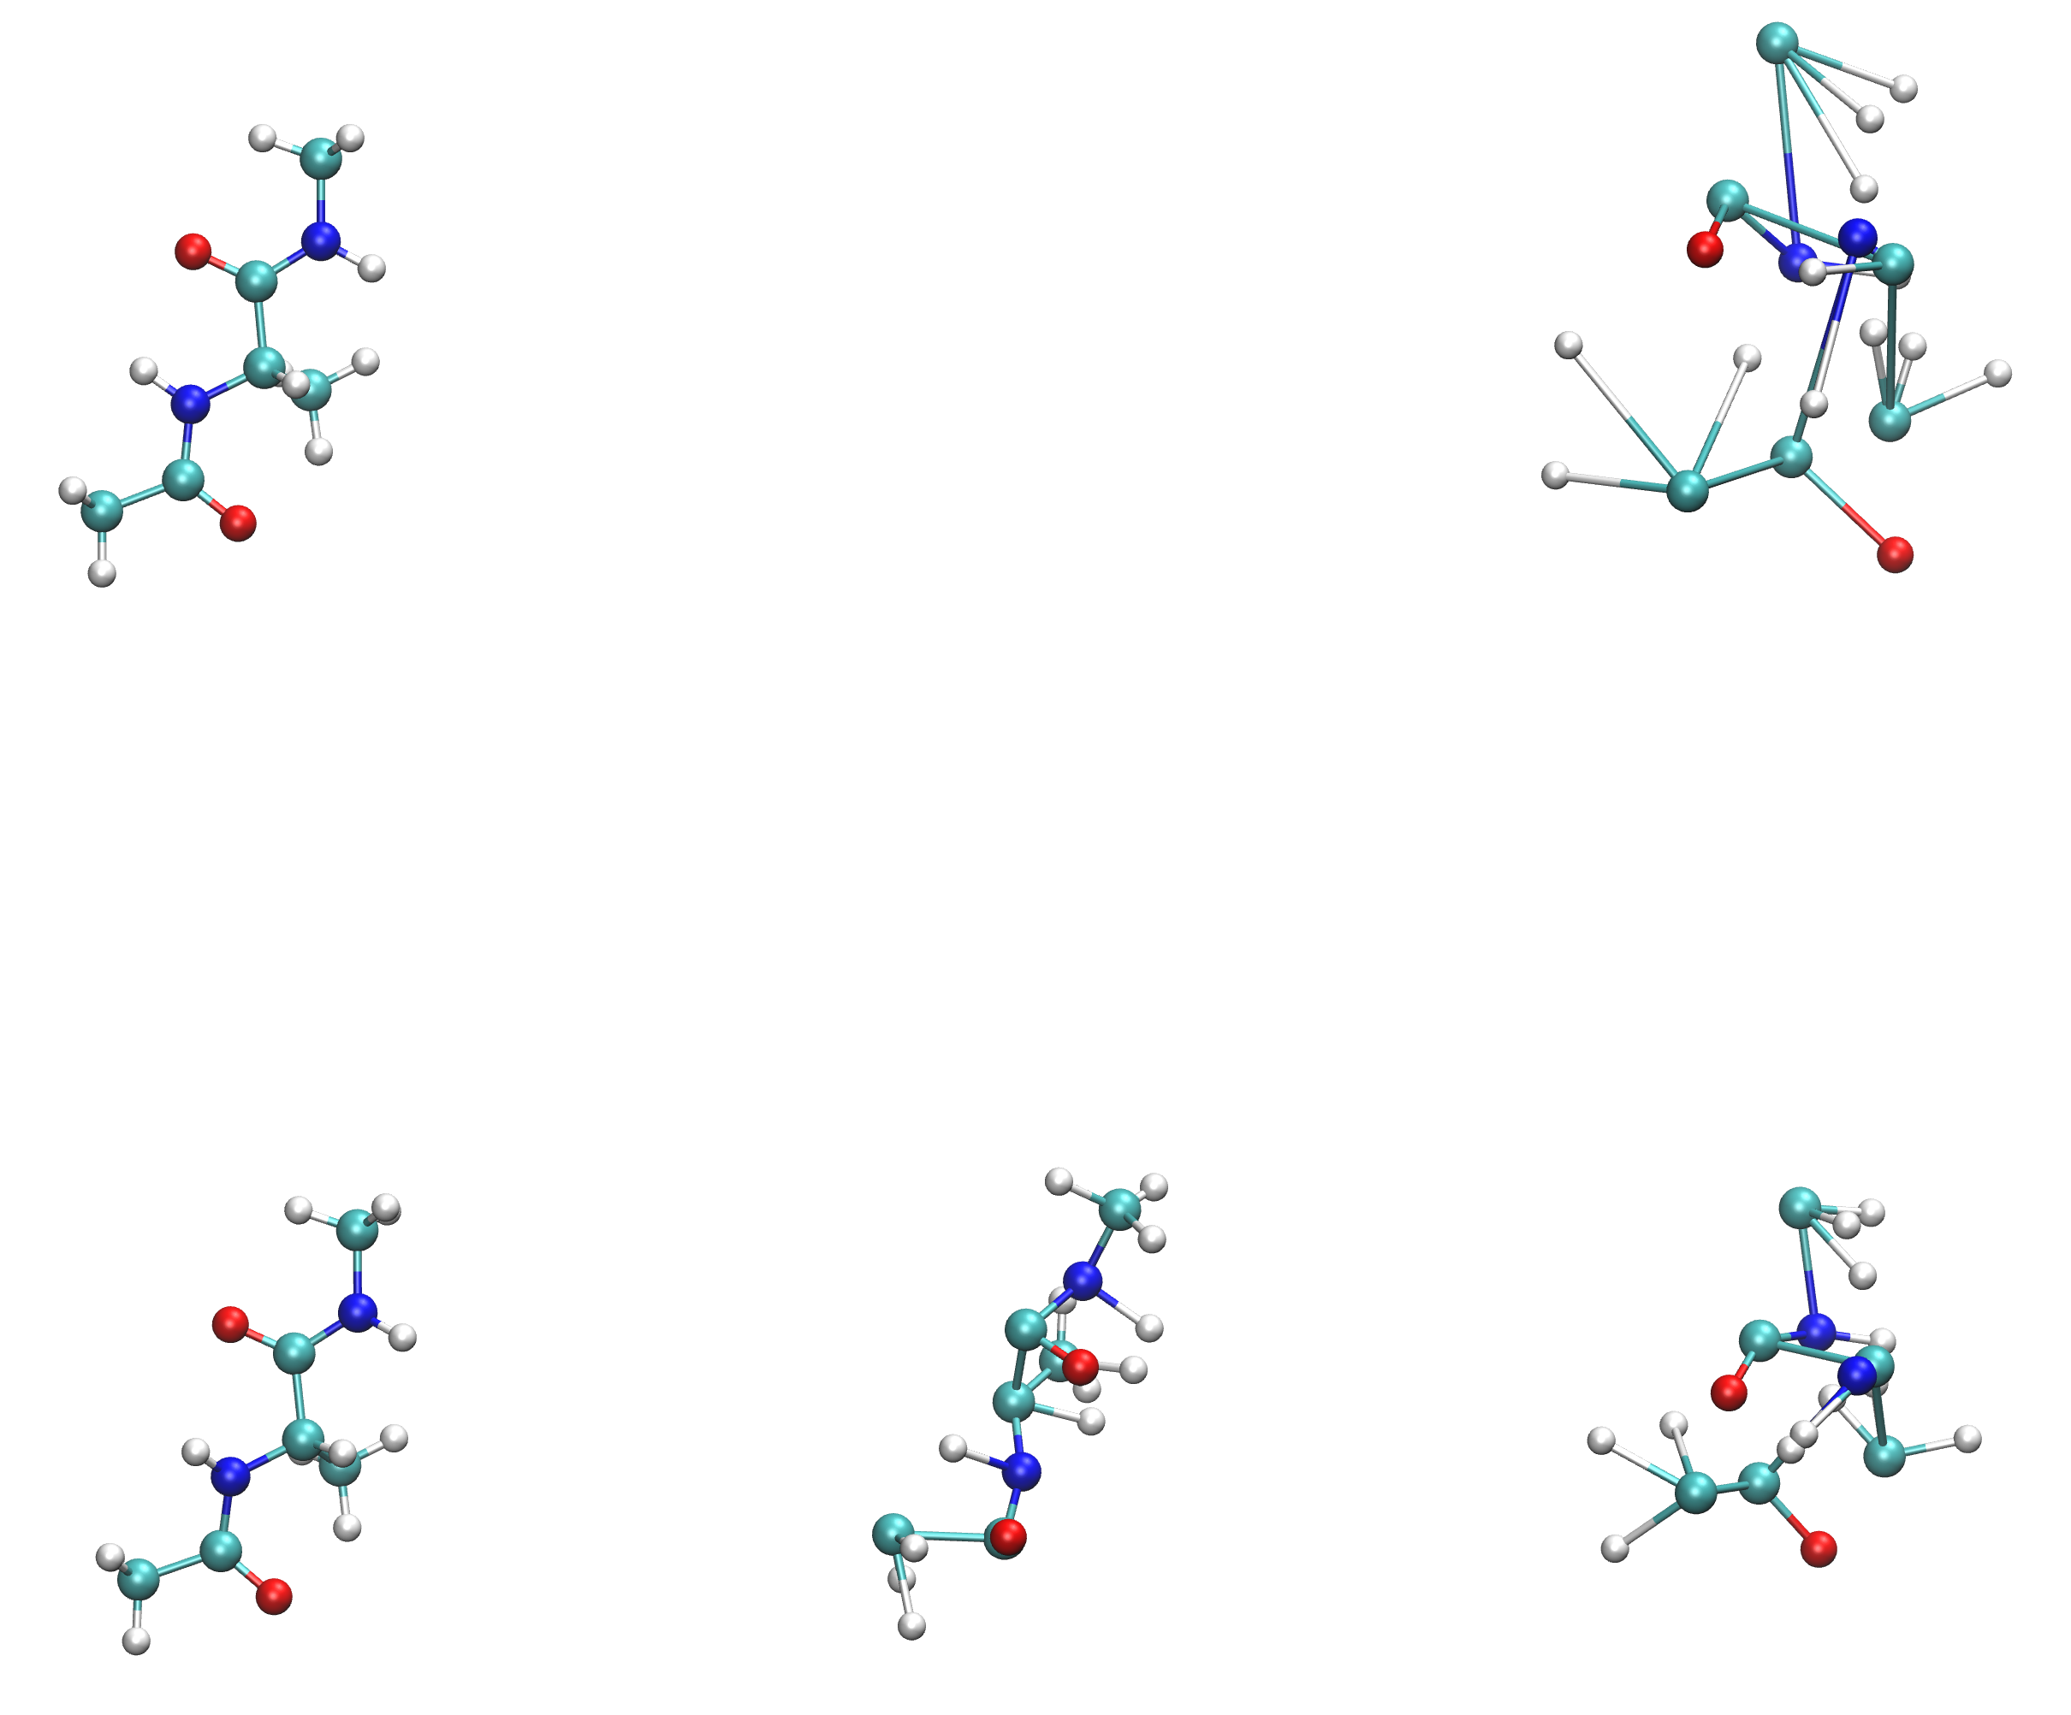
initial
Perturbation
perturbed
Reconstruction
recovered
iter 100
iter 2
iter 1

