Slide 1
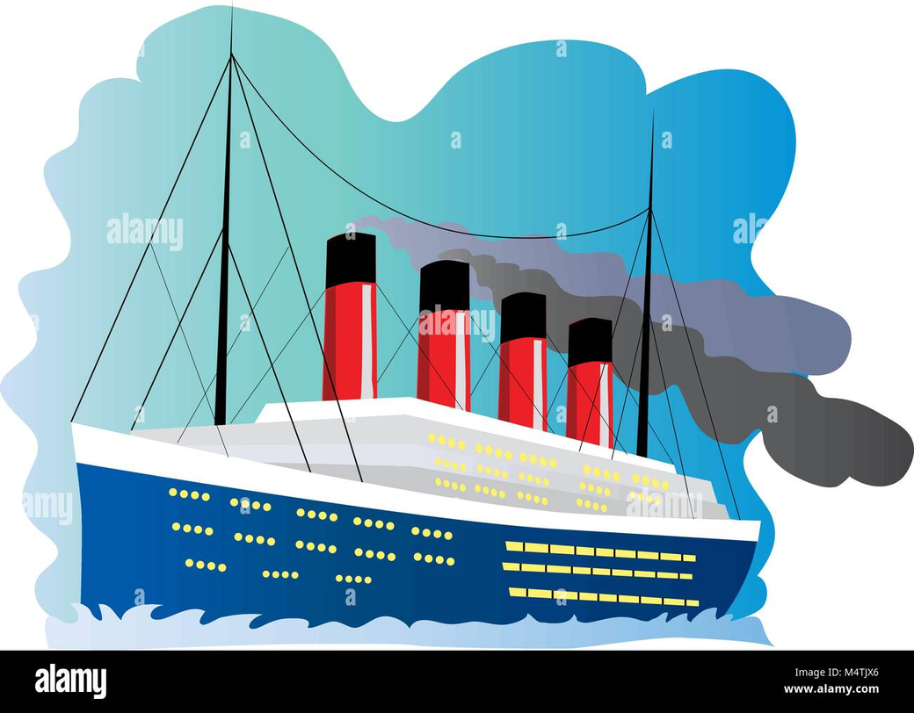
TITANIC SURVIVAL MODEL
Who Would Have Survived? Predicting Titanic Passenger Survival with Machine Learning
Ana Botchorishvili

Slide 2
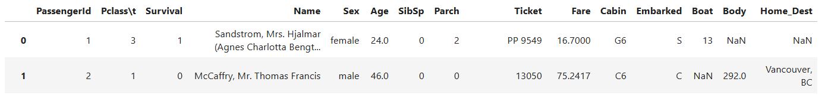
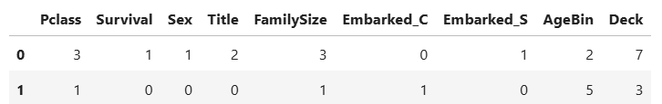
INTRODUCTION
The 1912 Titanic disaster claimed over 1,500 lives. Using machine learning, we predict passenger survival based on features like class, age, gender, fare, and family connections.
DATA BEFORE TREATMENT:
AFTER TREATMENT:
AFTER FEATURE SELECTION:
PROBLEMS IN THE TITANIC DATASET
  Missing Data
  Categorical Data
  Class Imbalance
  Outliers in Fare & Age
  Feature Correlation & Engineering
  Potential Data Leakage

Slide 3
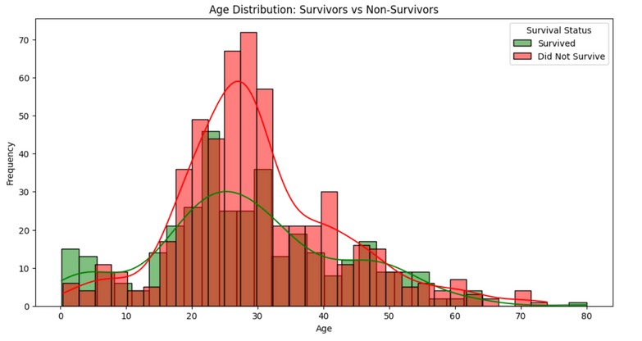
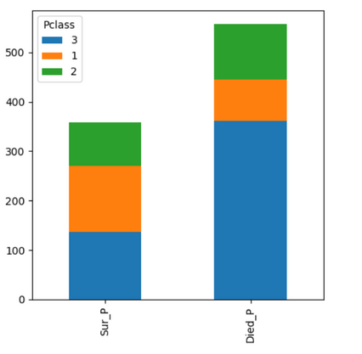
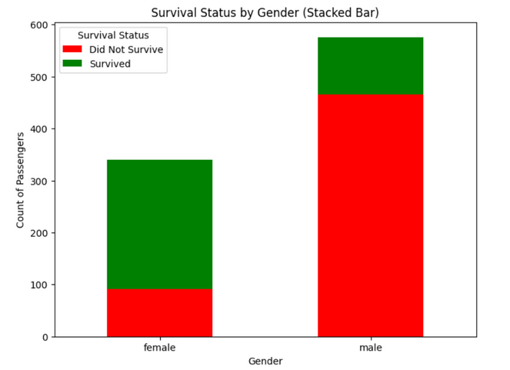
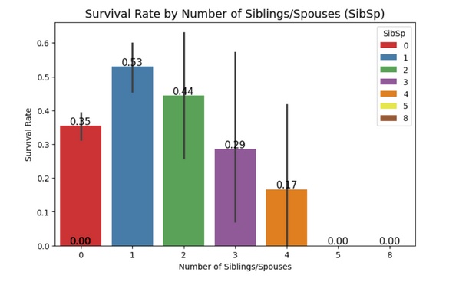
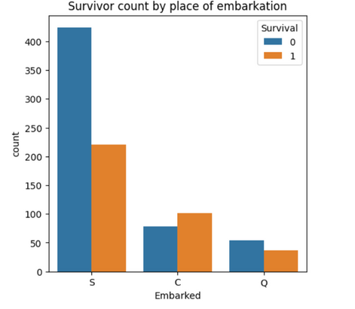
DATA EXPLORATION
Data preprocessing steps
Because the dataset contains many missing Age values, I decided to fill them using an XGBoost Regressor based on other features, which helped improve performance.
  Handling missing values (age, embarked, cabin)
  Encoding categorical variables
  Feature scaling where necessary(create bins)
Key Findings
  Survival Imbalance: 38% survived.
  Sex: Higher survival for females (74%) than males (19%).
  Pclass: First-class (63%) survived most, third-class (24%) least.
  Age: Younger passengers had better survival; an 80-year-old also survived.
  Embarked: Highest survival at Cherbourg (55%).
  Family: Small families fared better; solo travelers had lower survival.

Slide 4
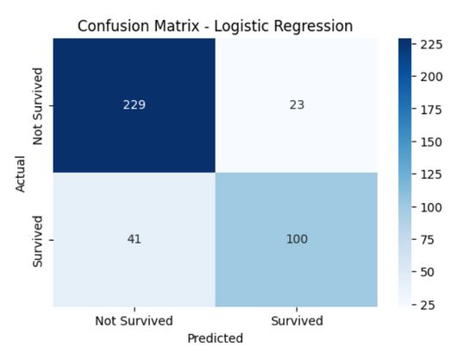
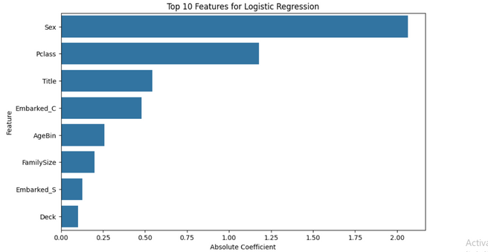
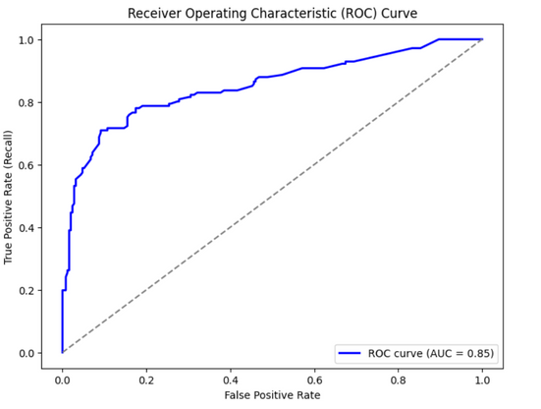
MODELING SELECTION
Tested as an alternative: XGBoost.
Model Chosen: Logistic Regression
Reasons
Well-suited for binary classification problems like survival prediction.
Provides probability scores for each prediction, aiding analysis.
Delivered solid performance, achieving 83.72% accuracy, 81.3% precision, 70.92% recall, and an F1-score of 0.7576
Training Process
Applied feature scaling to improve performance.
Evaluated using accuracy, precision, recall, and F1-score.
The model was evaluated using ROC curve and AUC score[ 0.8501] to assess its classification performance.
EXAMINED TWO METHODS: LOGISTIC REGRESSION AND XGBOOST.
KAGLLE SCORE: 0.85279

Slide 5
🚀 CONCLUSION
Handling Missing Data:
    Age: Missing Age values were filled using an XGBoost model, which predicted ages based on other features, improving model performance.
Key Insights:
    Females and first-class passengers had higher survival rates. Higher fares and smaller families improved survival chances.
Model Used:
    Logistic Regression was chosen for predicting survival due to its simplicity, interpretability, and solid performance.

Slide 6
THANK YOU! 🚀😊

