Slide 1
UCB - CS189 Introduction to Machine Learning Fall 2015 Lecture 8: Kernel machines
Isabelle Guyon
ChaLearn

Slide 2
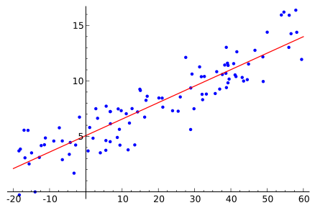
Come to my office hours… Wed 2:30-4:30 Soda 329
Last time
w₁
w₂
Σ
w_{D}
b
Linear regression

Slide 3
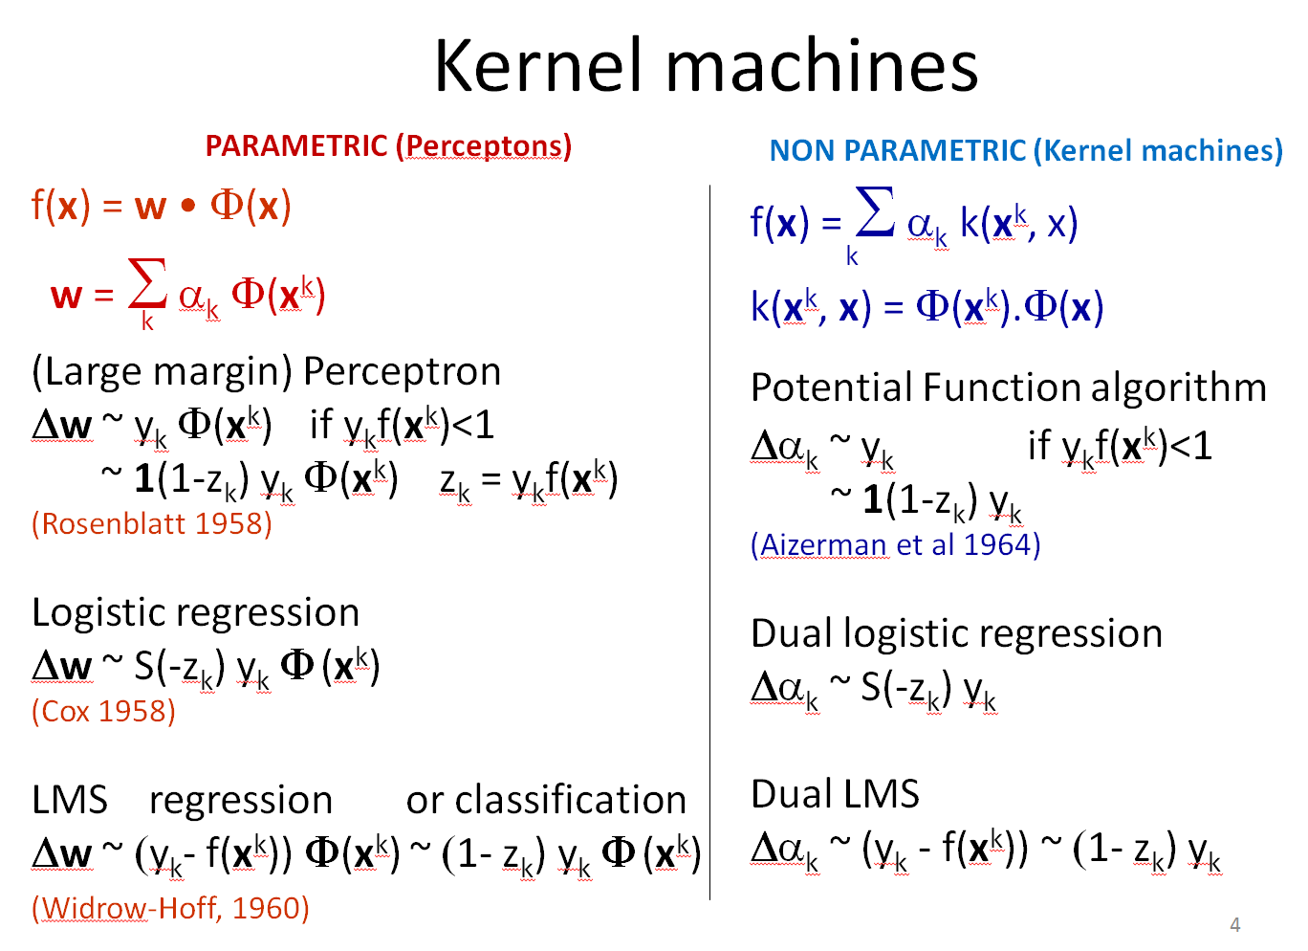
Come to my office hours… Wed 2:30-4:30 Soda 329
Today

Slide 4
Linear regression
Problem setting:
N training input/output pairs {(x^{k}, y^{k})}; y is continuous.
Linear model f(x) = w.x (w₀ corresponds to x₀≡1, dim(x)=d)
Solve a system of N equations y^{k} = w₀+ w₁ x₀ + … of (d +1) unknown.
Matrix notation:
X w^{T} = y
X = [x^{k}_{i}] of dim(N,d); y = [y^{k}] of dim(N,1); w = [w_{i}] of dim(1,d).
Solution:
Case 1: N > d, over-determined, no exact solution. w^{T} = X⁺y is the best solution in the least-square sense. RSS=Σ_{k}(f(x)-y^{k})².
Case 2: N < d, under-determined, w^{T} = X⁺y is the solution of min ǁwǁ.
Pseudo-inverse:
X⁺ = lim_{λ→0+} (X^{T}X + λI)⁻¹ X^{T} = lim_{λ→0+} X^{T} (X X^{T} + λI)⁻¹
Inverse the smallest matrix and adjust λ>0 by cross-validation (see SVD trick).
Kernel trick:
in case 2, N<<d, replace X X^{T} by a (N, N) kernel matrix K = k(x^{k}, x^{h})
α = (K+ λI)⁻¹ y, gives you a non linear regression function f(x) = Σ_{k} α_{k} k(x, x_{k}).

Slide 5
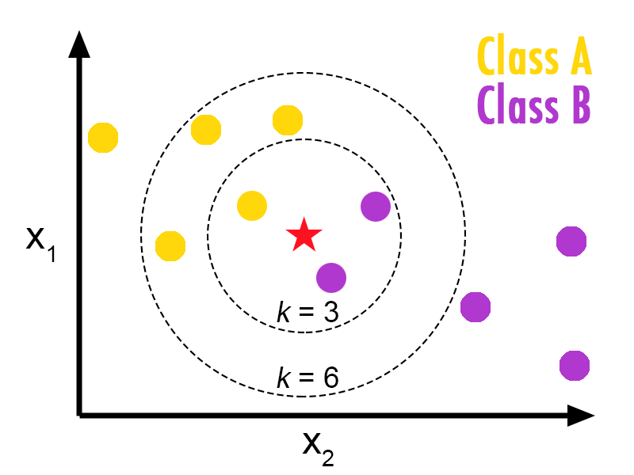
Ancestor of kernel methods: KNN
Assign to the class label of the majority of the k closest examples.
Source: http://bdewilde.github.io/blog/blogger/2012/10/26/classification-of-hand-written-digits-3/

Slide 6
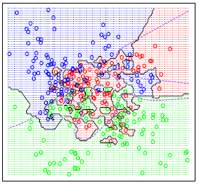
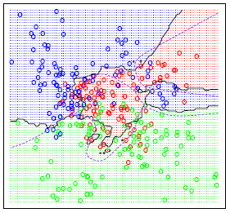
Optimum k in k-nearest neighbors
k=1
k=15
Fit vs. robustness tradeoff in kNN:
kNN does not have any parameters (non parametric method).
The “complexity” (of the decision function) decreases with k.
k is a hyper-parameter adjustable by cross-validation.
kNN can also be used for regression.
Source: https://onlinecourses.science.psu.edu/stat857/node/21

Slide 7
Parzen windows
σ₁
σ₂
Assign to the class label of the majority of the examples
enclosed in a sphere of radius σ_{r}.

Slide 8
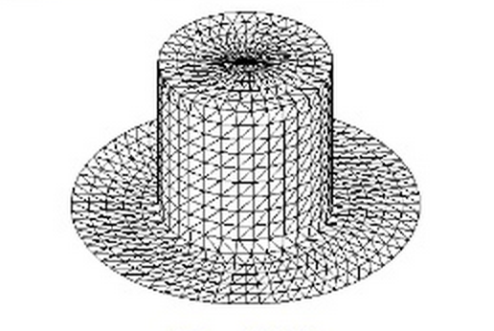
Parzen windows is a kernel method
Assign to x the class label of the majority of the examples enclosed in a sphere of radius σ.
f(x)= Σ_{k=1:N} y_{k} k(x, x_{k})
Top hat kernel:
k(x, x_{k}) = 1(ǁx-x_{k}ǁ² < σ²)
Gaussian kernel:
k(x, x_{k}) = exp -(ǁx-x_{k}ǁ² / σ²)

Slide 9
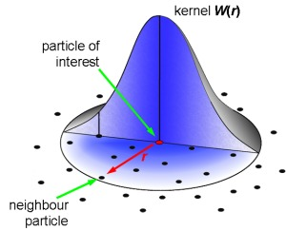
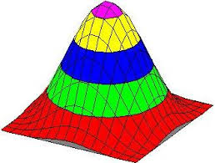
Parzen windows is a kernel method
Assign to x the class label of the majority of the examples enclosed in a sphere of radius σ.
f(x)= Σ_{k=1:N} y_{k} k(x, x_{k})
Top hat kernel:
k(x, x_{k}) = 1(ǁx-x_{k}ǁ² < σ²)
Gaussian kernel:
k(x, x_{k}) = exp -(ǁx-x_{k}ǁ² / 2σ²)
Pattern to classify x
k
x_{k}
neighbor training
example

Slide 10
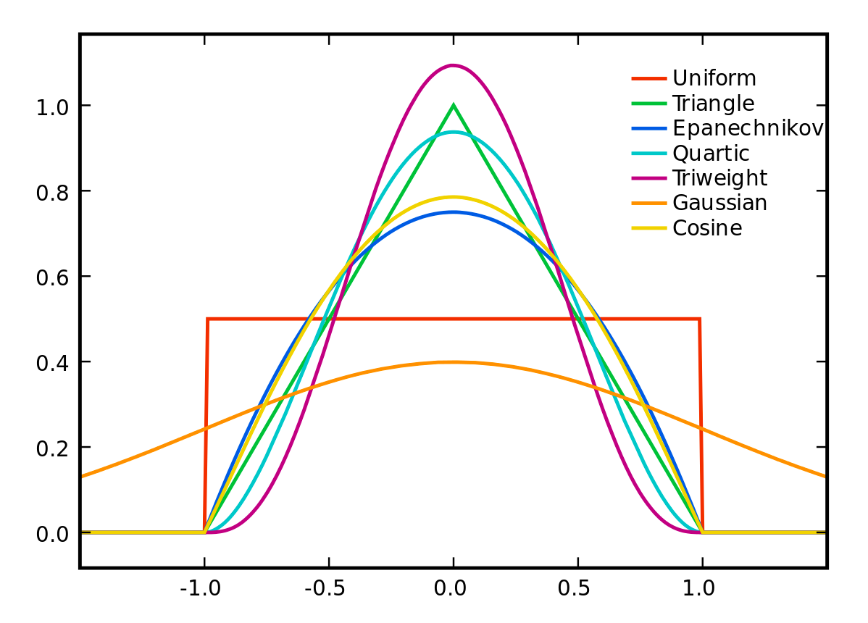
Some radial kernels
Source: https://en.wikipedia.org/wiki/Kernel_(statistics)
See also: http://crsouza.com/2010/03/kernel-functions-for-machine-learning-applications
http://www.cs.berkeley.edu/~bartlett/courses/281b-sp08/8.pdf

Slide 11
Non radial kernels
f(x) = Σ_{k=1:N} y_{k} k(x, x_{k})
Linear kernel:
k(x, x_{k}) = x.x_{k}
The Parzen windows f(x) for the linear kernel is just Hebb’s rule!
Polynomial kernel:
k(x, x_{k}) = (1+ x.x_{k} )^{q}

Slide 12
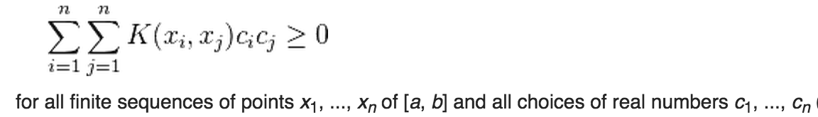
What makes k(x, x’) a “good” kernel?
Symmetric k(x, x’) = k(x’, x)
Kernel matrix K = [k(x_{k}, x_{h})] _{k=1:N, h=1:N} invertible, possibly after “regularization” (K+λI), λ>0. Satisfied if all eigenvalues≥0 (PSD matrix).
True in particular if:
k(x, x’) is a PSD kernel i.e.
satisfies Mercer’s condition.
There exists an eigen decomposition k(x, x’) = Σ_{i=1:∞} λ_{i} ψ_{i}(x) ψ_{i}(x’)
K is a Gram matrix (outer product K = XX^{T} or K = ΦΦ^{T})
K is a covariance matrix.
The sigmoid kernel tanh(x.x’) is NOT PSD.

Slide 13
Remember the “kernel trick”
f(x) = Σ_{k} α_{k} k(x^{k}, x)
k(x^{k}, x) = Φ(x^{k}) • Φ(x)
f(x) = w • Φ(x)
w = Σ_{k} α_{k} Φ(x^{k})
NON
PARAMETRIC
Dual forms
PARAMETRIC

Slide 14
Reproducing kernels
A Hilbert space H is a space of functions {f(x)}.
A “reproducing kernel” Hilbert space (RKHS) is endowed with a dot product:
<f, g>_{H} = ∫ f(x) g(x) p(x) dx
H has a (unique) positive definite “reproducing kernel”:
k(s, t) = <k(., s), k(., t)>_{H}
Reproducing kernel property:
f(x) = <k(., x), f>_{H}
See for details: http://www.gatsby.ucl.ac.uk/~gretton/coursefiles/RKHS_Notes1.pdf

Slide 15
Representer theorem
Kimeldorf, George S.; Wahba, Grace (1970)
Schölkopf, Bernhard; Herbrich, Ralf; Smola, Alex J. (2001)
f(x) is a function in RKHS H, w. <f, g>_{H} = ∫ f(x) g(x) p(x) dx, and kernel k: f(x) = <k(., x), f>_{H} .
Given a risk functional R[f] and a regularizer Ω[f] and training examples {x^{k}, y^{k}} on which we evaluate R[f] + λΩ[f], λ>0.
f*(x) = argmin_{f} R_{train}[f] + λΩ[f] admits a representation
f*(x) = Σ_{k} α_{k} k(x, x^{k})
This means that we only have to solve for α_{k} and that the solution lies in the span of k(., x^{k}) that can be thought of as special kind of features. The kernel determines the type of function used and the type of regularization (smoothness).
See for details: https://en.wikipedia.org/wiki/Representer_theorem

Slide 16
Mercer kernels and kernel trick
k(x, x’) = Σ_{i=1:∞} λ_{i} ψ_{i}(x) ψ_{i}(x’)
<f, g> = ∫ f(s) g(s) p(s) ds ; ψ_{i}(x) are eigen functions, <ψ_{i} ψ_{j}>= δ_{ij}
λ_{i} ψ_{i}(x) = <k(.,x), ψ_{i}> with eigen values λ_{i}>0
<f, g>_{H} = Σ_{i=1:∞} (1/λ_{i}) <f, ψ_{i}><g, ψ_{i}>
Use φ_{i}(x) = √λ_{i} ψ_{i}(x)
f(x) = Σ_{k} α_{k} k(x^{k}, x) = Σ_{k} α_{k} Σ_{i} φ_{i}(x^{k}) φ_{i}(x)
= Σ_{i} (Σ_{k} α_{k} φ_{i}(x^{k}) ) φ_{i}(x)
= Σ_{i} w_{i} φ_{i}(x)
See for details: https://en.wikipedia.org/wiki/Representer_theorem
Notes:
The normalized eigenfunctions ψ_{i}(s) / sqrt(λαμβδα_{i}) have the reproducing kernel property (features normalized by eigen values). Hence f(x) is a linear combination of the reproducing kernel eigenfunctions. The k(.,s) features are NOT the eigenfunctions.
k(., s) = Συμ_{i=1:∞} λαμβδα_{i} ψ_{i}(.) ψ_{i}(x’) they are an (infinite) weighed sum of the eigen functions

Slide 17
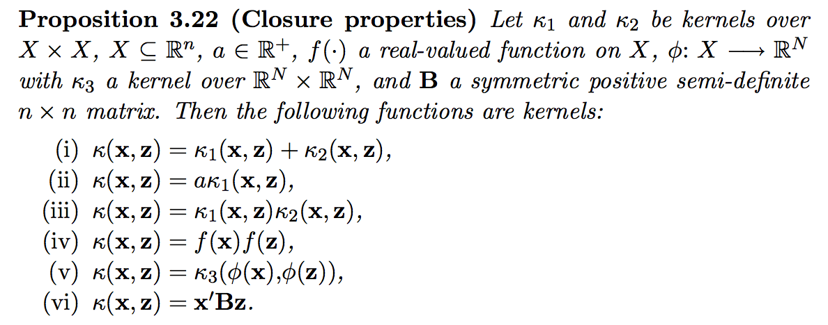
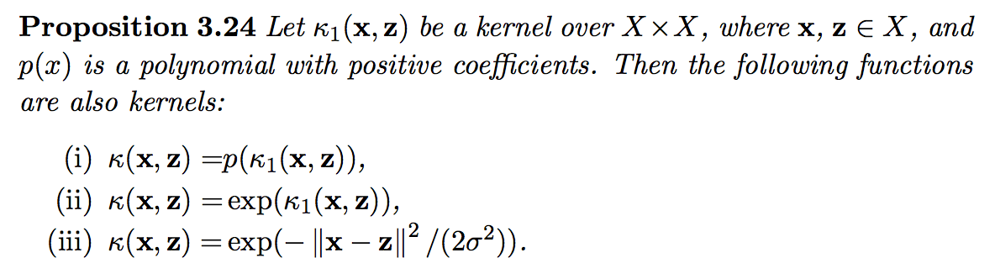
Kernel algebra
Cristianini and Shaw-Taylor, 2001
http://cs.du.edu/~mitchell/mario_books/Kernel_Methods_for_Pattern_Analysis_-_John_Shawe-Taylor_&_Nello_Christianini.pdf

Slide 18
Favorite kernel
k(x, x’) = (a + x . x’)^{b} exp(- d ǁx-x_{k}ǁ^{c} )
Of 4 hyper-parameters a, b, c, d.
Simplify: take a = 1 and c = 2.
Then: b = 0 → Gaussian kernel
d = 0 → Polynomial kernel
Adjust the hyper-parameters by cross-validation.

Slide 19
Kernel machines
PARAMETRIC (Perceptons)
NON PARAMETRIC (Kernel machines)
f(x) = w • Φ(x)
(Large margin) Perceptron
Δw ~ y_{k} Φ(x^{k}) if y_{k}f(x^{k})<1
~ 1(1-z_{k}) y_{k} Φ(x^{k}) z_{k} = y_{k}f(x^{k})
(Rosenblatt 1958)
Logistic regression
Δw ~ S(-z_{k}) y_{k} Φ (x^{k})
(Cox 1958)
LMS regression or classification
Δw ~ (y_{k}- f(x^{k})) Φ(x^{k}) ~ (1- z_{k}) y_{k} Φ (x^{k})
f(x) = Σ α_{k} k(x^{k}, x)
k(x^{k}, x) = Φ(x^{k}).Φ(x)
Potential Function algorithm
Δα_{k} ~ y_{k} if y_{k}f(x^{k})<1
~ 1(1-z_{k}) y_{k}
(Aizerman et al 1964)
Dual logistic regression
Δα_{k} ~ S(-z_{k}) y_{k}
Dual LMS
Δα_{k} ~ (y_{k} - f(x^{k})) ~ (1- z_{k}) y_{k}
w = Σ α_{k} Φ(x^{k})
k
k
(Widrow-Hoff, 1960)

Slide 20
Loss Functions
The risk is the average of the loss.
L(f(x), y)
Decision boundary
Margin
Adaboost loss e^{-z}
logistic loss log(1+e^{-z})
Hinge loss max(0, 1-z)
square loss (1- z)²
Perceptron loss max(0, -z)
0/1 loss
z=y f(x)
missclassified
well classified
Notes:
The loss measures the discrepancy between the target value y and the value f(x) estimated by the model. It is connected to the “noise model”.

Slide 21
Regularized risk minimization
f(x) = w • Φ(x) = Σ_{k} α_{k} k(x^{k}, x)
Minimize:
R_{reg}[w] = Σ_{k} L(f(x^{k}), y_{k}) + λ Ω(w)
Ω(w) = ǁwǁ²
Ω(w) = ǁwǁ

Slide 22
Stochastic gradient
f(x) = Σ_{j} w_{j} Φ_{j}(x) = w • Φ(x) = Σ_{k} α_{k} k(x^{k}, x)
1) Compute ∂L/∂w_{i} = ∂L/∂f . ∂f/∂w_{i} = ∂L/∂f Φ_{i}(x)
Classification: ∂L/∂w_{i} = ∂L/∂z.∂z/∂w_{i} with z = y f(x). ∂z/∂w_{i} = y Φ_{i}(x) → ∂L/∂w_{i} = ∂L/∂z . y Φ_{i}(x)
2) Compute ∂Ω/∂w_{i}
Ω(w) = ǁwǁ² → ∂Ω/∂w_{i} = 2w_{i}
3) Compute the negative gradient of L(f(x), y)+λΩ(w)
Δw_{i} = -η ∂L/∂f Φ_{i}(x) – γ w_{i}
Δw = - η ∂L/∂f Φ(x) – γ w

Slide 23
Kernel version
Φ−space version: Δw = - η ∂L/∂f Φ(x)
Learning (x^{k}, y^{k}): Δw = - η ∂L/∂f|_{(xk, yk)} Φ(x^{k})
w = Σ_{k} α_{k} Φ(x^{k}), Δw = Δα_{k} Φ(x^{k})
Δα_{k} = - η ∂L/∂f|_{(xk, yk)}
f(x) = Σ_{k} α_{k} k(x^{k}, x)

Slide 24
Kernel version with shrinkage
Φ−space version: Δw = - η ∂L/∂f Φ(x) – γ w
Learning (x^{k}, y^{k}):
Δw = - η ∂L/∂f|_{(xk, yk)} Φ(x^{k}) – γ w
w = Σ_{k} α_{k} Φ(x^{k}), Δw = Δα_{k} Φ(x^{k})
Δα_{k} = - η ∂L/∂f|_{(xk, yk)} -γ α_{k} for example k
Δα_{h} = -γ α_{h} for other examples
f(x) = Σ_{k} α_{k} k(x^{k}, x)

Slide 25
Example: Least Mean Square or LMS
Widrow-Hoff, 1960
L_{square_loss} = (f(x)– y)²
L/∂f = 2 (f(x)– y)
∂f/∂w_{i =} Φ_{i}(x) for f(x) = Σ_{j} w_{j} Φ_{j}(x)
∂L/∂w_{i} = 2 (f(x)– y) Φ_{i}(x) Loss variation
Δw_{i} = - η (f(x)– y) Φ_{i}(x) – γ w
Δw = η (y – f(x)) Φ(x) – γ w LMS learning rule
Δα_{k} = η (y^{k} – f(x^{k})) -γ α_{k} for example k
Δα_{h} = -γ α_{h} for other examples

Slide 26
Comparison Hebbs’s rule
f(x) = w • Φ(x) = Σ_{k} α_{k} k(x^{k}, x)
Hebb’s rule:
Δw_{i} = η y Φ_{i}(x)
Δα_{k} = η y^{k}
LMS rule:
Δw_{i} = η (y – f(x)) Φ_{i}(x)
Δα_{k} = η (y^{k} – f(x^{k}))
1

Slide 27
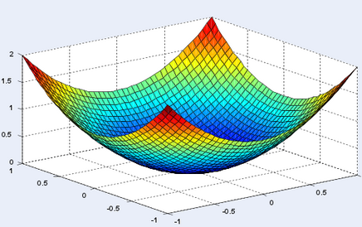
Exploiting convexity?
Stochastic gradient does not exploit convexity, is this the best approach?
Yes for BIG data.
No if either N or d is small.
For regression,
regularized inverse:
w^{T} = (X^{T}X + λI)⁻¹ X^{T} y or X^{T} (X X^{T} + λI)⁻¹ y
α = (K+λI)⁻¹ y
R[w1, w2]
w1
w2

Slide 28
Classification with optimum margin
Hard margin
Soft margin
M = 1/ ǁwǁ
M_{opt} = max (1/ ǁwǁ)
s.t. min_{k}(y^{k}f(x^{k})) = 1
min R_{reg}[f] = R_{train}[f] + λ ǁwǁ²
x₂
x₂
Use the hinge loss: max(0, 1-y^{k}f(x^{k}))
f(x) = 0
f(x) = 0
w
w
f(x) = 1
f(x) = 1
f(x) = -1
f(x) = -1
x₁
x₁

Slide 29
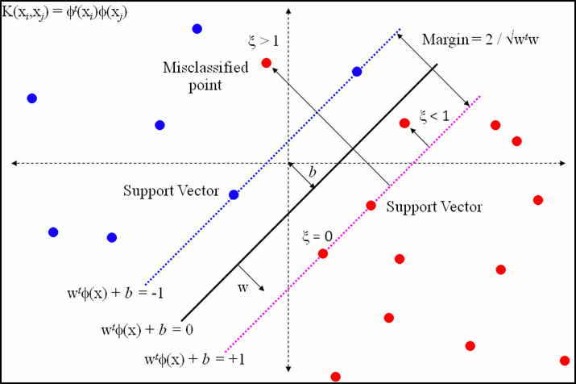
Soft margin
Cortes-Vapnik, 1995
min R_{reg}[f] = R_{train}[f] + λ ǁwǁ²
min C Σ_{k=1:N} ξ_{k} + (1/2) ǁwǁ²
Use the hinge loss: max(0, 1-y^{k}f(x^{k}))
1-y^{k}f(x^{k}) ≤ ξ_{k} ξ_{k}>0
http://stats.stackexchange.com/questions/108617/simple-svm-question

Slide 30
Standard quadratic programs
f(x) = w • Φ(x)+b
Soft margin Perceptron-style
(with hinge loss)
min_{w,b,ξ} C Σ_{k=1:N} ξ_{k} + (1/2) ǁwǁ²
y^{k}f(x^{k}) - 1 + ξ_{k} ≥ 0
ξ_{k} ≥ 0
2) Soft margin RSS-style
(with square hinge loss)
min_{w,b,ξ} C Σ_{k=1:N} (ξ_{k})² + (1/2) ǁwǁ²
y^{k}f(x^{k}) - 1 + ξ_{k} ≥ 0
ξ_{k} ≥ 0
Decision boundary
Margin
hinge loss max(0, 1-z)
1
square hinge loss max(0, (1- z)²)
0
missclassified
1
well classified

Slide 31
Dual problems (in α space)
f(x) = Σ_{k} α_{k} y_{k} k(x^{k}, x) H = [y_{k}y_{h} k(x^{k}, x^{h})]
Hinge loss version:
min_{α} α^{T} 1 - (1/2) α^{T} H α
0 ≤ α_{k} ≤ C box constraint
α^{T} y = 0 bias constraint
2) Square hinge loss version
min_{α} α^{T} 1 - (1/2) α^{T}(H + (1/C) Ι)α
α_{k} ≥ 0
α^{T} y = 0 bias constraint
Decision boundary
Margin
hinge loss max(0, 1-z)
1
square hinge loss max(0, (1- z)²)
0
missclassified
1
well classified
http://homepages.rpi.edu/~bennek/class/mmld/papers/svn.pdf
http://cs229.stanford.edu/notes/cs229-notes3.pdf

Slide 32
Dual problems (in α space)
f(x) = Σ_{k} α_{k} k(x^{k}, x) K = [k(x^{k}, x^{h})]
Hinge loss version:
min_{α} α^{T} y - (1/2) α^{T} K α
0 ≤ α_{k} y_{k} ≤ 1/λ box constraint
α^{T} 1 = 0 bias constraint
2) Square hinge loss version
min_{α} α^{T} y - (1/2) α^{T}(K + λΙ)α
α_{k} y_{k} ≥ 0
α^{T} 1 = 0 bias constraint
Decision boundary
Margin
hinge loss max(0, 1-z)
1
ridge
square hinge loss max(0, (1- z)²)
0
missclassified
1
well classified
http://homepages.rpi.edu/~bennek/class/mmld/papers/svn.pdf
http://cs229.stanford.edu/notes/cs229-notes3.pdf

Slide 33
Summary
f(x) = Σ_{k=1:N} α_{k} k(x, x_{k})
Kernel methods are inspired by non-parameteric example-based methods; each example x_{k} votes according to:
How similar it is to x measured by k(x, x_{k})
It weight α_{k}
Kernels are “dot products” in a (possibly infinite) Φ space.
The validity of a kernel can be checked with Mercer’s condition; there are also kernel composition theorems.
The weights α_{k} can be optimized by gradient descent (for big data) or convex optimization methods.

Slide 34

Come to my office hours… Wed 2:30-4:30 Soda 329
Next time
Next time
Performance evaluation

