Slide 1
UCB - CS189 Introduction to Machine Learning Fall 2015 Lecture 5: Shrinkage
Isabelle Guyon
ChaLearn

Slide 2
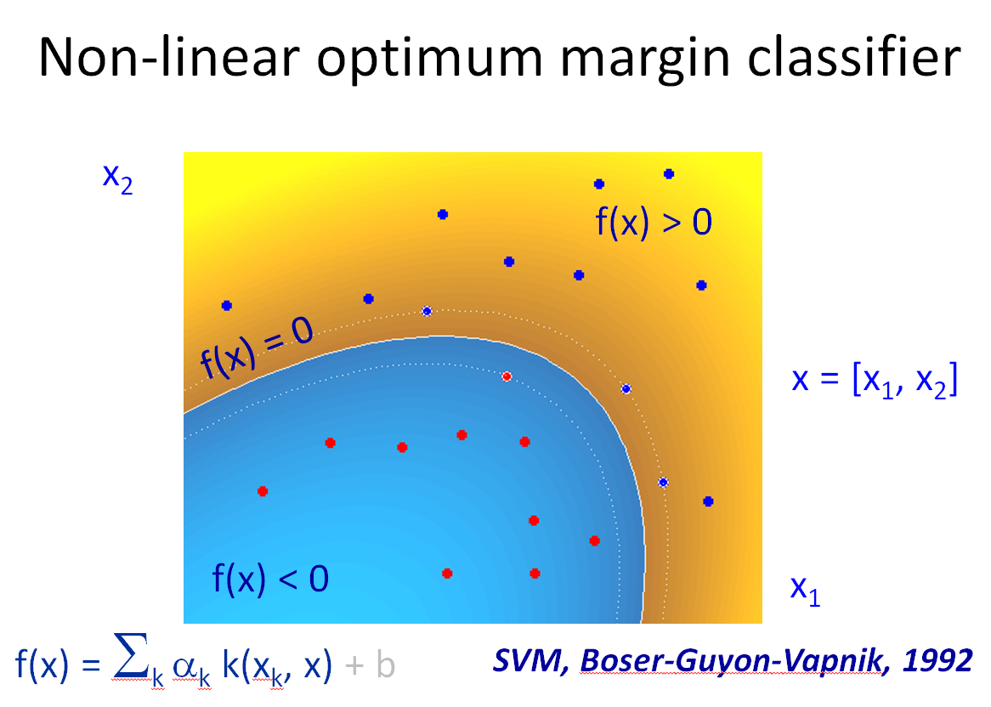
Come to my office hours… Wed 2:30-4:30 Soda 329
Last time
(HARD)

Slide 3
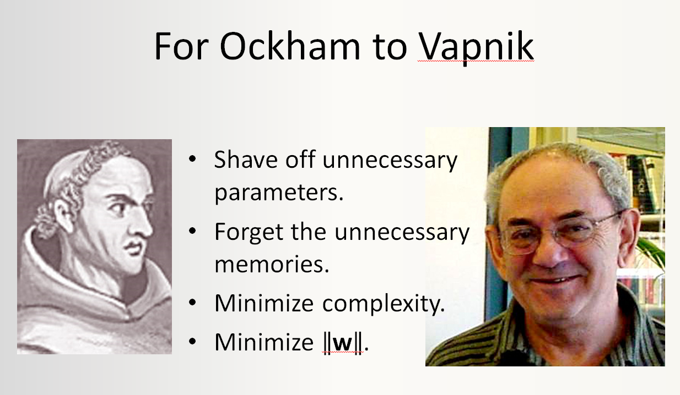
Come to my office hours… Wed 2:30-4:30 Soda 329
Today
(→ SOFT margin)

Slide 4
Math prerequisites
Derivative
Chain rule
Lagrange multiplier

Slide 5
Fit / Robustness Tradeoff
x₂
x₂
x₁
x₁
Notes:
Which one is best : linear or non-linear
The decision comes when we see new data
Very often the simplest model is better
This principle is implemented in Learning Theory

Slide 6
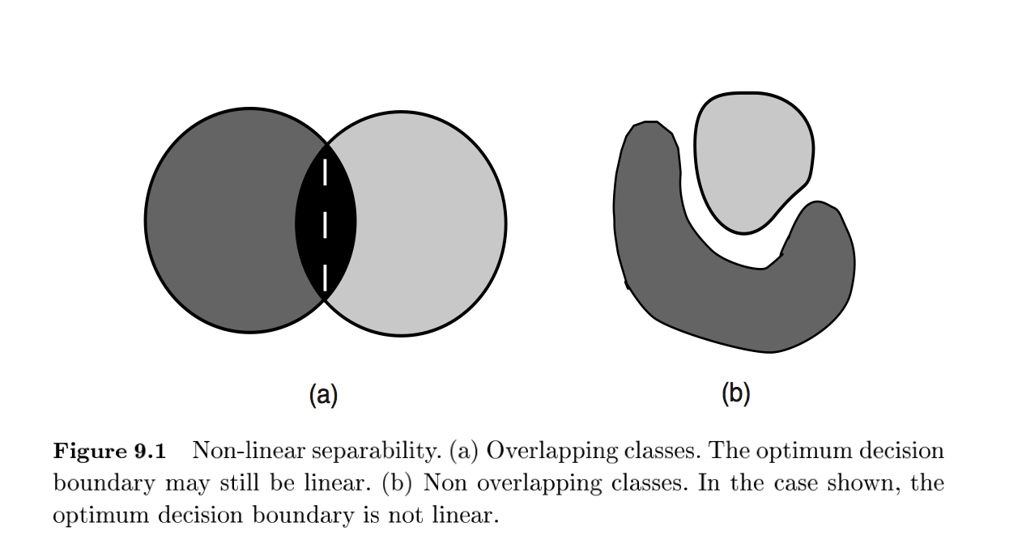
Reasons for non-linear separability
I. Guyon and D. Stork (2000). Linear Discriminant and Support Vector Classifiers.

Slide 7
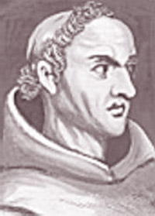
Ockham’s Razor
Principle proposed by William of Ockham in the fourteenth century: “Pluralitas non est ponenda sine neccesitate”.
Of two theories providing similarly good predictions, prefer the simplest one.
Shave off unnecessary parameters of your models.

Slide 8
Fit / Robustness Tradeoff
x₂
x₂
x₁
x₁
Notes:
Which one is best : linear or non-linear
The decision comes when we see new data
Very often the simplest model is better
This principle is implemented in Learning Theory

Slide 9
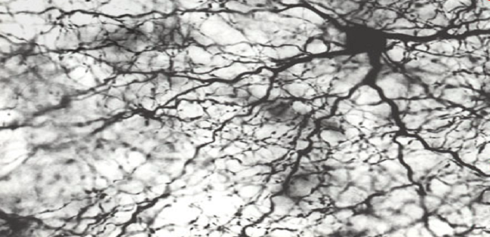
The Power of Amnesia
The human brain is made out of billions of cells or Neurons, which are highly interconnected by synapses.
Exposure to enriched environments with extra sensory and social stimulation enhances the connectivity of the synapses, but children and adolescents can lose them up to 20 million per day.

Slide 10
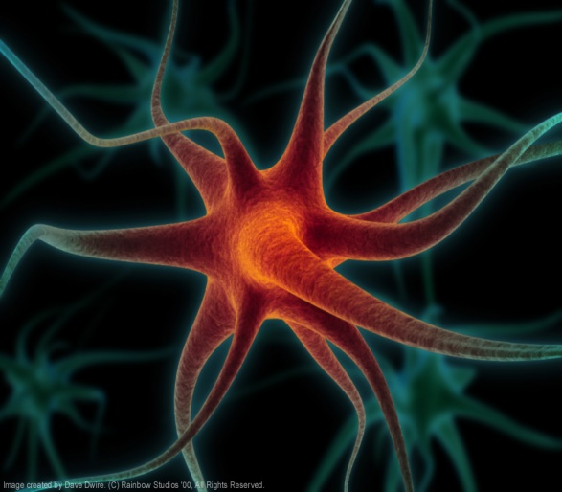
Artificial Neurons
Cell potential
x₁
w₁
x₂
w₂
Σ
f(x)
Axon
w_{d}
Activation of other neurons
x_{d}
b
Activation function
1
Dendrites
Synapses
McCulloch and Pitts, 1943
f(x) = w • x + b

Slide 11
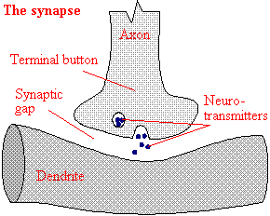
Hebb’s Rule
w_{i} ← w_{i} + y^{k} x^{k}_{i}
Activation of another neuron
x_{i}
w_{i}
y
Σ
Axon
Dendrite
Synapse

Slide 12
Weight Decay
w_{i} ← w_{i} + y^{k} x^{k}_{i Hebb’s rule}
w_{i} ← (1-γ) w_{i} + y^{k} x^{k}_{i Weight decay}
γ ∈ [0, 1], decay parameter

Slide 13
Weight Decay for MLP
Replace: w_{i} ← w_{i} + back_prop(i)
by: w_{i} ← (1-γ) w_{i} + back_prop(i)
Σ
x_{j}
Σ
Σ

Slide 14
Notion of “Risk”
Last time: The risk is the sum of losses
R[f] = (1/N) Σ_{k=1:N} L( f(x^{k}), y^{k} )
L( f(x), y ) = 1( f(x)≠y ) = 1( yf(x)<0 ) zero-one loss
L( f(x), y ) = ( f(x) - y )² = ( yf(x) - 1 )² square loss
with y=±1
Today: Expected risk
R[f] = ∫ L(f(x, w), y) dP(x, y)
Empirical risk
R_{train}[f] = (1/N) Σ_{k=1:N} L( f(x^{k}), y^{k} )

Slide 15
Notion of “Risk”
Last time: The risk is the sum of losses
R[f] = (1/N) Σ_{k=1:N} L( f(x^{k}), y^{k} )
L( f(x), y ) = 1( f(x)≠y ) zero-one loss
L( f(x), y ) = ( f(x) - y )² square loss
with y=±1
Today: Expected risk
R[f] = ∫ L(f(x, w), y) dP(x, y)
Empirical risk
R_{train}[f] = (1/N) Σ_{k=1:N} L( f(x^{k}), y^{k} )

Slide 16
Risk Minimization
Learning problem: find the best function f(x; w) minimizing a risk functional
R[f] = ∫ L(f(x; w), y) dP(x, y)
loss function
unknown distribution
Examples are given:
(x₁, y₁), (x₂, y₂), … (x_{N}, y_{N})
Notes:
In Machine Learning, everything starts from a proba distrib, which is unknown
I would say that we are NOT interested in the distribution
Only in the decision we want to take

Slide 17
Approximations of R[f] (generalization error)
Empirical risk: R_{train}[f] = (1/N) Σ_{k=1:N} L(f(x^{k}, w), y^{k})
0/1 loss 1(f(x_{k})≠y_{k}) : R_{train}[f] = error rate
square loss (f(x_{k})-y_{k})² : R_{train}[f] = mean square error
Guaranteed risk:
With high probability (1-δ), R[f] ≤ R_{gua}[f]
R_{gua}[f] = R_{train}[f] + ε(δ, C/N)
Notes:
If you minimize the training error you will get into the overfitting pb : you will not generalize well (explain “over-fitting”)
Isabelle Comments :
In the risk minimization framework, we address directly the classification or regression problems.
Generality of PAC: give the example of the sample mean.
Epsilon and delta are positive values. Delta is given, it is the risk of being wrong that we are willing to accept. Epsilon is a function of the complexity of the family of functions, of the number of training examples and of delta. A capacity is a measure of complexity. The VC dim is a capacity = the largest number of examples one can shatter (assign to labels in all possible ways.) A problem is PAC learnable if there exists a learning algorithm, which can attain the epsilon-delta condition for given values of epsilon and delta. It is efficiently PAC-learnable if there exists an algorithm that can PAC learn in time polynomial is epsilon, delta, and log(m). The sample complexity is the smallest training set size that makes the problem become PAC-learnable.
Two-part objectives: loss-> noise model; regularizer-> uncertainty about the model

Slide 18
Approximations of R[f] (generalization error)
Empirical risk: R_{train}[f] = (1/N) Σ_{k=1:N} L(f(x^{k}, w), y^{k})
0/1 loss 1(f(x_{k})≠y_{k}) : R_{train}[f] = error rate
square loss (f(x_{k})-y_{k})² : R_{train}[f] = mean square error
Guaranteed risk:
With high probability (1-δ), R[f] ≤ R_{gua}[f]
R_{gua}[f] = R_{train}[f] + ε(δ, C/N)
Notes:
If you minimize the training error you will get into the overfitting pb : you will not generalize well (explain “over-fitting”)
In the risk minimization framework, we address directly the classification or regression problems.
Generality of PAC: give the example of the sample mean.
Epsilon and delta are positive values. Delta is given, it is the risk of being wrong that we are willing to accept. Epsilon is a function of the complexity of the family of functions, of the number of training examples and of delta. A capacity is a measure of complexity. The VC dim is a capacity = the largest number of examples one can shatter (assign to labels in all possible ways.) A problem is PAC learnable if there exists a learning algorithm, which can attain the epsilon-delta condition for given values of epsilon and delta. It is efficiently PAC-learnable if there exists an algorithm that can PAC learn in time polynomial is epsilon, delta, and log(N). The sample complexity is the smallest training set size that makes the problem become PAC-learnable.
Two-part objectives: loss-> noise model; regularizer-> uncertainty about the model

Slide 19
Structural Risk Minimization
Vapnik, 1974
Nested subsets of models, increasing complexity/capacity:
S₁⊂ S₂ ⊂ … S_{N}
Ga, Guaranteed risk
Ga= Tr + ε(C/N)
ε, Function of Model Complexity C
S₃
Tr, Training error
Increasing complexity
S₂
Complexity/Capacity C
S₁

Slide 20
SRM Example (linear model)
S₁⊂ S₂ ⊂ … S_{N}
Rank with ǁwǁ² = Σ_{i} w_{i}²
S_{k} = { w | ǁwǁ² < ω_{k}² }, ω₁<ω₂<…<ω_{n}
Minimization under constraint:
min R_{train}[f] s.t. ǁwǁ² < ω_{k}²
Lagrangian:
R_{reg}[f,λ] = R_{train}[f] + λ (ǁwǁ² - ω_{k}²), λ > 0
Equivalent problems:
min R_{train}[f] s.t. ǁwǁ² < ω_{k}², ω₁<ω₂<…<ω_{n}
min R_{reg}[f] = R_{train}[f] + λ_{k}ǁwǁ², 0<λ₁<…<λ_{n}
R
capacity
Notes:
Ridge regression : use nested subsets with slowly increasing the parameters norm
To be correct on should use lambda (norm(w) – omega)
But this can be simplified by omitting omega since by derivating w.r.t. w this does not change the result.

Slide 21
Gradient Descent
R_{reg}[f] = R_{train}[f] + λ ǁwǁ² SRM/regularization
w_{j} ← w_{j} - η ∂R_{reg}/∂w_{j}
w_{j} ← w_{j} - η ∂R_{train}/∂w_{j} - 2 η λ w_{j} γ =2 η λ
w_{j} ← (1- γ) w_{j} - η ∂R_{train}/∂w_{j} Weight decay

Slide 22
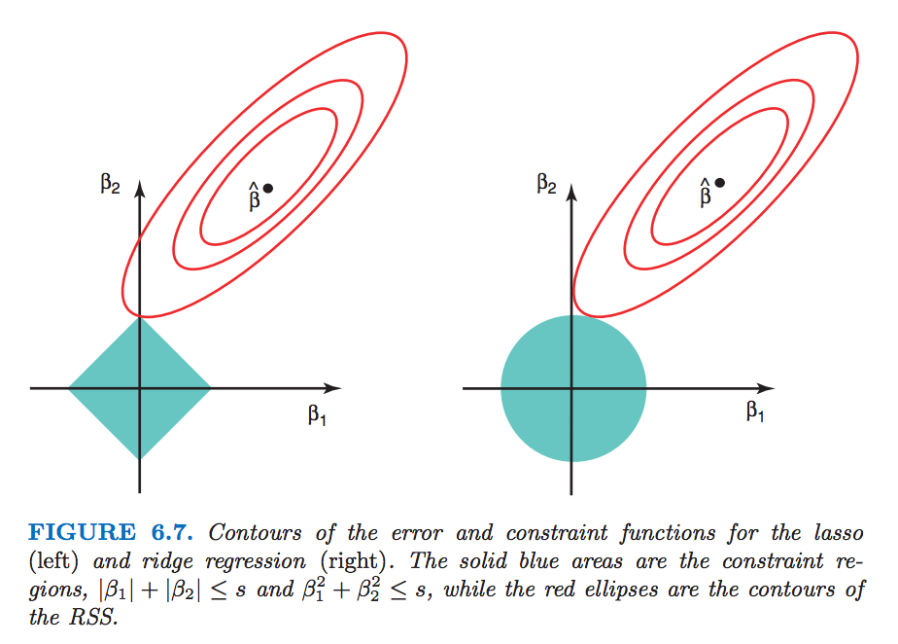
Example: Mean square error: (1/N) Σ_{k=1:N} ( f(x^{k}) - y^{k} )²
RSS
An Introduction to Statistical Learning: with Applications in R, Gareth James Daniela Witten Trevor Hastie Robert Tibshirani

Slide 23
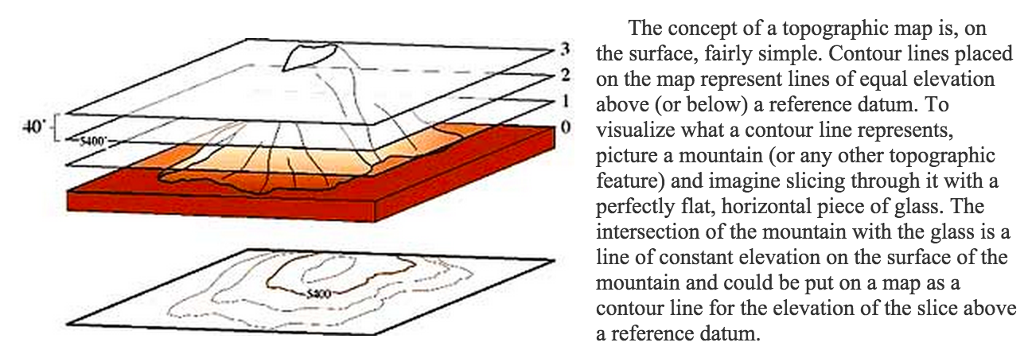
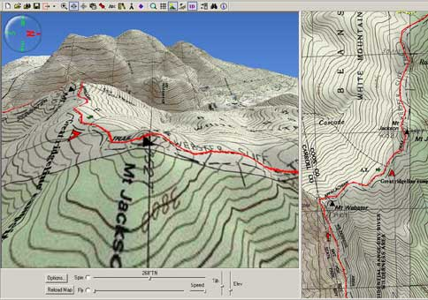
Contour maps
http://geology.isu.edu/geostac/Field_Exercise/topomaps/topo_map.htm
http://www.nationalgeographic.com/adventure/images/02_06/Appalachian_TOPO_5.jpg

Slide 24
Shrinkage justified
Why do we want “simple” models?
Everything is about mitigating risk
Guaranteed risk:
With high probability (1-δ), R[f] ≤ R_{gua}[f]
R_{gua}[f] = R_{train}[f] + ε(δ, C/N)
Regularized risk:
R_{reg}[f] = R_{train}[f] + λ ǁwǁ²
FIT
ROBUSTNESS

Slide 25
Multiple Structures
Shrinkage (weight decay, ridge regression, SVM):
S_{k} = { w | ǁwǁ₂< ω_{k} }, ω₁<ω₂<…<ω_{k}
γ₁ > γ₂ > γ₃ >… > γ_{k} (γ is the ridge)
Feature selection:
S_{k} = { w | ǁwǁ₀< ν_{k} },
ν₁<ν₂<…<ν_{k} (ν is the number of features)
Kernel parameters k(s, t) = (s • t + 1)^{q} :
q₁<q₂<…<q_{k} (q is the polynomial degree)
k(s, t) = exp(-ǁs-tǁ²/σ²)
σ₁ > σ₂ > σ₃ >… > σ_{k} (σ is the kernel width)
Notes:
0-norm : is the nb of parameters (hard clipping of the parameter vector)

Slide 26
Loss Functions
The risk is the average of the loss.
L(f(x), y)
Decision boundary
Margin
Adaboost loss e^{-z}
logistic loss log(1+e^{-z})
square loss (1- z)²
Hinge loss max(0, 1-z)
Perceptron loss max(0, -z)
0/1 loss
z=y f(x)
missclassified
well classified
Notes:
The loss measures the discrepancy between the target value y and the value f(x) estimated by the model. It is connected to the “noise model”.

Slide 27
Maximizing the margin
Large margin
Optimum margin
x₂
f(x) = 0
x₂
f(x) = 0
w
w
f(x) = 1
f(x) = M
f(x) = -1
f(x) = -M
x₁
x₁
ǁwǁ = 1
M_{opt} = argmax_{w} (min_{k}(y^{k}f(x^{k}))

Slide 28
Linking geometrical and functional margin
Imagine that we want to impose y^{k} f(x^{k}) ≥ 1
y^{k} f(x^{k}) is the functional margin
Take two points on opposite sides of geometrical margin:
w • x¹ + b = 1
w • x² + b = -1
Subtract:
w • (x¹ - x² ) = 2
The distance between x¹ and x² is:
2 M = ǁ x¹ – x² ǁ
= (x¹ - x² ) • w/ǁwǁ
= 2 / ǁwǁ
x₂
x¹
x²
f(x) = w • x + b = 0
w
f(x) = w • x + b = 1
M = 1 / ǁwǁ
f(x) = w • x + b = -1
2 M
x₁

Slide 29
Equivalent formulations
ǁwǁ = 1
⇔
M = 1/ ǁwǁ
M_{opt} = max (1/ ǁwǁ)
s.t. min_{k}(y^{k}f(x^{k})) = 1
M_{opt} = argmax_{w} (min_{k}(y^{k}f(x^{k}))
x₂
x₂
f(x) = 0
f(x) = 0
w
w/ǁwǁ
f(x) = M
f(x) = 1
f(x) = -M
f(x) = -1
x₁
x₁
29

Slide 30
Optimum margin
Hard margin
Soft margin
M = 1/ ǁwǁ
M_{opt} = max (1/ ǁwǁ)
s.t. min_{k}(y^{k}f(x^{k})) = 1
min R_{reg}[f] = R_{train}[f] + λ ǁwǁ²
x₂
x₂
Use the hinge loss
f(x) = 0
f(x) = 0
w
w
f(x) = 1
f(x) = 1
f(x) = -1
f(x) = -1
x₁
x₁

Slide 31
Large margin Perceptron with weight decay = soft margin
L_{hinge} = max(0, 1 - z)
z=y f(x)
min_{w} (L_{hinge} + λ ǁwǁ²)
w_{i} ←
L(f(x), y)
Decision boundary
Perceptron loss max(0, -z)
Hinge loss max(0, 1-z)
1
z=y f(x)
missclassified
0
well classified
(1-γ) w_{i +} η y x_{i} , if z < 1 (misclassified or within margin)
(1-γ) w_{i} otherwise
(γ =2 η λ)

Slide 32
Soft Margin Compromise
PREVIEW
Minimize
(1/Margin) + C Training error
Good robustness
Good fit

Slide 33
Soft Margin Compromise
Minimize
λ ǁwǁ² + Σ_{k}max(0, 1-z^{k})
R_{train}[f]
Good robustness
Good fit

Slide 34
Hyper-parameter Selection
X
y
Learning = adjusting:
parameters (w vector).
hyper-parameters (γ, ν, q, σ).
Cross-validation with K-folds:
For various values of γ, ν, q, σ:
- Adjust w on a fraction (K-1)/K of training examples e.g. 9/10th.
- Test on 1/K remaining examples e.g. 1/10th.
- Rotate examples and average test results (CV error).
- Select γ, ν, q, σ to minimize CV error.
- Re-compute w on all training examples using optimal γ, ν, q, σ.
Training data: Make K folds
Test data
Prospective study / “real” validation

Slide 35
Summary
High complexity models may “overfit”:
Fit perfectly training examples
Generalize poorly to new cases
SRM solution: organize the models in nested subsets such that in every structure element
complexity < θ
Regularization: Formalize learning as a constrained optimization problem, minimize
regularized risk = training error + λ complexity
Both formulations are equivalent via the use of Lagrange multipliers.
θ and λ are hyperparamenters, which can be optimized by cross-validation.

Slide 36
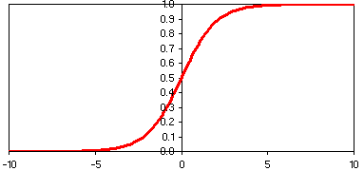
Come to my office hours… Wed 2:30-4:30 Soda 329
Next time
w₁
w₂
Σ
w_{D}
b
Logistic regression

