Slide 1
UCB - CS189 Introduction to Machine Learning Fall 2015 Lecture 6: Logistic regression
Isabelle Guyon
ChaLearn

Slide 2
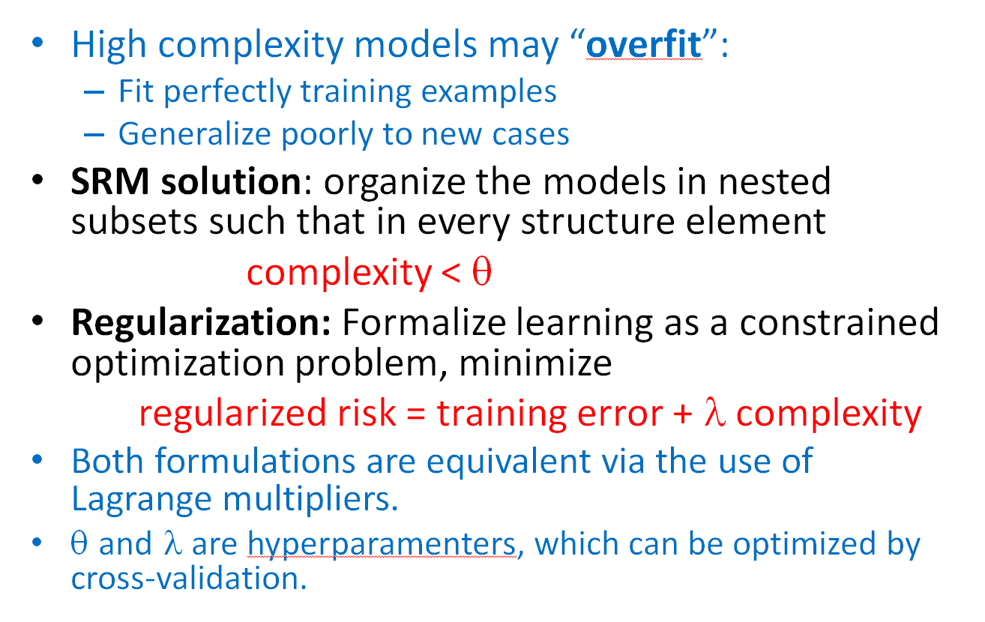
Come to my office hours… Wed 2:30-4:30 Soda 329
Last time

Slide 3
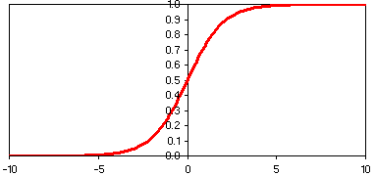
Come to my office hours… Wed 2:30-4:30 Soda 329
Today
w₁
w₂
Σ
w_{D}
b
Logistic regression

Slide 4
Math prerequisites
Random variable, probability distribution
CDF, PDF
Normal Law
Bernouilli trials, Binomial law
Maximum likelihood
Bayes rule

Slide 5
Probabilistic output
w₁
w₂
Σ
X
P(Y|X)
w_{D}
b
Advantages:
Soft decisions: output more informative than hard decision.
Modular decisions: easier to integrate as part of big decision system.
Flexible decisions: (still) possible to monitor tradeoff between false positive and false negative.
Disadvantages:
Need to estimate probabilities (never solve a harder problem than you need).

Slide 6
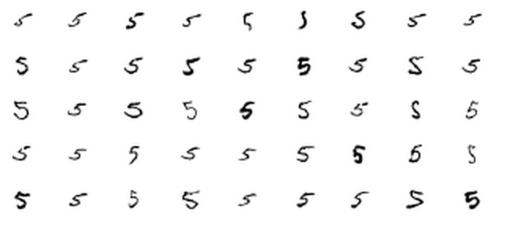
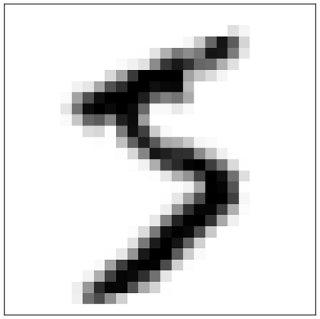
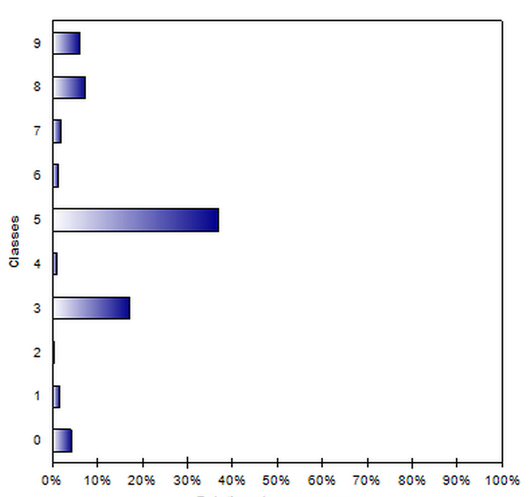
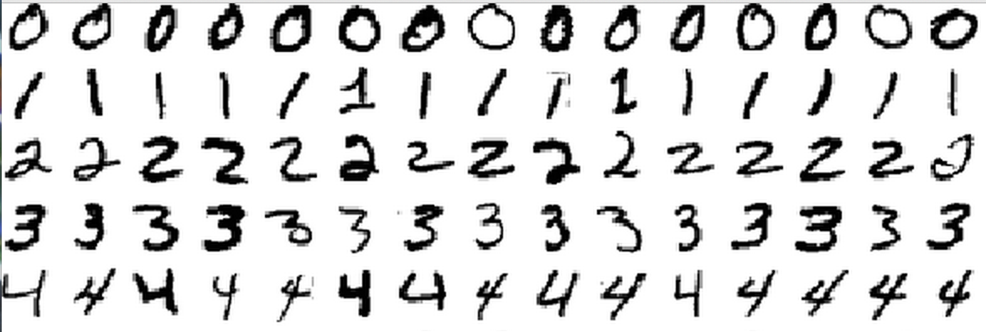
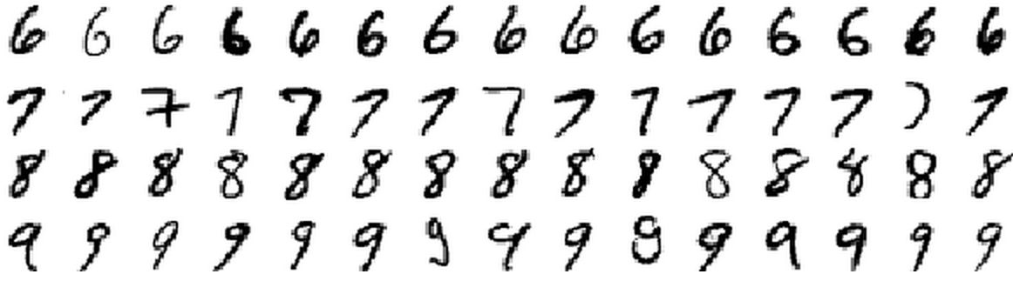
Benefit 1: Soft decisions

Slide 7


Benefit 2: Modular decisions
The “HaHa” machine:
1
0.1
H
0.8
a
0.2
0.3
0.6
Combine Proba(H | ) coming from the handwriting recognizer
with the current state in the “HaHa” machine, which provides a “prior” Proba(H | previous state).
Photo: Bravel’s bucket

Slide 8
Benefit 3: Flexible decisions
f(x)
S
S(f(x)) = S°f(x)
x₂
S°f(x) > 0
Since S is a smooth monotonically increasing function, varying a threshold on S°f(x) allows us to monitor the fraction of FP and FN, just like for f(x).
10 errors
5 FP
5 FN
Success rate = 79%
Sensitivity = TP/pos = 50%
Specificity = TN/neg = 86%
BAC = 68%
S°f(x) = 0
S°f(x) < 0
x₁
Notes:
Which one is best : linear or non-linear
The decision comes when we see new data
Very often the simplest model is better
This principle is implemented in Learning Theory

Slide 9
Benefit 3: Move up the decision boundary → fewer False Positive
x₂
S°f(x) > 1
10 errors
1 FP
9 FN
Success rate = 79%
Sensitivity = TP/pos = 10%
Specificity = TN/neg = 97%
BAC = 53%
S°f(x) = 1
S°f(x) < 1
x₁
Notes:
Which one is best : linear or non-linear
The decision comes when we see new data
Very often the simplest model is better
This principle is implemented in Learning Theory

Slide 10
Benefit 3: Move up the decision boundary → fewer False Negative
x₂
S°f(x) > -1
10 errors
9 FP
1 FN
Success rate = 79%
Sensitivity = TP/pos = 90%
Specificity = TN/neg = 76%
BAC = 83%
S°f(x) = -1
S°f(x) <-1
x₁
Notes:
Which one is best : linear or non-linear
The decision comes when we see new data
Very often the simplest model is better
This principle is implemented in Learning Theory

Slide 11
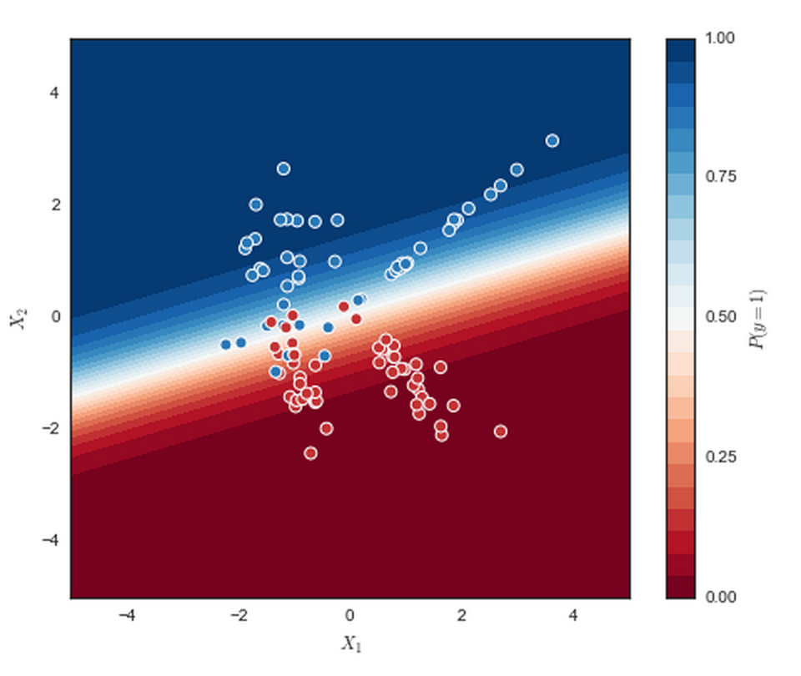
Soft boundary
Picture: Stackoverflow mwaskom
f(x) = w • x + b f(x) = Σ_{i} w_{i} x_{i} + b
S(f(x)) = P_{f}(Y=1 | X=x)
S
f(x) = g(p)
p
S⁻¹ = g = link function

Slide 12
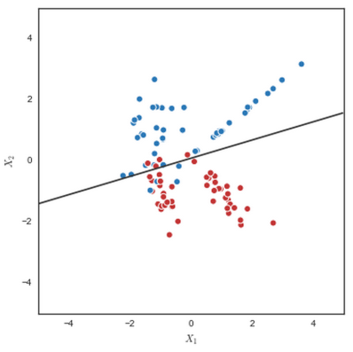

Which function S?
f(x) = w • x + b
f(x) ∈ [-∞, +∞]
S(f(x)) = P(Y=1 | X=x)
S(f(x)) ∈ [0, 1]
S
How do we map [-∞, +∞] to [0, 1]?

Slide 13
Which function S?
f(x) = w • x + b
f(x) ∈ [-∞, +∞]
S(f(x)) = P(Y=1 | X=x)
S(f(x)) ∈ [0, 1]
S
How do we map [-∞, +∞] to [0, 1]?
P_{f} (Y=1 | X=x) = p(x) ∈ [0, 1]
P_{f} (Y=-1 | X=x) = 1 – p(x) ∈ [0, 1]
log p(x) ∈ [-∞, 0]
- log (1- p(x)) ∈ [0, +∞]
f(x) = log [ p(x) / (1-p(x)) ] ∈ [-∞, +∞] g(p) = log(p/(1-p))
odds ratio logit link function
g(p)

Slide 14
Which function S?
f(x) = w • x + b
f(x) ∈ [-∞, +∞]
S(f(x)) = P(Y=1 | X=x)
S(f(x)) ∈ [0, 1]
S
How do we map [-∞, +∞] to [0, 1]?
P_{f} (Y=1 | X=x) = p(x) ∈ [0, 1]
P_{f} (Y=-1 | X=x) = 1 – p(x) ∈ [0, 1]
log p(x) ∈ [-∞, 0]
- log (1- p(x)) ∈ [0, +∞]
f(x) = log [ p(x) / (1-p(x)) ] ∈ [-∞, +∞] g(p) = log(p/(1-p))
odds ratio logit link function
f(x) = w • x + b
P_{f} (Y=1|X=x ) = 1 / (1+ e^{-f(x)})
S(t) = g⁻¹(t) = 1 / (1+ e^{-t}) logistic function

Slide 15
Assumptions made
Linear logistic regression:
The log odds ratio (logit) is a linear function of x log [P_{f} (Y=1|X=x) / P_{f} (Y=-1|X=x)] = w • x + b
Non-linear logistic regression:
The log odds ratio (logit) is any function of x
log [P_{f} (Y=1|X=x) / P_{f} (Y=-1|X=x)] = f(x)
(think of the kernel trick).

Slide 16
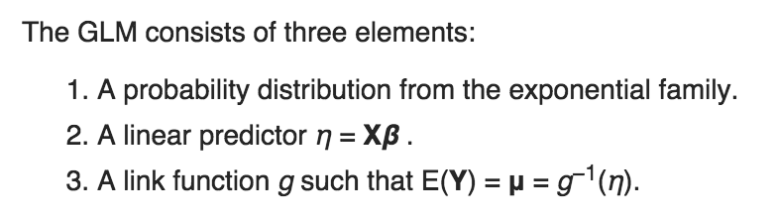
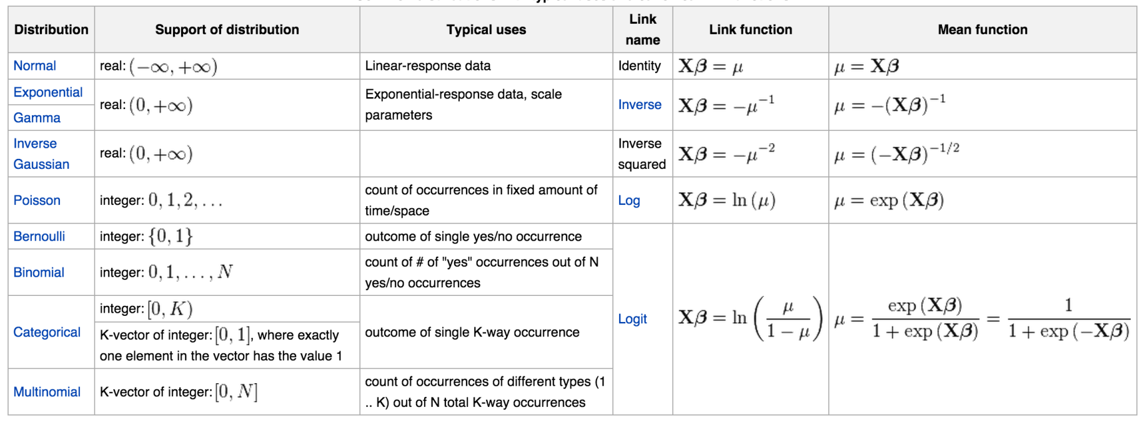
Generalized linear models
Logistic regression belongs to the GLM family:
Notations:
↔ w
↔ p
f(x) = w . x = g(p)
g
S=g⁻¹
logit
logistic
Source: Wikipedia

Slide 17
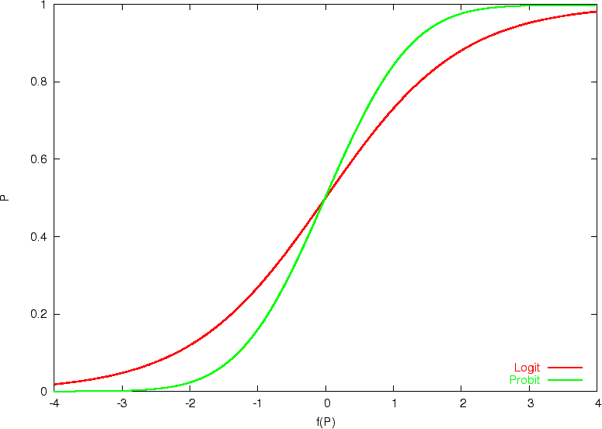


Other choices of link function
probit
logit
p = S
= g(p)
Probit: g⁻¹ =
S
Reminder: β ↔ w
Source: Wikipedia

Slide 18
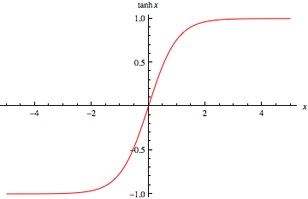
Similitude with the sigmoid neuron
+1
w₁
w₂
Σ
f(x)
P_{f} (Y=1|X) - P_{f} (Y=-1|X)
= tanh (f(x)/2)
X=x
w_{D}
-1
b
Sigmoid = tanh

Slide 19
Relationship with Bayes optimal discriminant classifier
Imagine we knew the true probability distribution P(X, Y), then…
decide: y=+1, if P(Y=1|X=x) > P(Y=-1|X=x)
y=-1, otherwise
would give the smallest error rate (irreducible error).
P(Y=1|X=x) = P(Y=-1|X=x) is the Bayes optimal decision boundary.
Valid Bayes optimal discriminant:
f*(x) = P(Y=1|X=x) – P(Y=-1|X=x) sigmoid neuron
f*(x) = log P(Y=1|X=x) – log P(Y=-1|X=x) logit

Slide 20
How to define a risk functional?
f*(x) = log P(Y=1|X=x) – log P(Y=-1|X=x) Bayes optimal
f(x, w) = w • x + b Proposed estimator (learning machine)
How do we get the target values? All we have are data samples (x₁, y₁), (x₂, y₂), … (x_{N}, y_{N}).
Idea: compare the predicted distribution
P_{f} (Y=y^{k}|X=x^{k}) with the empirical distribution.
Distance between distributions: Use KL divergence or the related “cross-entropy”:
R(f) = (1/N) Σ_{k=1:N} - log P_{f} (Y=y^{k}|X=x^{k})

Slide 21
Link to Maximum Likelihood (ML)
People who know about ML will recognize that min(cross-entropy) ⇔ max(likelihood):
Cross-entropy:
R(f) = (1/N) Σ_{k=1:N} - log P_{f} (Y=y^{k}|X=x^{k})
Likelihood:
P(data|f) = Π_{k=1:N} P_{f} (Y=y^{k}|X=x^{k})
Cross-entropy = negative log likelihood.

Slide 22
Logistic loss = cross-entropy loss
P(Y=1 | X=x ) = 1 / (1+ e^{-f(x)})
P(Y=-1 | X=x ) = 1 / (1+ e^{f(x)})
z = y f(x) functional margin (y = ± 1)
P(Y=y| X=x ) = 1 / (1+ e^{-z})
- log P(Y=y| X=x ) = log (1+ e^{-z})

Slide 23
Loss Functions
The risk is the average of the loss.
L(f(x), y)
Decision boundary
Margin
Adaboost loss e^{-z}
logistic loss log(1+e^{-z})
square loss (1- z)²
SVC loss max(0, 1-z)
Perceptron loss max(0, -z)
0/1 loss
z=y f(x)
missclassified
well classified
Notes:
The loss measures the discrepancy between the target value y and the value f(x) estimated by the model. It is connected to the “noise model”.

Slide 24
Dual learning machines
PARAMETRIC
NON PARAMETRIC
f(x) = Σ α_{k} k(x^{k}, x)
k(x^{k}, x) = Φ(x^{k}).Φ(x)
Potential Function algorithm
α_{k} ← α_{k} + y_{k} if y_{k}f(x^{k})<0
(Aizerman et al 1964)
Dual minover
α_{k} ← α_{k}+ y^{k} for min y_{k}f(x^{k})
Dual LMS
α_{i} ← α_{i} + η (y_{i} - f(x^{k}))
f(x) = w • Φ(x)
Perceptron algorithm
w ← w + y_{k} Φ(x^{k}) if y_{k}f(x^{k})<0
(Rosenblatt 1958)
Minover (optimum margin)
w ← w + y_{k} Φ(x^{k}) for min y^{k}f(x^{k})
(Krauth-Mézard 1987)
LMS regression
w ← w + η (y_{k}- f(x_{k})) Φ(x^{k})
(Widrow-Hoff 1960)
w = Σ α_{k} Φ(x^{k})
k
k
(ancestor of SVM 1992,
similar to kernel Adatron, 1998,
and SMO, 1999)

Slide 25
Exercise: Gradient Descent
Linear discriminant f(x) = Σ_{i} w_{i} x_{i}
Functional margin z = y f(x), y=±1
Compute ∂z/∂w_{i}
Derive the learning rules Δw_{i}=-η ∂L/∂w_{i} corresponding to the following loss functions:
SVC loss L=max(0, 1-z)
Adaboost loss L=e^{-z}
square loss L=(1- z)²
Perceptron loss L=max(0, -z)
logistic loss L=log(1+e^{-z})

Slide 26
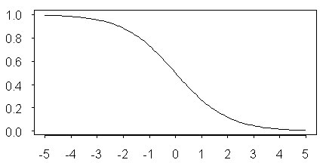
Logistic regression
Cox, 1958
f(x) = Σ_{i} w_{i} x_{i}
z = y f(x) = Σ_{i} w_{i} y x_{i}
∂z/∂w_{i} = y x_{i} Hebb’s rule update
L_{logistic} = log(1+e^{-z})
L/∂z = - e^{-z} / (1+e^{-z}) = - S(-z) Loss variation
Δw_{i} = -η ∂L/∂w_{i} = -η ∂L/∂z . ∂z/∂w_{i}
Δw_{i} = η S(-z) y x_{i}
Like Hebb’s rule but weighted: misclassified examples count more.
S(-z)
z

Slide 27
Logistic regression in Φ−space
Cox, 1958
f(x) = Σ_{i} w_{i} Φ_{i} (x)
z = y f(x) = Σ_{i} w_{i} y Φ_{i} (x)
∂z/∂w_{i} = y Φ_{i} (x)
L_{logistic} = log(1+e^{-z})
L/∂z = - e^{-z} / (1+e^{-z}) = - S(-z)
Δw_{i} = -η ∂L/∂w_{i} = -η ∂L/∂z . ∂z/∂w_{i}
Δw_{i} = η S(-z) y Φ_{i} (x)
Like Hebb’s rule but weighted: misclassified examples count more.
S(-z)
z

Slide 28
Kernel “Trick”
f(x) = Σ_{k} α_{k} k(x^{k}, x)
k(x^{k}, x) = Φ(x^{k}) • Φ(x)
f(x) = w • Φ(x)
w = Σ_{k} α_{k} Φ(x^{k})
NON
PARAMETRIC
Dual forms
PARAMETRIC

Slide 29
Kernel logistic regression
f(x) = Σ_{i} w_{i} Φ_{i}(x) = Σ_{h} α_{h} k(x^{h}, x)
Φ−space version: Δw_{i} = η S(-z) y Φ_{i}(x)
For example (x^{k}, y^{k}):
Δw = η S(-z) y^{k} Φ(x^{k})
w = Σ_{k} α_{k} Φ(x^{k}), Δw = Δα_{k} Φ(x^{k})
Δα_{k} = η S(-z) y^{k}
Note: the Δα
is different when
∂L/∂α is computed directly.

Slide 30

Comparison with hinge loss
f(x) = Σ_{i} w_{i} Φ_{i}(x) = Σ_{h} α_{h} k(x^{h}, x)
z = y f(x)
Maximum margin (hinge loss max(0, 1-z)):
Δw_{i} = η 1(1-z) y^{k} Φ_{i}(x^{k})
Δα_{k} = η 1(1-z) y^{k}
Logistic regression (logistic loss log(1+e^{-z})):
Δw_{i} = η S(-z) y^{k} Φ_{i} (x^{k})
Δα_{k} = η S(-z) y^{k}
1(1-z)
1
1
z
S(-z)
z

Slide 31
Adding shrinkage
f(x) = Σ_{i} w_{i} Φ_{i}(x) = Σ_{h} α_{h} k(x^{h}, x)
We present example k for learning.
Logistic regression without shrinkage:
Δw_{i} = η S(-z) y^{k} Φ_{i}(x^{k})
Δα_{k} = η S(-z) y^{k}
Logistic regression with shrinkage:
Δw_{i} = -γ w_{i +} η S(-z) Φ_{i}(x^{k})
w_{i} = Σ_{k} α_{k} Φ_{i}(x^{k})
Δα_{k} = -γ α_{k +} η S(-z) y^{k} for example k
Δα_{h} = -γ α_{h} for the other examples

Slide 32
Summary
To map a discriminant function f(x) to probabilities p = P(Y=1|X=x) use a link function:
f(x) = g(p)
Using the logit link g(p) = p/(1-p) leads to logistic regression; S(z) = g⁻¹(z) = 1/(1+e^{-z}) is the logistic (or sigmoid) function.
P(Y=y|X=x) = S(z) with z = y f(x).
The logistic loss is –log S(z) = log (1+ e^{-z}).
The Hebb’s rule update is multiplied by S(-z).

Slide 33
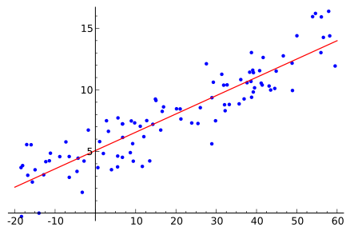
Come to my office hours… Wed 2:30-4:30 Soda 329
Next time
w₁
w₂
Σ
w_{D}
b
Linear regression

