Slide 1
UCB - CS189 Introduction to Machine Learning Fall 2015 Lecture 7: Ridge regression
Isabelle Guyon
ChaLearn

Slide 2
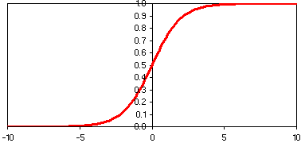
Come to my office hours… Wed 2:30-4:30 Soda 329
Last time
w₁
w₂
Σ
w_{D}
b
Logistic regression

Slide 3
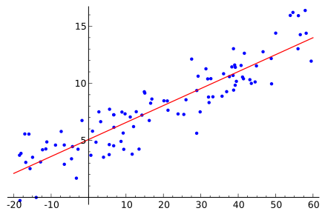
Come to my office hours… Wed 2:30-4:30 Soda 329
Today
w₁
w₂
Σ
w_{D}
b
Linear regression

Slide 4
Math prerequisites
Vectors and matrices
Matrix multiplication
Matrix inverse, determinant
Matrix diagonalization, eigen vectors, eigen values, rank of a matrix
Pseudo-inverse

Slide 5
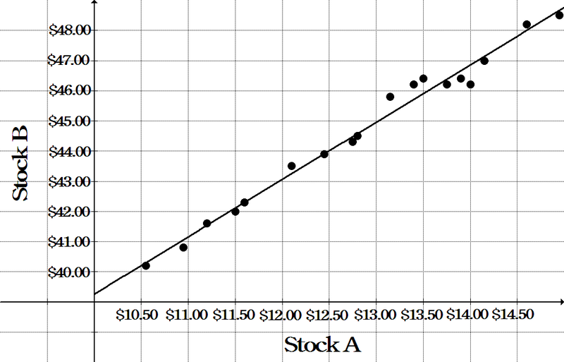
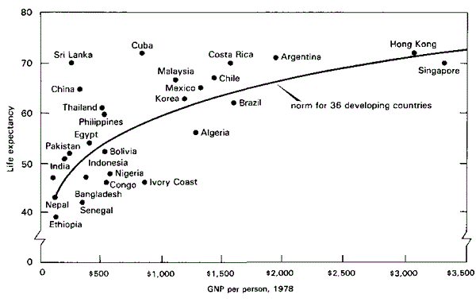
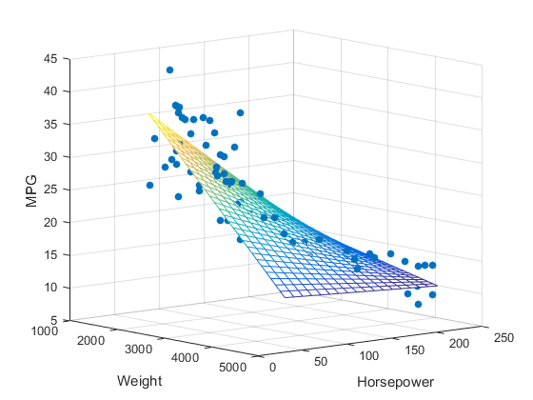

Uses of regression
Economy and Finance
Epidemiology and medicine
Apparent age estimation: http://gesture.chalearn.org
Engineering

Slide 6
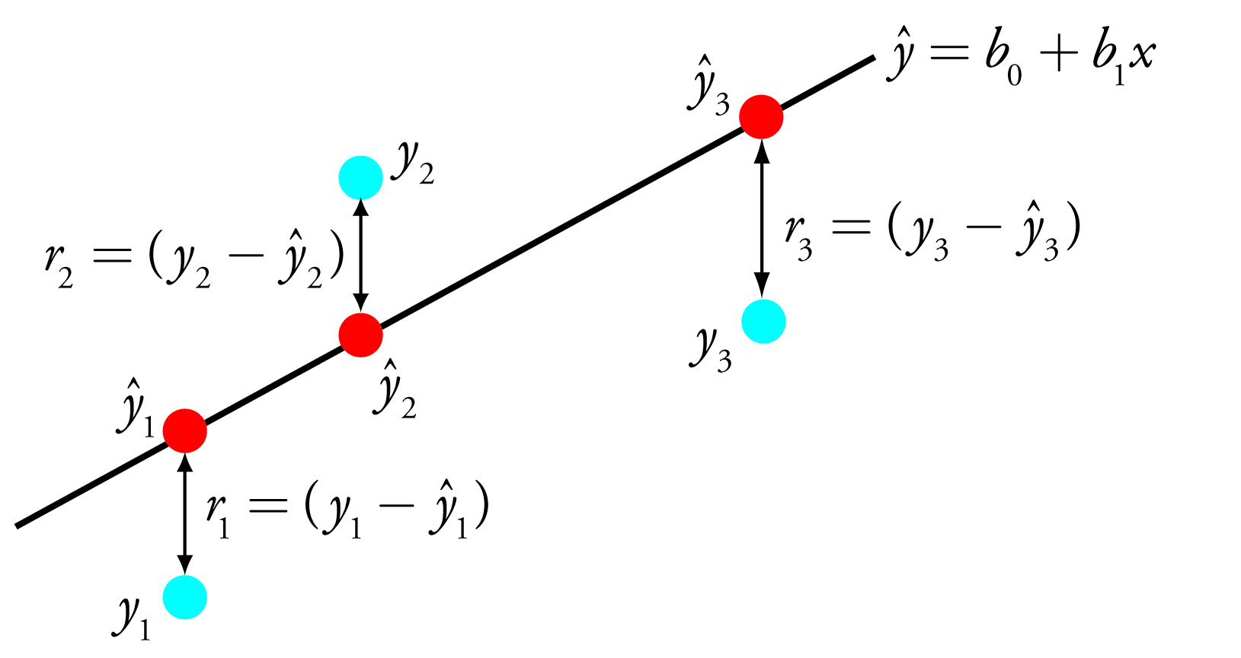
Least square regression
w₀ + w₁ x
Residual Sum of Squares (RSS):
R[w] = Σ_{k} (w₀ + w₁ x_{k} – y_{k} )² = Σ_{k} (w.x_{k} – y_{k})²
Picture: http://chemwiki.ucdavis.edu/

Slide 7
Polynomial Ridge Regression
d=polynomial degree
r=ridge (λ)
R[w] = Σ_{k} (w.Φ(x_{k}) – y_{k})² + λ ǁ w ǁ² Φ(x)=[1, x, x², x³…., x^{d}]

Slide 8
Conventions
d
X={x^{k}_{i}}
y ={y^{k}}
x^{k}
N
α
w

Slide 9
Matrix Notations
w_{i} = Σ_{k} y^{k} x^{k}_{i} w = y^{T} X w^{T} = X^{T} y
w_{i} = Σ_{k} α^{k} x^{k}_{i} w = α^{T} X w^{T} = X^{T} α
(1,d) = (1,N)(N,d) (d,1) = (d,N)(N,1)
f(x)= Σ_{i} w_{i} x_{i} f(x)= x w^{T} = w x^{T}
(1,d)(d,1) (1,d)(d,1)

Slide 10
Linear Regression
What we want:
Σ_{i}w_{i} x^{k}_{i} = y^{k} for all examples k=1…m (b=w₀)
or for classification, y^{k}=±1, sign(Σ_{i}w_{i} x^{k}_{i}) = y^{k}
Solve: Xw^{T} = y
(N,d)(d,1)=(N,1)

Slide 11
Regression: N>d
d
Solve:
X w^{T}= y
(N,d)(d,1) = (N,1)
Normal equations
X^{T}X w^{T} = X^{T}y
(d,N)(N,d)(d,1) = (d,N)(N,1)
Solution:
w^{T} = (X^{T}X)⁻¹X^{T}y
X
N
rank(X)≤min(d,N)
assume rank(X)=d
implies rank(X^{T}X)=d
X^{T}X is invertible

Slide 12
Pseudo-Inverse
Solution:
w^{T} = (X^{T} X)⁻¹ X^{T} y
(d,1) (d,N)(N,d) (d,N)(N,1) (d,N)
Predictor:
f(x) = x w^{T} = x X⁺ y
(1,1) (1,d)(d,1) (1,d)(d,N)(N,1)
Residual:
y-y = y - X w^{T} = (I-XX⁺)y
X⁺ pseudo-inverse, X⁺X=I
y
residual
projector
y
Subspace of columns of X

Slide 13
Least-Squares
y
residual
projector
y
y-y = y - X w^{T} = (I-XX⁺)y
The pseudo-inverse solution is optimal
in the least-square sense:
min_{w} ǁ y - X w^{T} ǁ² = ǁ (I-XX⁺)y ǁ²
Subspace of columns of X

Slide 14
Gradient Descent
Square loss:
L_{k} = (x^{k} w^{T} –y^{k})²
Risk = Residual Sum of Squares (RSS):
R = Σ_{k} (x^{k} w^{T} –y^{k})²
= ǁ Xw^{T} –y ǁ²
= wX^{T}Xw^{T} –2wX^{T}y +y^{T}y
Gradient:
∇_{w}R = 2 (X^{T}Xw^{T} – X^{T}y)

Slide 15
Normal Equations
At the optimum:
∇_{w}R = 0
2 (X^{T}Xw^{T} – X^{T}y) = 0
Normal equations (again):
X^{T}Xw^{T} = X^{T}y
Solve by inverting X^{T}X, if regular.
What if X^{T}X, is singular?

Slide 16
Regularization
Normal equations:
X^{T} X w^{T} = X^{T} y
(d,N)(N,d)(d,1) = (d,N)(N,1)
Case N<d (interpolation),
rank(X)≤N<d, matrix X^{T}X singular.
Replace X^{T}X by (X^{T}X+λI) λ>0
Solution:
w^{T} = (X^{T} X +λI)⁻¹ X^{T} y
(d,1) (d,N)(N,d) (d,d) (d,N) (N,1)
Regularized inverse

Slide 17
Why it works
Diagonalization:
X^{T}X = U D U^{T}
U orthogonal matrix of eigenvectors (UU^{T}=I)
D diagonal matrix of eigenvalues
Singularity: some eigenvalues are zero.
Regularization:
X^{T}X + λI = U (D+λI) U^{T} λ>0
no more zero eigenvalue.

Slide 18
Penalized Risk
Residual Sum of Squares (RSS):
R = Σ_{k} (x^{k} w^{T} –y^{k})²
= ǁ Xw^{T} –y ǁ²
Add “regularizer”:
R = ǁ Xw^{T} –y ǁ² + λ ǁ w ǁ² λ>0
Gradient:
∇_{w}R = 2 ((X^{T}X+ λ I) w^{T} – X^{T}y)

Slide 19
Mechanical Interpretation
Quadratic form:
R = ǁ Xw^{T} –y ǁ² + λ ǁ w ǁ²
One dimension:
R = p (w-w₀)² + λ w²
Two dimensions:
(w-w₀)²
−2λw
2p(w-w₀)
p
w₂
w₀
w
w₁

Slide 20
Principal Component Analysis
x^{k}
X
(N,d)
U(d,d’)
=
X’
(N,d’)
x’^{k}
f_{j}
u_{j}
Problem: Construct features that are linear combinations of the original features, such that the reconstructed patterns are as close as possible to the original in the least square sense.
f_{j} = X u_{j} linear combinations of columns of X
x’’^{k} = x’^{k} U^{T} = Σ_{j} x’^{k}_{j} u_{j} reconstructed pattern
X’
(N,d’)
U^{T}
(d’,d)
=
X’’
(N,d)
x’^{k}
x’’^{k}

Slide 21
PCA Solution
X’ = X U
X’’ = X’ U^{T}
X’’ = X UU^{T}
min_{U} ǁ X - X UU^{T} ǁ²
Can be brought back to solving and eigenvalue problem: X^{T}X = UDU^{T} i.e. X’^{T}X’=D
Compare:
Regularization X^{T}X + λI = U(D+ λI)U^{T}
PCA: Remove the dimensions with smallest eigenvalues.

Slide 22
Kernel “Trick” (N<d)
Solve: Xw^{T} = y
Assume: w = Σ_{K} α^{k} x^{k} = α^{T} X
(1,d) (1,N) (N,d)
Solve instead: X X^{T} α = y
(N,d)(d,N)(N,1)=(N,1)
Solution: α = (X X^{T})⁻¹ y
w^{T}= X^{T}(X X^{T})⁻¹ y
Full rank (N,N) matrix
X⁺

Slide 23
Kernel Ridge Regression
Ξ = Φ(X)
Solve: Ξw^{T} = y
Assume: w = Σ_{i} α_{i} ξ_{i} = α^{T} Ξ
(1,D) (1,N) (N,D)
Solve instead: Ξ Ξ^{T} α = y
(N,D)(D,N)(N,1)=(N,1)
Solution: α = K⁻¹ y
Regularization: replace K by K+λI
(N,N) kernel matrix K

Slide 24
Regularization and PI
Case N>d and rank(X^{T}X)=d
X⁺ = (X^{T} X)⁻¹ X^{T}
Case N<d and rank(X^{T}X)=N
X⁺ = X^{T}(X X^{T})⁻¹
Either case:
X⁺ = lim _{λ→0} (X^{T}X + λI) ⁻¹ X^{T}
= lim _{λ→0} X^{T} (X X^{T} + λI)⁻¹

Slide 25
Summary
Least square regression for models linear in their parameters can be achieved with:
Stochastic gradient (suited for big data, see next lesson)
Pseudo-inverse (requires matrix inversion):
If d<N, invert X^{T}X, a (d,d) matrix.
If N<d, invert X X^{T}, a (N,N) matrix.
Kernelization is easy Ξ = Φ(X)
Invert Ξ Ξ^{T}, the kernel matrix K, a (N,N) matrix.
Shrinkage for robustness:
Add a “ridge” = a small positive value to the diagonal.

Slide 26
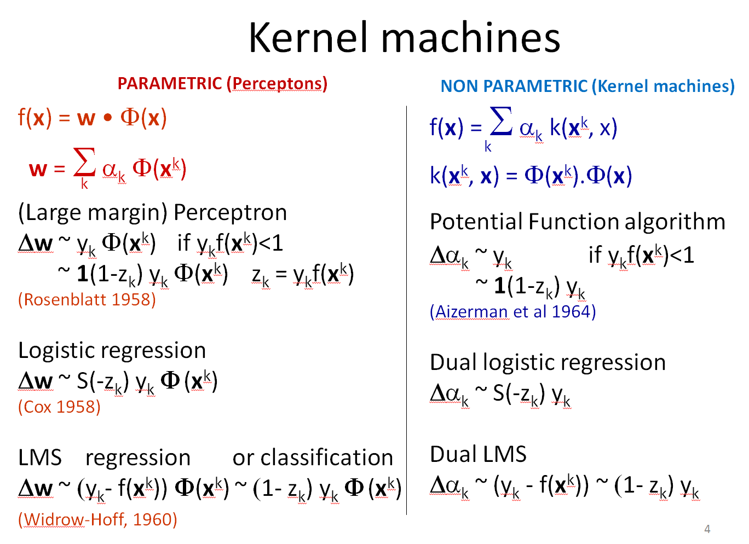
Come to my office hours… Wed 2:30-4:30 Soda 329
Next time

