Slide 1
Biomimicry Project

Slide 2
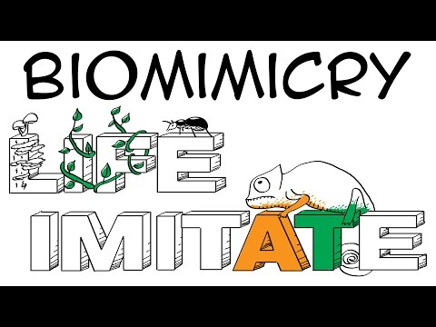
What is Biomimicry

Slide 3
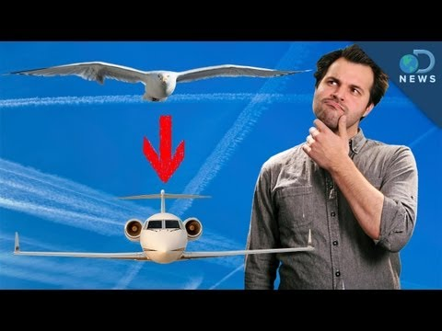
Nature is Smarter than Us

Slide 4
How Biomimicry Works
In your Notebooks, answer the following questions:
Define sustainability
Describe why our current technology and way of life is not sustainable. (Give at least 3 examples)
List Nature’s Nine Laws, described by Janine M. Benyus
USE THESE LINKS FOR YOUR RESEARCH: goo.gl/eVBggV https://tinyurl.com/y6mlc7ar

Slide 5
Day 2

Slide 6
Defining the Problem and Researching Solutions
Define/redefine the problem in your own words.
Example: I want a hovercraft.
Ask the question in biological terms.
Example: How do various animals hover?
Research the problem and possible solutions.
Record your ideas/information in your NB.
List questions you have and information needed to solve it.
Example: How do current hovercrafts work? Which animals hover? Which animals must hover to survive? How does a hummingbird hover?
List topics and keywords to use in your research.
Two credible sources are required. A good place to start is www.asknature.org

