Slide 1
Basic Genetic Concepts & Terms
Notes:
This set of slides can be used as a review or introduction of basic genetic concepts that students should know before the Lessons 1 and 2.

Slide 2
Genetics: what is it?
What is genetics?
  “Genetics is the study of heredity, the process in which a parent passes certain genes onto their children.” (http://www.nlm.nih.gov/medlineplus/ency/article/002048.htm)
What does that mean?
  Children inherit their biological parents’ genes that express specific traits, such as some physical characteristics, natural talents, and genetic disorders.
Notes:
Conduct a brief class discussion to assess students’ knowledge and assumptions about genetics, while providing the information to those students who may not have any prior knowledge.

Slide 3
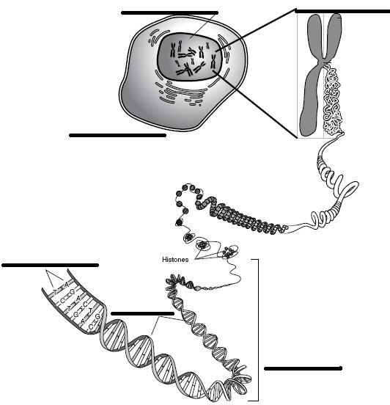
Word Match Activity
Match the genetic terms to their corresponding parts of the illustration.
base pair
cell
chromosome
DNA
(Deoxyribonucleic Acid)
double helix*
genes
nucleus
Illustration Source: Talking Glossary of Genetic Terms http://www.genome.gov/glossary/
Notes:
Hand out the Word Match Activity worksheet and ask students to work in pairs to complete the worksheet.
* Tell students that “double is paired with another term, and that both terms should be placed in one of the six areas indicated on the illustration.

Slide 4
Word Match Activity
base pair
cell
chromosome
DNA
(Deoxyribonucleic Acid)
double helix*
genes
nucleus
Illustration Source: Talking Glossary of Genetic Terms http://www.genome.gov/glossary/
nucleus
chromosome
cell
base pair
(double
helix)
DNA
genes
Notes:
Have students volunteer the answers and clarify that “double helix” is the structure of DNA.

Slide 5
Genetic Concepts
H describes how some traits are passed from parents to their children.
The traits are expressed by g , which are small sections of DNA that are coded for specific traits.
Genes are found on ch ___.
Humans have two sets of _ (hint: a number) chromosomes—one set from each parent.
Notes:
Use this overhead for students to complete the 4 sentences.

Slide 6
Genetic Concepts
Heredity describes how some traits are passed from parents to their children.
The traits are expressed by genes, which are small sections of DNA that are coded for specific traits.
Genes are found on chromosomes.
Humans have two sets of 23 chromosomes—one set from each parent.
Notes:
Have students volunteer their answers, and help students understand that the inherited traits are passed from one generation to the next as the parents’ chromosomes are copied and passed to their children.

Slide 7
Genetic Terms
Use library resources to define the following words and write their definitions using your own words.
  allele:
  genes:
  dominant :
  recessive:
  homozygous:
  heterozygous:
  genotype:
  phenotype:
  Mendelian Inheritance:
Notes:
Optional: For this task, pre-arrange with a school librarian or media specialist to provide students with the computers with the web sites, “Talking Glossary of Genetic Terms” (http://www.genome.gov/10002096) and/or “DNA from the Beginning’s Classical Genetics” (http://www.dnaftb.org/dnaftb/), in addition to other reference materials student pairs can used to complete the task.
Hand out the Basic Genetic Terms worksheet and provide reference materials for students to use in completing the worksheet.
Have student pairs take turns in sharing their definitions and examples of the terms. (See the Basic Genetic Terms for Teachers for sample definitions and examples.)

Slide 8
Mendelian Inheritance
The inherited traits are determined by genes that are passed from parents to children.
A child inherits two sets of genes—one from each parent.
A trait may not be observable, but its gene can be passed to the next generation.
Notes:
Review key concepts of Mendelian Inheritance with students. For #3, ask students what situations may call for an unobservable trait to be passed from parents to children. Students may be able to apply their understanding of dominant and recessive traits where parents with both dominant and recessive traits only show dominant traits while being able to pass their recessive traits to the next generation.

Slide 9
Mendelian Inheritance
Each person has 2 copies of every gene—one copy from mom and a second copy from dad. These copies may come in different variations, known as alleles, that express different traits.
For example, 2 alleles in the gene for freckles are inherited from mom and dad:
  allele from mom = has freckles (F)
  allele from dad = no freckles (f)
  child has the inherited gene pair of alleles, Ff (F allele from mom and f allele from dad).
Notes:
Review with students the term “allele” (a variant form of a gene) and help students understand that each gene has a pair or two alleles—one allele from mom and the other from dad.

