Slide 1

The Anacaz
Integrated Diagnostics Subsystem
www.anacaz.com

Slide 2

Contents
Integrated Diagnostics Subsystem
Changing How Platforms Are Developed
1
Anacaz
2
Diagnostics Overview
3
The Solution
4
Wrap Up

Slide 3
About Anacaz
Established
  Incorporated in Delaware, November 2002
  HQ – San Jose, CA
On-Demand Solutions
  MCP, Information Technologies , Application Development, Application Roll Out, Server Deployments
Advanced Communications Engineering
  System, Hardware, ASIC, FPGA, Firmware, RTOS, BSP, Protocol Stacks, Applications, GUIs
Power Systems
  Design, Reliability, Root Cause Analysis, Corrective Action Determination, Low Impact ECOs

Slide 4






Anacaz Partners
Partnerships
  Intel ICA Affiliate Partner
  Cavium Networks
  WindRiver
  MontaVista
  Microsoft
  Marvell

Slide 5












Anacaz Serves

Slide 6
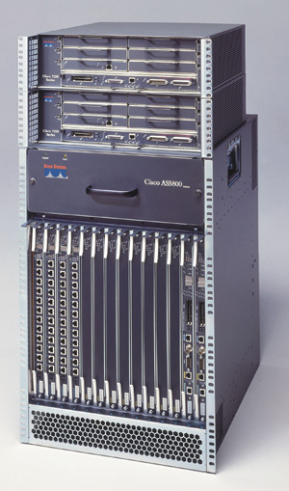

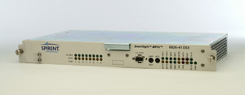
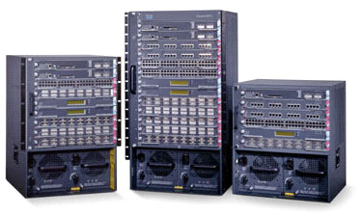
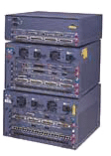
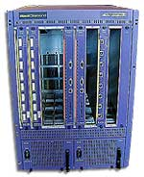
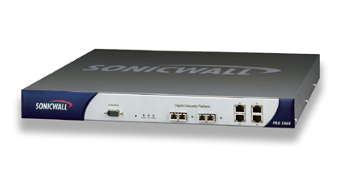
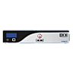
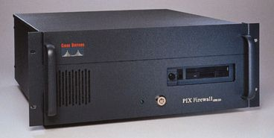

Anacaz Accomplishes

Slide 7
Diagnostics Overview

Slide 8
History
Diagnostics have typically been an after thought during the product development cycle
Only after outsourcing to contract manufacturers did hardware diagnostics become a requirement
Still today diagnostic subsystems have not kept up with the exponential evolution of the hardware they have to test

Slide 9
The Reality
Based on current design trends, PCB designs started this year are expected to exceed 5100 components
Test development ranges from hours to days depending on component complexity
Total time to provide full functional tests can easily exceed 20 engineering months!!

Slide 10
The Challenge
Improve verification, validation and in-systems diagnostics processes
Shorten product development cycle
Squeeze development and manufacturing schedules and costs
Improve time-to-market

Slide 11
The Solution

Slide 12
Anacaz IDS
Run diagnostic tests on custom hardware using easy to install Diagnostic Framework with menu driven user interface
Integrates into boot loader with direct access to hardware
Includes basic diagnostics
Add downloadable parameterized tests easily/quickly
Hardware bringup, prototype regressions, manufacturing burn-in/verification
Functional and design documentation to facilitate developer ramp up

Slide 13
Shortened product
development cycle
Easy to port
IDS
Bring-up, regressions,
burn-in/verification
Full Documentation
Add new tests easily
Pre-defined basic
diagnostics

Slide 14
Key Features
Ports to new hardware quickly
Close to the hardware in boot loader
Basic tests available immediately
Add new downloadable tests readily
Parametrically configure test suites easily
Easy to use intuitive menu driven user interface
Easy to script for automated execution and results capture using Industry Standard tools, i.e., LabVIEW
Core IDS has small footprint; download diagnostic tests from TFTP server
Full documentation for quick ramp up

Slide 15
Benefits
Time-to-market accelerated by at least 3 man months
Improved design validation coverage shortening board re-spin decision time
Reduced risk of design errors leading to product failures
Significantly reduced development costs

Slide 16
Wrap Up

Slide 17
Complete Diagnostic Solution
IDS
Solves Your Diagnostic
Needs
Fast Development Cycle
Reduced Development Costs

Slide 18
Thank You !
www.anacaz.com

