Slide 1
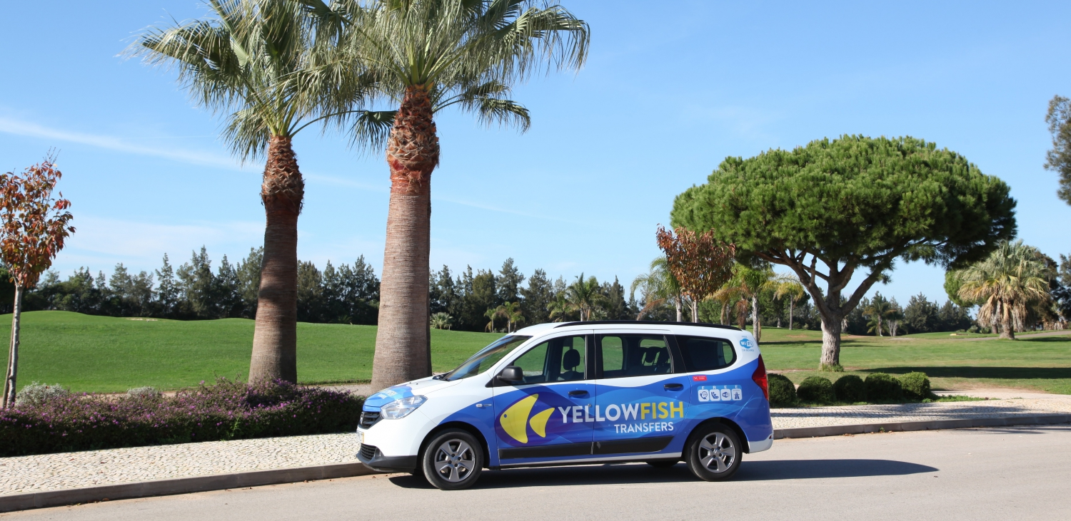
Business Cases with Data Science
2019-2020 Nuno António
Business Case:
Service Demand Forecast
Palm & Company
Pedro Santos (M20190420)
Ana Cláudia Alferes (M20190932)
Lennart Dangers (M20190251)
Michael Machatschek (M20190054)

Slide 2




Current Situation and Problems
Palm & Company
Volatile Market
High dependencies: Seasonality and other effects
Recruiting is time-consuming and costly
Booking and Cancellation Policy
No limitation within the booking
Cost of Underestimation
Subcontract competitors: Future losses and no quality control
Cost of Overestimation
Too many employees: High fixed costs
Notes:
Your business is expected by seasonality and other dependencies such as natural disasters
Your demand is fairly volatile
Your booking and cancellation strategy to accept every booking and short time cancellation may be appropriate in terms of sales
More challenging to obtain the right demand
If you hire less drivers, cost of underestimation occur:
Loss of potential future revenues
Due to subcontracting partners aka competitors, less quality control possible
If you hire too many drivers, cost of overestimation occur:
High HR cost (fixed costs)
--> Recruiting is a time-consuming and costly process! We cannot cure this or the seasonality of your business, but we can help to obtain a more accurate planning in advance. How? …. Next slide

Slide 3
How does a demand forecast help you
Palm & Company
Avoid costs
Keep control
Focus on humans
Accurate demand forecast can help to get rid of costs due to under- and overestimation.
Services can execute inhouse → keep the full quality control.
Enough time to do a decent hiring process. Choose the best!
Notes:
Our demand forecast helps to cure under- and overestimation of drivers and therefore can save money
Secondly, you will keep the control about the quality because less services has to be done by competitor in which you don't have the quality control
Lastly, you can focus on your core business. A prediction of 8 weeks in advance helps you to start a proper hiring process and gives you the chance to pick and train the best employees

Slide 4


Business Goals
Palm & Company
Understand your business
Predict demand forecast
Knowledge as a key resource.
Maximum deviation of 10 %.
Provide Data Insights
Provide Deployment Strategies
Patterns as a side product.
How could you implement and maintain our model.
Notes:
In this project we had the following goals the suit you best:
1. Understand your business:
It is vital to understand all of your business: how yellow fish operates and what are the day-to-day processes
2. Provide you with valuable insight: Even though the task is to create a prediction model, we want to give you patterns that your data shows us
3. Main goal: Predict your forecast, 8 weeks in advance in 4 weeks batches
Here we try to predict the demand with a deviation of 10 % at a maximum
4. Provide Deployment Strategy and recommendations how to maintain the model
How we did it: You can see on the next slides of this presentation

Slide 5
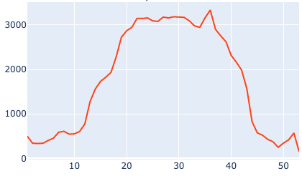
Data Exploration
Palm & Company
Average Number of Services per week
The number of services usually increases in the Summer Season

Slide 6
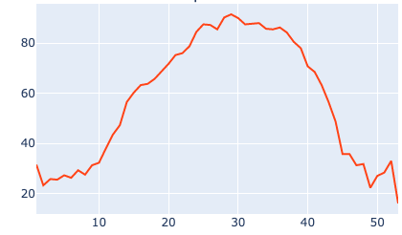
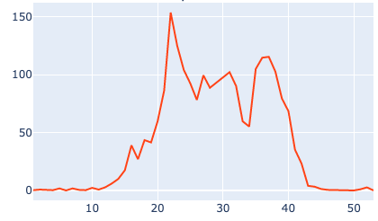
Data Exploration
Palm & Company
Average Number of Drivers per week
Average Number of Services made by Partners per week
The company needs more resources on the Summer Season
It is required to give up some of the services to company partners, because of the lack of resources

Slide 7
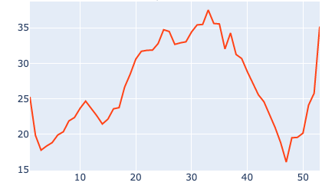
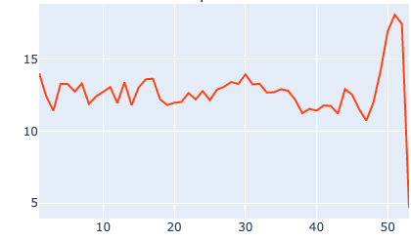
Data Exploration
Palm & Company
Average Lead Time per week
Average Cancelation Ratio per week
Customers book more in advanced on the weeks corresponding to the higher market demand
The peak of the cancellation ratio it's 18.1% in December

Slide 8
Data Preparation and Modeling
Palm & Company
1. ETL Process
3. Model Selection
2. Feature Engineering
and Selection
4. Final Model Evaluation
Notes:
Overlook of our Data preparation and Modeling process
Started by creating an ETL process to generate our working data set.
Followed by the creation of new features.
model selection and evaluation
Finally working with the best performing model and evaluate the results

Slide 9
Palm & Company
Methodology – step by step
1.
ETL Process
Merging different datasets
Filtering relevant data
Computing new variables
Aggregating values by week

Slide 10
Palm & Company
2.
Feature Engineering and Selection
Creation of lag features
Creation of ratio features
Creation of anomaly detection
Evaluation of different feature sets

Slide 11
Palm & Company
3.
Model Selection
Definition of evaluation metrics
Comparison of different models
Eight different models
Usage of different feature sets
Notes:
Definition of evaluation metrics, such as the MAPE and the MAE, which measure the average size of the error
Used 8 different models, such as ensemble models, linear models and Neural Networks, and compared them on the above metrics
This comparision was made over several different feature sets to evaluate the best performing model

Slide 12
Palm & Company
4.
Final Model Evaluation
Fully connected Neural Network
Evaluation on test set – MAPE 12,5%
Evaluation with Walk Forward approach
Evaluation with Rolling Window
Iterative Process
Notes:
The best performing modeel was a Fully Connected Neural Network, which presented a MAPE of 12,5% on the test set
There was also performed an evaluation with a walk forward and rolling window approach, which you can read more about it on the report
Finally, it is improtant to mention that this was an iterative process, since whenever changes were made, like new features or new etl process, all the previou steps were retaken to ensure the output was the best model possible.

Slide 13
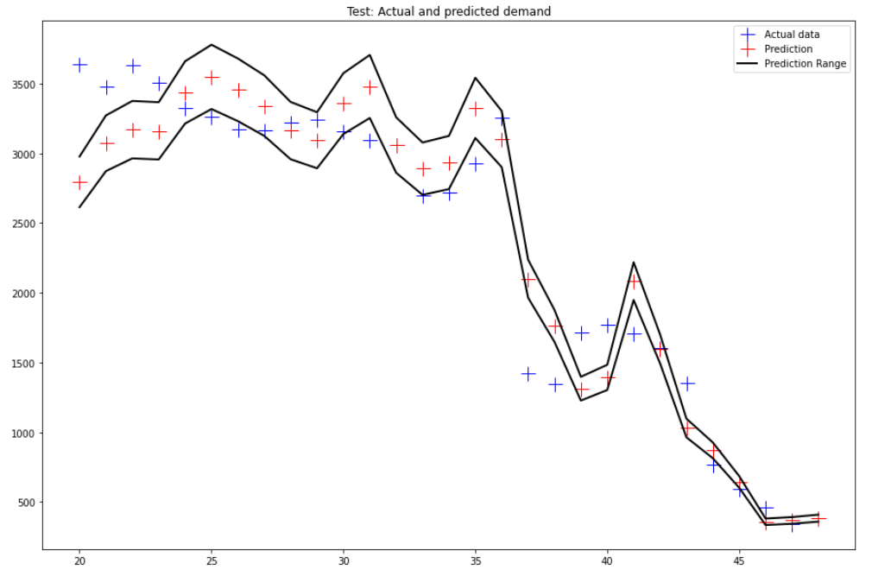
Final Model Visualization
Palm & Company
Number of Services
MAPE:12,5%
Week of Year
Notes:
Plot of the predicitons (red cross) and actual data (blue cross). The black line is the 10% interval requested (+-5% from the predicted value)
It is important to note that the testing data contains some irregularities, such as the bankruptcy of the Thomas Cook airlines, which is difficult for the model to predict the actual drop in demand.

Slide 14




Model deployment
Palm & Company
Yellow Fish
Database
Planning Software
Update Model
Insert in
Output
Final Model
Dashboard
Files (i.e. CSV)
Notes:
- Depending on your wishes several ways are possible
- main part of deployment deals with the question of how to extract, transform, and load (ETL) the data to ensure a smooth integration in the already existing infrastructure
- one option: load the predictions into the Yellow Fish’ database
- this should include automated ETL jobs
- new transaction data can update the model to improve the predictions
- file-Output, such as CSV, is also possible
- we would recommend the first version because of data consistency
- In both approaches, the output can be used to feed data into the already existing planning software of Yellow Fish
- In addition: a dashboard could be created to provide the management with live forecasts and crucial business figures

Slide 15



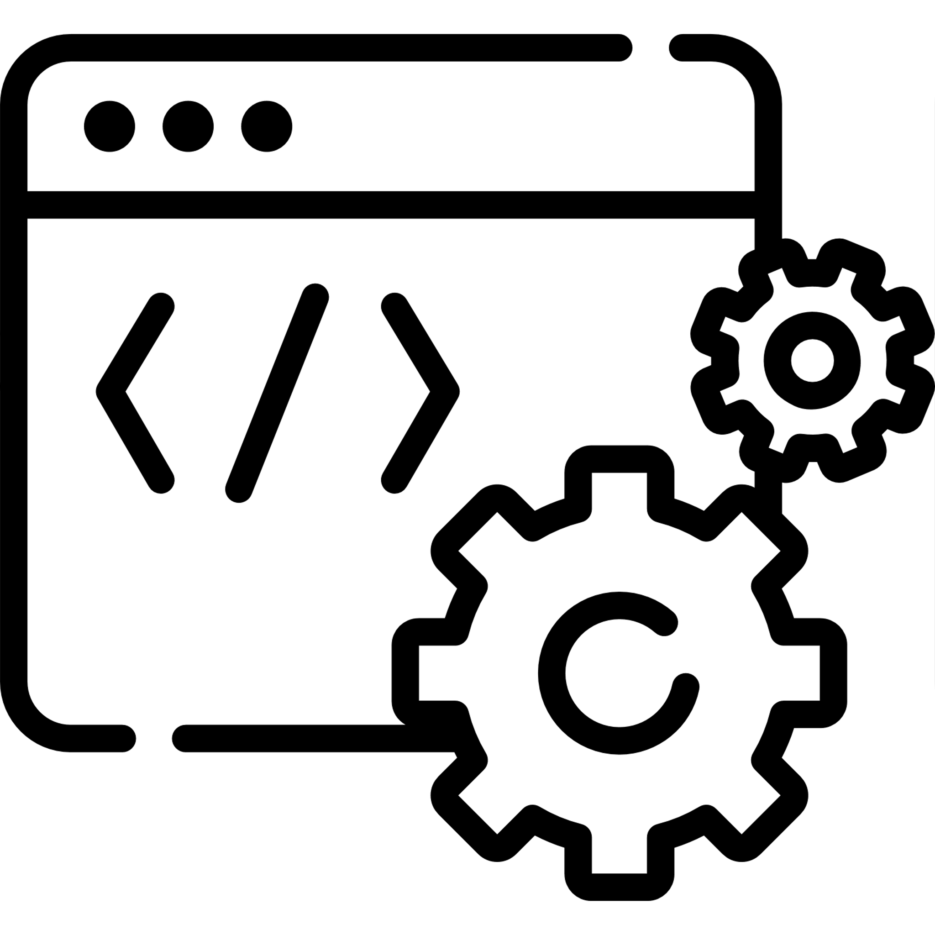
Maintenance is crucial
Palm & Company
Controlling
Implement a metrics to retrospectively check the predictions
Automation
Check ETL processes to ensure automation
Cyclically
Model should be cyclically renewed
Maintenance
Ongoing maintenance is required

Slide 16
Our evaluation
Palm & Company
Still a good model?
Business Insights
Test data (2019) could have been not a "normal" year
less time in advance to do prediction
more data cause better results
Predict Services
Through our exploratory data analysis useful insights were found.
12 - 13 % deviation (in several iterations) from the actual prediction
Notes:
- regarding our defined goals, we could get several valuable insights which we already showed you. More can be found in the source code and report
- we were able to create a model with deviation of 12.5 % from the actual prediction
- although this is above the business goal of 10 % this model can be considered as a good model
- due to the weekly data aggregation, we had less data to train our model
- more data will improve the predictions
- a possible recommendation would be to use less time in advance to do the prediction until more data is available
- the model was evaluated with the data of 2019 which could represent an abnormal year

Slide 17


Flexible solution
Conclusion
Demand Forecasting
Satisfying solution for demand forecasting
Better planning capability
Future Improvements
Notes:
Flexible solution:
- Our solution offers you enough flexibilty to react to short-term events that affect your business.
Satisfying solution for demand forecasting:
- Our solution let you save costs and build your customer base by balancing over- and underestimation of the demand.
Better planning capability:
Particularly in uncertain times like these, companies need to adapt their strategic and operational plans wisely. Data can offer additional intelligence for planning capability.
Future Improvements:
- With more training data and further model optimization, there is still a lot potential for improvement. We are dedicated to realize this potential for you.

Slide 18
Thank You!
Palm & Company
Pedro Santos (M20190420)
Ana Cláudia Alferes (M20190932)
Lennart Dangers (M20190251)
Michael Machatschek (M20190054)

