Slide 1








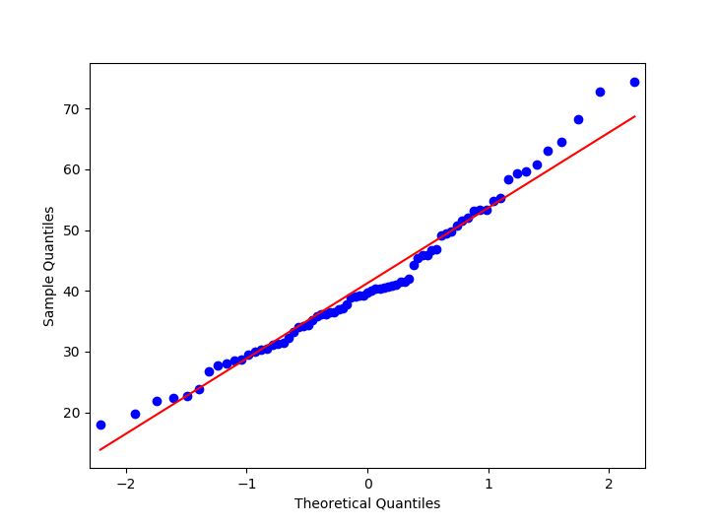
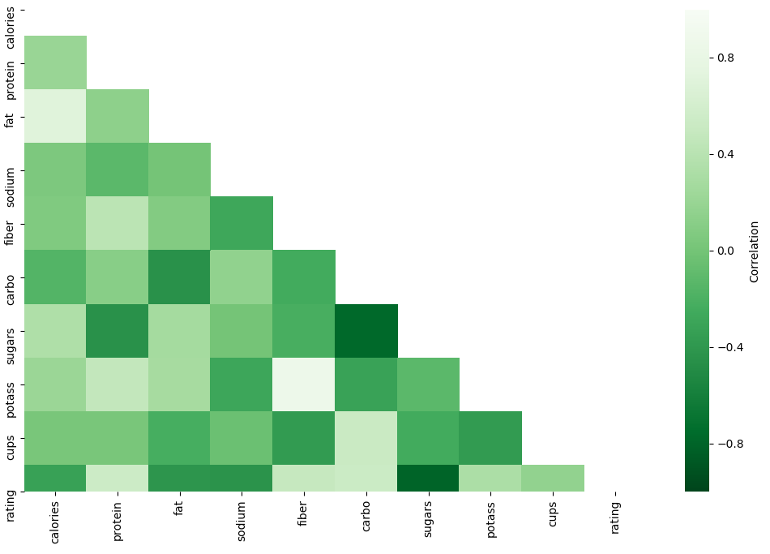
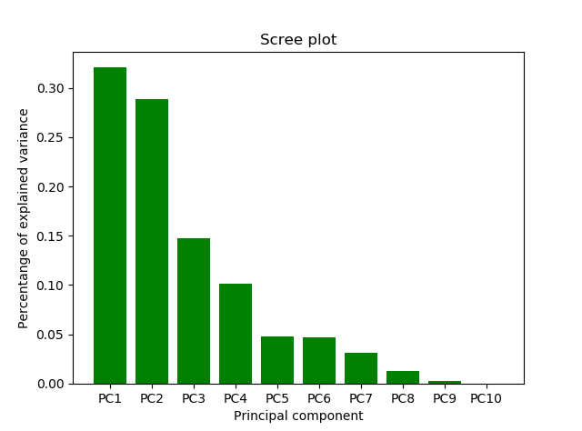
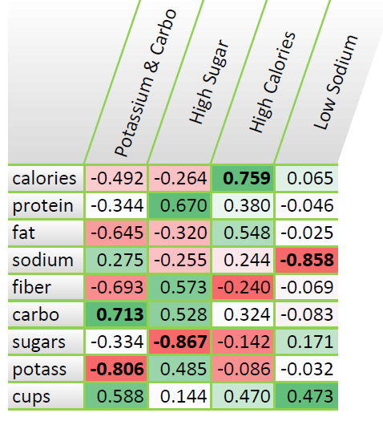
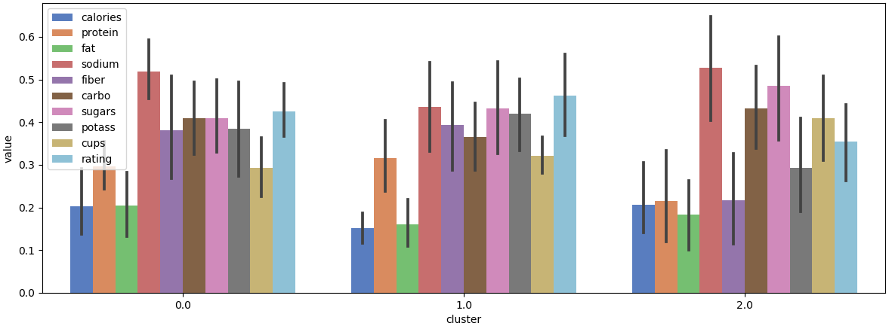
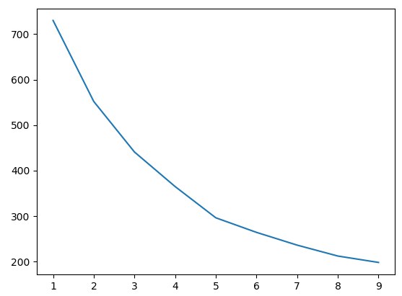
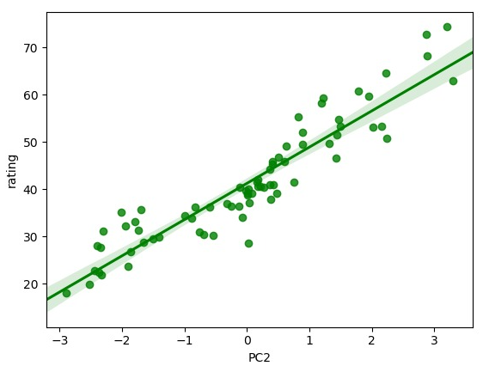


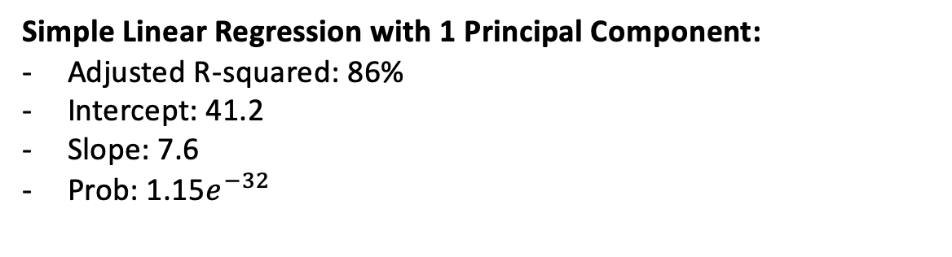
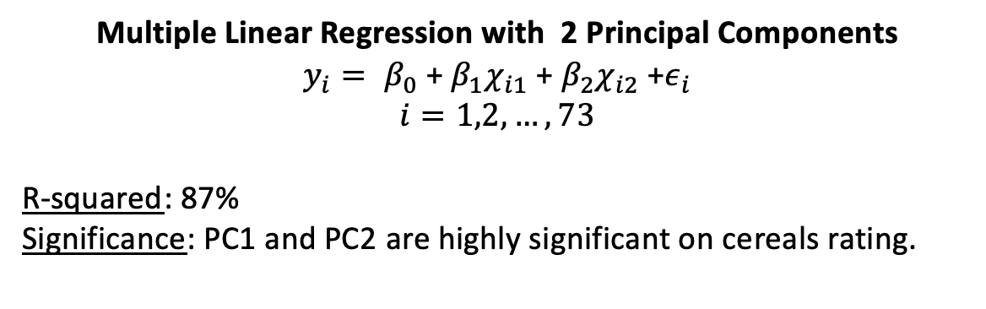
Cereals & Ratings
A Statistical Overview
Data Description & Exploration
Data Source:
Cereal dataset with multiple different cereals with
different ratings based on survey from the consumers.
16 Variables & 80 Entries
Variables:
Methodology:
Data pre-processing
Dimension Reduction
PCA
Clustering
K-Means
Linear Regression
Normality Assumption:
In order to use standard techniques (parametric statistical methods), the dataset has to follow the normal distribution
Quantile-Quantile Plot (QQ-Plot):
A QQ-Plot is a graphical method to verify a normal distribution. If the datapoints (represents the quantiles of the dataset) are close to line (represents normal distribution), the data is normally distributed.
Correlation:
The correlation heatmap shows
Strong negative correlation between sugar and the rating
Strong negative correlation between sugar and carbohydrates
Strong positive correlation between fiber and potassium
Average correlation among all other variables
Rating
Calories
Protein
Carbs
Standardize everything related to weight to 100 Grams
Sugar
Sodium
Fiber
Fat
Objective:
Analysis of the ratings of the cereals
Similarity analysis of the cereals
Predict the ratings of new possible cereals
Interpretation QQ-Plot:
The datapoints are close to the line. Hence, we can assume normal distribution and are able to apply standard parametric statistical methods.
Principal Component Analysis (PCA)
Conclusion PC:
PC1 (Potassium & Carbs) is strongly positive correlated to carbo (complex carbohydrates) and highly negative correlated to potassium, therefore the PC1 increases with increasing in carbo and decrease with increasing in potassium
PC2 (High Sugar) has a strong negative correlation with sugar and a relatively high positive correlation with protein. PC2 mostly explains variable sugar
PC3 (High Calories) has a positive correlation with calories and is primarily an explanation of calories and increases with increasing calories
PC4 (Low Sodium) has a strong negative correlation with sodium and is primarily a measure of sodium. This PC decreases with increasing in sodium
Objectives of PCA:
Build new variables (linear combinations of existing variables)
Reduce dimensionality
Interpretation Scree Plot:
PC 1 explains 32 % of the variation
PC1 – PC4 explains 86 % of the variation which can be considered as adequate
Further use of PCA:
Computed PC’s can be used for the following clustering analysis or a linear regression
Clustering
Interpretation Clustering:
On the side plot we can have a visual look of our final clusters according our variables
Cluster 0 - Medium Rating, High Protein
- This group are composed by the least healthy cereals with High Calories; High Fat and High Fiber
Cluster 1 - High Rating, Low Calories
- This group are composed by the healthy cereals with Low Calories; Low Fat and Low Sugar
Cluster 2 - Low Rating, High Sugar
- This group are composed by the sweet cereals with an Average Calorie and Average Fat but High Sugar
The calculation of the distance between clusters using Euclidean distances it’s also presented on the right table.
Objectives Clustering:
Grouping cereals with similar components
K-Means was the chosen method with 3 clusters based on the elbow graph below
 | C0 | C1 | C2
C0 | 0 | 47.2 | 21.9
C1 | 47.2 | 0 | 47.8
C2 | 21.9 | 47.8 | 0
Conclusion Clustering:
After looking into the final clusters we realize that, unlike to our initial thinking, healthier cereals have a higher rating than sweeter cereals.
Linear Regression
Simple Linear Regression with 1 Principal Component:
Adjusted R-squared: 86%
Intercept: 41.2
Slope: 7.6
Prob: 1.15$e^{−32}$
Multiple Linear Regression with 2 Principal Components
$y_{i}= β_{0}$ + $β_{1}χ_{i1}$ + $β_{2}χ_{i2}$ $\text{+}ε_{i}$
$$i=1,2,…,73$$
R-squared: 87%
Significance: PC1 and PC2 are highly significant on cereals rating.
Objectives Linear Regression:
Predicting the rating of cereals
Understanding the importance of each variable through the coefficients
Assumption of the Model:
Linear in parameters
No perfect collinearity
Zero conditional zeros
Homoscedasticity
No correlation of errors
Normality
Conclusion Linear Regression:
The rating is mostly driven by sugars. Since our PC2 explains the most variance of sugars it’s the one which fits better the model for rating.
The addiction of PC1 improves the model score by adding the Potassium and Carbs components while keeping an easy interpretability.
Conclusion
Cereals are grown for their highly nutritious edible seeds which are often referred to as grains, but once they are processed and mix with other ingredients in order to be commercialized, they might become a dangerous to our health.
PCA analysis we can see that the most import feature in cereals are values for Potassium and Carbs; Sugar; Calories and Sodium.
Clustering analysis show us an overview of the differences and similarities between groups of cereals with emphasis on the rating variable made by the consumers of the different cereals. We can easily see that healthier cereals have higher ratings.
Linear Regression proves the conclusions above as a higher amount of sugars will lead to a lower rating.
Nova IMS – Data Science & Advanced Analytics
Statistics for Data Science
2019/20
Ana Cláudia Alferes M20190932
Lennart Dangers M20190251
Pedro Santos M20190420

