Slide 1
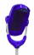

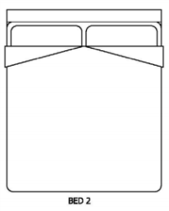
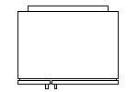
Environmental sensors
Balcony
5 PIR
2 Door contact
2 Bed/Chair Occupancy
1 Flood detector
1 Giraff robot
Bedroom
Living room
Physiological sensors
1 Fall detector
1 Scale
1 Blood pressure
1 Giraff Robot
Bathroom
Entrance
Kitchen

