Slide 1
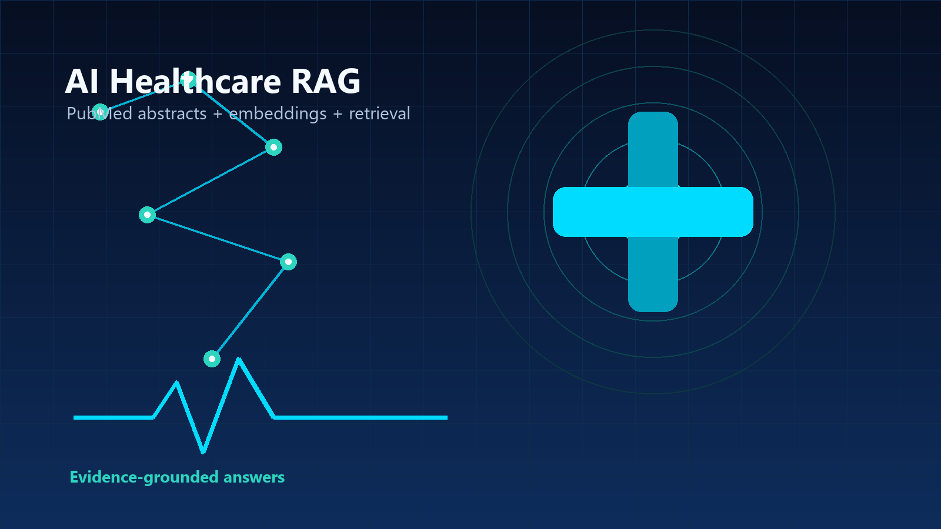
PubMed RAG Chatbot
Retrieval-Augmented Generation for PubMed Medical Abstracts
- MongoDB vector storage
- Sentence-transformers embeddings
- Conversation memory
- Gradio chatbot interface
Team Members
AI
Healthcare
Cybersecurity Style
Omar Medhat
221004675
Nagham ElNoshokaty
221006874
Yousef Ashraf
221005207
Marwan Ashraf
221005698
Farouk Faisal
221006961
Arab Academy for Science, Technology & Maritime Transport
PubMed RAG Chatbot | MongoDB + Sentence-Transformers + Gradio
Notes:
Open by introducing the team and the project as a medical RAG chatbot that uses PubMed abstracts, embeddings, MongoDB, memory, and a Gradio UI.

Slide 2
Introduction
Why medical chatbots need grounded answers
CHAT
Chatbot
RISK
Hallucination Risk
MED
Medical Accuracy
A software assistant that receives a user question and returns a conversational answer.
Normal LLMs may generate confident answers that are not supported by the project data.
Medical questions require traceable evidence, source chunks, and conservative answers.
Project Motivation
- Answer from medical abstracts, not from unsupported model memory
- Show the retrieved PubMed sources used for each answer
- Say when the dataset does not contain enough information
PubMed RAG Chatbot | MongoDB + Sentence-Transformers + Gradio
02
Notes:
Explain that the project focuses on reducing unsupported answers in a medical dataset setting.

Slide 3
What Is RAG?
Retrieval-Augmented Generation in one flow
Q
User Question
RET
Retrieval
CTX
Context
ANS
Answer
Medical query from the chat UI
Find similar PubMed chunks in MongoDB
Attach top source chunks to the prompt
Respond only from retrieved context
Key Idea
The model does not answer from memory alone. It first retrieves project-specific evidence, then builds the final response.
PubMed RAG Chatbot | MongoDB + Sentence-Transformers + Gradio
03
Notes:
Use this slide to define RAG simply: retrieval first, answer second.

Slide 4
Project Idea
A chatbot grounded in PubMed abstracts
Without RAG
With This Project
- Question goes directly to model memory
- No project dataset check
- Higher risk of unsupported medical claims
- Sources are not visible to the user
- Question is embedded as a vector
- MongoDB returns relevant PubMed chunks
- Prompt includes evidence and memory
- Answer is generated only from retrieved context
!
OK
PubMed RAG Chatbot | MongoDB + Sentence-Transformers + Gradio
04
Notes:
Contrast a generic chatbot with this grounded RAG workflow.

Slide 5
Dataset
Kaggle PubMed Multilabel Text Classification Dataset
Dataset Content
Detected CSV Structure
- PubMed medical abstract text
- Article titles and PMID identifiers
- Multilabel medical categories
- MeSH-style disease, treatment, and diagnosis topics
Title
abstractText
meshMajor
PMID 1
medical abstract chunk...
labels
PMID 2
medical abstract chunk...
labels
PMID 3
medical abstract chunk...
labels
PMID 4
medical abstract chunk...
labels
Diseases
Diagnosis
Treatments
Biology
PubMed RAG Chatbot | MongoDB + Sentence-Transformers + Gradio
05
Notes:
Mention that ingestion detects the abstract text column and extracts metadata like title, PMID, and labels.

Slide 6
System Architecture
From CSV data to grounded chatbot answers
CSV
Dataset CSV
CHK
Clean + Chunk
VEC
Embeddings
DB
MongoDB
PubMed abstracts
Text preprocessing
Sentence-transformers
Chunks + vectors
Stored vectors searched at question time
MongoDB
Q
Question
TOP
Retrieval
MEM
Memory
ANS
Final Answer
User asks in UI
Cosine top 5
Short + long term
Grounded response
PubMed RAG Chatbot | MongoDB + Sentence-Transformers + Gradio
06
Notes:
Walk left to right: ingestion pipeline at the top, live chatbot pipeline at the bottom.

Slide 7
Chunking and Embeddings
Turning abstracts into searchable vectors
1. Clean Text
2. Split Into Chunks
3. Vector Embeddings
Remove extra spaces and prepare abstract text for chunking.
sentence-transformers converts text meaning into numbers.
Chunk 0
Chunk 1
Abstract text Title metadata Labels
Chunk 2
[0.21, 0.78, 0.46, ...]
Smaller chunks improve retrieval precision.
Similar meaning = vectors point in similar directions
PubMed RAG Chatbot | MongoDB + Sentence-Transformers + Gradio
07
Notes:
Explain chunks as smaller pieces of abstract text, and embeddings as numeric representations of meaning.

Slide 8
MongoDB Storage
What is stored after ingestion
Stored Document Shape
text: "medical chunk text..."
embedding: [0.021, -0.113, 0.402, ...]
chunk_hash: duplicate prevention key
pubmed_chunks
metadata.source_file: CSV file name
metadata.row_index / chunk_index
metadata.pmid / title / labels
Unique chunk_hash
Vector search ready
Metadata for sources
Labels if available
PubMed RAG Chatbot | MongoDB + Sentence-Transformers + Gradio
08
Notes:
Explain that MongoDB stores the text chunks, embeddings, and metadata needed for source display.

Slide 9
Retrieval Process
Cosine similarity finds the most relevant chunks
Q
Question Embedding
COS
Compare Vectors
5
Top 5 Chunks
Embed the user question with the same model
Calculate cosine similarity against MongoDB chunks
Keep the strongest source chunks for the prompt
Ranked Results
Cosine Similarity
Source 1
score 0.5358
metadata + abstract chunk
Source 2
score 0.5312
metadata + abstract chunk
score = dot(question_vector, chunk_vector)
Source 3
score 0.5134
metadata + abstract chunk
Higher score means closer semantic meaning.
Source 4
score 0.5015
metadata + abstract chunk
Source 5
score 0.5004
metadata + abstract chunk
PubMed RAG Chatbot | MongoDB + Sentence-Transformers + Gradio
09
Notes:
Describe retrieval as comparing question meaning against stored chunk meanings and selecting the top five.

Slide 10
Memory System
Short-term chat state plus long-term vector memory
Short-Term Memory
Long-Term Memory
- Lives inside the active chat session
- Stores role/content pairs
- Keeps the last 20 messages
- Used to understand recent follow-up questions
- Stored in MongoDB
- Past user and assistant messages get embeddings
- Relevant old memories are retrieved by cosine similarity
- Added to prompt as supporting conversation context
user: message content
assistant: message content
memory
user: message content
PubMed RAG Chatbot | MongoDB + Sentence-Transformers + Gradio
10
Notes:
Explain the difference between session memory and persistent vector memory.

Slide 11
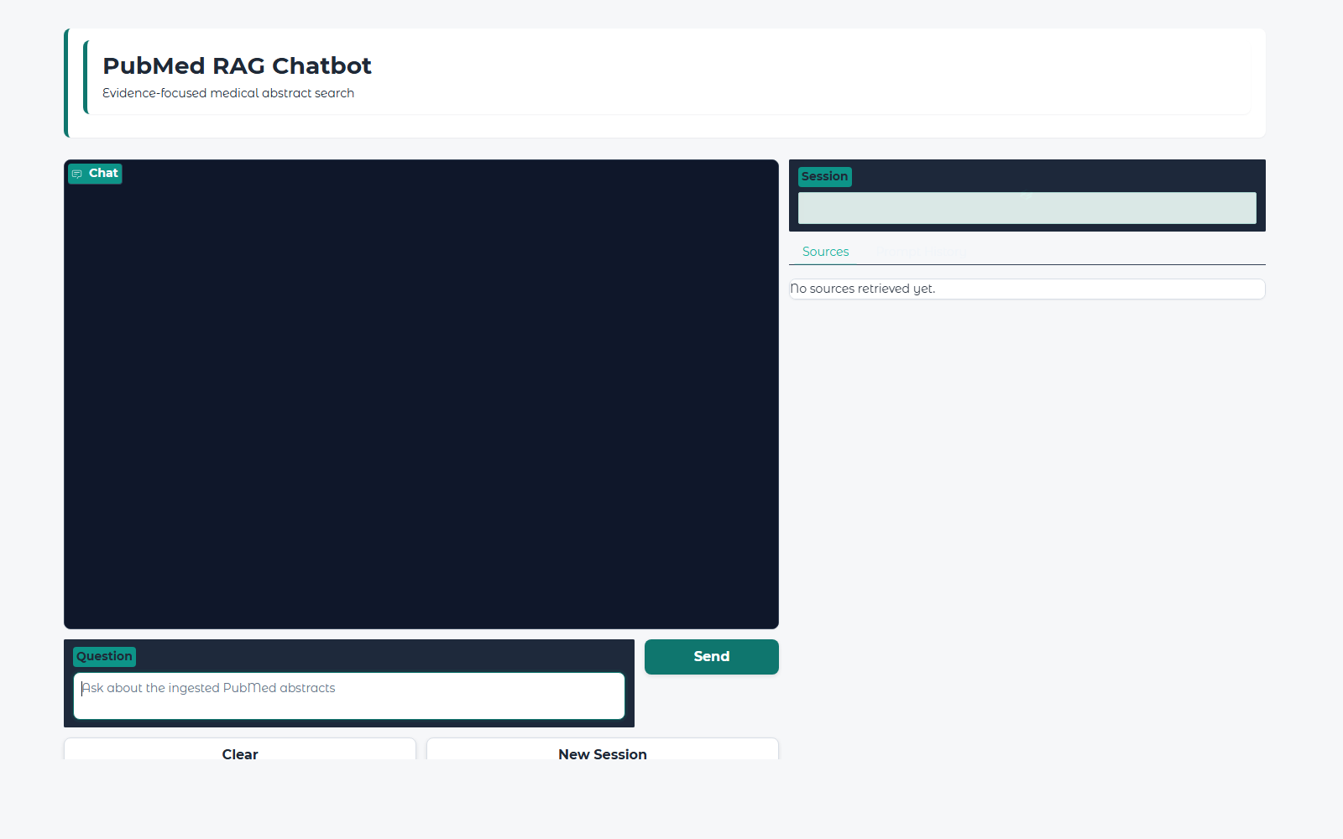
Gradio UI
User-facing chatbot interface
Gradio UI Screenshot
UI Features
- Chat interface
- Streaming response
- Session management
- Prompt history panel
- Clear and new-session controls
- Retrieved source/chunk display
Logic stays in src/
UI stays in ui/
PubMed RAG Chatbot | MongoDB + Sentence-Transformers + Gradio
11
Notes:
Point out that the UI calls the RAG pipeline and does not contain the retrieval logic.

Slide 12
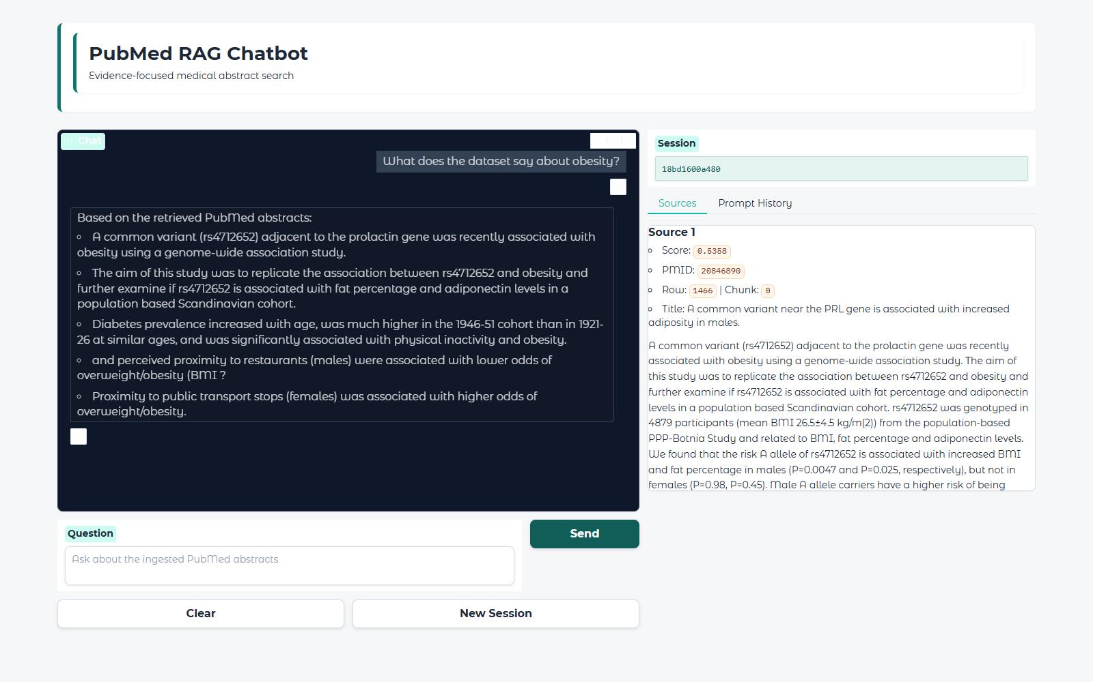
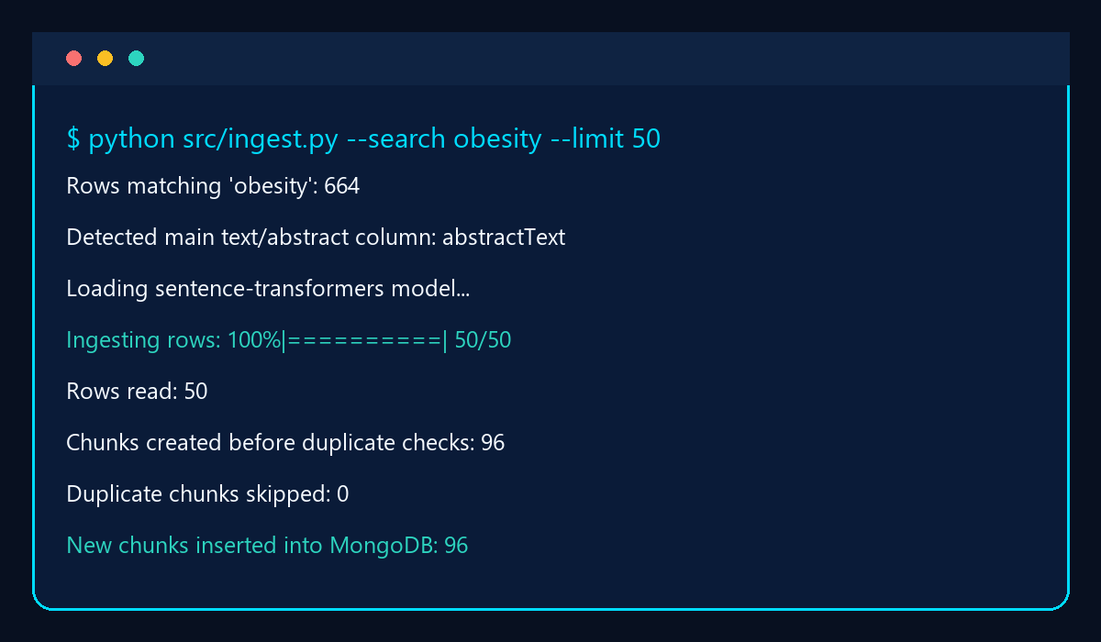
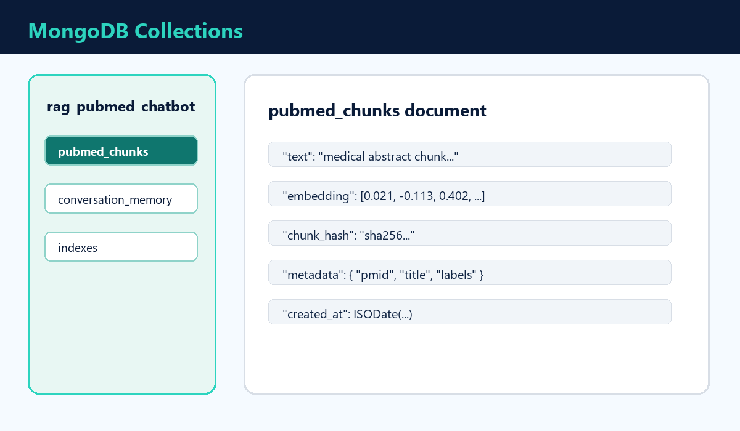
Demo Flow
Question -> Retrieval -> Answer
Real Chatbot Output Screenshot
Ingestion Output
MongoDB Storage
Demo Script
Question: "What does the dataset say about obesity?"
Embedding -> cosine retrieval -> top source chunks -> grounded streamed answer
PubMed RAG Chatbot | MongoDB + Sentence-Transformers + Gradio
12
Notes:
Use this slide while running a live demo or showing screenshots from ingestion, MongoDB, retrieval, and the UI.

Slide 13
Advantages
Why this design is useful
SAFE
Reduced Hallucination
SRC
Source Visibility
Answers are tied to retrieved PubMed context.
Users can inspect the chunks used for the answer.
MEM
Context-Aware
PY
Beginner-Friendly Stack
Recent and older memory improve follow-up handling.
Python, MongoDB, sentence-transformers, Gradio.
PubMed RAG Chatbot | MongoDB + Sentence-Transformers + Gradio
13
Notes:
Summarize the main technical benefits, especially grounding and source visibility.

Slide 14
Future Improvements
Next engineering steps
1
Gemma or Llama LLM
Add a local or API-based language model for stronger natural answers.
2
Better Vector Search
Use MongoDB Atlas Vector Search, FAISS, or Qdrant for scalable retrieval.
3
Voice Assistant
Speech-to-text input and text-to-speech output for hands-free use.
4
Medical Recommendation Layer
Only after stronger validation, evaluation, and clinical safety checks.
PubMed RAG Chatbot | MongoDB + Sentence-Transformers + Gradio
14
Notes:
Make clear that clinical recommendation systems require validation and safety work beyond this prototype.

Slide 15
Conclusion
What the project demonstrates
Summary
- Built an end-to-end RAG chatbot over PubMed medical abstracts
- Ingested CSV data into chunks with embeddings and metadata
- Used MongoDB for chunk storage, duplicate prevention, and memory
- Retrieved top medical context with cosine similarity
- Displayed grounded answers and sources through a Gradio interface
RAG + MongoDB + Embeddings + Memory = explainable medical QA prototype
PubMed RAG Chatbot | MongoDB + Sentence-Transformers + Gradio
15
Notes:
Close the technical explanation by tying together ingestion, retrieval, memory, and UI.

Slide 16
GitHub Repository
Project code, README, and setup instructions
Repository
https://github.com/anaconda0/rag_pubmed_chatbot
Includes ingestion, retrieval, memory, RAG prompt building, Gradio UI, and test questions.
src/
ui/
app.py
README.md
test_questions.txt
Run locally: python app.py
PubMed RAG Chatbot | MongoDB + Sentence-Transformers + Gradio
16
Notes:
Show the GitHub link and mention that the project is structured as separate logic and UI modules.

Slide 17
Thank You
Questions?
PubMed RAG Chatbot
https://github.com/anaconda0/rag_pubmed_chatbot
PubMed RAG Chatbot | MongoDB + Sentence-Transformers + Gradio
17
Notes:
End with questions and invite the audience to view the repository.

