Slide 1
CS202
Object Oriented Programming
Scott F. Rice
301161515

Slide 2
Current Issues
If the internet Slows down too much or cuts out The Program will Crash.

Slide 3
Program Description
This program gets stock from the internet and Graphs the price or volume as it changes.

Slide 4
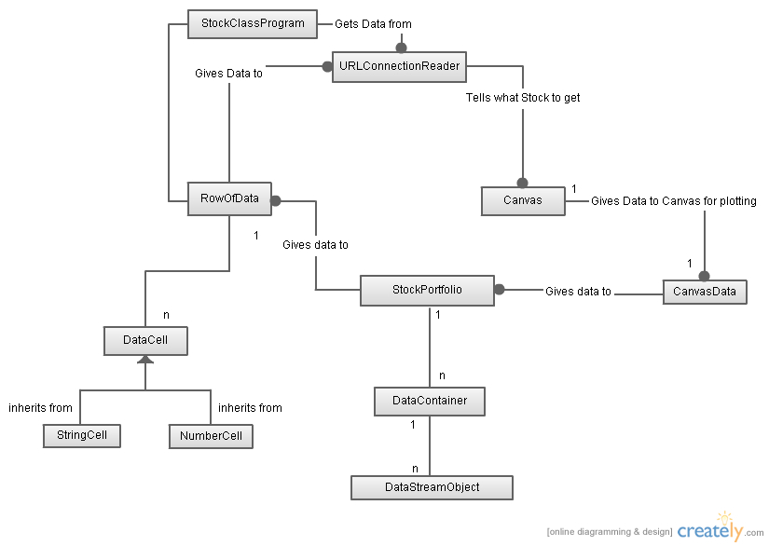
Class Diagram

Slide 5
Event Diagram
Window Pops up
Wait for go
Collect Data
PlotGraph

Slide 6
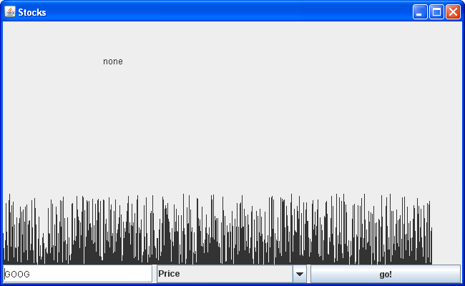
Screen Shots
Plot of the Stock
Stock Symbol
Stock
Price or Volume
Start
Right after Starting the Program

Slide 7
Application Statistics
Number of Files: 12
Lines of Code: 595

Slide 8
References
Introduction to Java Programming, Eighth Edition by Y. Daniel Liang
Proffessor Tran for Some of the classes as well as the outlines and hints.

