Slide 1

Awais Nadeem, Kenneth Baity, Matt Tobeck
“The fusion of functional and object-oriented programming”
(Martin Odersky, Creator of Scala)

Slide 2
The context and primary purpose of the language.
• The paradigm.
• A quick overview of the grammar.
• Presentation of one of the parse trees – pick the one you think demonstrates a particularly interesting characteristic of the language.
• Explanation of the design choices you consider most characteristic of the language.
• A summary of your evaluation of the language design

Slide 3
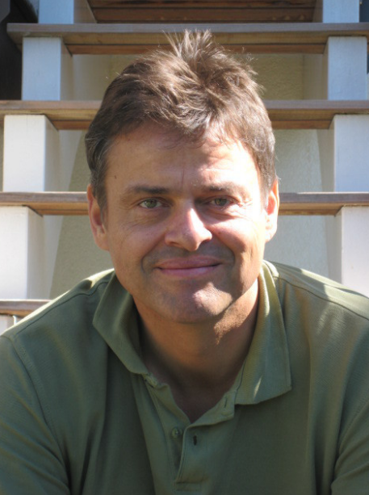
Context & Purpose - Awais
Scala began at the École Polytechnique Fédérale de Lausanne (EPFL) in 2001, introduced to public in 2004
Created/designer by Martin Odersky professor at EPFL
Primary goal – fusion of functional & OOP possible & practical
Wanted to express common programming patterns in a concise, elegant, and type-safe way
Strongly typed like ML
Derived from the word scalable
Wants to grow with the demand of its users.

Slide 4
The paradigm - Matt

Slide 5
Grammar - Matt
Conditional
Methods
Classes/objects
Traits
Try/catch

Slide 6
Parse Tree - Kenneth

Slide 7
Explanation of the design choices you consider most characteristic of the language. - Kenneth
Polymorphism (default or requires specification – Why?), overloading, parameter passing, scope, typing (implicit/explicit), how that applies to the purpose. Information hiding (visibility modifier), functional programming (pattern matching, higher order, function literals, recursion).
Scala iterations in development.

Slide 8
A summary of your evaluation of the language design – Awais
Most interesting aspects
Most important design choices
What things we like
What things we dislike or would change
How everything comes together and helps Scala accomplish goal
How Scala works/does stuff for us to be successful as programmers

Slide 9
Functional
Strongly typed like ML
Every function is a value

Slide 10
Object Oriented
Pure object-oriented language
Every value is an object

