Slide 1

Awais Nadeem, Kenneth Baity, Matt Tobeck
“The fusion of functional and object-oriented programming”
(Martin Odersky, Creator of Scala)

Slide 2

Context & Purpose
A
Began at the École Polytechnique Fédérale de Lausanne (EPFL) in 2001, introduced to public in 2004
Creator/designer - Martin Odersky
Derived from the word scalable
Goal – fusion of functional & OOP possible & practical
Derived from Java - concise, flexible, and type-safe
Large-scale maintainability, portability, and performance
Interoperability with existing tooling & ecosystem

Slide 3
The Paradigm(s)
M
Multi-paradigm: object-oriented, functional, imperative
Java-like OO with functional features such as:
Currying
Pattern matching
Anonymous types
Operator overloading
High-order types

Slide 4
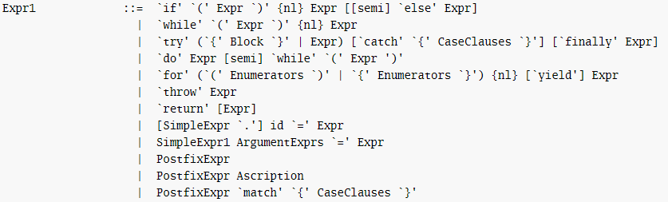

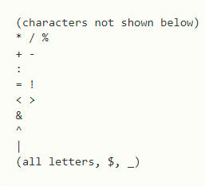
Grammar
M
val vs var
for loops
Classes/objects
Scala Grammar

Slide 5
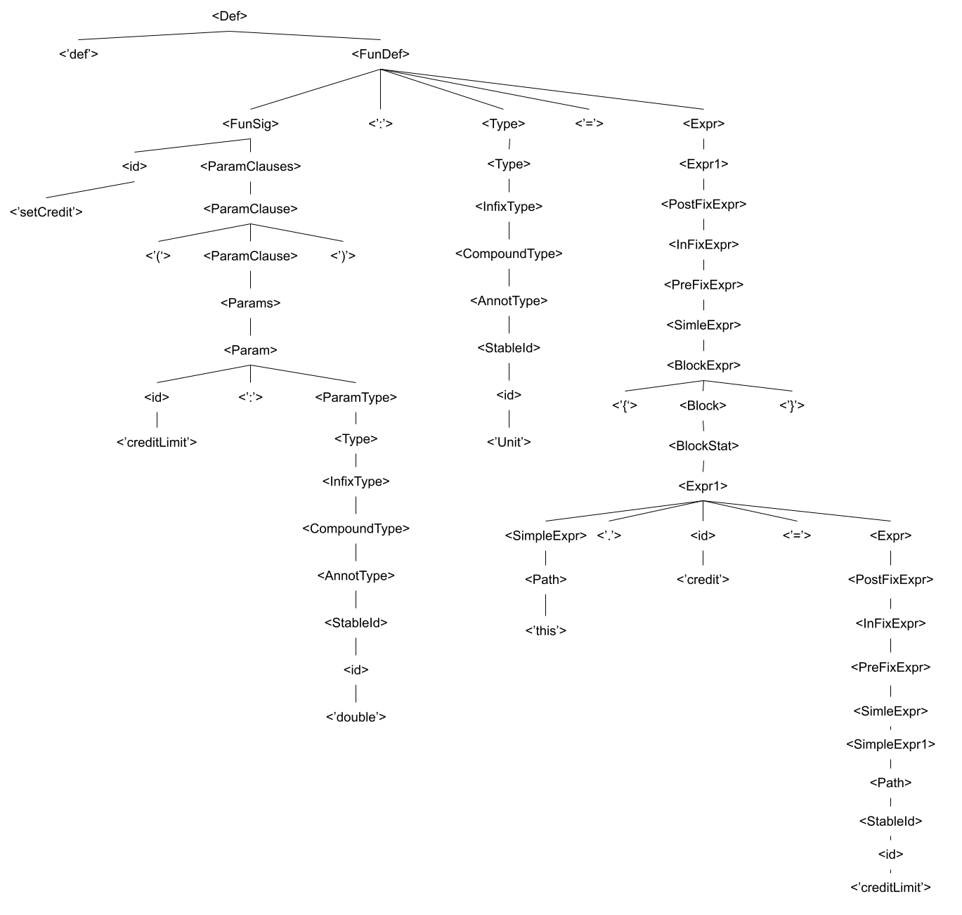

M

Slide 6

Object Oriented
Supports all types of Polymorphism, Encapsulation, and Inheritance
Pure object-oriented language
Every value is an object
Similar to the programming language Smalltalk

Slide 7
Functional
Strongly typed like ML
Every function is a value
Created just like String and Int values
Nested methods
Can nest method definitions
Pattern matching
Mechanism for checking a value against a pattern
More powerful version of the switch statement
Match Tuples
Higher order function
Take other functions as parameters or return a function as a result
Recursion
Supports tail recursive functions by performing tail call optimization.
Special annotation, @tailrec, to ensure that the method can be executed

Slide 8
Inheritance
Traits
Used to share interfaces and fields between classes
Similar to multiple inheritance
Cannot be instantiated and therefore, have no parameters
Useful as generic types and with abstract methods
Multiple inheritance is not supported with classes, but you can extend multiple traits

Slide 9

Parameter Passing
Pass by value
Default way that parameters are passed
By name
Function argument won't be evaluated until the corresponding value is used inside the function body
Explicit method declaration

Slide 10
Encapsulation and Information Hiding
Supports Encapsulation
Can declare both properties and methods as private and public, protected, object-private, and package specific
Scala methods are public by default

Slide 11

Different Types of Scopes
Public
Private
Protected
Can only be accessed only by the sub classes in the same package
Different from Java
Cannot be accessed by other members in other packages even with imports
Object Private
Member is available only from in which the member is defined
No object can access the member
Package Specific
Member is available to a whole package
Can be accessed by any other package whose name is being qualified to
Same as Java
Same as Java

Slide 12
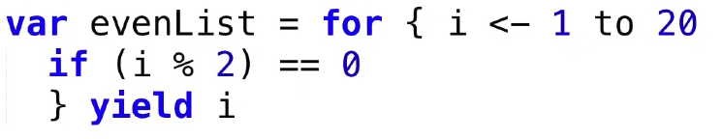
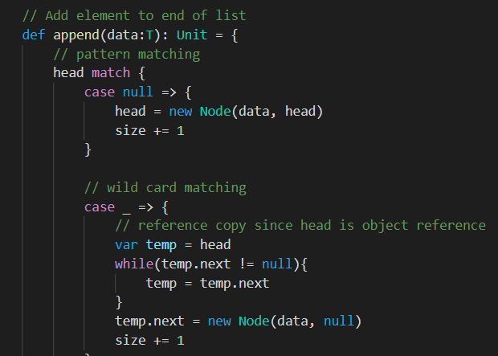
Interesting Aspects
A
Compiled + Interpreted features
List comprehension + nested loops
Bounded types
Singleton objects
Extractor objects
RegEx

Slide 13
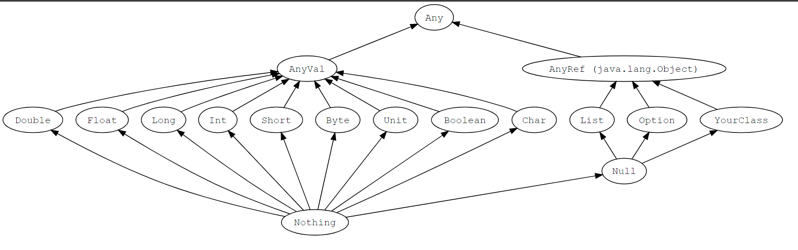
Scala Type Hierarchy

Slide 14
Important Design Choices
A
Java interoperability
OOP Improvements
Polymorphism
Functional programming support
Compilation & static typing
Garbage collection

Slide 15

Our Analysis
A
Pros
Code structure & compatibility
Implementation in traits
Identifiers
Improvements
Slow complication & execution
Easily declare & use data structures
Functional + OOP
SBT

Slide 16
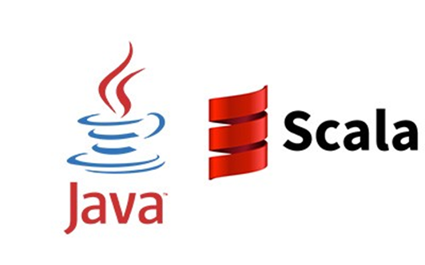

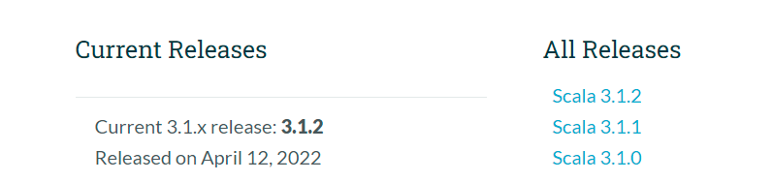
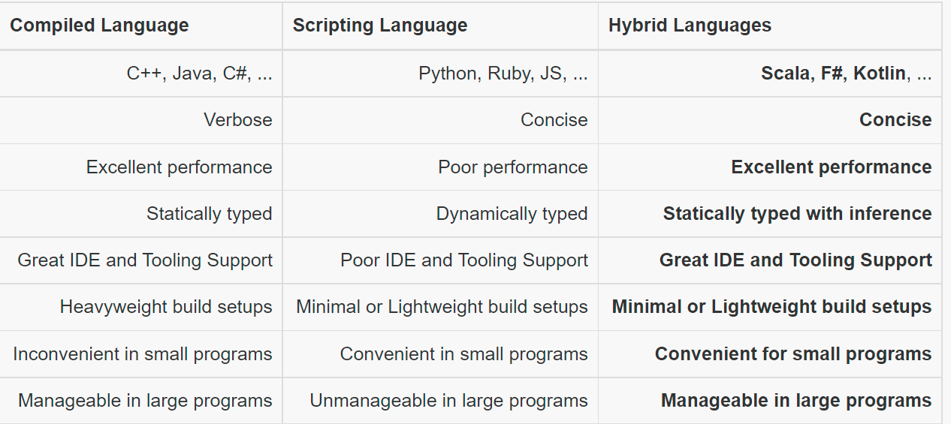




Scala Today
A

