Slide 1
Jenkins - Guided Tour – Hands On
Training

Slide 2
TRaining Jenkins - Guided Tour – Hands On v1.0
Pedro Candeias
18/02/2020

Slide 3
Agenda
01 Creating Pipelines 04
02 Running Multiple Steps 08
03 Defining Execution Environments 11
04 Using Environment Variables 13
05 Recording Test Results and Artifacts 15
06 Cleaning Up and Notifications 17
07 Deployment 19

Slide 4


Creating Pipelines
Tools, Setup and Exercises

Slide 5

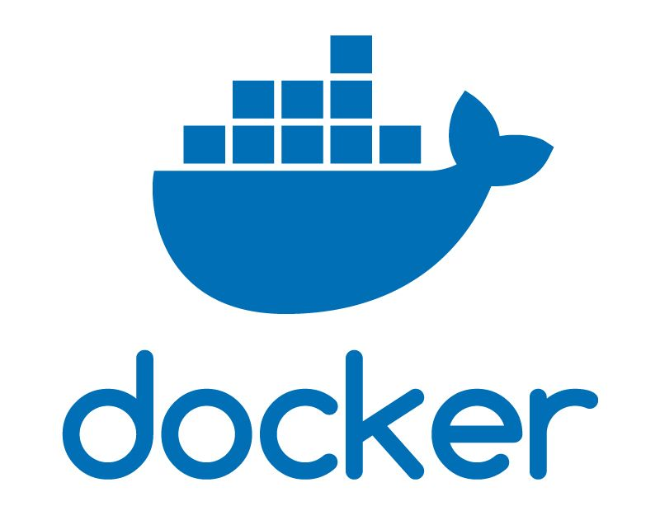



Creating Pipelines Tools
https://docs.docker.com/install/
https://jenkins.io/doc/pipeline/tour/getting-started/
Later

Slide 6

Creating Pipelines Setup
15 Minutes for Setup
14 Minutes for Setup
13 Minutes for Setup
12 Minutes for Setup
11 Minutes for Setup
10 Minutes for Setup
9 Minutes for Setup
8 Minutes for Setup
7 Minutes for Setup
6 Minutes for Setup
5 Minutes for Setup
4 Minutes for Setup
3 Minutes for Setup
2 Minutes for Setup
1 Minutes for Setup
0 Minutes for Setup
Check if main tools are already installed (docker, Jenkins, git);
Create GitHub account and clone https://github.com/PC-CF/training-playground into a personal repo;
Check if additional tools are already installed (sonarqube, sonartype nexus);
Disable security in Manage Jenkins (optional);
Study Jenkins Pipeline Syntax from https://jenkins.io/doc/book/pipeline/syntax/

Slide 7
Creating Pipelines Exercises
Exercise 01 - First Pipeline
Create a job that runs the “001 - Creating Pipelines / 01 - Jenkinsfile - First Pipeline” directly from Git repo:
Expect some issues;
Check for updates in your local docker instance (images, containers, volumes, etc…)
Exercise 02 - Java Pipeline
Create a job that runs the “001 - Creating Pipelines / 02 - Jenkinsfile - Java Pipeline”
Exercise 03 - Node Pipeline
Create a job that runs the “001 - Creating Pipelines / 03 - Jenkinsfile - Node Pipeline”
Exercise 04 - Triggered Pipeline
Create a job that runs the “001 - Creating Pipelines / 04 - Jenkinsfile - Triggered Pipeline” and then change it to print the system date:
Check if job was automatically executed after change;

Slide 8

Running Multiple steps
Exercises

Slide 9
Running Multiple Steps Exercises
Exercise 01 – Multiple Actions
Create a pipeline that creates a file containing the system date, then prints it and repeats the same 2 actions after 10 seconds:
Avoid code duplication;
Exercise 02 – Multiple Stages
Create a pipeline with a build stage that saves the system date in a file and a test stage that checks if same file contains the value “2019”
Exercise 03 – Pipeline With Inputs
Create a pipeline that asks the user name and age when executed
Exercise 04 – Conditional Stages
Create a pipeline that asks the user to select if he wants to execute “build” or “test” and based on selection executes only the respective stage:
Multiple stages pipeline with predefined inputs needs to be created;

Slide 10
Running Multiple Steps Exercises
Exercise 05 – Finish Up
Create a pipeline that will print “Success”, “Fail” and “Always” before finish based in pipeline execution result.
Exercise 06 – Multiple Agents
Create a pipeline with a stage that prints maven version and another that prints npm version
Exercise 07 – Nested Stages
Create a pipeline that has a build and a test stage. The build phase will simultaneously print the maven version and npm version.
Exercise 08 – Parallel Stages
Create a pipeline that will simultaneously print maven version and npm version

Slide 11
Defining execution environments
Exercises

Slide 12
Defining Execution Environments Exercises
Exercise 01 – Install Software
Create a pipeline that is able to execute the “curl www.google.com” command using alpine image:
Compare durations of multiple executions;
Exercise 02 – Dockerfile Agent
Create a pipeline that will be executed using the image generated by “003 - Defining Execution Environments\02 - Dockerfile - Dockerfile Agent”
Exercise 03 – Install Software in Dockerfile
Create a pipeline that is able to execute the “curl www.google.com” command using a Dockerfile that builds an image based in alpine:
Compare durations of multiple executions;
Exercise 04 – Multiple Agents using Dockerfile
Create a pipeline with a stage that prints maven version and another that prints npm version using dockerfiles

Slide 13

Using Environment Variables
Exercises

Slide 14
Using Environment Variables Exercises
Exercise 01 – Configuration Variable
Create a pipeline with a configuration section containing the “NOTIFICATION_EMAIL” variable
Exercise 02 – JSON Configuration
Create a pipeline with a JSON configuration that supports multiple build configurations, each with a different build command
Exercise 03 – Dynamic Stages
Create a pipeline with a JSON configuration that supports multiple build configurations and a stage is dynamically created for each build
Exercise 04 – Change Variable Value
Create a pipeline with variable “NUMBER_OF_ISSUES”, the test stage will set this variable to “10” and the notification stage will print the value of the variable

Slide 15

Recording Test Results and Artifacts
Exercises

Slide 16
Recording Test Results and Artifacts Exercises
Exercise 01 – Archive Artifact
Create a pipeline that downloads the www.google.com html file and archives it in job execution
Exercise 02 – Java Unit Tests
Create a pipeline that runs the unit tests of java application in “005 - Recording Test Results and Artifacts \ Java Application” folder
Exercise 03 – Sonar Integration
Create a pipeline that runs the build and unit tests of java application in “005 - Recording Test Results and Artifacts \ Java Application” folder and generate a Sonar analysis
Exercise 04 – Publish in Nexus
Create a pipeline that packages the java application in “005 - Recording Test Results and Artifacts \ Java Application” folder and publish the package in Nexus

Slide 17

Cleaning Up and Notifications
Exercises

Slide 18
Cleaning Up and Notifications Exercises
Exercise 01 – Clean Workspace When Finished
Create a pipeline that creates a file containing the system date and then cleans the workspace when finished
Exercise 02 – Clean Workspace On Start
Create a pipeline that cleans the workspace and then creates a file containing the system date
Exercise 03 – Git Reset
Create a pipeline that resets versioned files between executions
Exercise 03 – Email Integration
Create a pipeline that sends an email notification

Slide 19
DEployment
Exercises

Slide 20
Deployment Exercises
Exercise 01 – Deployment Pipeline
Create a pipeline that downloads and runs 'org.jenkins-ci.main:cli:jar:2.85’ application available in central maven repository
Ref: java -jar jenkins-cli.jar -s YOUR_SERVER_URL help

Slide 21
Thank you

