Slide 1

CAPSTONE PRESENTATION
‘Travel App’
Submitted by:-
NAME : Anadi Gautam
Batch : Wipro Salesforce B-13 (WIP-SF-13)
LMS_ID : MGSA_491
Date : 28/ 02 / 2023

Slide 2
Objectives
Building a Lightning app, adding tabs, and customizing page layouts.
Creating custom objects and fields for the app.
Defining relationships between objects.
Importing data and testing the app.

Slide 3
Introduction
This project is about a Travel Approval App.
We need to build an app for an organisation by which employees can place the travel approval requests under their manager.
In which the manager has the privilege to approve or reject the request and the administrator can see the report of total requests by “Month” or by “Department” using a Dashboard.

Slide 4
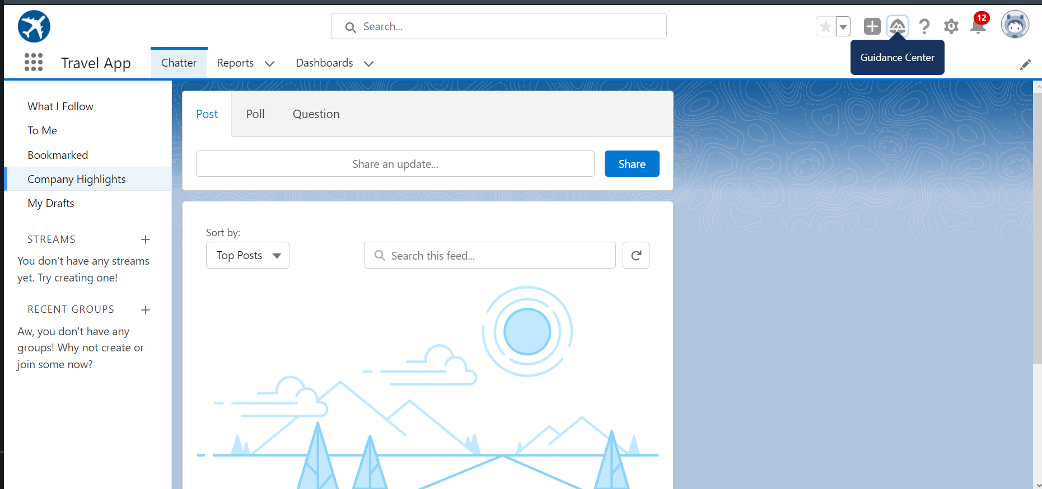
MODULE:- 1 ‘Travel App Playground’
Creating Lightning Travel App Via App Manager

Slide 5
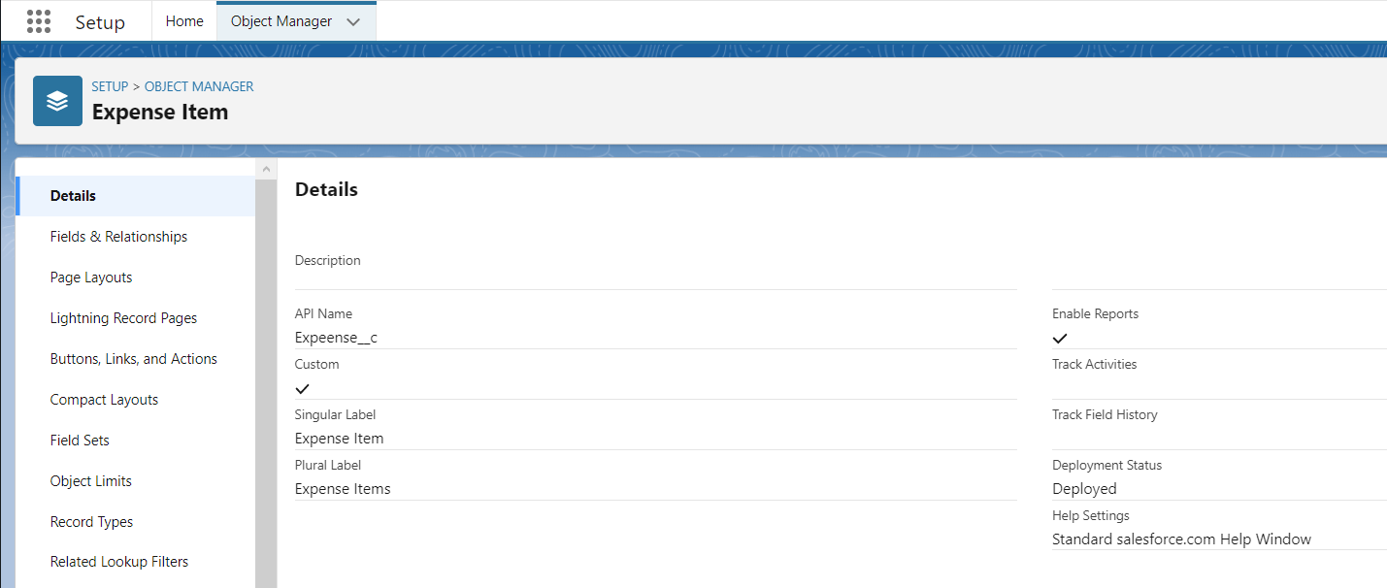
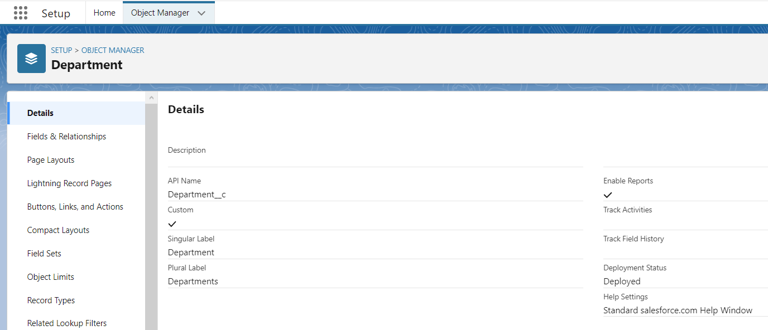
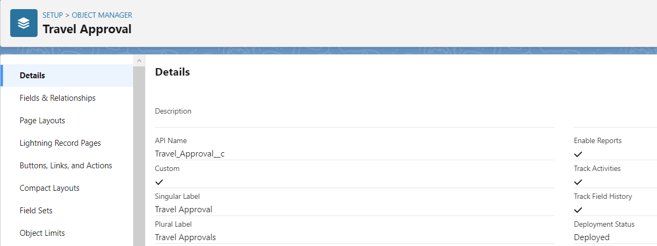
MODULE:- 1
Creating Custom Objects Department, Travel Approval & Expense Items

Slide 6
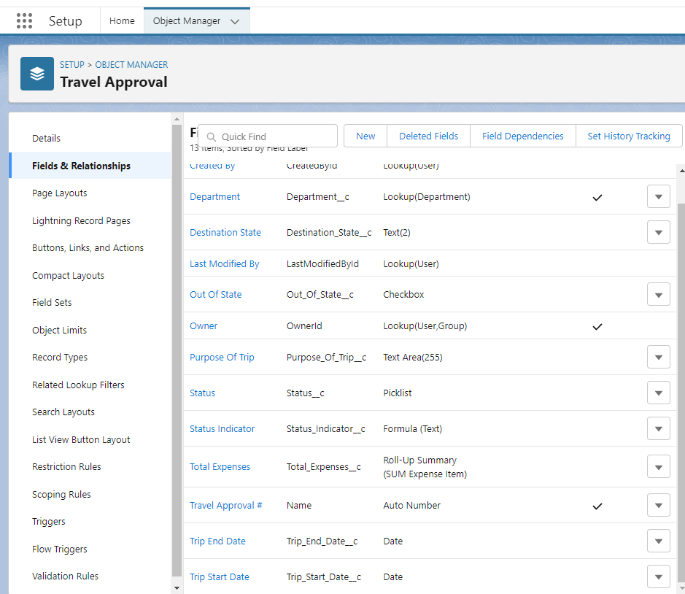
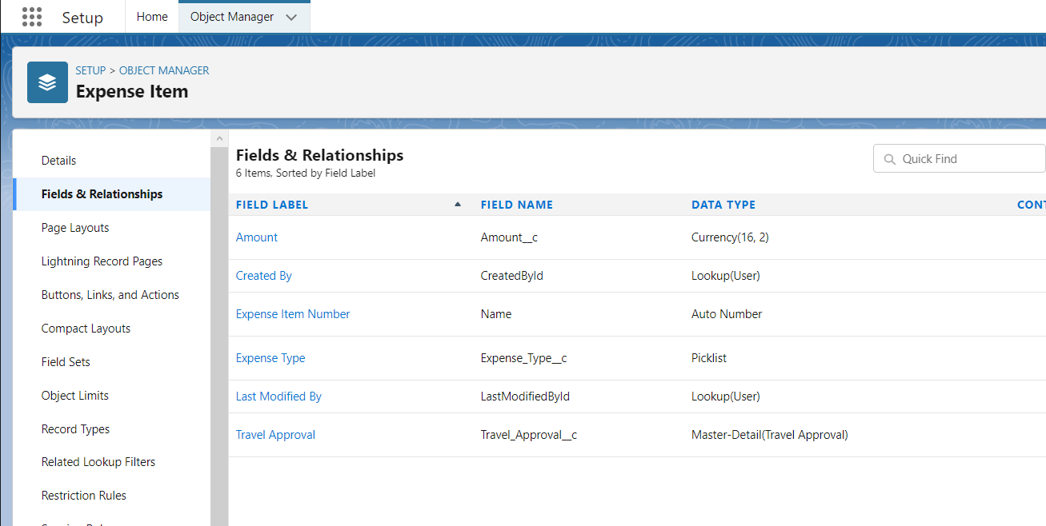
MODULE:- 1
Creating Custom Fields for the Custom Objects :
Department Code, Location, Department Type for department objects
Purpose of trip, Trip Start/End Date, Destination State, etc for Travel Approval
Amount, Expense Type for Expense Item

Slide 7
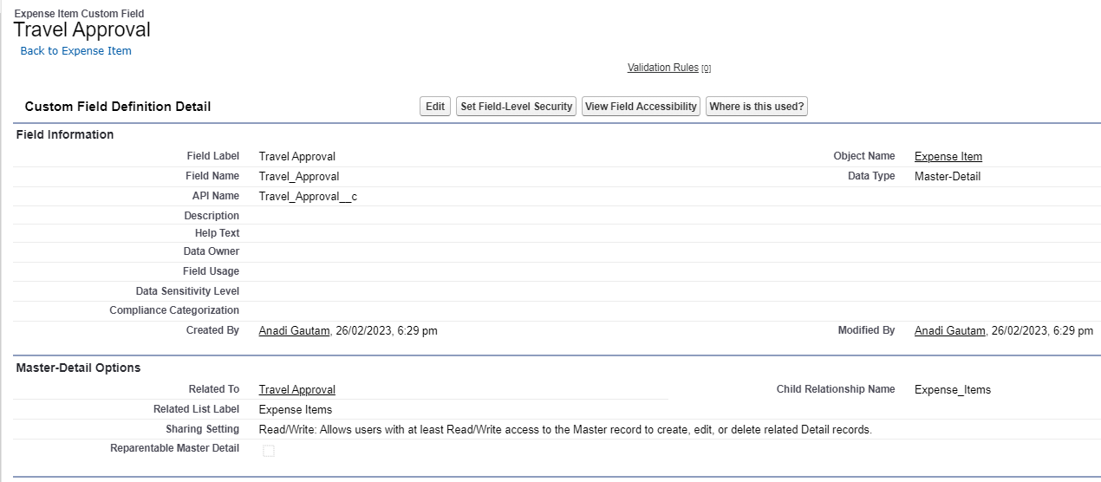
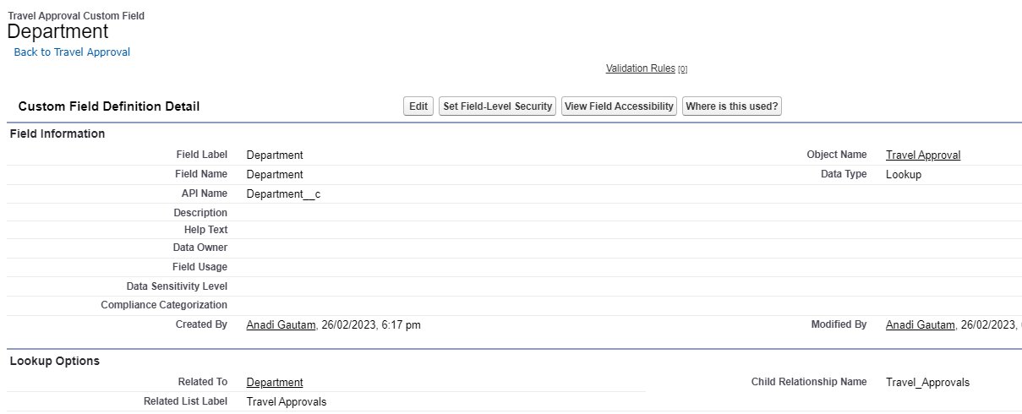
MODULE:- 1
Creating custom Tabs
Defining Relationships between objects.
Master Detail in Expense Item Related to Travel Approval
Lookup Related to Department Object

Slide 8
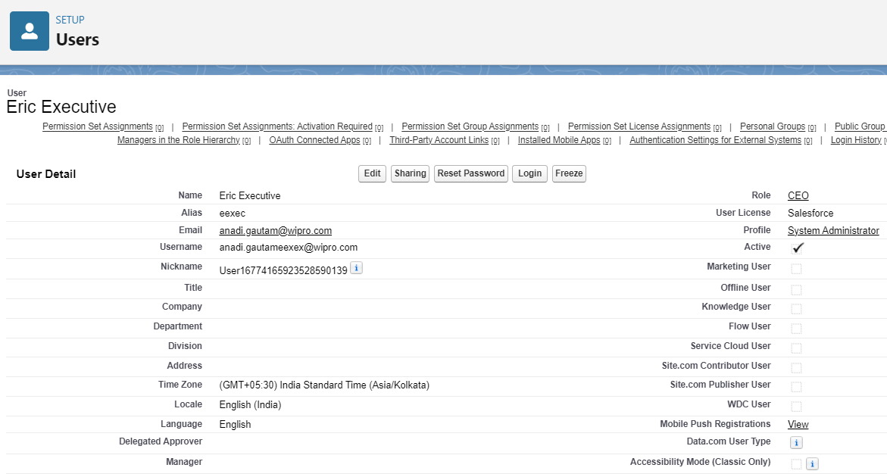
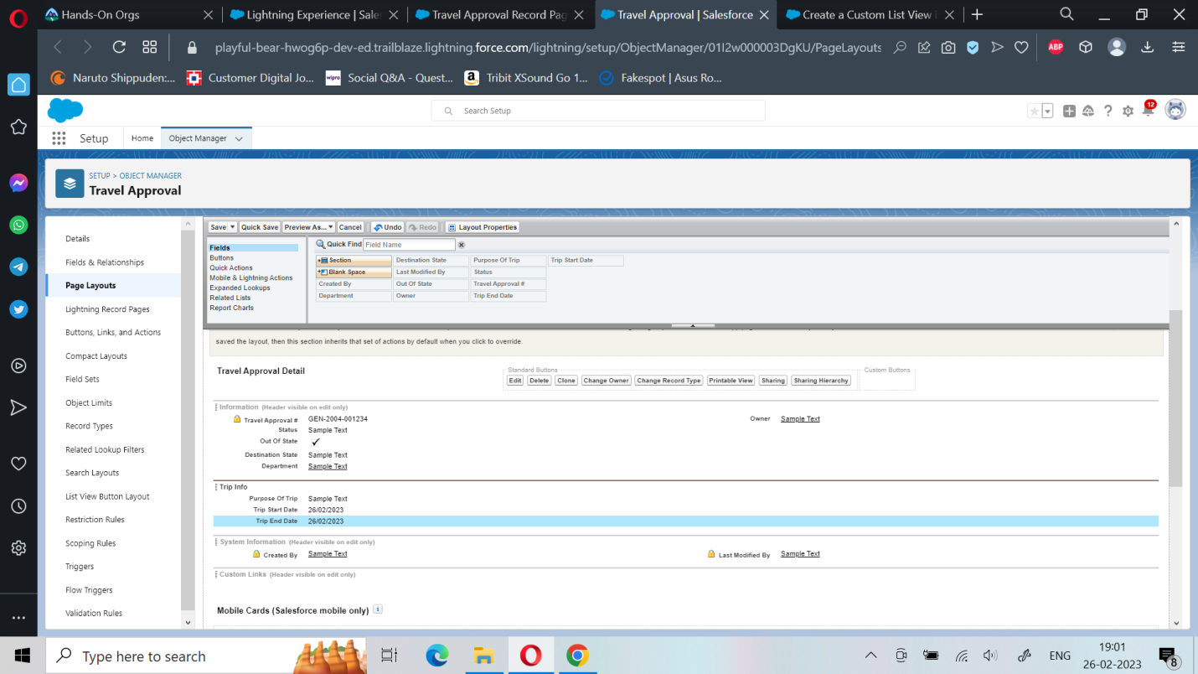
MODULE:- 2
Importing Departments.csv File
Testing the App by creating Travel approval records and Expense Items
Creating User for CEO role, assigning CEO manager to System Administrator
Updating Approval page and search layout

Slide 9
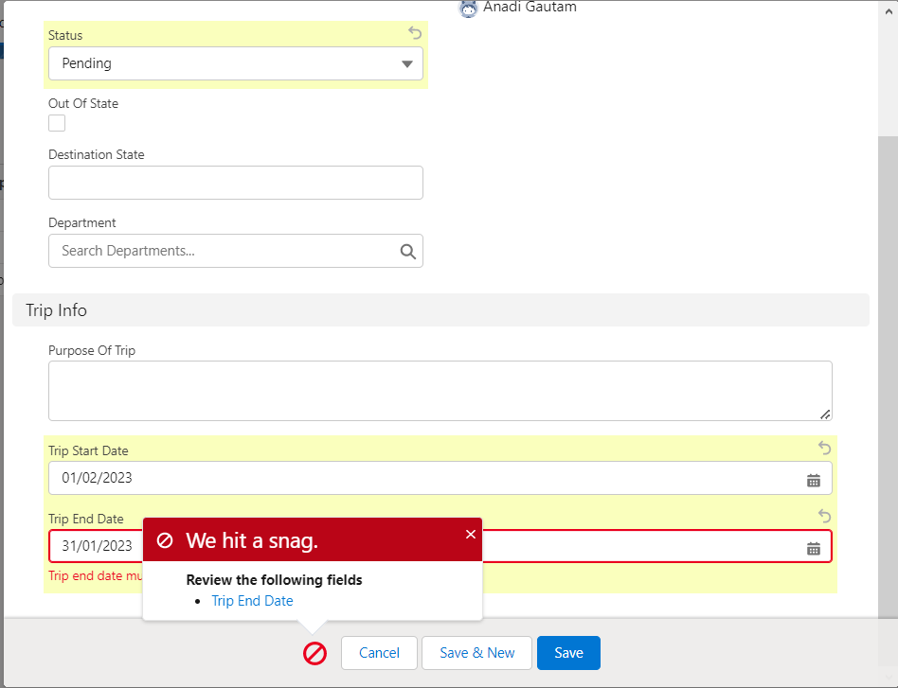
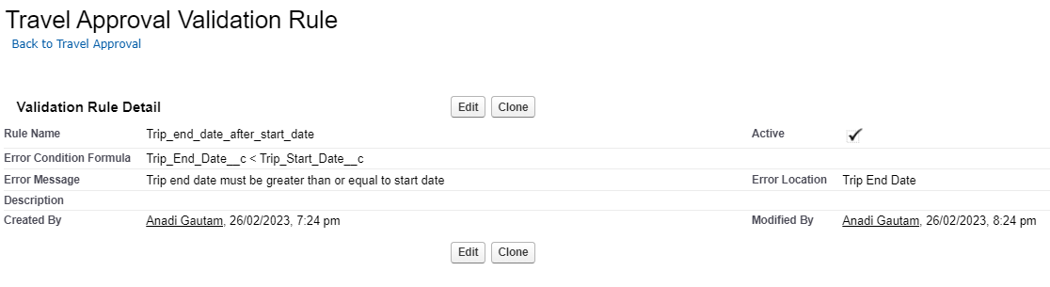
MODULE:- 2
Adding Validation Rules as per the requirements

Slide 10
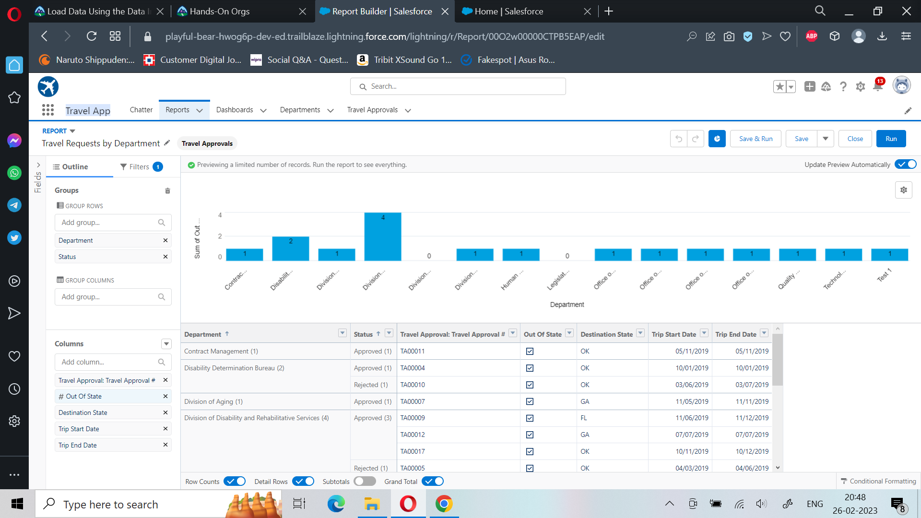
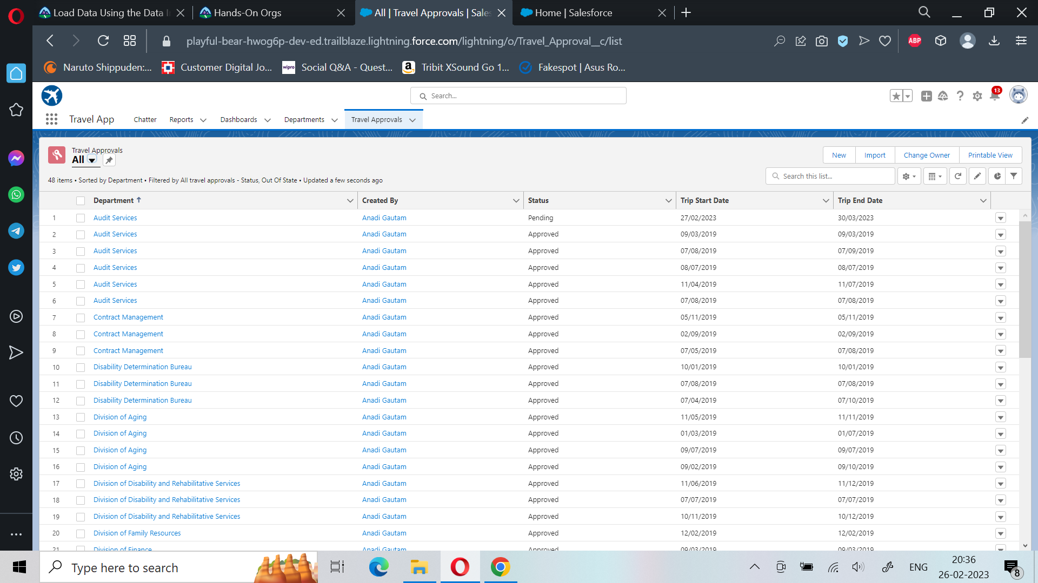
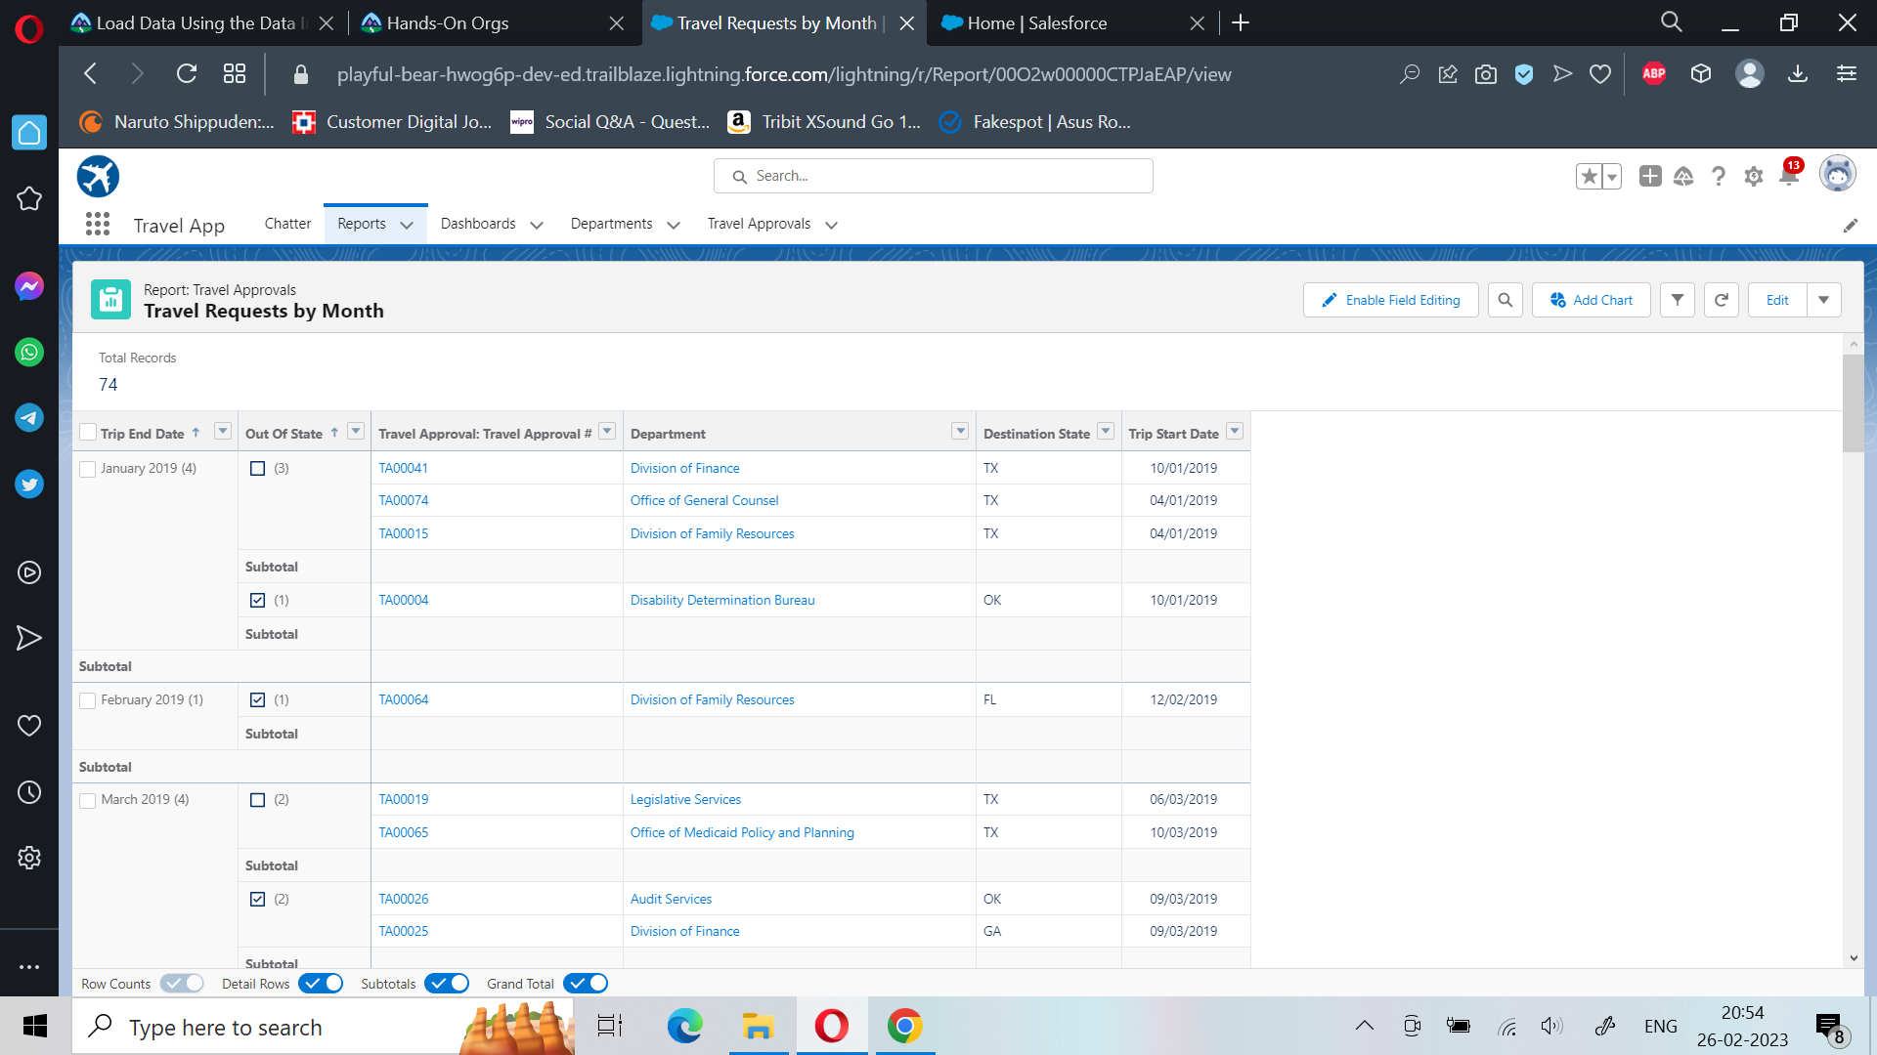
MODULE:- 2
Building Reports and Testing the App by creating Travel approval records

Slide 11
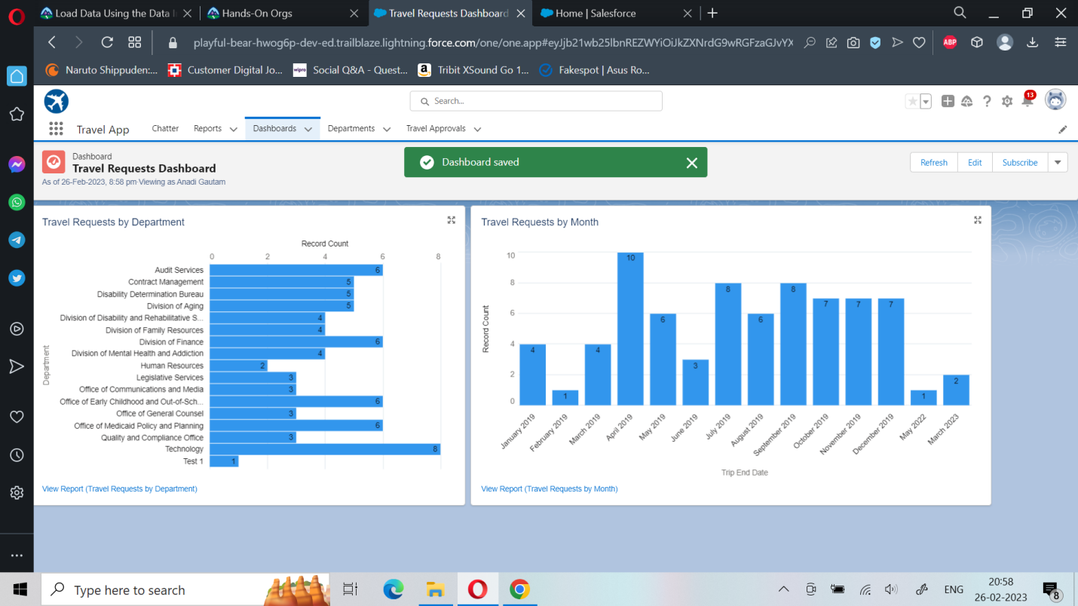
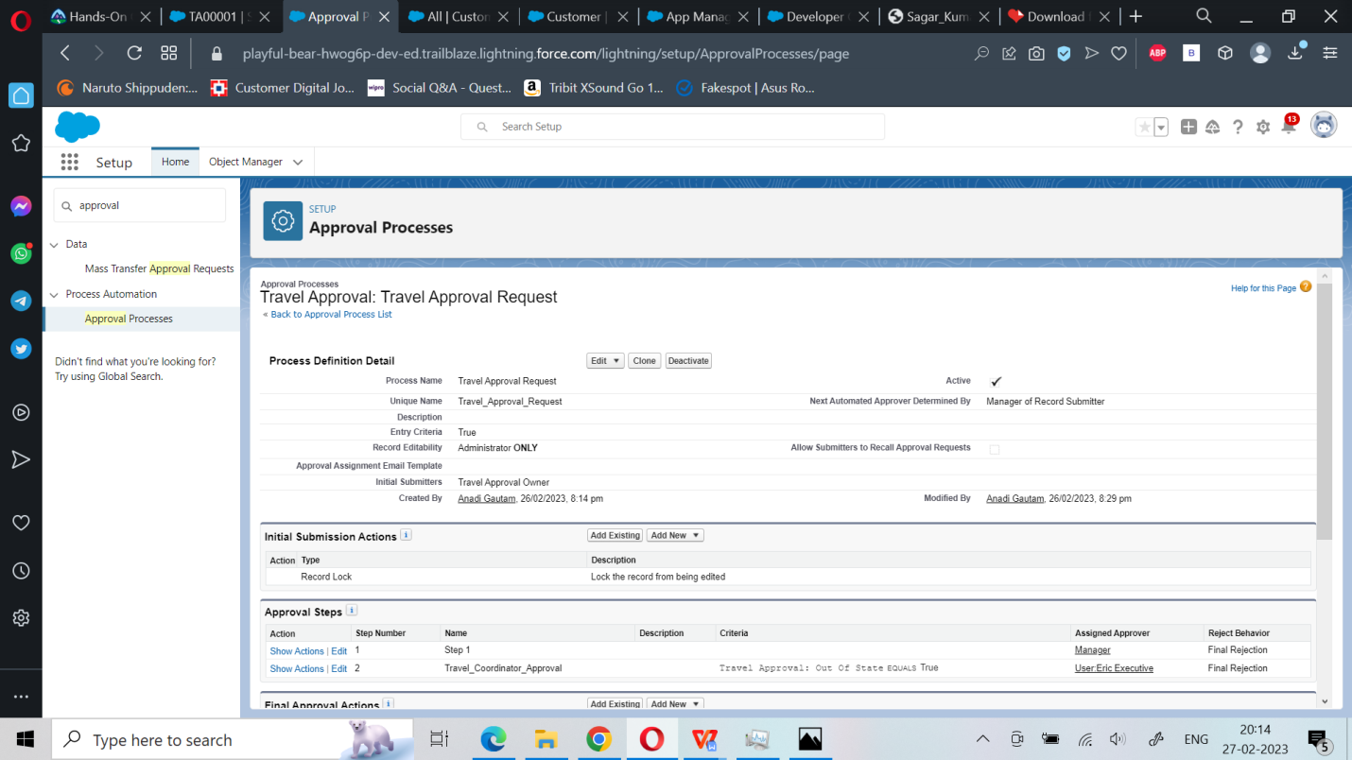
MODULE:- 2
Defining Approval Process for Travel Approval App
Building Dashboards

Slide 12
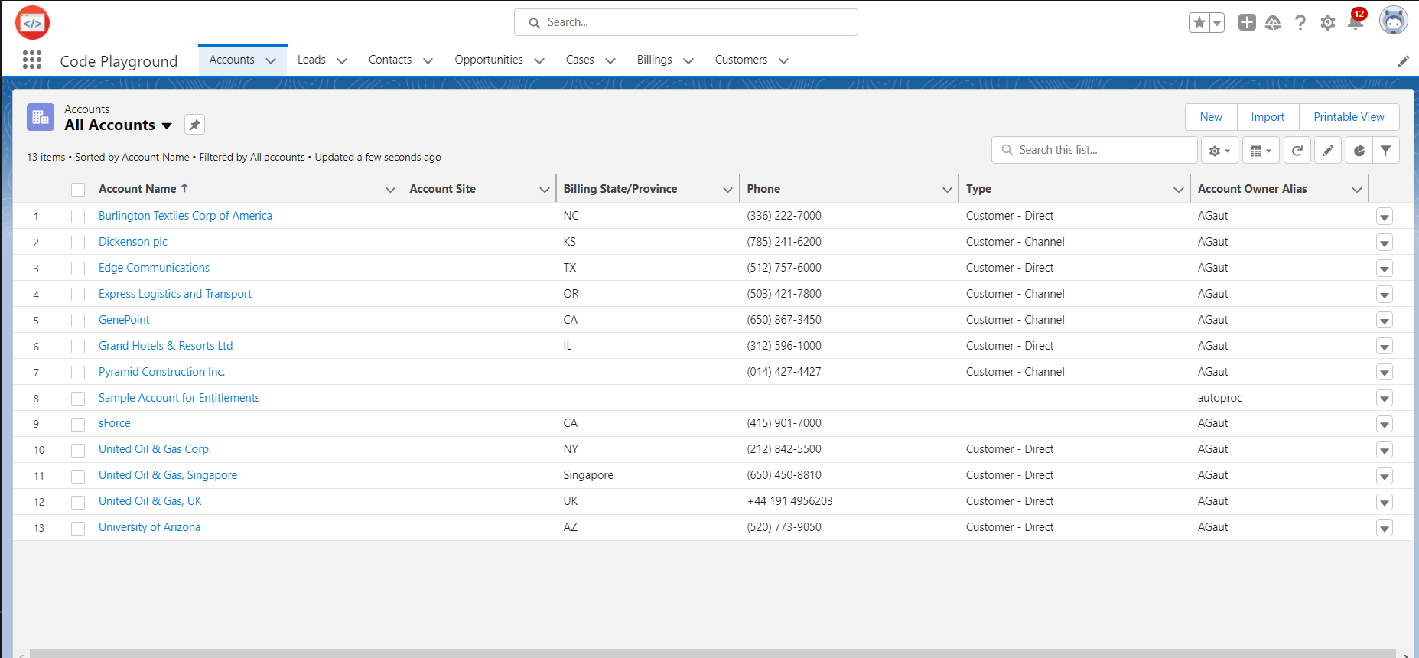
MODULE-3 ‘Code Playground’
Creating Lightning Code Playground App Via App Manager

