Slide 1
Locally Repairable Codes
Dimitris Papailiopoulos and Alex Dimakis
USC
ISIT 2012

Slide 2
Intro
Storing information using Erasure Codes and the Exact Repair problem.
What is Locality?
A Locality-Distance-Storage Tradeoff
Locally Repairable Codes
2

Slide 3
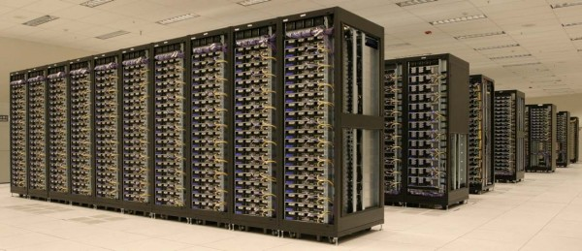
Big Data
Big Data Players (Facebook, Amazon, Google, Yahoo, …)
FB has the biggest Hadoop cluster.
Cluster of machines running Hadoop at Yahoo! (Source: Yahoo!)
Failures are the norm.
We need to protect the data: Introduce redundancy
3

Slide 4
Coding on the Biggest Hadoop Cluster
Data one week old
A node is lost: We need to exactly repair it.
Practice: ALL nodes are contacted,
everything is downloaded for repair [Hadoop]
(matrix inversions take place)
(14,10) - Reed Solomon
Main issue: Recovery Cost
Q; What metrics can we optimize?
4

Slide 5
Repair Metrics of Interest
The number of bits communicated in the network during repairs (Repair BW)
Capacity known (for two extreme points only). No high-rate practical codes known for MSR point. [Rashmi et al.], [Shah et al.], [El Rouayheb et al.], [Wang et al.], [Tamo et al.], [Suh et al.] [Cadambe et al.] [Papailiopoulos et al.], [Shum], [Oggier et al.] ….
The number of bits read from disks during single node repairs (Disk IO)
Capacity unknown.
Only known technique is bounding by Repair Bandwidth
Capacity unknown.
Scalar linear bounds [Gopalan et al.]
No Code Constructions
The number of nodes accessed to repair a single node failure (Locality)

Slide 6
Locality-Storage Tradeoff
A new information theoretic tradeoff for Erasure Codes
(Code Distance, Locality, Storage Cost)
There exist erasure codes that achieve it:
Codes with local and XOR based Repairs (simple)
Easy road to low repair BW
6

Slide 7
The Singleton Bound
Def.:
Min. distance d of a code = min. num. of erasures after which data is lost
Ex.: ReedSolomon (14,10), d = 5
R. Singleton (1964) showed a bound on the optimal distance
ReedSolomon codes achieve the Singleton Bound (MDS)
7

Slide 8
Generalizing Singleton
What happens when we put locality in the picture?
r=k (trivial locality) gives Singleton bound.
Non-trivial locality induces a distance penalty
No explicit codes known for all-symbol locality.
Thm 1: (Locality, distance)
But, we like MDS codes, because they have high-distance…
Q: What if.. pay a little more on storage? Can we still have 1) high-rate, 2) high-distance, 3) local repairs
8

Slide 9
Locally Repairable Codes
Thm 2: (n,k) code with locality r and storage
must have distance
Thm 3: 1) Locally Repairable Codes match the bound.
2) For ε=1/r, d = n-k+1, explicit constructions.
9

Slide 10
Achievability Proof

Slide 11

Proof Sketch (Bound)
We divide the nodes in “repair groups”
Let r=2
Any 2 nodes within a group can repair the 3rd node.
node 1
node 2
node 3
node 4
node 5
node 6
node 1
node 5

Slide 12

Proof Sketch (Bound)
Information Theory: Entropy(3 nodes) = Entropy(2 nodes)
Local (r,r+1)-MDS code
node 1
node 2
node 3
Entropy(node1|node2, node3)=0
node 1
12

Slide 13
A New “locality aware” Flow Graph
If we want the “any 4” property we need data collectors with degree 4.
File reconstruction is possible if flow is enough = tune extra storage
Data Collector 1
Data Collector 2
Data Collector M
Cut-set Bound: locality r, requires (1+1/r)M/k in storage
13

Slide 14
Proof Sketch (Achievability)
This is a multicasting Network. Minimum cut-set bound achievable using
Random Linear Network Coding [Ho et al.]
Data Collector 1
Data Collector 2
Data Collector M
Random Locally Repairable Codes Exist
14

Slide 15
Locally Repairable Codes: Constructions

Slide 16



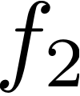

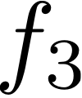


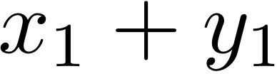
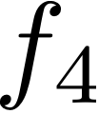

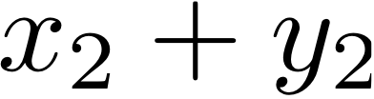

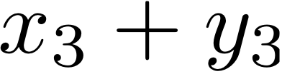













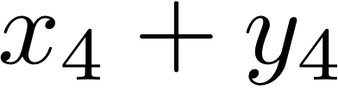
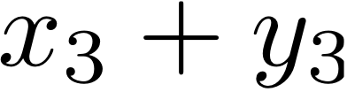
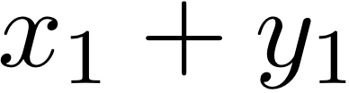
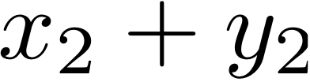
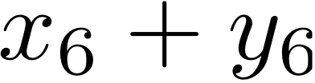
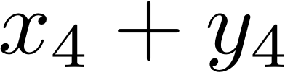
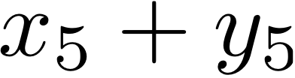
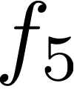

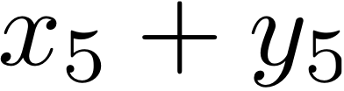
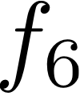

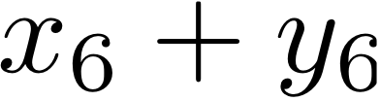
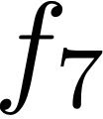

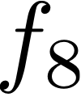


Locally Repairable Codes
Two stages: MDS-Precode and Placement
(n=6,k=4,r=2)-LRC
Coding
Placement
(6,4)MDS
node1
node2
node3
node4
node5
node6
(6,4)MDS
Group 1
Group 2
16

Slide 17
Locally Repairable Codes
LRC vs. MDS specs
 | (n,k)-Locally Repairable Code | (n,k)-MSR Code
Storage per node
Coding Rate
Repair Locality
Repair Bandwidth
17

Slide 18
Locally Repairable Codes
What happens if we require log locality
And let
 | (n,k)-Locally Repairable Code | (n,k)-MSR Code
Storage per node
Coding Rate
Repair Locality
Repair Bandwidth
18

Slide 19
Conclusions
We have introduce a new locality, storage tradeoff
Locally Repairable Codes lie on the tradeoff
Code constructions based on simple and Local XORs
LRCs can be made asymptotically MDS
Open Problems:
1) LRC deterministic constructions for any point.
2) Put repair BW in picture (BW+locality tradeoff?)
3) Connections to Locally Decodable Codes.
MS, fb, Google are investigating LRC constructions in their cloud storage clusters.

Slide 20
the end

