Slide 1
Simple Regenerating Codes: Network Coding for Cloud Storage
Dimitris Papailiopoulos
USC
Based on Joint work with:
Alex Dimakis (USC)
Jianqiang Luo (EMC Data Domain)
Cheng Huang (MSR Redmond)
Jin Li (MSR Redmond)

Slide 2
Intro
Storing information using Erasure Codes
The Repair problem
Disk Accesses during Repair?
Simple Regenerating Codes:
A new family of high-rate low-disk access codes
Performance on simulated Hadoop
2

Slide 3
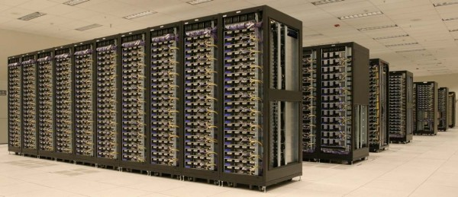
Big Data
Big Data Players (Facebook, Amazon, Google, Yahoo, …)
FB has the biggest Hadoop cluster.
Cluster of machines running Hadoop at Yahoo! (Source: Yahoo!)
Failures are the norm.
We need to protect the data: Introduce redundancy
3

Slide 4
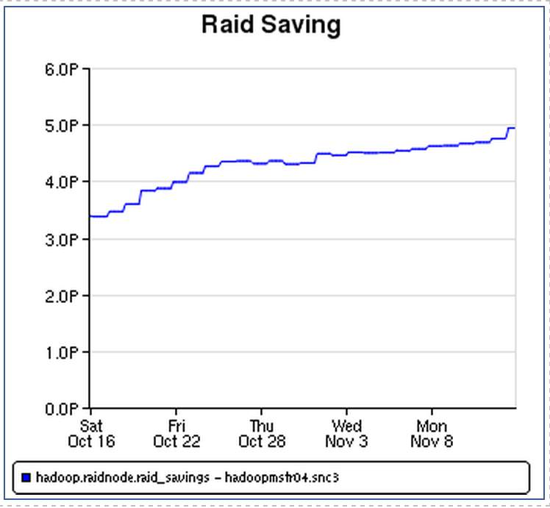
Reliability: Replication vs. MDS Codes
“Cold” data stored using (14,10)-ReedSolomon Code
n = 4
n = 4
k = 2
data pieces
A
A
A
B
B
B
Main issue: Repair Cost
A
A+B
B
A+2B
(n,k)-MDS: storage/reliability optimal
R = k/n, nodes store filesize/k
“the any k erasure property”
(4,2) MDS code
Any 2 failures are OK
RAID 6
4

Slide 5
The Code Repair Problem

Slide 6
The Code Repair Problem
A node is lost: We need to exactly repair it.
Practice: ALL nodes are contacted,
everything is downloaded for repair [Hadoop]
(matrix inversions take place)
A naïve repair: 1) generates enormous communication
: 2) accesses a great number of nodes
6

Slide 7
The Code Repair Problem
Many Metrics can be optimized:
1) Repair Bandwidth/ Storage (Well Understood)
[Dimakis et al.], [Rashmi, Shah, Kumar, Ramchandran],
[El Rouayheb et al.], [Tamo, Wang, Bruck], [Cadambe, Jafar, Maleki],
[Suh et al], [Shum], [Oggier et al.] ……..
2) Disk Accesses d (how many I talk to)
Locality of Repairs
3) Processing needed for repair
Code Complexity
Q: Low-complexity Codes with good Repair Locality?
7

Slide 8
Disk Accesses: Replication vs. MDS Codes
A
A
Replication
Efficient Repair
Low reliability
MDS Codes
High reliability
Inefficient Repair
B
B
A
B
A+B
A
A+B
B
A+2B
Lemma: An (n,k) MDS code has locality no less than k.
Repair BW = #blocks lost
Disk Accesses = #blocks lost
Repair BW = file size
Disk Accesses = all file blocks
8

Slide 9
Simple Regenerating Codes

Slide 10
Simple Regenerating Codes
Replication
MDS Codes
Efficient Repair
Low Locality
High Reliability
High Rate
Simple Regenerating Codes
Replication-like Repair
MDS-like Reliability
10

Slide 11



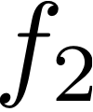

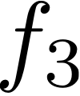


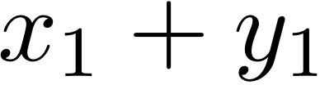
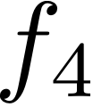

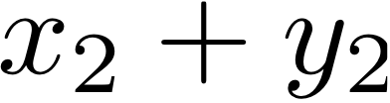

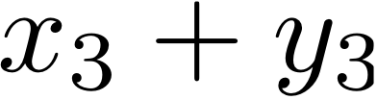













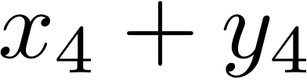
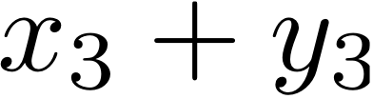
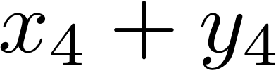
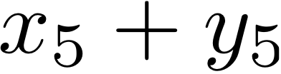
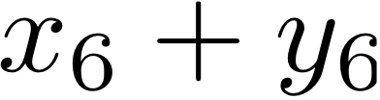
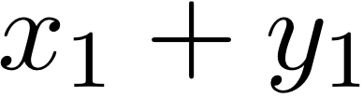
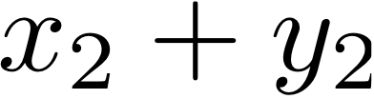
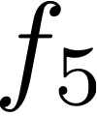

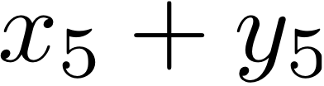
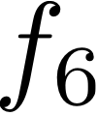

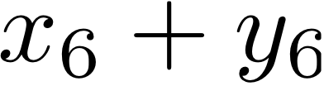
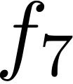

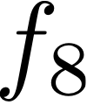


Simple Regenerating Codes
Two stages: MDS-Precode and Placement
(n=6,k=4)-SRC
Coding
Placement
(6,4)-RS
node1
node2
node3
node4
node5
node6
(6,4)-RS
11

Slide 12

SRC: Repair
Simple Look-up Repair Based on XORs
A repair requires 4 node accesses
Repair BW = 2α = 3*M/k
12

Slide 13
SRC: File Reconstruction
File Reconstruction Based on the MDS-Precode
Each 4 nodes have access to 4+4 RS pieces
node1
node2
node3
node4
node5
node6
13

Slide 14
SRC Specs
(10,8,2)-SRC
(10,8)-MDS (BW optimal)
Storage
Repair Communication
Rate
Nodes used in repair

Slide 15
SRC Specs
(n,k,f)-SRC
(n,k)-MDS (BW optimal)
Storage
Repair Communication
Rate
Nodes used in repair

Slide 16
Performance on HADOOP

Slide 17
Simulations
16 machine on MSR-HADOOP Simulator. RS vs Replication vs SRC
SRC = a graceful mix of RS and Replication
17

Slide 18
Conclusions
We have introduce a family of low-locality, high-rate, simple codes
Repairs based on simple and Local XOR
SRCs combine the merits of replication and MDS codes
Open Problems:
1) Combinatorial View of SRCs based on expanders
2) Optimal Disk Accesses Tradeoff
3) Connections to Locally Decodable Codes
18

Slide 19
the end

