Slide 1


Distributed Storage Codes through Hadamard Designs
Dimitris S. Papailiopoulos and Alex G. Dimakis
USC
ISIT 2011
St. Petersburg, Russia

Slide 2
Intro
Storing information using Erasure Codes
The Exact Repair problem. State of the Art.
The Role of Interference Alignment.
The Role of Hadamard.
A repair optimal code based on Hadamard Designs.
2

Slide 3
Intro
Erasure Codes and the Repair Problem
Exact Repair
Interference Alignment and Dots
Hadamard: Making Asymptotic IA Exact
Conclusions

Slide 4
Erasure Codes Vs. Replication
n = 4
n = 4
A
k = 2
data pieces
A
A
A
B
B
B
B
A
A+B
B
A+2B
(n,k)-Erasure: Any k nodes give back the data object
(n,k)-MDS: redundancy optimal (n,k)-Erasure
(4,2) MDS code
Any 2 failures are OK
RAID 6
4

Slide 5

The Repair Problem
Downside of off-the-shelf erasure codes:
The entire file is downloaded for repair A single node failure can bottleneck the entire storage network
Naïve repair works for sure.
But I can do better?
Q: What about Exact Repair?
A
B
C
D
E
Functional Repair: After Repair, the code is still (n,k)-MDS
Thm: we only download 1/#parities the contents of the remaining nodes
[Dimakis et al.]
5

Slide 6
Intro
Erasure Codes for Storage
The Repair Problem
Exact Repair
Interference Alignment and Dots
Hadamard: Making Asymptotic IA Exact
Conclusions

Slide 7
Exact Repair Optimal Codes Exist
Example: (4,2) EvenOdd Code = more that 1 chunks per node
4Mb data object, 2 Mb per node
Repair costs 3Mb instead of 4Mb!
a
c
a+c
b+c
[Blaum and Bruck ’95]
b
d
b+d
a+b+d
c+d
a+b+c+d
a+c+d
a
b
We can download less because interference equations align!
7

Slide 8
Prior Work
Before:
R <=1/2: explicit constructions
[Wu,Dimakis‘09] [Rashmi,Shah,Kumar,Ramchadran’09] [Suh,Ramchandran ’10]
Any R, asymptotically optimal codes exist (Impractical Construction)
[Cadambe,Jafar,Maleki], [Suh, Ramchandran]
Now and Future:
ISIT 2011: Optimal systematic repair R>=1/2
[Tamo, Wang, Bruck ] [Cadambe, Huang, Li]
Arxiv: Optimal Repair n-k=2 / systematic R>=1/2
[Papailiopoulos, Dimakis, Cadambe]
Arxiv: Optimal Repair of any node n-k
[Wang, Tamo, Bruck]
Interference Alignment necessary for all constructions
We present one of the first repair optimal, high-rate, code
8

Slide 9



2-parity Code: Exact Repair
(5,3)-MDS storage code: filesize = 3*N Mb, every
Each Node Stores N
: NxN
Systematic Node 1
Systematic Node 2
Systematic Node 3
Parity Node 1
Parity Node 2
9

Slide 10

2-parity Code: Exact Repair
Q: If a disk fails? A: Repair exactly what was lost.
# unknowns to recover = N
Repair process: an NxN/2 matrix “mixes” the contents of each parity
Basis 1
Replicate interference 1
Basis 2
Replicate interference 2
N equations
10

Slide 11
Repair Spaces
Useful space
Interference space
Interference space
Thm: Repair BW = size of what was lost + interference rank
Requirements for BW optimal repair
Useful space full-rank.
Interference space minimum rank.
Rank Constrained Rank minimization:
min rank 1 + rank 2
s.t.: rank = N
Perfect Alignment:
Full Rank:
11

Slide 12
Intro
Erasure Codes for Storage
The Repair Problem
Exact Repair
Interference Alignment and Dots
Hadamard: Making Asymptotic IA Exact
Conclusions

Slide 13




Asymptotic IA: The Road to Solution?
Interference space
Interference space
The Freedom(?) I give my self: make N whatever I like + matrices are diagonal
…. But I want perfect alignment
OK, start with N = 2, arbitrary matrices and
No Alignment ☹
Idea: combine everything in a new V and try again
Perfect Alignment:
Full Rank:
13

Slide 14
Aligning Interference
We have
Some Alignment is created.
OK iterate again…
Wait! maybe I can fix that to be perfect
Perfect Alignment:
Full Rank:
14

Slide 15






IA = Dots on a lattice
Lets revisit things combinatorially
Perfect Alignment = Perfect Dots Overlap
Q: When does it happen?
Perfect Alignment:
Full Rank:
15

Slide 16

Perfect IA?
When dots “wrap around”
Hence I need {-1,+1}:
Perfect Alignment:
Full Rank:
16

Slide 17
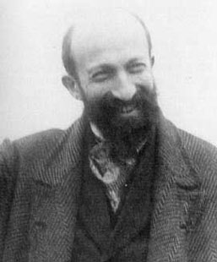

Perfect IA?
OK, now I that if I want perfect IA, I will use, {-1,1} diagonals
To be full rank, what do I want?
2 ingredients:
{-1,1} columns + linear independence
Hmm…
Useful space
Perfect Alignment:
Full Rank:
17

Slide 18

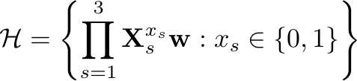
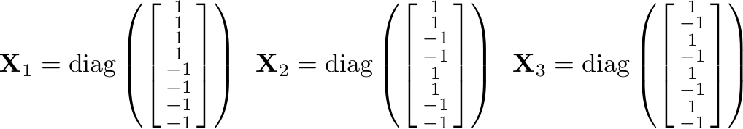

Hadamard Repair Spaces
Hadamard is {-1,+1} and full-rank
Columns in the set
1) We set
2) and choose the matrix
Perfect Alignment:
Full Rank:
18

Slide 19
Intro
Erasure Codes for Storage
The Repair Problem
Exact Repair
Interference Alignment and Dots
Hadamard: Making Asymptotic IA Exact
Conclusions

Slide 20

Perfect IA
Because spaces wrap around, and because of Hadamard we are optimal
Useful space
Interference space
Interference space
20

Slide 21
The big picture of the high rate world
Cellular Subspace Alignemnt
Suh and Tse
me et al.
Tamo et al.
Cadambe et al.
21

Slide 22
Conclusions
Perfect Alignment Codes for high-rate: an open problem
ISIT 2011: The first constructions
Our Solution = Roots of Unity + Hadamard Matrices
Many open problems
1) The way I cut the file is still exponential, anything better?
2) Non-commutative group alignment?
3) Extensions to wireless channels [P., Dimakis]
4) If I give up a bit on storage and alignment can I still be
i) high-rate, ii) almost MDS, iii) and simple to repair?
5) Minimum Disk Access of Optimal MDS codes?
Maybe, practical+optimal+MDS is overly optimistic…
maybe it’s not.

Slide 23
fin

