Slide 1



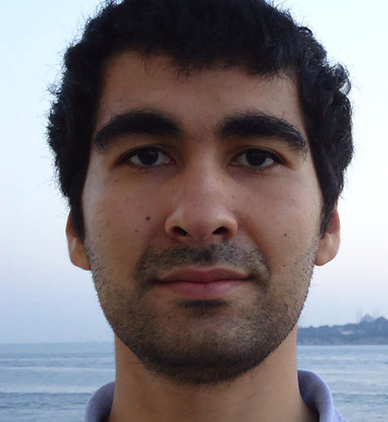



Correlation Clustering for Big Graphs
Dimitris Papailiopoulos
Xinghao Pan
Samet Oymak
Ben Recht
Kannan Ramchandran
Michael I. Jordan

Slide 2
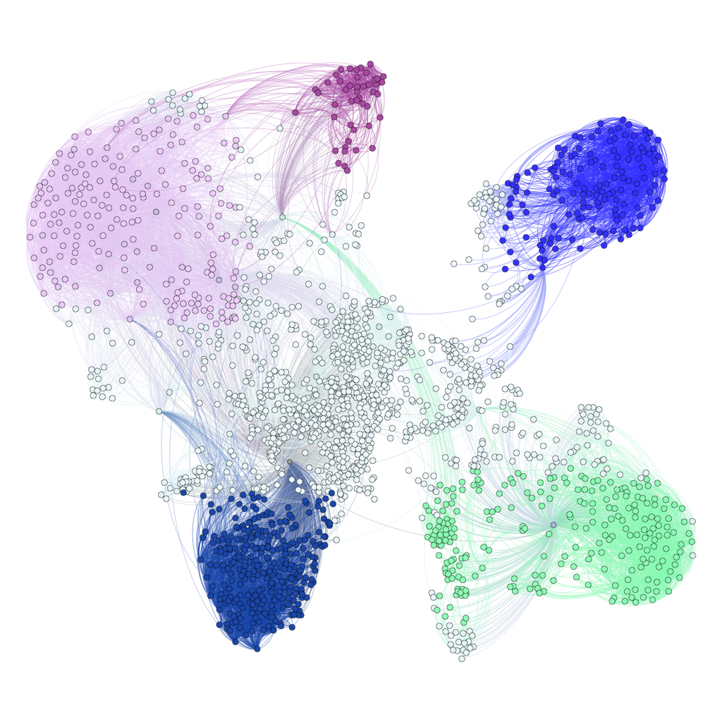
Correlation Clustering

Slide 3
Correlation Clustering
We are given a graph,
with similar and dissimilar vertices
similar
[Bansal, Blum, Chawla FOCS’02]
Group vertices in clusters so that
Similar ones are together
Dissimilar are apart
Objective:
Group vertices in clusters
to minimize un-happy pairs

Slide 4
Correlation Clustering
Clustering Ex.
Unhappy pairs:
- similar nodes in different clusters
- dissimilar nodes in same cluster
Objective:
Group vertices in clusters
to minimize un-happy pairs

Slide 5
Correlation Clustering
Clustering Ex.
Cost = 1 unhappy pairs
Unhappy pairs:
- similar nodes in different clusters
- dissimilar nodes in same cluster
Objective:
Group vertices in clusters
to minimize un-happy pairs

Slide 6
Application: Deduplication
similar
UC Berkeley
Stanford University California
UC Berkeley
Stanford University California
University of California at Berkeley
University of California at Berkeley
Lawrence Berkeley National Labs
Lawrence Berkeley National Labs

Slide 7
Application: Deduplication
Correlation Clustering:
Cluster to minimize unhappy pairs (clustering error)

Slide 8
Application: Deduplication
NP Hard!
Lot’s of prior work:
-Approximation algorithms
-Statistical Guarantees
-Distributed Approaches
-many variants
[AilonCharikarNewman08], [AilonLiberty09], [CharikarGuruswamiWirth03], [DemainFiat06]…[MathewSchudy10], [MakarychevMackarychevVijayaraghavan14] [ChierichettiDalviKumarKDD14] , [Bonchi et al KDD14], [Puleo, Milenkovic, 15]
Many more Applications:
Community Detection
[Yang, Cheung, Liu, TKDE’ 07]
Opinion/Trust Network Link Classification
[C.-Bianchi, Gentile, et al, COLT’12]
Co-reference Resolution
[Soon et al., CompLing ’01], [McCallum, Wellner. NIPS’04]
Gene Clustering
[Ben-Dor, Shamir, Yakhini, JCompBio ’99]
Consensus Clustering
[Goder Filkov, ‘08]

Slide 9
Goal of this work

Slide 10
Goal of this work: Provable Graph Clustering for Distributed Graph Engines Real Systems implementation on GraphX/Spark

Slide 11
Graph Engines 101

Slide 12

Recipes for graph-parallel algorithms
“Think like a Vertex.”
-Pregel [SIGMOD’10]
Graph-Parallel Paradigm:
Receive Messages from friends

Slide 13

Recipes for graph-parallel algorithms
“Think like a Vertex.”
-Pregel [SIGMOD’10]
Specifications of a good distributed algorithm
Quality of solution
Small #rounds ( constant, logarithmic )
Small Communication ( few messages / round )
Graph-Parallel Paradigm:
Receive Messages from friends
Compute f(messages)
Send Messages to friends
repeat

Slide 14
A Serial Algorithm: Peeling
Serially process vertices
active
Nir Ailon, Moses Charikar, and Alantha Newman.
Aggregating inconsistent information: ranking and clustering.
Journal of the ACM (JACM), 55(5):23, 2008.

Slide 15
A Serial Algorithm: Peeling
Serially process vertices
active
Nir Ailon, Moses Charikar, and Alantha Newman.
Aggregating inconsistent information: ranking and clustering.
Journal of the ACM (JACM), 55(5):23, 2008.

Slide 16
A Serial Algorithm: Peeling
Serially process vertices
active
Nir Ailon, Moses Charikar, and Alantha Newman.
Aggregating inconsistent information: ranking and clustering.
Journal of the ACM (JACM), 55(5):23, 2008.

Slide 17
A Serial Algorithm: Peeling
Serially process vertices
In practice:
good performance after local improvement heuristics
[Elshner, Shudy ’09]
Approximation 3 OPT (in expectation)
Nir Ailon, Moses Charikar, and Alantha Newman.
Aggregating inconsistent information: ranking and clustering.
Journal of the ACM (JACM), 55(5):23, 2008.

Slide 18
A Serial Algorithm: Peeling
Serially process vertices
approx. ratio = 3*OPT
Messages = minimal
#rounds = O(#vertices)

Slide 19
Our Approach

Slide 20
Careful Sampling: Activate vertices / round similar to [Blelloch et al.12], [Chierichetti et al KDD’14]
active
active

Slide 21
What if active vertices are friends?
Concurrency Control Correlation Clustering (C4)
Concurrency rule:
No clusters between active friends
active
Two Novel Algorithms:
Follow rules:
a provably correct algorithm (3*OPT)
(using Concurrency Control Xinghao Pan et al.)
Break rules:
a provably fast algorithm
Nearly 3*OPT
(using Hogwild! ideas [Niu, Recht, Re, Wright])
active

Slide 22
ClusterWild!: A Coordination-free Approach
active
active

Slide 23
ClusterWild! A Coordination-free Approach
Cannot introduce
adjacent cluster centers
Go Hogwild!
active
active
Not free:
We lose accuracy (Q: how much?)

Slide 24
How to analyze ClusterWild!?
Cannot introduce
adjacent cluster centers
active
active
Aha! It’s like that edge was never there!!
It’s like Serial algo. on a “noisy”graph!

Slide 25
How much is noise hurting me?
Idea:
Cost(Break Rules) = Cost(Follow Rules)+#extra unhappy pairs
Break Rules
Follow Rules
versus

Slide 26
How much is noise hurting me?
Idea:
Cost(Break Rules) = Cost(Follow Rules)+#extra unhappy pairs
Extra unhappy pairs = Edges cut across clusters
Break Rules
Follow Rules
versus

Slide 27
How many unhappy pairs?
Def:
= Bad Triangle
Charge unhappy pairs to Bad Triangles (+ignored edges)
#Bad Triangles due to edge removals?
Lemma:
#Bad Triangles < (#Edges ignored) * (max degree)
Lemma:
#Bad Triangles < εV log V

Slide 28
Main Theorem
ClusterWild!
approx. ratio
(3+ε) OPT+εV*logV*log Δ
#rounds
( 14 /ε) log(V) log(Δ)
State of the art
[Chierichetti et al KDD’14]
Approximation ratio
(3+ε) OPT
( 224/ε) log(V) log(Δ)
Similar to Serial*
Similar to Serial
~20-100
~500-2,000
Proof Ingredient:
Lock-free(Algorithm( Graph )) = Algorithm( Graph+Noise )

Slide 29
Main Theorem
ClusterWild!
approx. ratio
(3+ε) OPT+εV * logV
#rounds
( 14 /ε) log(V) log(Δ)
Concurrency Control
Approximation ratio
3 OPT
#rounds
50 log(V)^2 log(Δ)
Similar to Serial*
Same as Serial
~20-100
~50-200
Proof Ingredient:
Lock-free(Algorithm( Graph )) = Algorithm( Graph+Noise )
2. After log V rounds max.deg. get halved whp

Slide 30
Experiments (#rounds) fb_small (V = 4k , E = 180K )
Follow Rules, be smart about it
Break
Rules
Fast Regime, no Guarantees
60x
[Chierichetti et al]

Slide 31
GraphX/Spark Implementation

Slide 32
Conclusions
Provable Clustering for Billion-Scale Graphs
Real Systems Implementation (GraphX / Apache Spark)
Meta-framework for Hogwild! (async. Lock-free) algorithms
easier analysis + better algorithms ?(SGD, SVD, x = f(x) type algos)
- Trying to Close the loop of
Algorithms + Systems
Theory + Practice
Lock-free(Algorithm( Data )) = Algorithm( Data + Noise )

Slide 33
fin

Slide 34
Small Experiments (#rounds) astro (V = 19K , E = 400K )
Turn εnob way higher than theory
Greedy > 10,000 Round
KDD’14 (if you want provable) > 2,000 rounds

Slide 35
Empirical Validation on Billion Edge Graphs
Amazon EC2 r3.8xlarge instances
Multicore up to 16 threads
Real and synthetic graphs
100 runs (10 random orderings x 10 runs)
Graph |  | Vertices | Edges
IT-2004 | Italian web-graph | 41 Million | 1.14 Billion
Webbase-2001 | WebBase crawl | 118 Million | 1.02 Billion
Erdos-Renyi | Synthetic random | 100 Million | ≈ 1.0 Billion

Slide 36
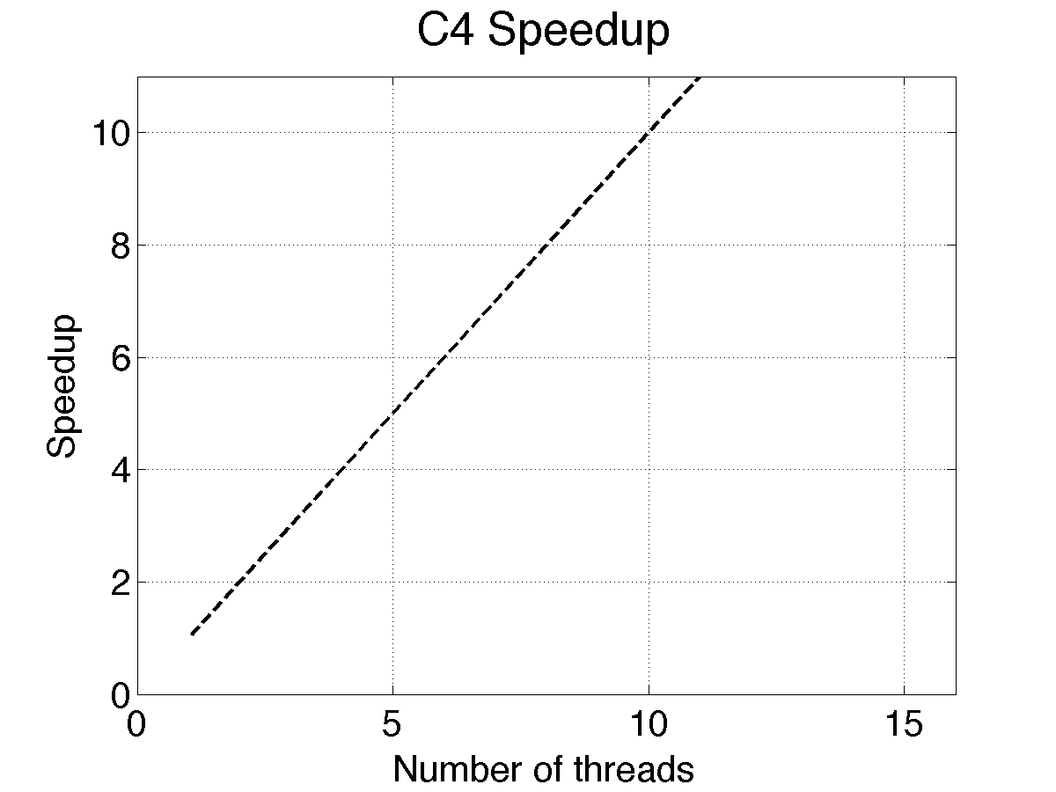
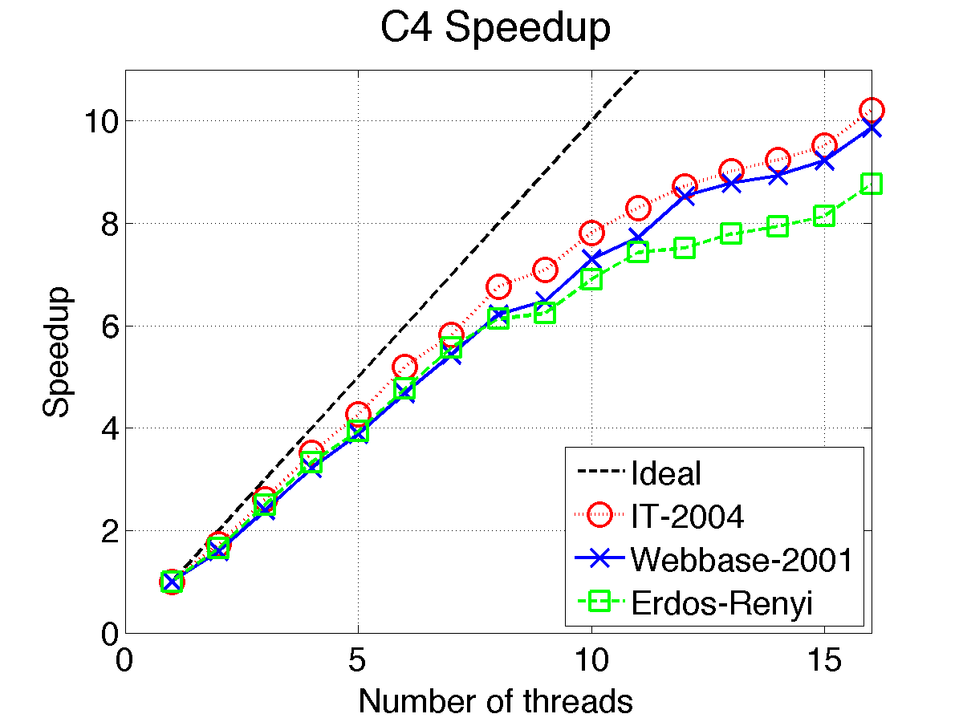
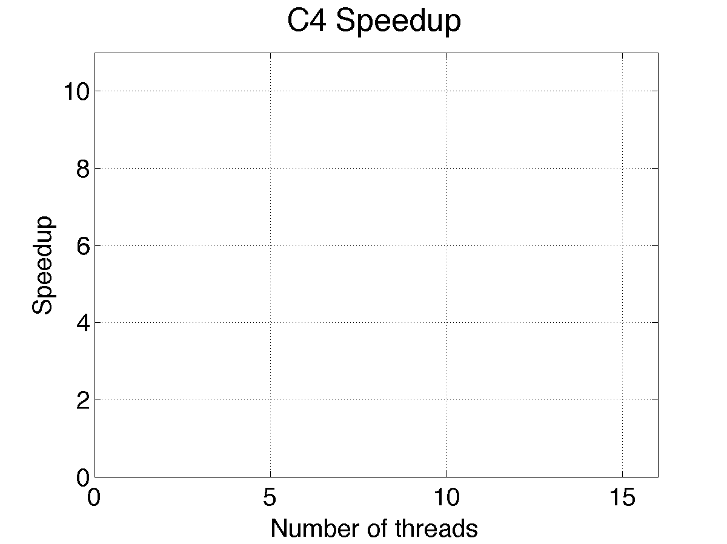
C4: Speed-up
10x
speedup
Ideal

