Slide 1
Law Enforcement & Data analytics
Mariana Aguilera
Manav Jatakia
Harsh Bharatbhai Anadkat

Slide 2

Introduction
Understand the evolution of data analytics used by the Law Enforcement Industry.
Discover the current techniques being used.
Learn about Artificial Intelligence (AI) integration.

Slide 3
Evolution of Law Enforcement and Data Analytics
1948
Adoption of radio for traffic law enforcement.
2020s
AI for facial recognition, surveillance, and anomaly detection.
Real-time crime centers integrating CAD, gunfire detection, and live video.
Post 2020s
Advancements + higher spending in real-time surveillance, predictive analytics, mobile apps, body cameras, and AI-driven data analytics.
1967
1990s
Before 1940s
2000s
Adoption of computer programs for crime analysis.
FBI creates National Crime Information Center (NCIC).
Police data was largely stored on paper-based filing systems.
Force-wide control rooms with advanced tools integrating call data, maps, and resource deployment.

Slide 4
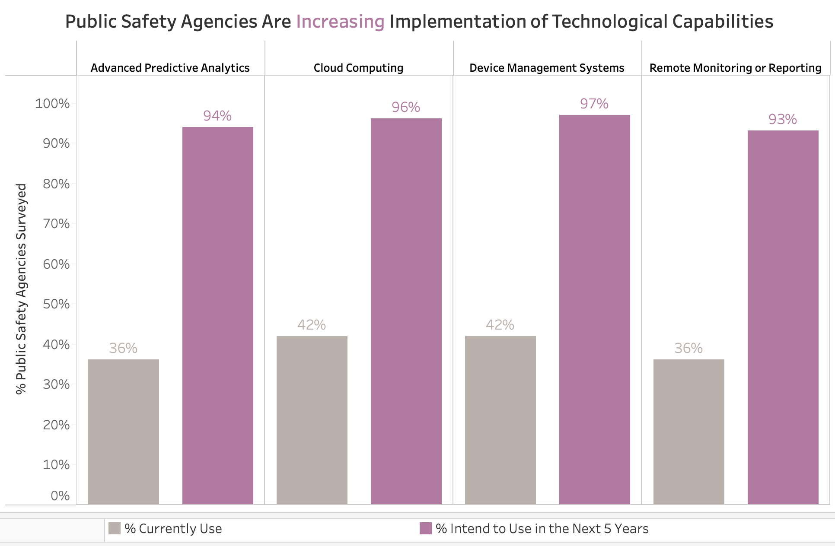
How is the timeline of events evidenced in the data?

Slide 5
Data Analytical TECHNIQUES used in Law Enforcement
Statistical Analysis: statistical methods to identify patterns and trends in crime data.
Predictive Analytics: Forecasting future criminal activities based on historical data and current trends.
Geospatial Analysis: Mapping crime patterns and hotspots to inform resource allocation and strategic decision-making.
Text Analysis: Extracting information from unstructured data such as police reports, witness statements, and social media to identify potential leads.

Slide 6
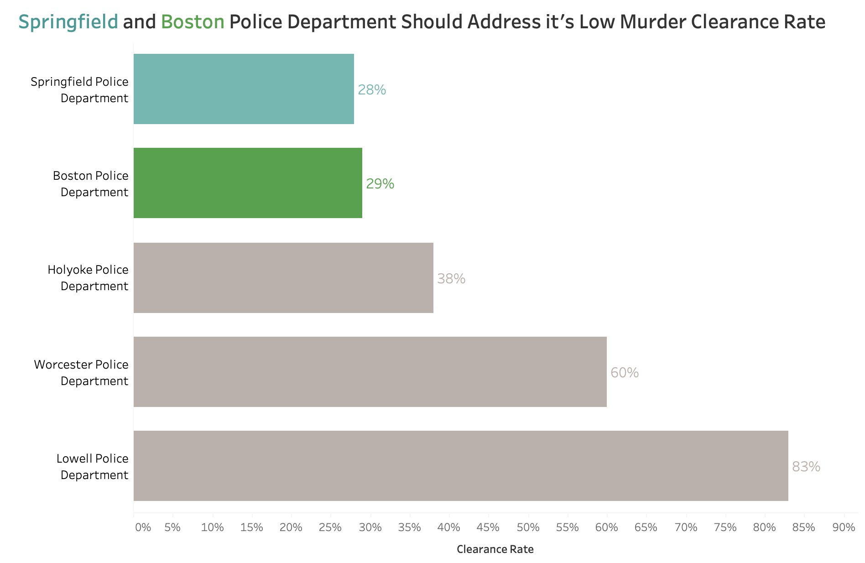
Data Analysis Examples with crime data
Location – Based

Slide 7
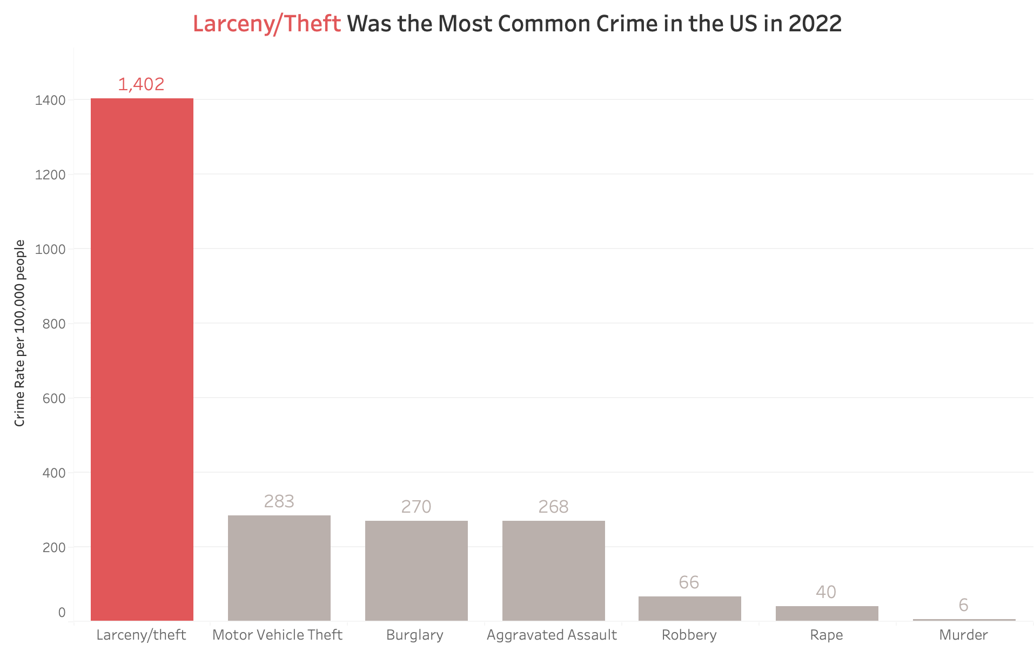
Data Analysis Examples with crime data
By Crime Category

Slide 8
Integration of AI in Law Enforcement
Predictive Policies: AI foresees high-crime locations to allocate resources proactively and prevent crime.
Upgraded Data Analysis: AI enables the discovery of trends and possible crimes in large databases.
Surveillance and Monitoring: AI helps with facial recognition and real-time surveillance for questionable conduct.
Enhanced Investigations: AI contributes with crime scene investigation, suspect identification, and gleaning insights from unstructured data.

Slide 9
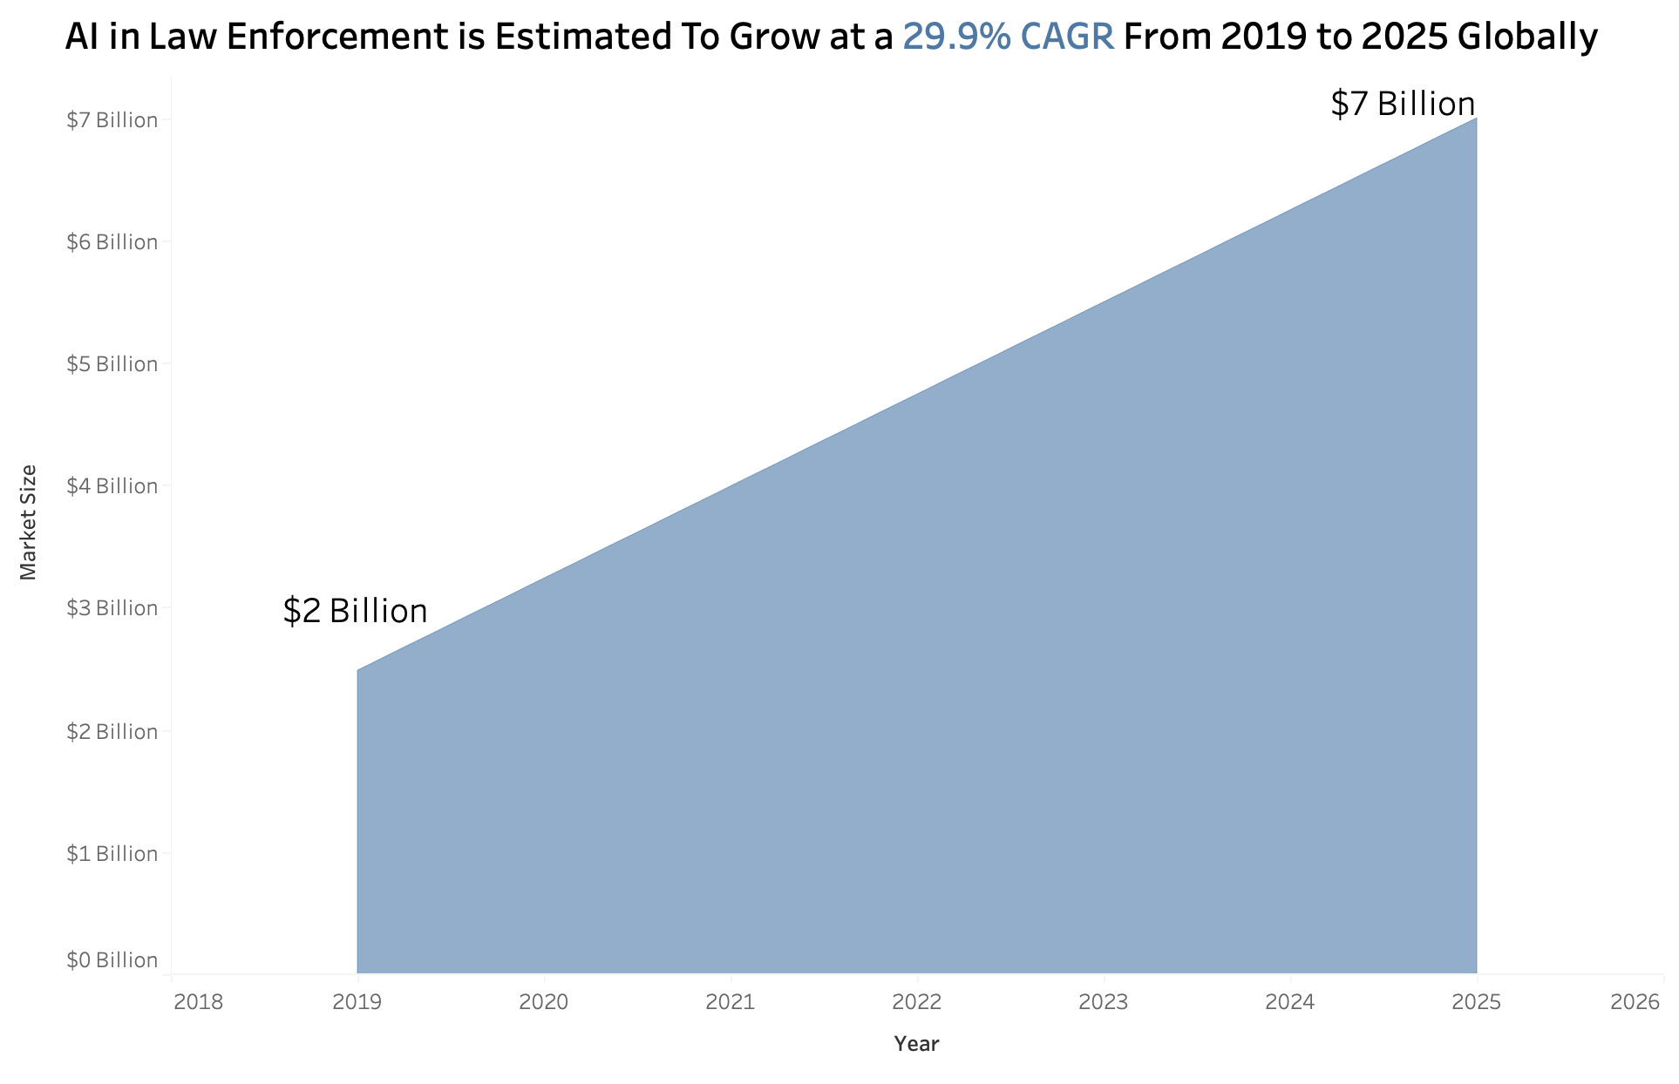
GROWTH OF AI IN LAW ENFORCEMENT

Slide 10
Ethical Considerations in Applying AI in Law Enforcement
Privacy and Data Protection: The rights of citizens to privacy may be violated by the increased use of surveillance technology and data collection for AI-powered crime prediction.
Bias: AI systems that have been trained on biased data have the potential to maintain discriminatory practices in domains such as resource distribution and suspect identification.
Misuse of Power: An over-reliance on AI to assist in decision-making may restrict an officer's ability to use discretion and judgment in urgent situations.

Slide 11
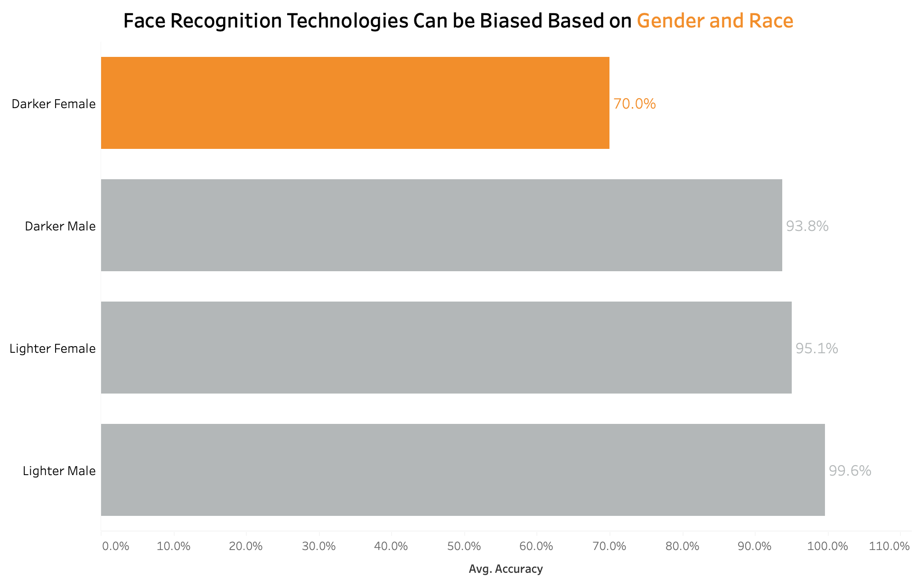
racial BIAS Caused by ai in policing

Slide 12
Conclusion
Data analytics have proven helpful in the Law Enforcement industry over time.
There has been a steady growth of investments in AI by law enforcement agencies over the years.
However, there are still ethics concerns regarding the use of AI in Law Enforcement that needs to be addressed.

Slide 13

REferences
Li, W., & Lartey, J. (2022, January 12). As Murders Spiked, Police Solved About Half in 2020. The Marshall Project.
McGregor, A. (2021, March 1). The evolution of data in policing. Capita.
Vomiero, J. (2018, February 11). Studies show facial recognition software almost works perfectly – if you’re a white male. Global News.

Slide 14
THANK YOU

