Slide 1
ALY 6110 Data Management and Big Data
Group 7 - Air Quality Analysis and Big Data Insights in the United States
Professor:
Daya Rudramoorthi
Project Members:
Harsh Anadkat
Mohammed Abdoul

Slide 2
Introduction – Real World Problem
Air pollution remains one of the biggest environmental and public health challenges worldwide. Carbon Monoxide (CO) is a hazardous air pollutant emitted from vehicular traffic, industrial processes, and wildfires.
Impact of High CO Levels:
With extended exposure, it can result in brain damage, cardiovascular problems, and respiratory illnesses. Due to the disproportionate impact of poor air quality in metropolitan areas, real-time monitoring is essential.
Our Goal:
Examine trends in air quality by applying Big Data methods. Predict the Air Quality Index (AQI) using machine learning algorithms. Provide policymakers and environmental agencies useful information.

Slide 3

Data Selection and Rationale
Data Source: https://www.epa.gov/outdoor-air-quality-data
Dataset Overview:
1.8+ million observations (Jan – Dec 2022)
Multiple monitoring stations across urban and rural areas.
Key attributes include:
Daily Maximum 8-hour CO Concentration (ppm).
Air Quality Index (AQI) levels.
Site Latitude & Longitude.
Observation frequency & data completeness
Why This Dataset?
Comprehensive and reliable – official government data.
Nationwide scope – allows urban vs. rural comparison.
Well-suited for Machine Learning – contains large volumes of structured data.

Slide 4
Methodology – Data Processing & Tools
Big Data Approach: CRISP-DM (Cross-Industry Standard Process for Data Mining)
Business Understanding – Understanding CO’s impact on AQI.
Data Understanding – Examining EPA dataset structure.
Data Preparation – Cleaning, feature engineering, and standardization.
Modelling – Training ML models for AQI prediction.
Evaluation – Assessing model accuracy using metrics.
Deployment – Implementing real-world applications.
Technologies Used:
Data Processing: Python (Pandas, NumPy), Apache Spark
Visualization: Seaborn, Matplotlib, Tableau, Plotly, Dash
Machine Learning Models: Scikit-learn (Random Forest, Decision Tree)

Slide 5
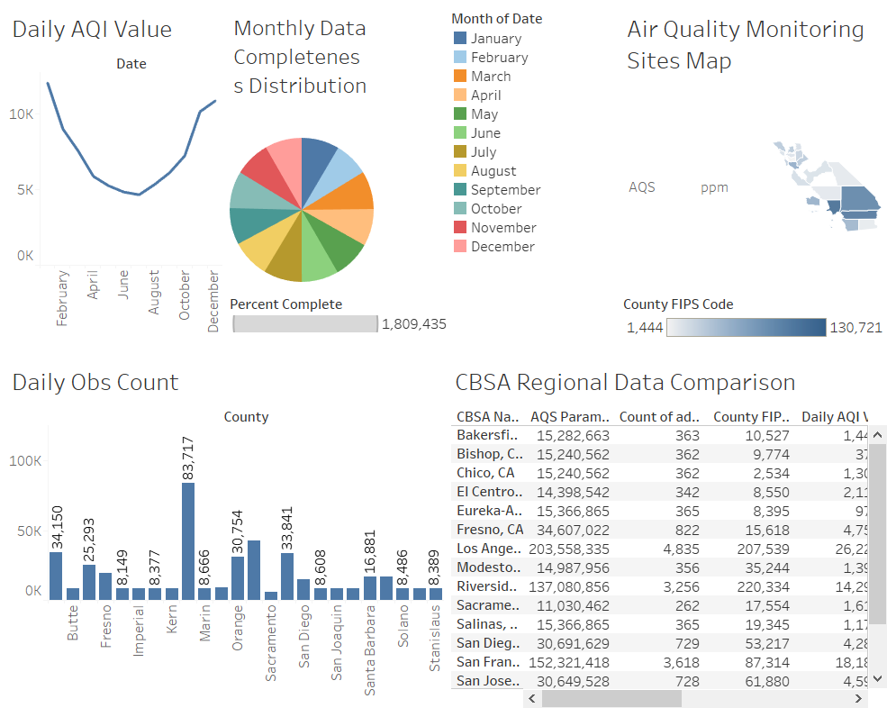
Dashboard 1 - Visual Insights

Slide 6
Dashboard 1 - Explanation
1. Daily AQI Value (Line Graph): This illustrates the daily Air Quality Index values' historical trend, maybe exposing seasonal variations or trends.
2. The Monthly Data Completeness Distribution (Pie Chart): illustrates any possible gaps or inconsistencies in the dataset by showing the proportion of complete data for each month.
3. Map of Air Quality Monitoring stations (Choropleth Map): This map uses color gradients to show a measure associated with air quality monitoring stations geographically throughout a region (probably California).
4. Daily OBS Count (Bar Chart): This graphic illustrates differences in data collecting efforts by comparing the total number of daily observations across several locations (presumably counties).
5. This table: presents comprehensive information for several California metropolitan areas (CBSAs), including measures such as "Daily AQI Value," "Daily Max 8-hour CO Concentration," and "Daily Obs Count."

Slide 7
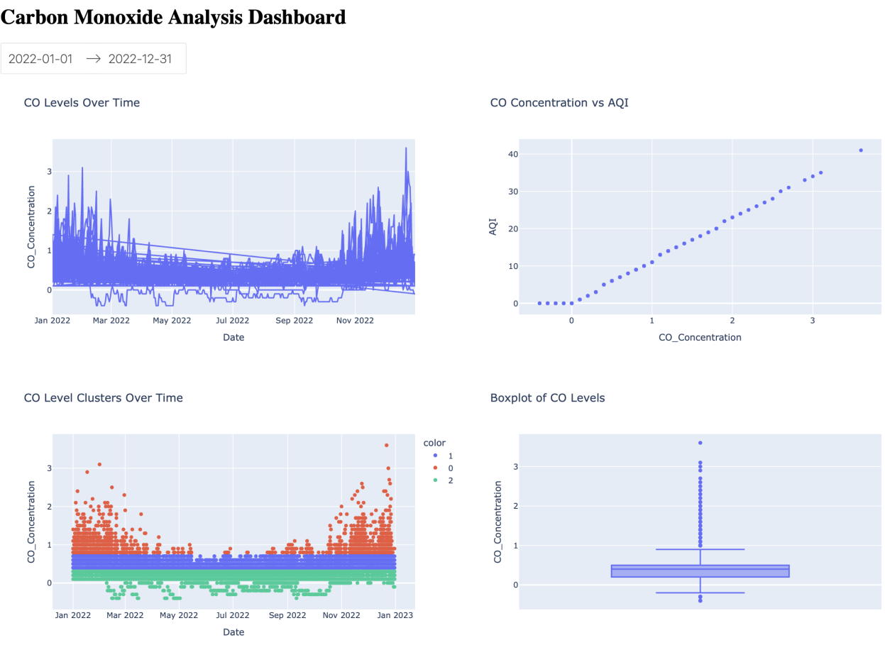
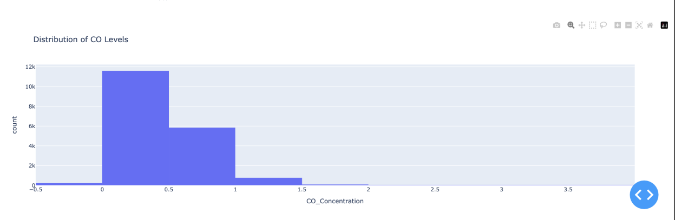
Dashboard 2 - Visual Insights

Slide 8
Dashboard 2 - Explanation
1. CO Levels Over Time – CO fluctuates, with noticeable spikes towards year-end.
2. CO Concentration vs AQI – Strong positive correlation; higher CO worsens air quality.
3. CO Level Clusters – Clustering shows varying CO levels, with higher concentrations later in the year.
4. Boxplot of CO Levels – Highlights CO distribution and outliers, indicating pollution spikes.
CO Levels Distribution:
Most CO values are below 0.5 ppm (low pollution).
Higher CO levels (>1.0 ppm) are rare but present.
Some outliers indicate occasional pollution spikes.

Slide 9
Predictive Modelling Approach
Objective: Forecast AQI values based on CO concentration and other factors.
Models Implemented:
Random Forest Regressor
An ensemble learning technique that uses multiple decision trees.
Reduces variance, making predictions more robust.
Decision Tree Regressor
A simpler model, prone to overfitting, but highly interpretable.
Feature Engineering & Data Preparation:
Converted date/time features for seasonal analysis.
Used StandardScaler to normalize numerical variables.
Selected most important features for prediction:
CO Concentration (Primary predictor)
Geolocation (Latitude & Longitude)
Observation Frequency & Completeness

Slide 10
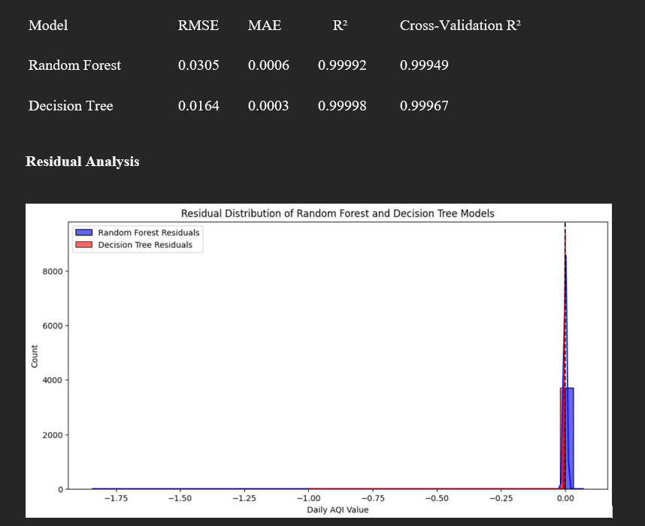
Model Performance and Residual Analysis

Slide 11
Model Evaluation and Results
Evaluation Metrics Used:
Root Mean Squared Error (RMSE): Measures prediction errors.
Mean Absolute Error (MAE): Measures absolute prediction deviations.
R² Score: Measures model effectiveness in explaining variance.
Results:
Random Forest: RMSE = 0.0305, R² = 0.99992 (Best performer)
Decision Tree: RMSE = 0.0164, R² = 0.99998 (Overfits slightly)
Key Takeaways:
CO concentration is the most significant predictor of AQI (99.99% impact).
Random Forest provides the most reliable, generalizable predictions.
Decision Tree, while interpretable, struggles with overfitting.

Slide 12
Deployment & Real-World Applications
Interactive AQI Dashboards:
Provides real-time air quality predictions.
Accessible to policymakers, health agencies, and the public.
Automated Data Pipelines:
Continuous model updates with new EPA data.
Reduces manual intervention and ensures accurate forecasting.
Real-Time Alert Systems:
Notifications for pollution spikes above safety thresholds.
Helps in enforcing emission control measures.

Slide 13

Recommendations and Conclusions
Deploy AI Models in Real-Time Systems: Utilize predictive models in government and environmental agencies for continuous air quality monitoring and proactive response.
Enhance Data Quality: Standardize data collection methods to reduce inconsistencies and improve model accuracy.
Expand Monitoring Systems: Increase sensor deployment in high-risk and underserved areas for comprehensive air quality tracking.
To Conclude, The analysis confirms that CO levels have a direct impact on AQI, highlighting the need for proactive monitoring.
Machine learning models significantly enhance AQI prediction accuracy, making real-time forecasting feasible.

