Slide 1
EAI 6400 Data Governance and Responsible AI
The Impact of Bias in AI: Ethical Challenges in Diabetes Prediction With Facial Recognition
Professor:
Dr. Mimoza Dimodugno
Project Members:
Harsh Anadkat

Slide 2
Introduction
Business Question:
How is the diabetes prediction system going to help us?
Why is this important?
Early detection and prevention of diabetes are essential to avoid severe complications like heart disease and kidney failure. Integrating FRT ensures equitable care while addressing gaps in traditional testing, significantly improving patient outcomes.
What is our goal?
The project aims to create a comprehensive, fairness-aware diabetes prediction system that integrates FRT to enhance accuracy, equity, and scalability in healthcare AI solutions.

Slide 3

Data Selection
Comprehensive Dataset: Pima Indians Diabetes Dataset: 768 samples, 8 features, and a binary outcome (0 = non-diabetic, 1 = diabetic).
Key Features: Includes glucose, BMI, insulin, age, and family history of diabetes.
Rationale for Selection: Relevance: Focuses on critical risk factors for diabetes.
Real-World Challenges: Contains class imbalance and missing values (zeros).
Benchmarking: Widely used for evaluating diabetes prediction models.
Applicability: Perfect for binary classification tasks.
The dataset is retrieved from https://www.kaggle.com/datasets/hasibur013/diabetes-dataset

Slide 4
How is Facial Recognition Technology related to Diabetes Prediction Analysis?
Facial Recognition Technology (FRT) analyses facial features like skin texture and patterns linked to Type 2 Diabetes Mellitus (T2DM).
It complements traditional predictors like glucose and BMI, offering a non-invasive, rapid screening method.
By combining FRT with fairness-aware algorithms, biases in predictions are mitigated, ensuring equitable and accessible diabetes prediction.

Slide 5
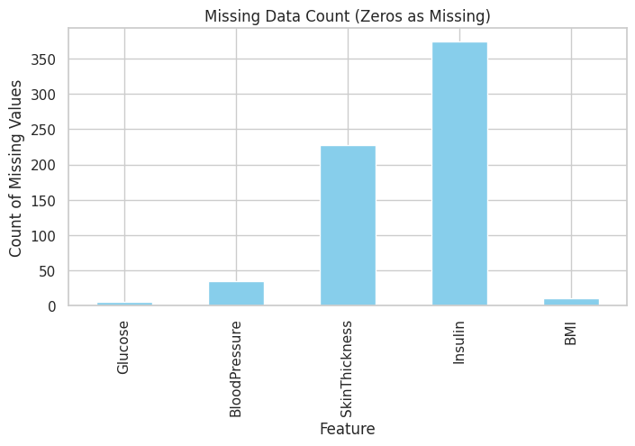
Exploratory Data Analysis
Analysis of the Missing Data Count Plot
High Missing Values in Insulin: The "Insulin" feature has the highest number of missing values, indicating that a significant portion of the data is missing for this particular attribute.
Other Missing Values: While the other features have fewer missing values, their presence can still impact the model's performance if not handled appropriately.

Slide 6
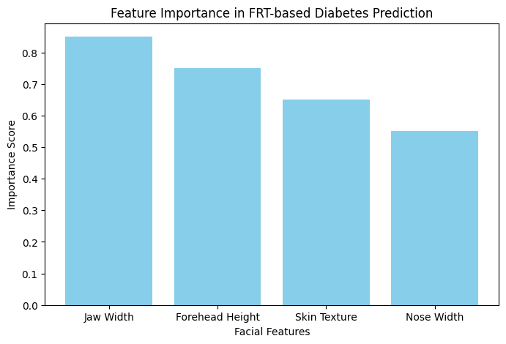
Feature Importance in FRT-based Diabetes Prediction
Feature Ranking: Features like jaw width and skin texture might be more predictive, as indicated by higher scores.
Model Interpretation: The chart helps identify which facial characteristics are key markers for diabetes, enhancing transparency in the AI model's decision-making process.
Mitigation: Actionable Insight: Provides guidance on which features to focus on for improving data quality and training.

Slide 7
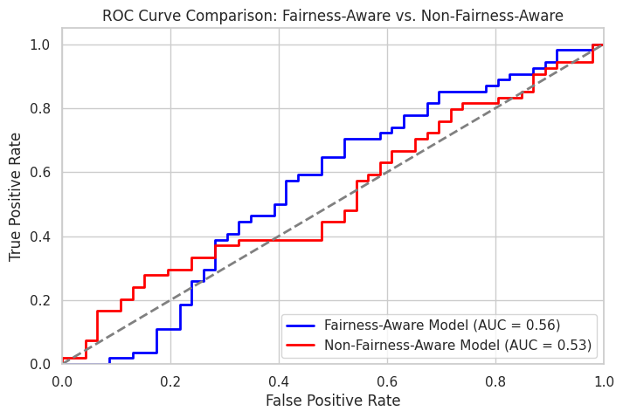
Predictive Models
Logistic Regression Model
Logistic Regression is often used for baseline performance in binary classification tasks. The ROC curve generated from Logistic Regression helps to assess sensitivity (true positive rate) vs. specificity (false positive rate) for the baseline.

Slide 8
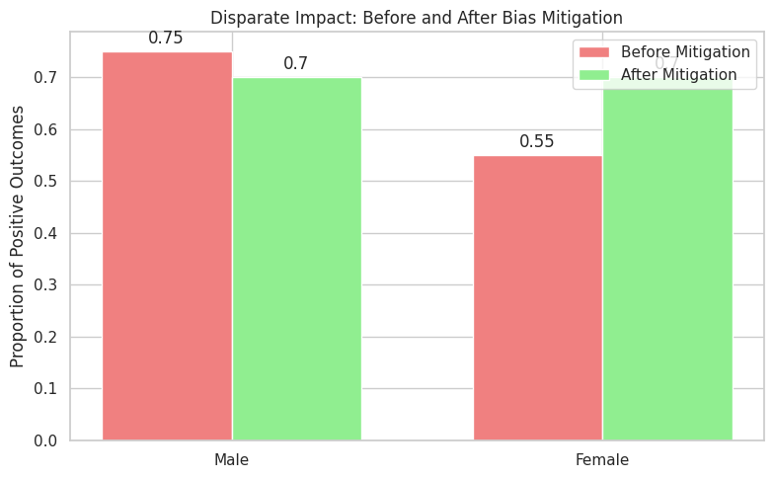
Random Forest Model
The bar chart shows the disparity in positive outcomes between two groups before and after bias mitigation. Before mitigation, one group had significantly higher positive outcomes than the other. After applying bias mitigation techniques, the disparity has been reduced, leading to a more equitable distribution of positive outcomes.

Slide 9

What Does This Mean For Business?
A fairness-aware diabetes prediction system helps businesses:
Enhance Patient Care: Early detection reduces costs and improves outcomes.
Build Trust: Promotes equity and fairness across patient groups.
Boost Innovation: Offers cutting-edge AI healthcare solutions.
Ensure Compliance: Meets ethical and legal standards.

Slide 10

Recommendations and Conclusions
Incorporate diverse datasets to reduce biases in FRT predictions. Combine FRT outputs with traditional factors (e.g., glucose, BMI) for enhanced reliability. Use fairness-aware algorithms and privacy-preserving techniques to ensure equity and security.
Integrating FRT into diabetes prediction enhances accessibility and scalability, making AI-driven healthcare more inclusive and impactful. Addressing ethical challenges and biases will foster trust and maximize the technology's benefits across demographics.

