Slide 1

Credit Card
Approval
Prediction
ANASTASIA DRAKOU 2022202304006
DESPOINA ANGELIKI MOYSIDOU 2022202304016
ANNA KOUTOUGERA 2022202304012

Slide 2
Our Goal
The Credit Card Approval Prediction dataset aims to predict whether a credit card application will be approved or denied based on various features
PEEK AT THE DATA
CREATION OF TARGET FEATURE
DATA CLEANING / FEATURE SELECTION/OVERSAMPLING
BUILD A MACHINE LEARNING MODEL FOR PREDICTION

Slide 3
WORKFLOW
6
5
PREDICTION
+
HYPERPARAMETER TUNNING
ALGORITM SELECTION
EDA
1
4
FEATURE SELECTION
+
OVERSAMPLING
DATA CLEANING
2
3
FEATURE ENGINEERING
+
NORMALIZATION

Slide 4
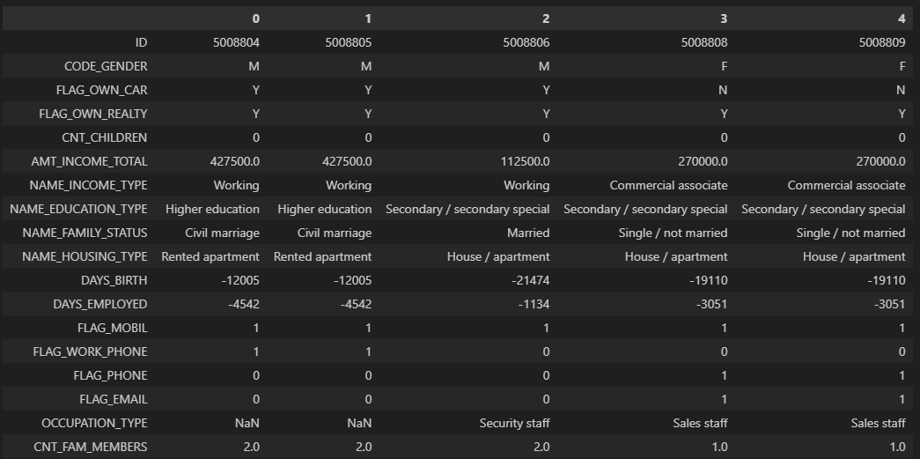
PEEK AT THE DATA
1
APPLICATION RECORD
NUMERICAL DATA
CATEGORICAL DATA
ORDINAL DATA
Contains appliers personal information, which we could use as features for predicting.

Slide 5
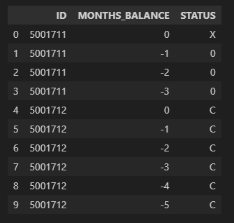
PEEK AT THE DATA
1
APPLICATION RECORD
NUMERICAL DATA
CATEGORICAL DATA
ORDINAL DATA
2
CREDIT RECORD
NUMERICAL DATA
CATEGORICAL DATA
In this table, a person - month record identifies a row. Every row represents a client's condition in different months

Slide 6
PEEK AT THE DATA
438.510 unique clients from APPLICATION RECORD
1
APPLICATION RECORD
NUMERICAL DATA
CATEGORICAL DATA
ORDINAL DATA
2
45.985 unique clients from CREDIT RECORD
CREDIT RECORD
NUMERICAL DATA
CATEGORICAL DATA
3
NUMBERS INSTANCES
36.457 common clients

Slide 7
PEEK AT THE DATA
1
"Occupation Type" column has 11,323 missing values.
This represents around 31% of the total 36,457 filtered records.
Retaining the "Occupation Type" column is crucial due to its potential significance in understanding and predicting process
APPLICATION RECORD
NUMERICAL DATA
CATEGORICAL DATA
ORDINAL DATA
31%
2
CREDIT RECORD
NUMERICAL DATA
CATEGORICAL DATA
3
Each record is uniquely identified by the ID column, leading to the perception of no duplicate values upon initial observation.
Excluding the ID column, reveals a presence of 26,729 duplicate values, constituting 73.3% of the dataset.
NUMBERS INSTANCES
73,3%
4
MISSING VALUES AND DUPLICATES

Slide 8
Target generation
SUPERVISED DATA
UNSUPERVISED DATA

Slide 9
Vintage analysis is a widely used method in credit risk management.
Provides a dynamic understanding of credit portfolio performance.
Identifies patterns in the emergence of bad customers over different periods.
Facilitates proactive risk management strategies based on historical trends
Evaluate the performance of customers in defined time intervals post loan or credit issuance.
Aggregate the cumulative percentage of customers exhibiting unfavorable outcomes within each time window
It assesses the performance of a portfolio over distinct periods post the issuance of a loan or credit card
Calculate the cumulative percentage of bad customers within specific performance windows.
Create a bad customer ratio based on historical data, offering insights into the evolving risk over time.
Target production
Vintage Analysis

Slide 10
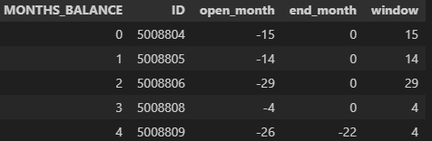
Target generation
Vintage Analysis
STEP 1
We want to keep the performance window most common in all cases. We don't simply look at the most recent data, because as we can see for certain clients, we may have last payment information from 2 years ago.

Slide 11
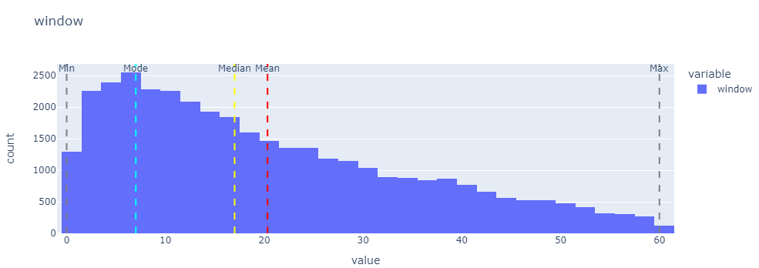
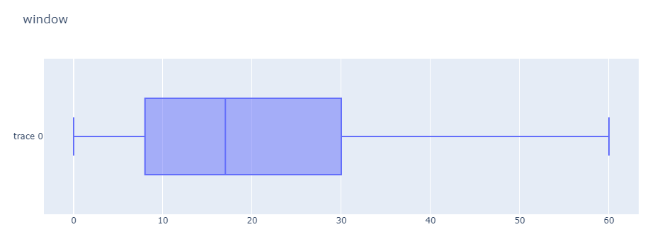
Target generation
Let's visualize it and see the mode and median value
MIN
0
MAX
60
MODE
7
MEAN
20
MEDIAN
17
We can observe that applicants typically delay making their payments until after the 7-month period.

Slide 12
Target generation
Vintage Analysis
STEP 1
We want to keep the performance window most common in all cases. We don't simply look at the most recent data, because as we can see for certain clients, we may have last payment information from 2 years ago.
STEP 2
Calculate ratios

Slide 13
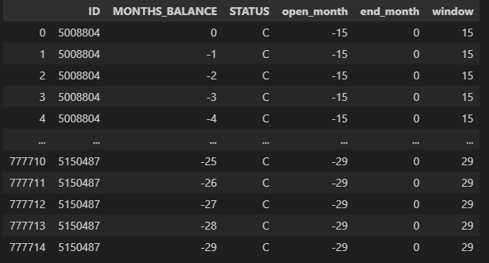
Target generation
Vintage Analysis
STEP 1
We want to keep the performance window most common in all cases. We don't simply look at the most recent data, because as we can see for certain clients, we may have last payment information from 2 years ago.
STEP 2
Calculate ratios
STEP 3
Analyzing Bad Customers

Slide 14
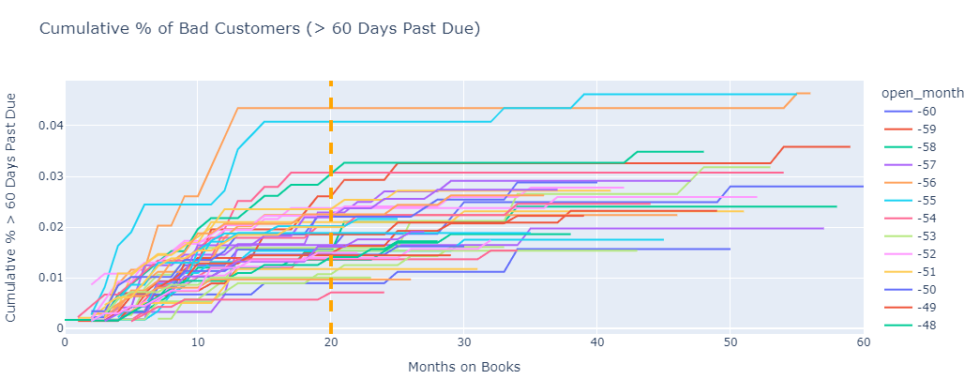
Target generation
Let's say that we consider someone a bad client if they have a payment overdue more than 60 days
In this situation, if a client becomes high risk after 60 days of overdue payment, it's observed that things settle down after about 20 months. After this time, there's usually no significant new information, making a 20-month timeframe suitable for making a confident decision

Slide 15
Target generation
Vintage Analysis
STEP 1
We want to keep the performance window most common in all cases. We don't simply look at the most recent data, because as we can see for certain clients, we may have last payment information from 2 years ago.
STEP 2
Low Risk vs. High Risk: Research indicates that users late on payments by 30 days or more in any month are classified as 'high risk’. Those who do not exhibit this behavior are labeled as 'low risk' credit users.
Default Criteria: A customer is considered 'bad' if they default by being 90 days or more past due within a 20-month performance window. The decision to use this timeframe is based on analysis and practical experience, focusing on identifying high risk through payments overdue by more than 60 days.
Calculate ratios
STEP 3
Analyzing Bad Customers
STEP 4
Target Column Creation

Slide 16
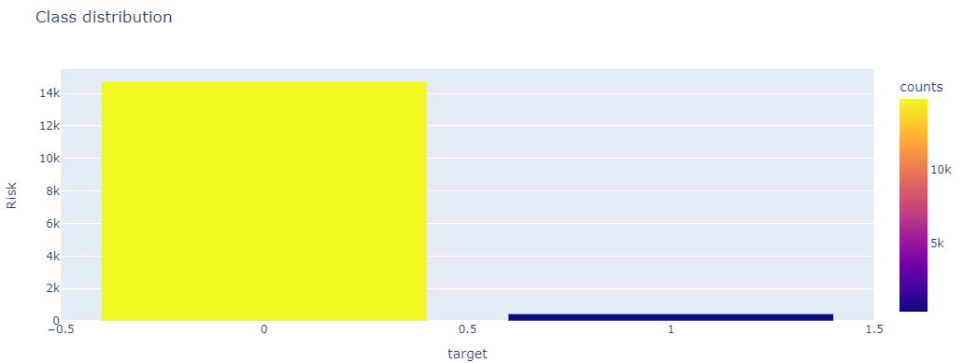
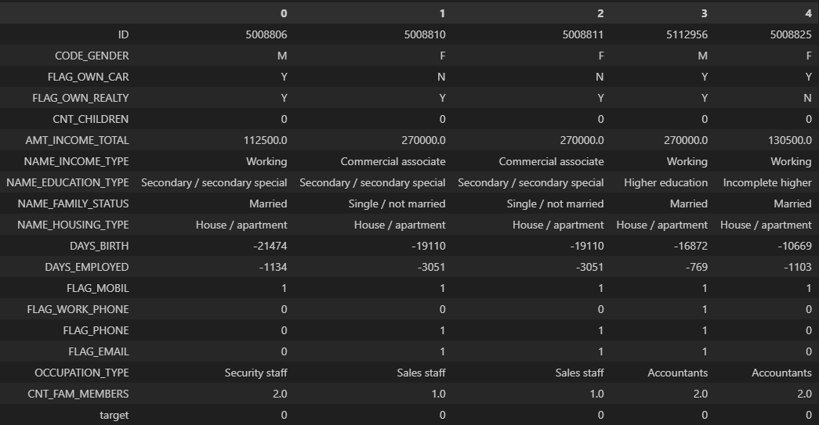
Target generation
Now that we have the targets, let's check our class distribution
14.722
444

Slide 17
Target generation
Now that we have the targets, let's check our class distribution
14.722
IMBALANCED DATA
444

Slide 18
EXPLORATORY DATA ANALYSIS
Continuous Features
AMT_INCOME_TOTAL
DAYS_BIRTH
DAYS_EMPLOYED
CNT_CHILDREN
CNT_FAM_MEMBERS

Slide 19
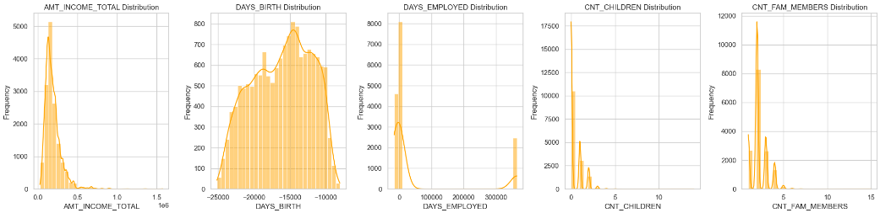
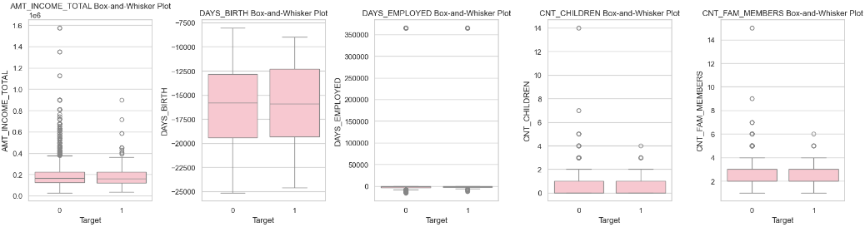
Univariate feature plots
Histogram and Density plots showing each attribute's frequency
Looking on the DAYS_EMPLOYED plot we can clearly see that there are some outliers
It is difficult for us to simply remove those outliers due to their high frequency
We will investigate later the way we will use them on the data cleaning process
Whisker plot
We can also see the outliers on DATA_EMPLOYED.
We observe that there are also outliers on the family members and children per family

Slide 20
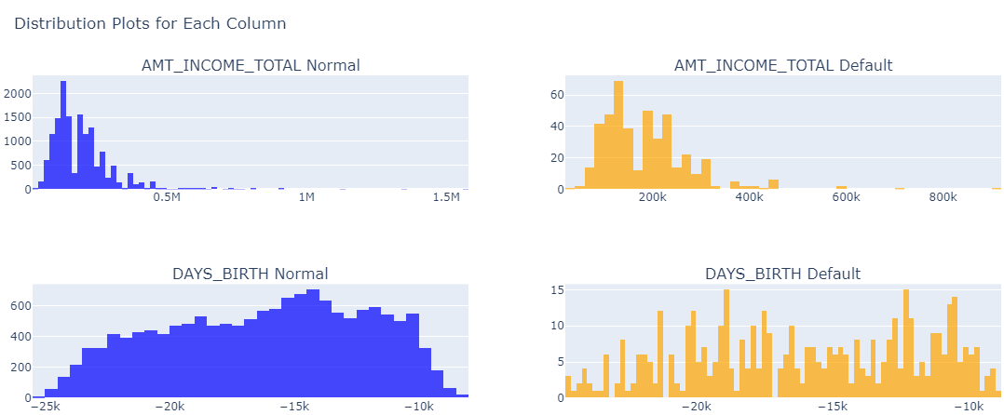
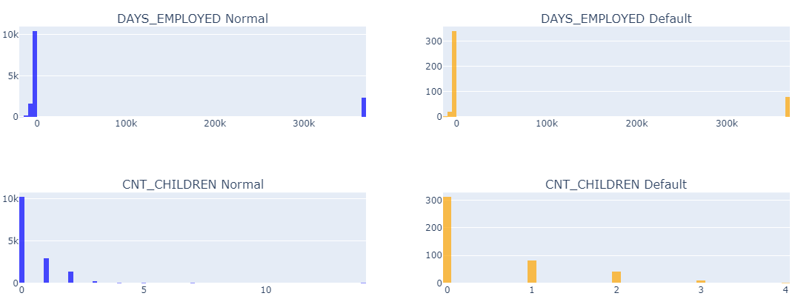
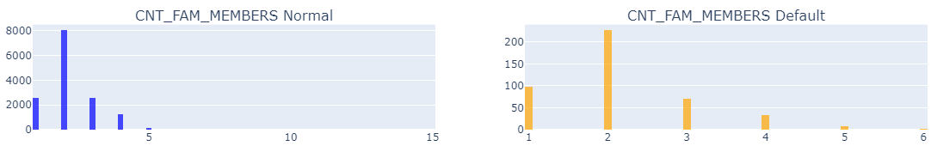
Bar plot
Let's check each case now based on the target classes

Slide 21
EXPLORATORY DATA ANALYSIS
Categorical features
NAME_EDUCATION_TYPE
NAME_FAMILY_STATUS
NAME_HOUSING_TYPE
FLAG_WORK_PHONE
FLAG_PHONE
FLAG_EMAIL
OCCUPATION_TYPE
CODE_GENDER
FLAG_OWN_CAR
FLAG_OWN_REALTY
CNT_CHILDREN
NAME_INCOME_TYPE
CNT_FAM_MEMBERS

Slide 22
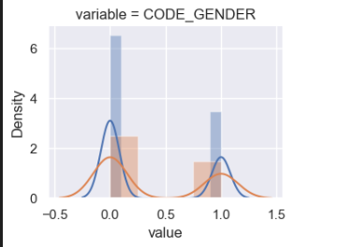
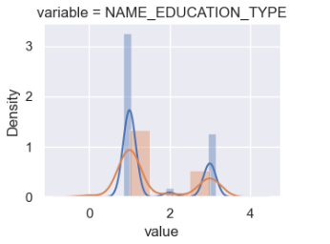
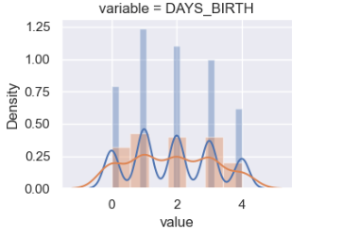
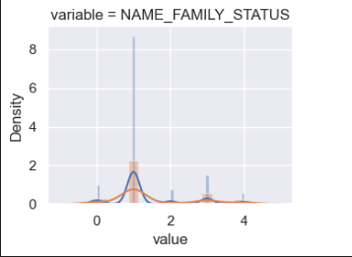
Bar plot
Let's check each case now based on the target classes without scaling so we can see how imbalanced our data are and make some observations
1
0s have a higher proportion of More Educated
2
0s have a higher proportion of Females
3
0s have a higher proportion of Singles
4
0s have a higher proportion of people 30-40years

Slide 23
DATA CLEANING
REPLACE WITH [O,1]
BINARY
HIERARCHICAL PRESENTATION
ONE-HOT ENCODING
BUCKETS
OR
ONE-HOT ENCODING
ORDINAL
CATEGORICAL
CONTINUOUS

Slide 24
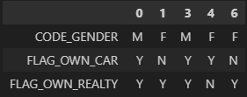
DATA CLEANING
At first, we will encode the binary features CODE_GENDER, FLAG_OWN_CAR and FLAG_OWN_REALTY.
In the attribute CODE_GENDER we will replace female 'F' to value 0 and male 'M' to value 1.
In the attribute FLAG_OWN_CAR we will replace yes 'Y' and no 'N' to 1 and 0 respectively.
In the attribute FLAG_OWN_REALTY we will replace as above yes 'Y' and no 'N' to 1 and 0 respectively.
BINARY
Before

Slide 25
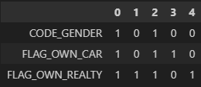
DATA CLEANING
At first, we will encode the binary features CODE_GENDER, FLAG_OWN_CAR and FLAG_OWN_REALTY.
In the attribute CODE_GENDER we will replace female 'F' to value 0 and male 'M' to value 1.
In the attribute FLAG_OWN_CAR we will replace yes 'Y' and no 'N' to 1 and 0 respectively.
In the attribute FLAG_OWN_REALTY we will replace as above yes 'Y' and no 'N' to 1 and 0 respectively.
BINARY
After
Before

Slide 26
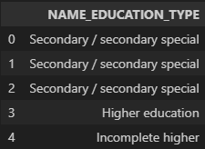
DATA CLEANING
In the attribute NAME_EDUCATION_TYPE there are five unique values which are :
Because this column has a hierarchy, we are going to implement ordinal encoding in order to preserve the ordinal nature of our feature.
Label encoding should not be used with linear models where magnitude of features plays an important role
ORDINAL
Before

Slide 27
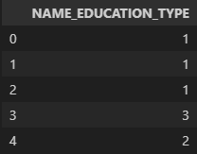
DATA CLEANING
In the attribute NAME_EDUCATION_TYPE there are five unique values which are :
Because this column has a hierarchy, we are going to implement ordinal encoding in order to preserve the ordinal nature of our feature.
Label encoding should not be used with linear models where magnitude of features plays an important role
ORDINAL
After
Before

Slide 28
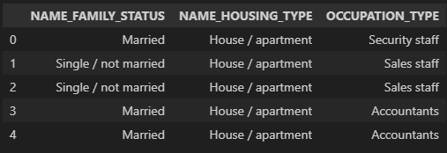
DATA CLEANING
In this case, because our categorical variables NAME_FAMILY_STATUS, NAME_HOUSING_TYPE and OCCUPATION_TYPE have equal order, we are going to implement One-hot encoding.
In One-hot encoding our number of features will increase, which is not good for any tree based algorithm like Decision-trees, Random Forest etc
CATEGORICAL
Before

Slide 29
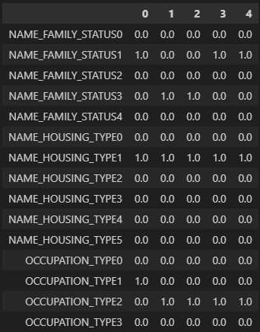
DATA CLEANING
In this case, because our categorical variables NAME_FAMILY_STATUS, NAME_HOUSING_TYPE and
OCCUPATION_TYPE have equal order, we are going to implement One-hot encoding.
In One-hot encoding our number of features will increase, which is not good for any tree based algorithm like Decision-trees, Random Forest etc
CATEGORICAL
Before
After

Slide 30
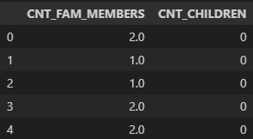
DATA CLEANING
For the case of CNT_FAM_MEMBERS and CNT_CHILDREN, we observe some outliers.
In order to deal with those edge cases and have a consistency across our dataset, we choose to group these columns into buckets
CONTINUOUS
Before

Slide 31
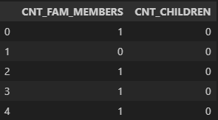
DATA CLEANING
For the case of CNT_FAM_MEMBERS and CNT_CHILDREN, we observe some outliers.
In order to deal with those edge cases and have a consistency across our dataset, we choose to group these columns into buckets
CONTINUOUS
After

Slide 32
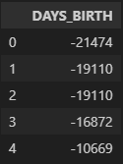
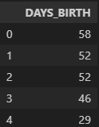
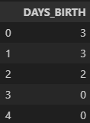
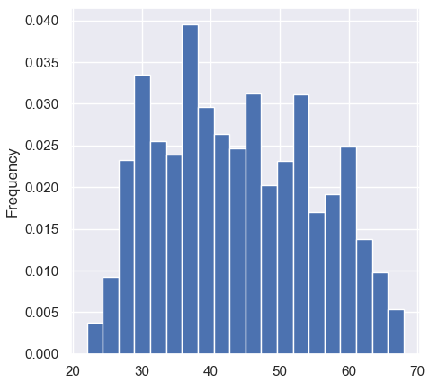
DATA CLEANING
OTHER ways of data cleaning
AFTER AGE-CLUSTRERING
INITIAL DATA
YEARS
DAYS_BIRTH

Slide 33
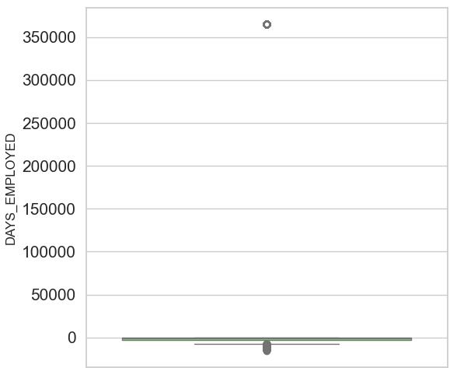
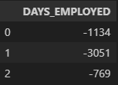
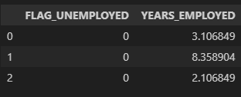
DATA CLEANING
OTHER ways of data cleaning
DAYS_EMPLOYED
DAYS_BIRTH
BEFORE
AFTER

Slide 34
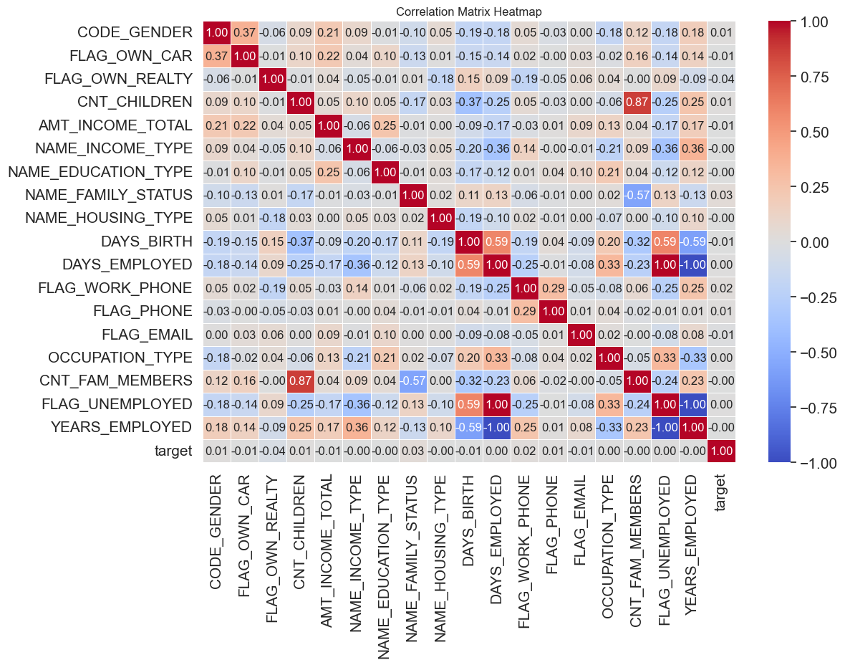
DATA CLEANING
OTHER ways of data cleaning
CNT_FAM_MEMBERS
DAYS_EMPLOYED
DAYS_BIRTH

Slide 35
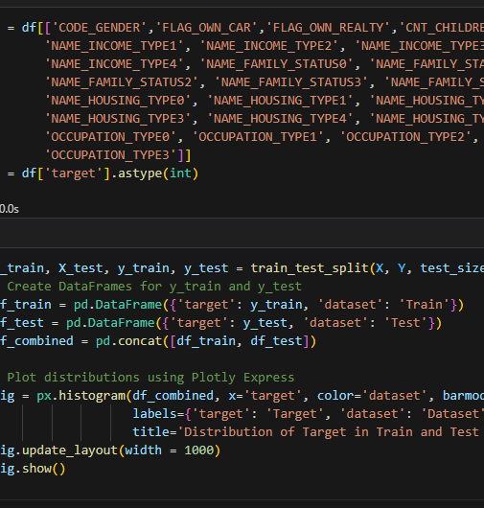
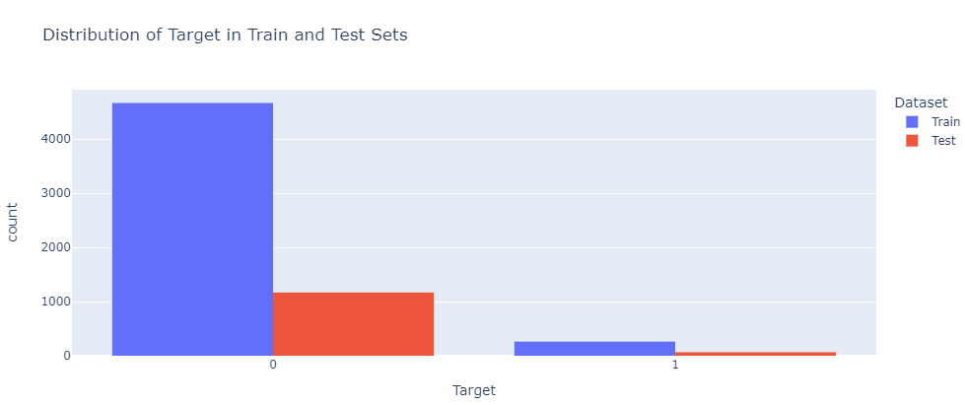
An important step for our project
Split to Train and Test
Get a modern PowerPoint Presentation that is beautifully designed. You can simply impress your audience and add a unique zing and appeal to your Presentations. Easy to change colors, photos and Text.
Normalization of features
Normalizing our features before oversampling depends on the specific oversampling technique we are using and the nature of our data.
From now on, we are going to continue with the training data only

Slide 36
FEATURE SELECTION
Select From Model
For Linear cases
Ex. Logistic Regression
Feature importance
through a coef_ attribute
01

Slide 37
FEATURE SELECTION
Select From Model
For Linear cases
Ex. Logistic Regression
Feature importance through a coef_ attribute
01
02
Select From Model
For Tree-based cases
Ex. Random Forest
feature_importances attribute

Slide 38
FEATURE SELECTION
03
RFECV using Stratified k-fold and f1 scoring
Select From Model
For Linear cases
Ex. Logistic Regression
Feature importance through a coef_ attribute
01
02
Select From Model
For Tree-based cases
Ex. Random Forest
feature_importances attribute

Slide 39
FEATURE SELECTION
Select From Model
Random Forest
 | CODE_GENDER CNT_FAM_MEMBERS
 | FLAG_OWN_CAR YEARS_EMPLOYED
 | AMT_INCOME_TOTAL
 | NAME_EDUCATION_TYPE
 | DAYS_BIRTH
FLAG_PHONE
Select From Model
Extra Trees Classifier
 | CODE_GENDER FLAG_PHONE
 | FLAG_OWN_CAR CNT_FAM_MEMBERS
 | CNT_CHILDREN YEARS_EMPLOYED
 | AMT_INCOME_TOTAL
 | NAME_EDUCATION_TYPE
DAYS_BIRTH
RFECV
Using Stratified k-fold and f1 scoring
 | CODE_GENDER
 | AMT_INCOME_TOTAL
 | NAME_EDUCATION_TYPE
 | DAYS_BIRTH
 | CNT_FAM_MEMBERS
YEARS_EMPLOYED

Slide 40


SMOTE-NC
Creates synthetic data for categorical as well as quantitative features in the data set.
A subset of minority class is taken and new synthetic data points are generated based on it.
SMOTE, is a clever way to perform over-sampling over the minority class to avoid overfitting(unlike random over-sampling that has overfitting problems)
SMOTE
OVERSAMPLING
When working on a dataset with class imbalance problem, one needs to oversample or under sample only the train set and not the test set

Slide 41


SMOTE-NC
Creates synthetic data for categorical as well as quantitative features in the data set.
A subset of minority class is taken and new synthetic data points are generated based on it.
SMOTE, is a clever way to perform over-sampling over the minority class to avoid overfitting(unlike random over-sampling that has overfitting problems)
SMOTE
OVERSAMPLING
OVERSAMPLING
When working on a dataset with class imbalance problem, one needs to oversample or under sample only the train set and not the test set

Slide 42
BUILD A MACHINE
LEARNING MODEL FOR PREDICTION
MODEL SELECTION
WHY?
METRICS SLECTION
Best metric for imbalanced data
F1 near 1 means that we have a good model
F1
01
ALGORITHMS FOR IMBALANCED DATA
Logistic Regression
Random Forest Classifier
SVC
Naïve Bayes
XGB Classifier
LGBM Classifier
02
ALGORITHMS
STRATIFIED-KFOLD
Ensures that each fold maintains the same proportion of target classes as the original dataset
CROS-VALIDATION
03
Tuning methods
04
HYPERPARAMETER TUNNING
GridSearchCV
RandomizedSearchCV

Slide 43

EVALUATION METRICS
F1-score
1
is a metric that combines precision and recall into a single value. It is particularly useful in binary classification settings where there is an imbalance between the classes
Precision Recall Curve
2
Provide insights into the model's performance
Confusion Matrix
3
Represents classifier's performance
4
Classification Report
With all the above now we can have a classification report

Slide 44
F1-score
Training set
Algorithm | Baseline | Normalization | Oversampling | Feature Selection
Logistic Regression | 0.000000 | 0.007547 | 0.658003 | 0.664809
Random Forest | 0.022884 | 0.011775 | 0.960154 | 0.959742
SVC | 0.000000 | 0.000000 | 0.832008 | 0.857495
Naive Bayes | 0.000000 | 0.095734 | 0.506672 | 0.694134
XGBoost | 0.034447 | 0.034447 | 0.961965 | 0.960625
LightGBM | 0.024964 | 0.025871 | 0.966350 | 0.965120

Slide 45

F1-score
Training set
Algorithm | Baseline | Normalization | Oversampling | Feature Selection
Logistic Regression | 0.000000 | 0.007547 | 0.658003 | 0.664809
Random Forest | 0.022884 | 0.011775 | 0.960154 | 0.959742
SVC | 0.000000 | 0.000000 | 0.832008 | 0.857495
Naive Bayes | 0.000000 | 0.095734 | 0.506672 | 0.694134
XGBoost | 0.034447 | 0.034447 | 0.961965 | 0.960625
LightGBM | 0.024964 | 0.025871 | 0.966350 | 0.965120

Slide 46


Our Path Forward
Perform Predictions
Finalize model
For three winning algorithms
Select the final model
Random Forest
XGBoost
LightGBM
Logistic Regression

Slide 47
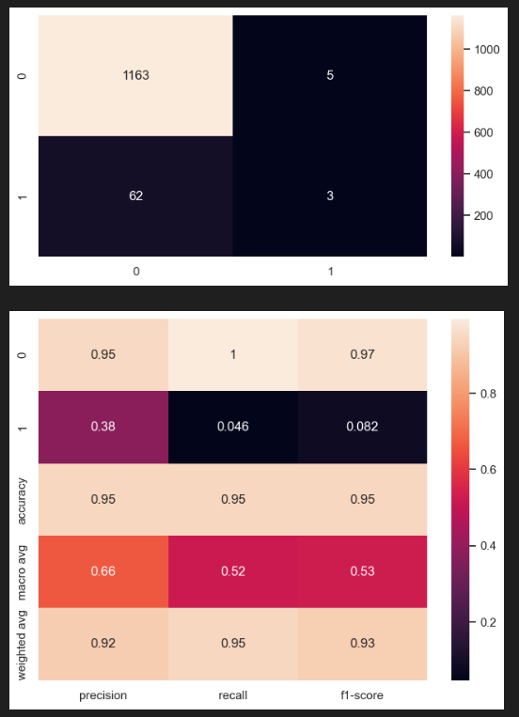
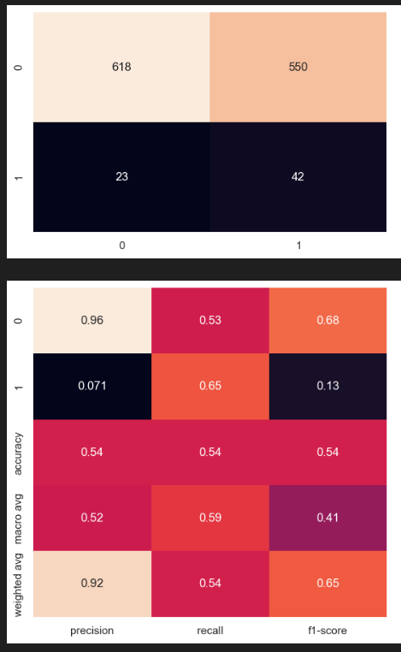
lGBM Classifier
Logistic regression

Slide 48
Conclusions
Training Data
Test Data
Imbalanced data
The Impact of Oversampling in Training
Test Data without oversampling
Numerous Attempts
(normalization, oversampling,feature selection,stratifiedkfold cross validation ,hyperparameter tuning)
,but the Data Imbalance Remained a Challenge
Oversampling data performs better
To evaluate True Model Performance
Best Algorithms
XGBoost
LightGBM
Random Forest
!!!Logistic Regression
Differces in f1 score
Best f1-score Logistic Regression but the performance is worst than others

Slide 49

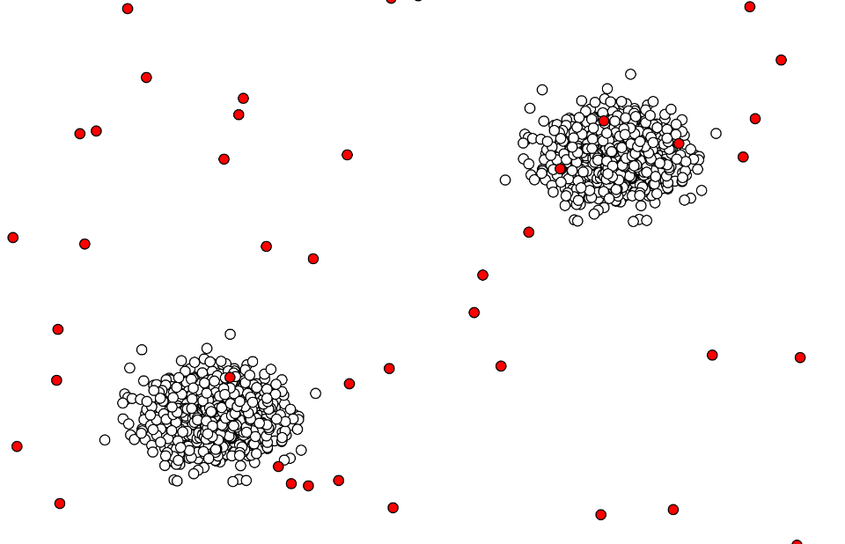
ALTERNATIVE APPROACHES
We can use the unsupervised data and make clusters
Outlier Detection
-Isolation Forest
-One-Class SVM
Robust to high-dimensional data
and can efficiently isolate outliers.
Handles high-dimensional data and
can effectively identify outliers by learning
the normal patterns in the feature space.

Slide 50

Thank you
for your time !!!

