Slide 1

META
Group 6
Anandu CS
Sankar S
Nimya Sunil
Aby George
Amith Jacob Mathew
Athul Raj

Slide 2
Contents
Introduction
Company Background
Major Products

Slide 3
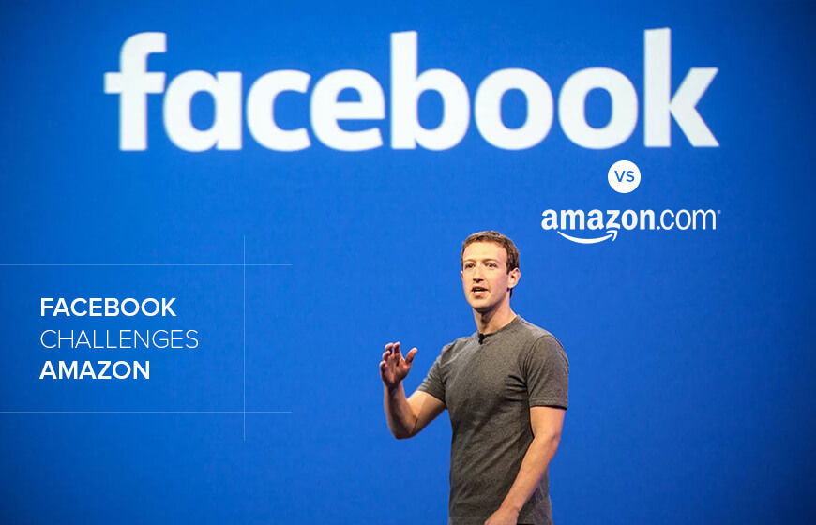
INTRODUCTION
Meta Platforms, Inc., formerly known as Facebook, Inc., is a leading technology company focused on connecting people and building virtual experiences.
Founded in 2004 by Mark Zuckerberg and his college roommates, Facebook started as a social networking platform primarily for college students.
Over the years, it grew into a global phenomenon, allowing billions of users to share content, communicate, and form communities.

Slide 4
Company Background
Founded: February 4, 2004, by Mark Zuckerberg and co-founders Eduardo Saverin, Andrew McCollum, Dustin Moskovitz, and Chris Hughes at Harvard University.
Original Purpose:
Initially designed as "TheFacebook," a social networking site for Harvard students.
Expanded to other Ivy League schools and then to the general public.
Growth Milestones:
2006: Became open to anyone aged 13 and older with a valid email address.
2012: Reached 1 billion active users, marking a significant milestone in social media history.
2014: Acquired WhatsApp for $19 billion and Oculus VR for $2 billion, expanding its portfolio.

Slide 5
Rebranding Announcement: October 28, 2021
Signified a shift in focus from social media to building the metaverse.
Metaverse Vision:
Aims to create interconnected virtual spaces for social interaction, work, and play.
Invests heavily in augmented reality (AR) and virtual reality (VR) technologies.
Current Structure:
Encompasses major platforms: Facebook, Instagram, WhatsApp, and Oculus.
Continues to prioritize user engagement, privacy, and community standards while navigating challenges such as regulation and misinformation.

Slide 6
Major Products
WhatsApp
Instagram
Messenger
Oculus VR
Onavo
Llama
Threads

Slide 7

WHATSAPP
WhatsApp is an instant messaging and voice-over-IP service owned by technology conglomerate Meta It allows users to send text, voice messages and video messages, make voice and video calls, and share images, documents, user locations, and other content.
WhatsApp was founded in February 2009 by Brian Acton and Jan Koum, former employees of Yahoo.
On February 19, 2014, one year after a venture capital financing round at a $1.5 billion valuation, Facebook, Inc. (now Meta Platforms) announced it was acquiring WhatsApp for US$19 billion, its largest acquisition to date.

Slide 8

Instagram
Instagram is a photo and video sharing social networking service owned by Meta Platforms. It allows users to upload media that can be edited with filters, be organized by hashtags, and be associated with a location via geographical tagging.
Originally launched for iOS in October 2010 by Kevin Systrom and Mike Krieger, Instagram rapidly gained popularity, with one million registered users in two months.
In April 2012, Facebook Inc. acquired the service for approximately US$1 billion in cash and stock.

Slide 9
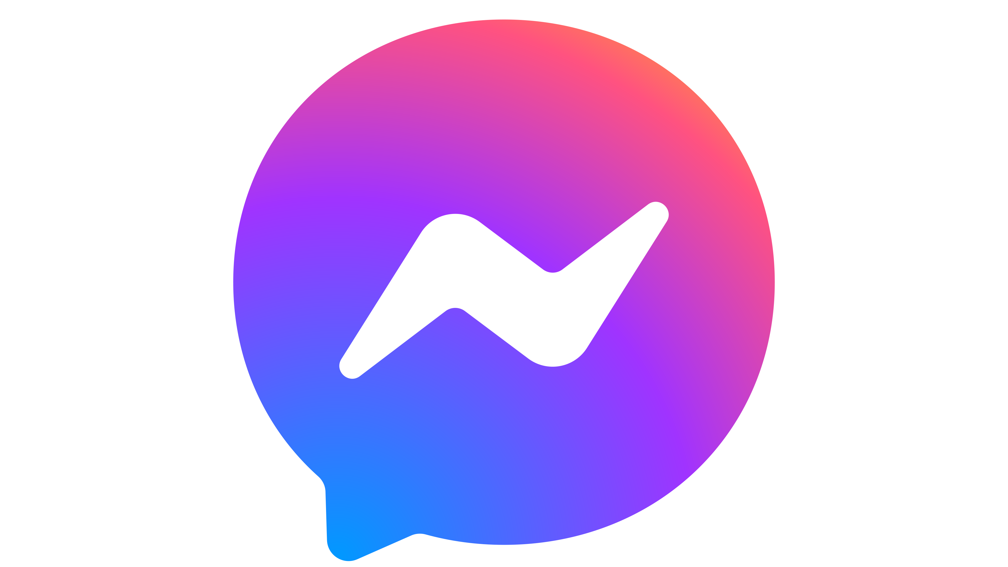
Messenger
Messenger, also known as Facebook Messenger, is an American proprietary instant messaging service developed by Meta Platforms. Originally developed as Facebook Chat in 2008,

Slide 10
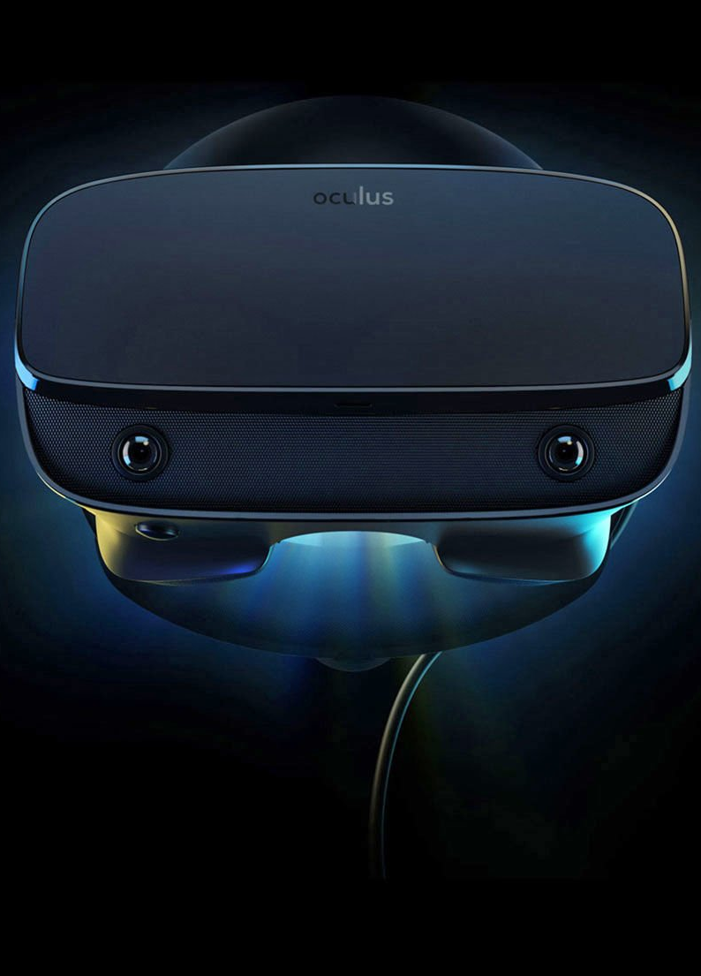
Oculus VR
Oculus is a brand of Facebook Technologies, LLC, (formerly known as Oculus VR, LLC), a subsidiary of Facebook, Inc. It produces virtual reality glasses, including the Oculus Rift and Oculus Quest lines.

Slide 11
Thank You☺
Thank You☺

