Slide 1
Chapter 3

Slide 2
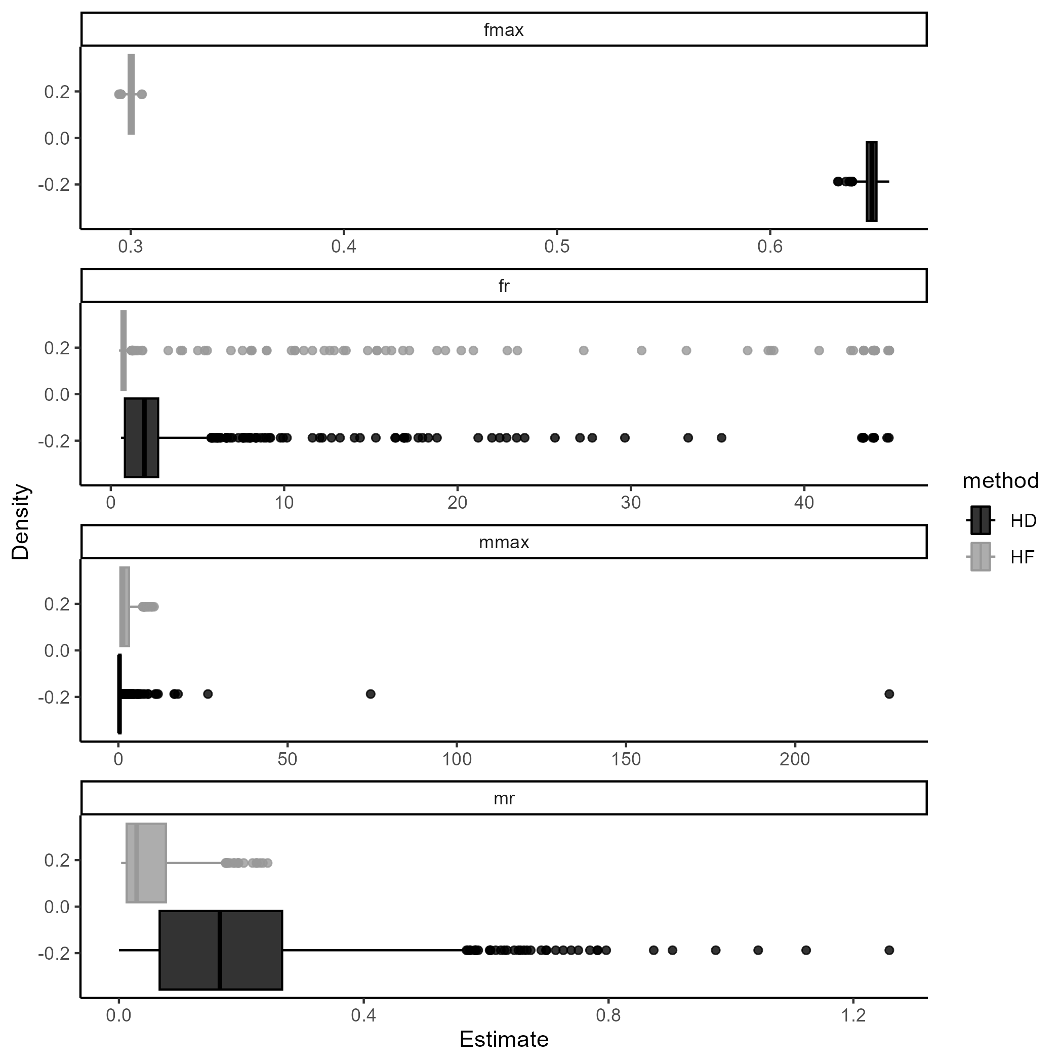
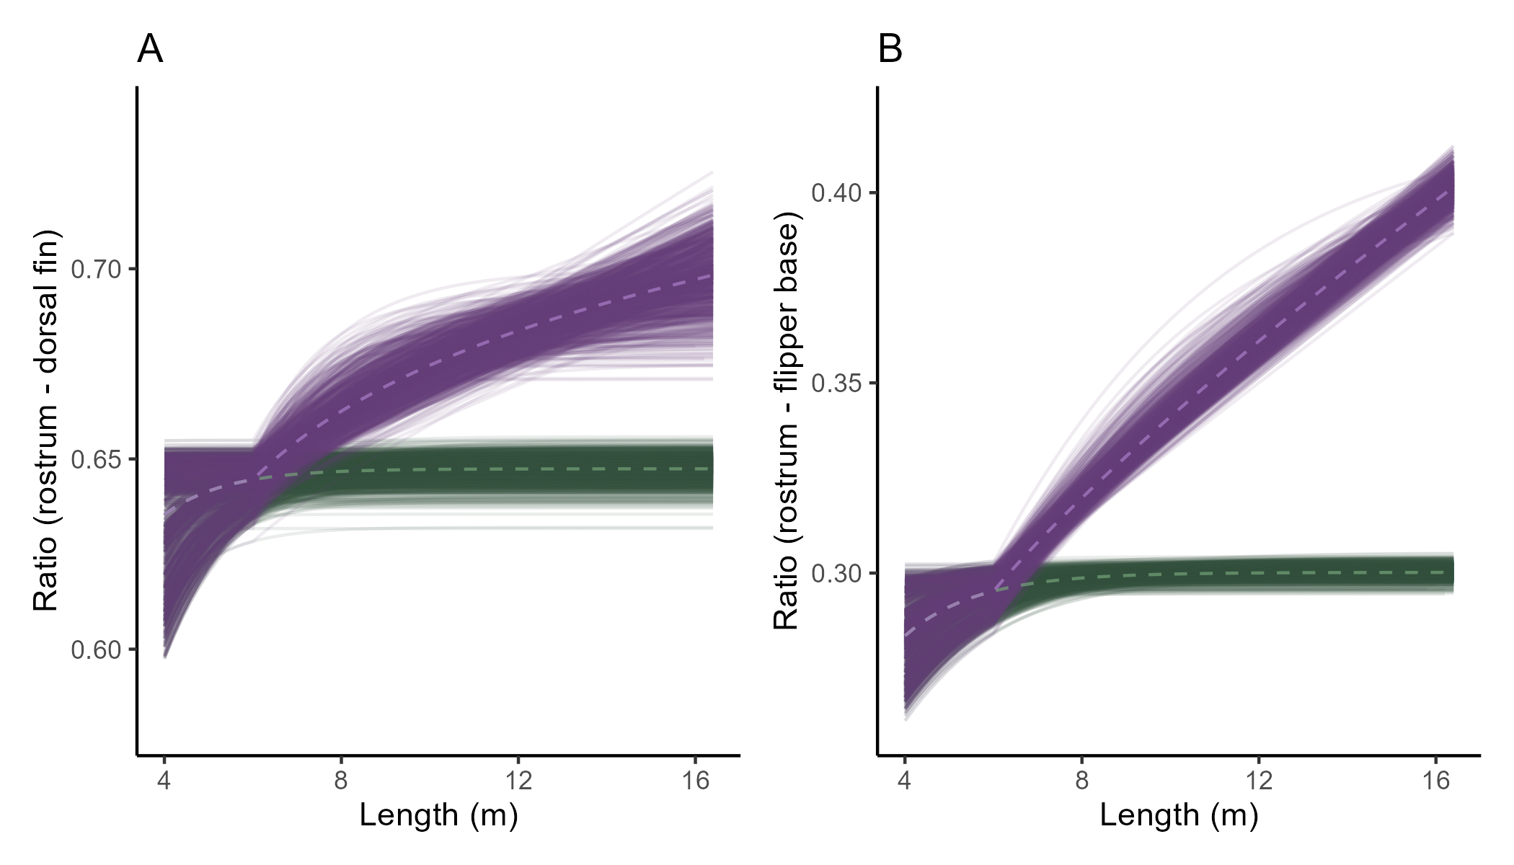
 | fr | fmax | mr | mmax
HD | 2.93 (0.64 - 17.1) | 0.65 (0.64 - 0.65) | 0.19 (0.01 - 0.62) | 1.07 (0.22 - 4.12)
HF | 2.38 (0.51 - 37.92) | 0.3 (0.3 - 0.3) | 0.05 (0.01 - 0.16) | 2.1 (0.46 - 6.69)

Slide 3
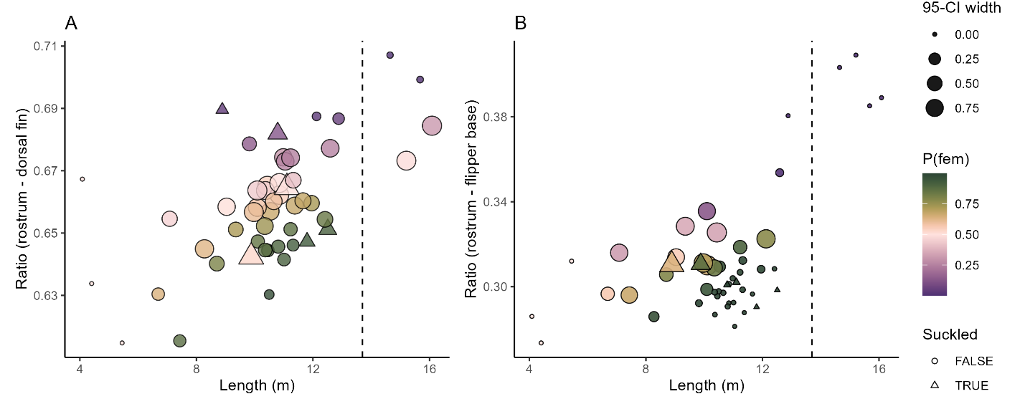

Slide 4
Final curve – all hf individuals with bootstrap

