Slide 1
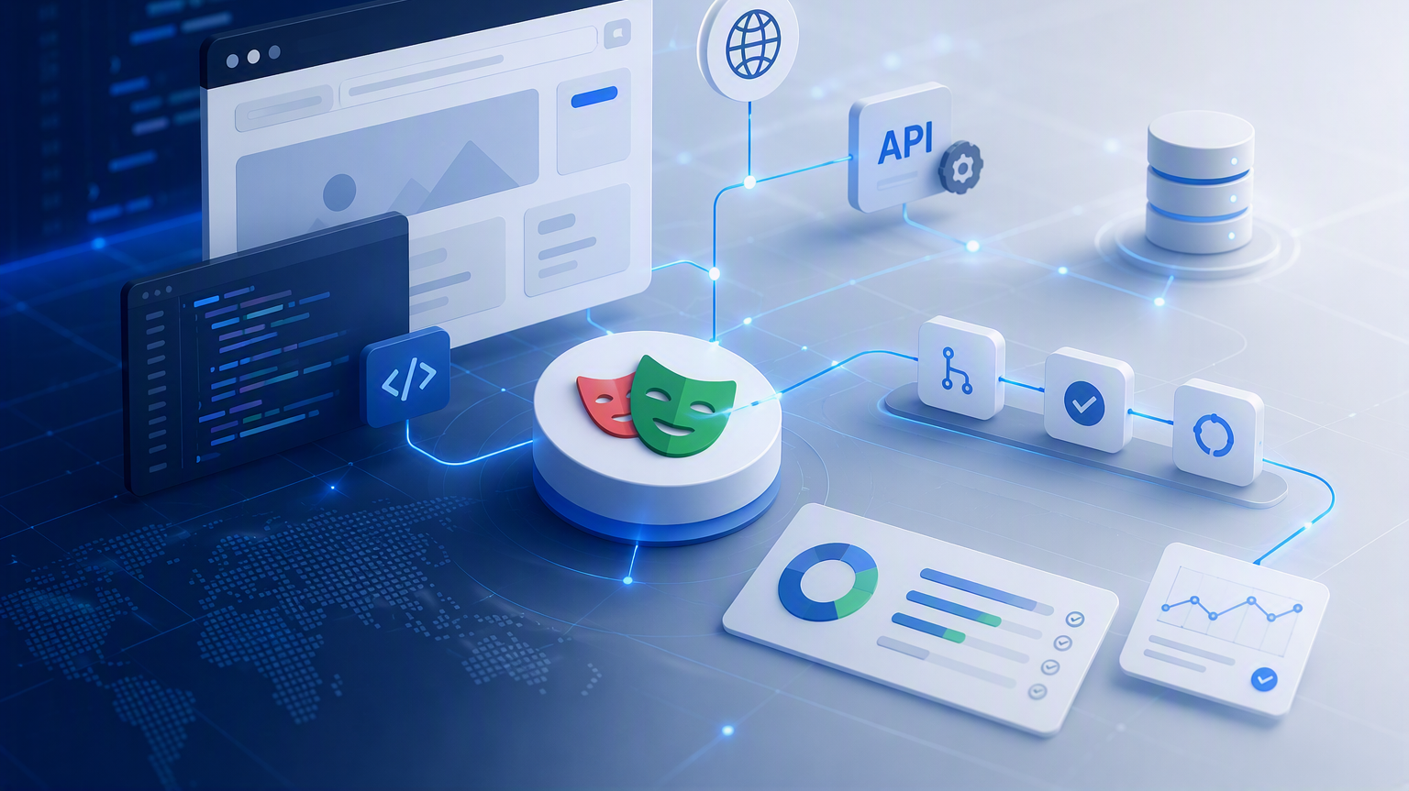

Web automation with playwright
Framework Setup & First Test
Instructor: Eliana Navia Claros

Slide 2
Web automation with Playwright
Module 3 | Framework Setup & First Test
Create an initial configured project, and the first executable result
PREPARE
CONFIGURE
CREATE
REPORT
Environment
Project files
First test
Evidence
Main outcome: first working test

Slide 3
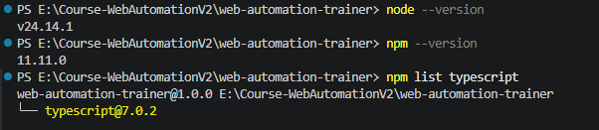
Required development environment
Prepare the tools before creating the project
NODE.JS
VS CODE
PLAYWRIGHT TEST
Runtime and npm
IDE and terminal
Runner and extension
CHROMIUM
GIT
First browser project
Version control
Verify the environment before starting the framework.
node --version
npm –version
npm list typescript

Slide 4
Install Playwright
Create the Playwright TypeScript baseline
Open VSCode > Terminal
npm init playwright@latest
Recommended choices
TypeScript: Yes
Tests folder: tests
GitHub Actions: Yes
Install browsers: Yes
Use the generated config as a starting point
playwright-docs-installation
Git –version
npx playwright install --dry-run chromium
npx playwright install chromium
Initialization creates a baseline; the team still reviews and adapts it.

Slide 5
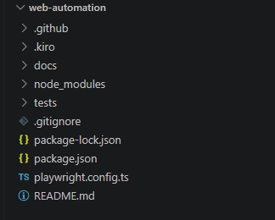
Project structure
Know where the initial responsibilities live
Initial responsibility
tests: executable test cases.
playwright.config: runner and browser behavior.
package.json: dependencies and scripts.
README: team usage and commands.

Slide 6
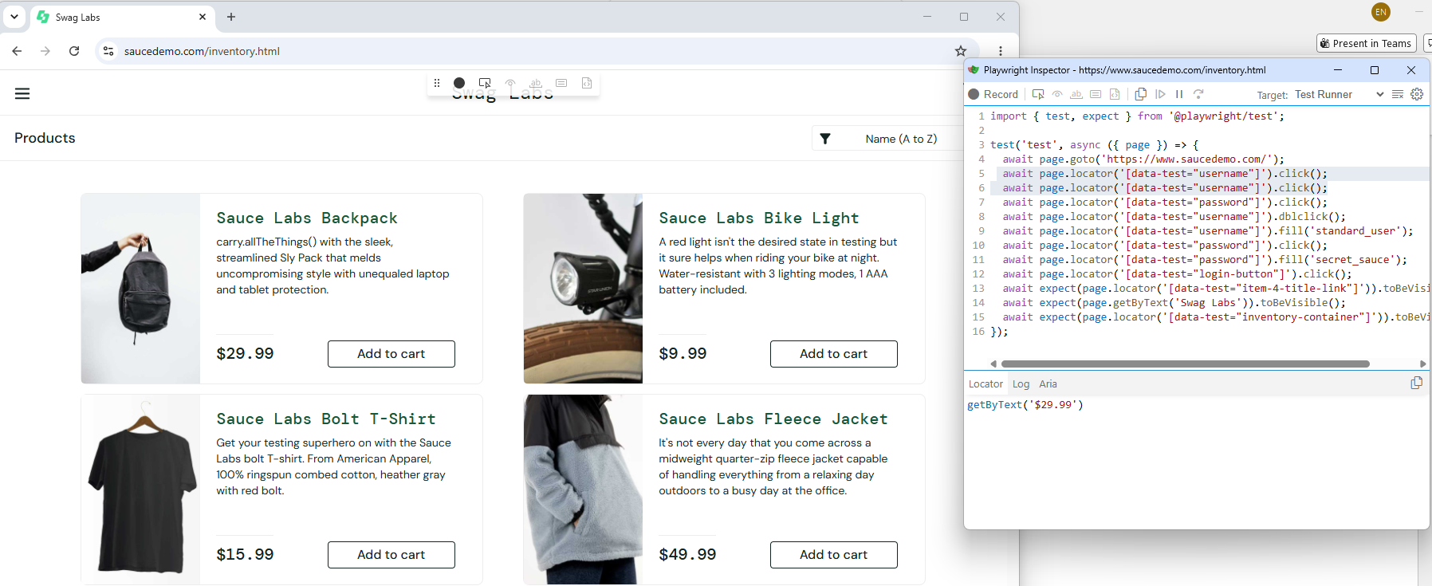
Codegen: Record and Play & Inspect
Use Codegen for discovery, not blind automation
npx playwright codegen https://www.saucedemo.com/
// Generated draft
import { test, expect } from '@playwright/test';
test('test', async ({ page }) => {
await page.goto('https://www.saucedemo.com/');
await page.locator('[data-test="username"]').click();
await page.locator('[data-test="username"]').fill('standard_user');
await page.locator('[data-test="password"]').click();
await page.locator('[data-test="password"]').fill('secret_sauce');
await page.locator('[data-test="login-button"]').click();
await expect(page.getByText('Swag Labs')).toBeVisible();
await expect(page.locator('[data-test="inventory-container"]')).toBeVisible();
});
Open VSCode > Terminal
npm init playwright@latest

Slide 7
Test case anatomy
Define the intent before recording actions
1
Test name
2
Arrange
Business outcome and optional AC ID
Setup, data, and starting state
3
Act
4
Assert
User actions and navigation
Expected behavior and evidence
5
Report
Result, errors, and artifacts
test(‘TC-001: verify login into the app',
async ({ page }) => {
// Arrange → Act → Assert
});
M8 deepens assertion design; M6 deepens lifecycle control.

Slide 8
Test file naming and discovery
Make Playwright discover the intended files
tests/
├── login.spec.ts
├── checkout.spec.ts
└── search.spec.ts
// Default Playwright convention
*.spec.ts
// Alternative requires configuration
testMatch: '**/*.test.ts'
Naming rule
Use one convention across the team.
Match the convention to testMatch.
Name files by feature or behavior.
Avoid ambiguous names.
Document the rule in README.
For this course, prefer the native *.spec.ts convention.

Slide 9
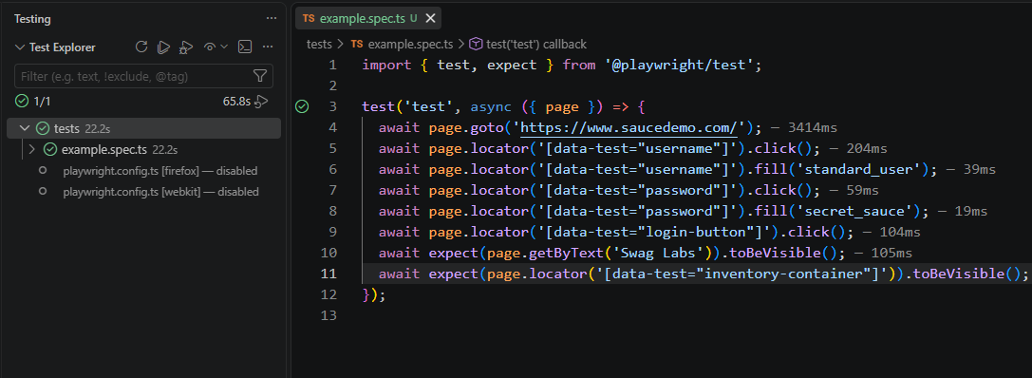
Run, debug, and report
Choose the execution mode for the learning goal
npm test
npm run test:headed
npm run test:debug
npx playwright test -g 'verify login into'
npx playwright test --project=chromium
npx playwright show-report
Modes
Test: by default, in headless mode.
Headed: show actions in browser.
Debug: debug mode, inspect step by step.
-g: filter and execute the test cases that match(exact or partial) their names.
--project: select browser/device.
Show-report: review results and evidence.
test('TC-001: verify login into the app', ...) // ✅
test(‘TC-010: verify invalid login credentials gets error', ...) // ❌
Reporting observes the execution; M11 and M12 deepen evidence and delivery.

Slide 10
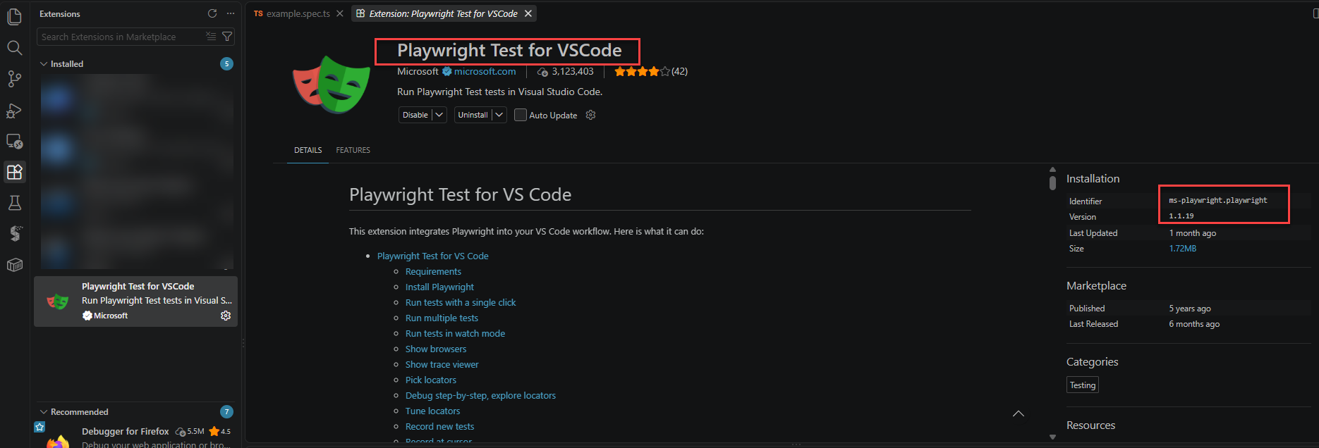
Run, debug, and report
Choose the execution mode for the learning goal

Slide 11
Module 3 | Session Summary
Module objectives, Wrap-Up, Key Takeaways
1
Verify Node.js, npm, VS Code, Playwright, Chromium, and Git installation.
2
Initialize a Playwright TypeScript project.
3
Understand the main configuration files.
4
Define the anatomy of an executable test case.
5
Use Codegen as a draft and review the generated code.
6
Run the test locally and open the first report.

Slide 12
Module 3 | Activities
Assignments & Next Steps
Required Actions
📋 Initialize the project.
📋 Use Codegen as a draft.
📋 Execute the test case.
📋 Push your code.
Evidence to submit
1
Project files created.
Acceptance Criteria documented.
Passing execution.
Report opened.
Repo url.
2
3
4
5
Next Module:
Design Patterns & Framework Architecture
Separate responsibilities so the framework becomes stable, readable, and easier to evolve

